Slide 1
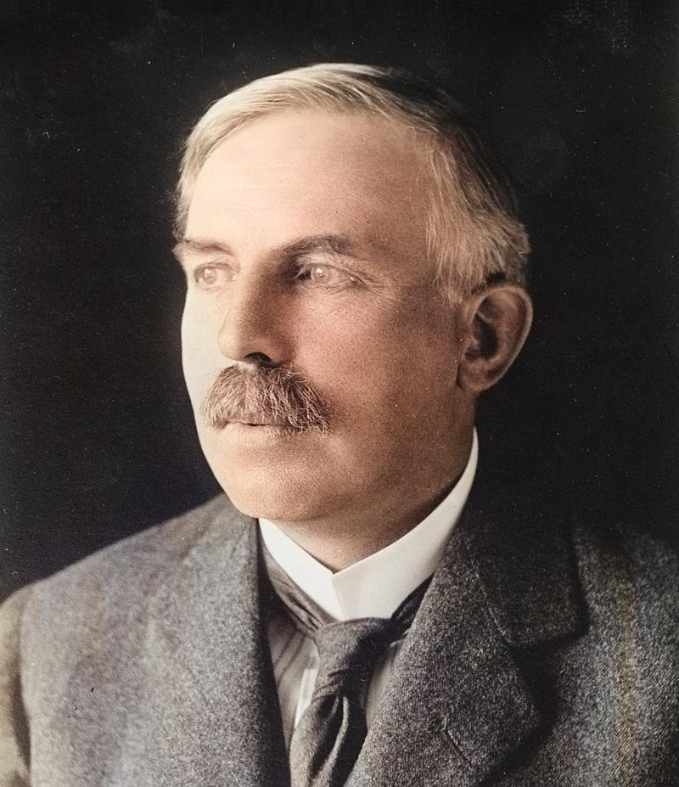
Ernest Rutherford
Nuclear Physics/Nuclear Chemistry

Slide 2
Born in Brightwater New Zealand

