Slide 1


Slide 2
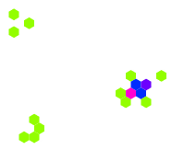
Motivation & Goals
Convert each ECA rule into a directed multi-graph.
Persist a JSON + render SVG/JPG plots.
Prepare GNN-ready features.
What are the Wolfram Rules?
Local Update & Wolfram Encoding
For a cell in ECA (radius 1), its status x at time t:
Neighborhood order for Wolfram bits (MSB→LSB):
111, 110, 101, 100, 011, 010, 001, 000
Elementary Cellular Automata

Slide 3
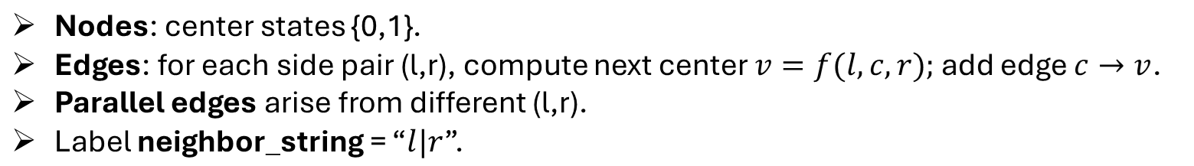
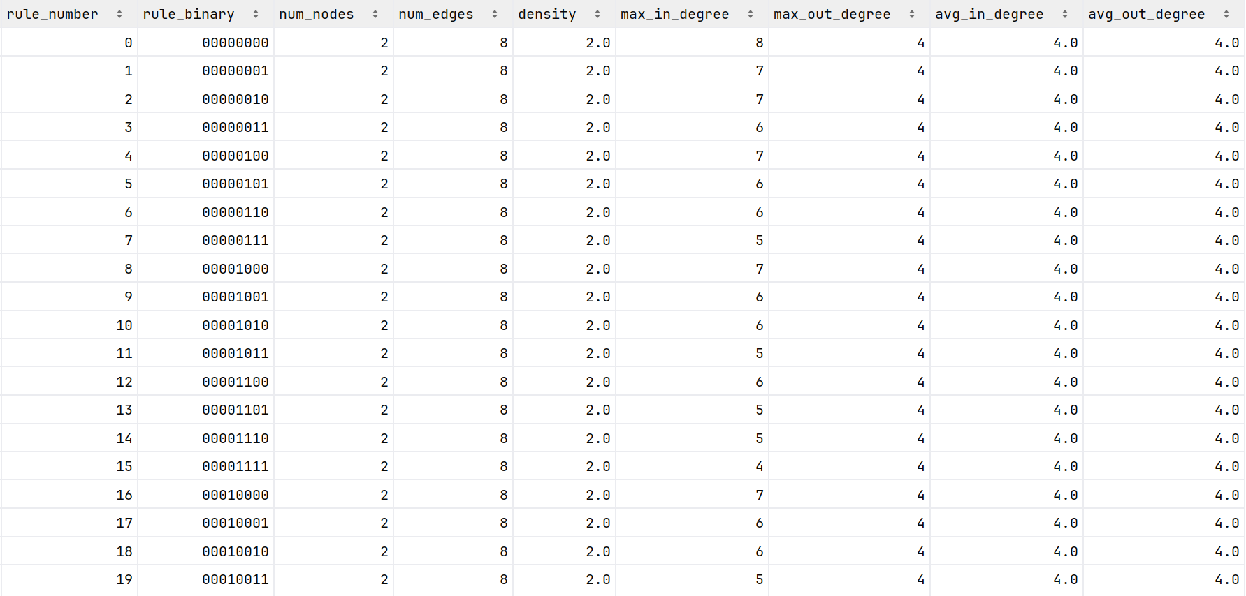
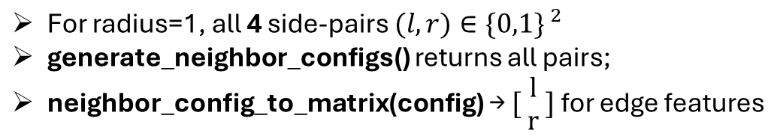
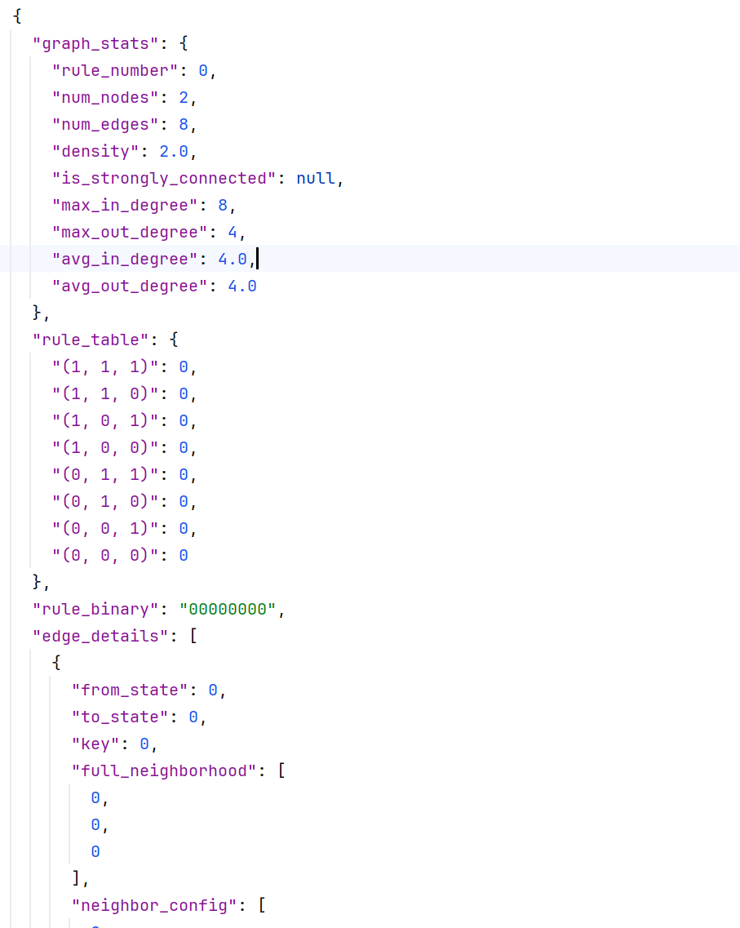
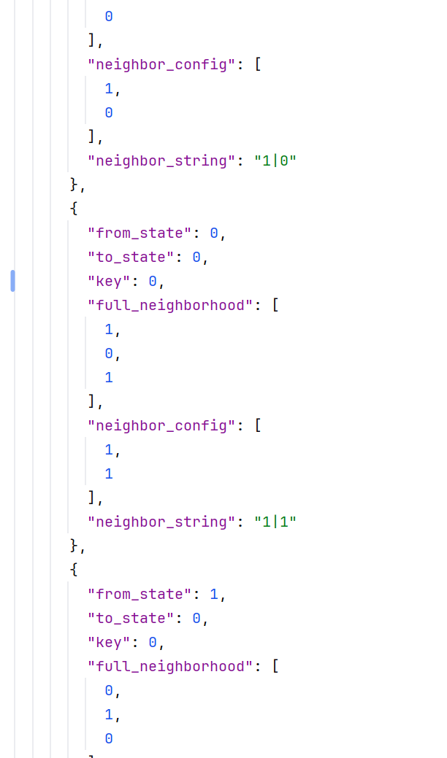
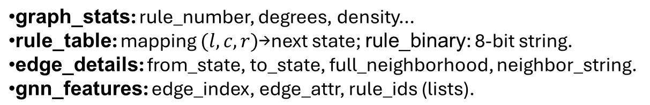
From Rule to Graph
Enumerating (l,r)
JSON Schema (Per Rule)

Slide 5
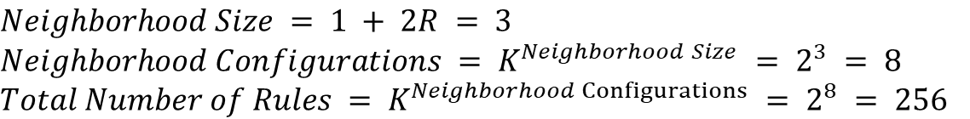
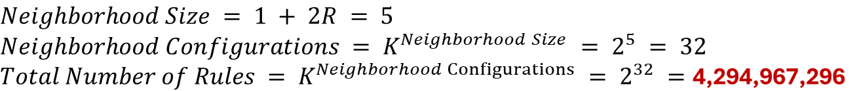
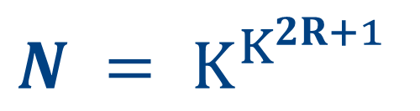
Radius = R, Cell Status = K
R = 1, K = 2
R = 2, K = 2 (Thread 1: extend neighbor size)
R = 1, K = 3 (Thread 2: extend cell status)
Total Number of Rules N:

Slide 6
Storage
What is the best way of storage?
Abandon storing all the rules themselves.
(Instead of storing the rules themselves, the "fingerprints" or "features" of the rules are stored.)
Method:
Run this rule, observe its dynamic behavior, and then extract and store the features that describe this behavior.
Features:
Dynamic Features: how does the entropy of the system change over time? Will a stable structure be formed? Will complex, seemingly random patterns emerge?
Graph Theory Features: The characteristics of the "state transition graph" corresponding to this rule, such as the degree of nodes, density, clustering coefficient, etc.
Computational Capability Features: Can this rule perform meaningful computations? (For example, the well-known Rule 110 is Turing complete.)

Slide 7
Turing Complete
Core Idea: A system that can simulate any other computer.
A system has the highest capacity for general computing. It is a "universal simulator" and, in principle, can execute any algorithm.
Rule 110: A one-dimensional cellular automaton with only 8 instructions "physical law". The next state of each cell is determined solely by its own and the current states of its immediate neighbors.
Glider: Rule 110, this simple rule, after a long period of evolution, spontaneously emerged from chaos, forming macroscopic patterns that can maintain their structure and move stably.

Slide 8
Set up a computer
Core idea: Carefully planned glider collision
Matthew Cook’s Experiment
Step 1: Define the signal
Step 2: Realize logic gates
Step 3: Turing Complete
AND Gate:
A new glider will be generated on the "output wire" only when both input "wires" convey a glider simultaneously and a specific collision occurs in the "reaction area".
NOT Gate: This is achieved through the annihilation collision of gliders based on the "clock signal" and the "input signal".
Functionality completeness: Since AND and NOT gates can be implemented, in principle any digital circuit can be constructed
Memory (Memory): By designing a "glider trap" (circular track) to store states.
Signal (Signal):
Presence of glider = 1
Absence of glider = 0
Wire (Wire):
The predictable trajectory left by the glider's movement in the spacetime diagram.

Slide 9
Classification
In case of { R=1, K=2 },
Method: (Strict, symmetric-based equivalence relation)
Left-Right Reflection(Mirror Symmetry)
State Inversion
The Final Classification: The symmetry possessed by a rule determines how many "partners" it is bound to, and thus determines the size of its equivalence class.

Slide 10
Classification
Symmetry Property | Example | Equivalence Class Composition | Class Size
No Symmetry (Asymmetric) | Rule 30 Its behavior is neither symmetric nor self-complementary. | Itself, its mirror version, its complementary version, and its mirror's complementary version. | 4
Only Left-Right Symmetric (Self-Mirroring) | Rule 250 It is its own mirror image, like a left-right symmetric pattern. | Itself, and its complementary version. | 2
Only State-Inversion Symmetric (Self-Complementary) | Rule 51 In a black-and-white inverted world, its behavior is the same as its own. | Itself, and its mirror version. | 2
Possesses Both Symmetries (Fully Symmetric) | Rule 204 Like a "palindrome," it is both left-right symmetric and self-complementary. It retains its essence under all transformations. | Only itself. | 1

Slide 11
Advanced Classification
Thread 1: Classification based on the final state (Attractor-Based Classification)
Thread 2: Classification based on computing power
Thread 3: Classification of statistical physical characteristics
Stephen Wolfram
Core idea: Regardless of the intermediate steps, focus solely on what the rules will eventually evolve into after a long period of time.
Categories
Fixed Point: No matter how complex the initial state is, in the end the entire system will become all zeros or all ones. (Boring!!!)
Periodic: The system will eventually enter a simple and repetitive cycle mode. (A Little Boring…)
Chaotic: The system will never stabilize and continuously generates seemingly random and unpredictable complex patterns. These rules are extremely sensitive to even the slightest changes in the initial conditions. (Interesting…)
Complex: The system is neither completely stable nor completely chaotic. It generates complex local structures, which can move, collide and interact, just like living "particles". (Very Interesting!!!)
Categories: Simple Calculation Section, Period Calculation Class, Turing Complete Class
Categories: High entropy/high degree of chaos class, Low entropy/ordered class, Critical Class (Edge of Chaos)

Slide 12
New Graph Representation Method
From Rule List to Relationship Network:
Graph Data Structure for GNN
What do the nodes represent?
Each rule is a node in the graph.
"id": The unique identifier of the node, which is the rule number (0-255).
What do the edges represent?
Each edge represents a symmetry transformation relationship.
"source" & "target": Defines which two rules are connected.
"type": The core feature of the edge (Edge Feature), used for GNN training.
"mirror": The blue edge, representing that the two rules are mirror images of each other on both sides
"complement": The red edge, representing that the two rules are in opposite states

Slide 13
Visual Insight
Visual Insights:
The "Galaxy Map" of the Rule-Based Universe
Key Insights
"Island" Structure: The graph is naturally divided into 88 independent "islands" (connected components), and each island represents an equivalence class. This intuitively verifies our classification theory.
Symmetry Forms:
Islands of size 4: Quadrilaterals composed of red and blue edges.
Islands of size 2: Connected only by a single red or blue edge.
Islands of size 1: Have "self-loop edges" pointing to themselves, indicating their complete symmetry.

Slide 18
Literature Review

