Slide 1
Chapter 16 Integration of Ordinary Differential Equations

Slide 2
Examples of Differential Equations
ODE:
Chemical reaction dynamics, dC/dt = -C
Pressure change with height, dp/dy = -mgp/kT
Newton’s equation of motion, F = md²r/dt²
PDE:
Maxwell’s equations for electricity and magnetism
Structure and fluid mechanics
Schrödinger equation in quantum mechanics

Slide 3
Higher ODE Reduces to 1st Order
In general, it is sufficient to solve coupled first-order ordinary differential equations of the form
Notes:
Because higher derivatives can be eliminated by introducing new variables.

Slide 4
Initial Value Problem
It is convenient to consider the independent variable x as time t. The solution to the equations
is uniquely determined if the initial value at t=0, y_{i}(0), is given.
The equation can be written in vector form
Notes:
The solution exists and is unique provided the F function is smooth enough (continuous and their derivative are continuous). A more precise statement is the function f should be Lipschitz continuous, which means | f(x) – f(x’) | < K | x – x’|, where K >= 0 is finite. The Lipschitz condition apply to the variable y.

Slide 5
Some General Properties of Autonomous Systems
F(t,Y) = F(Y), independent of time t
The space spanned by Y (a set of all possible Y) is called phase space
F forms a vector field (a vector at each point Y)
y₂
Solution of dY/dt = F(Y) produces a parametric curve Y(t) in phase space.
Intersection of trajectories cannot happen, why?
F
y₁

Slide 6
Fixed Points
A location in phase space such that F(Y)=0.
Attractor, repellor
Saddle point or hyperbolic fixed point

Slide 7
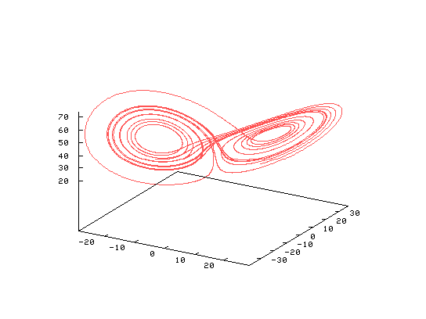
Chaos
Extremely sensitive to initial conditions [dY(t) = exp(λt)dY(0)]. E.g., Lorenz’s weather model:
y₃
y₂
y₁

Slide 8
Finite difference
Forward difference:
Backward difference:
Central difference:
Euler Method:
Notes:
We set Y(nh) = Y_{n}, x_{n}=nh. See NR Chapter 5.7 for finite difference method for derivative.

Slide 9
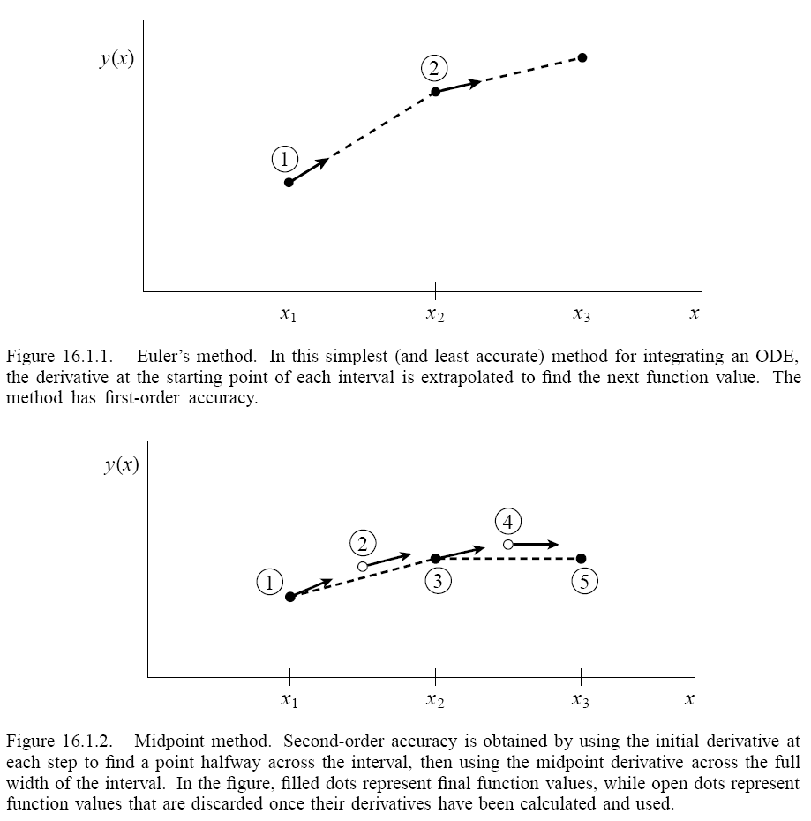
Euler and Midpoint
h

Slide 10
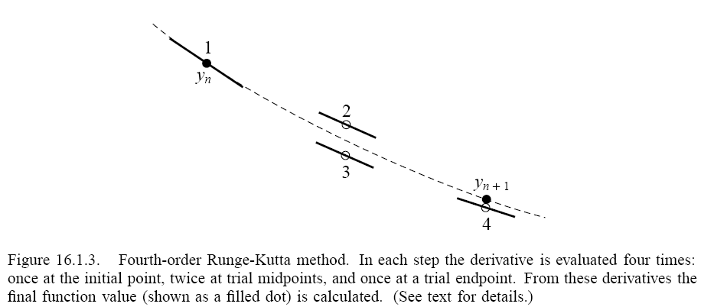
4-th Order Runge-Kutta Method

Slide 11
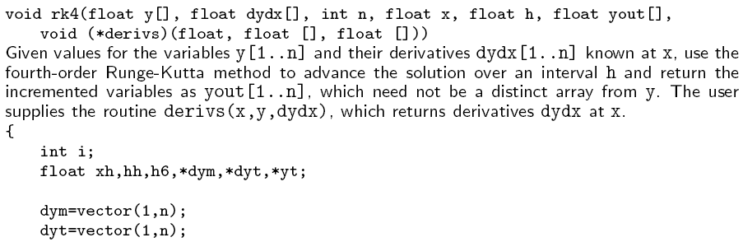
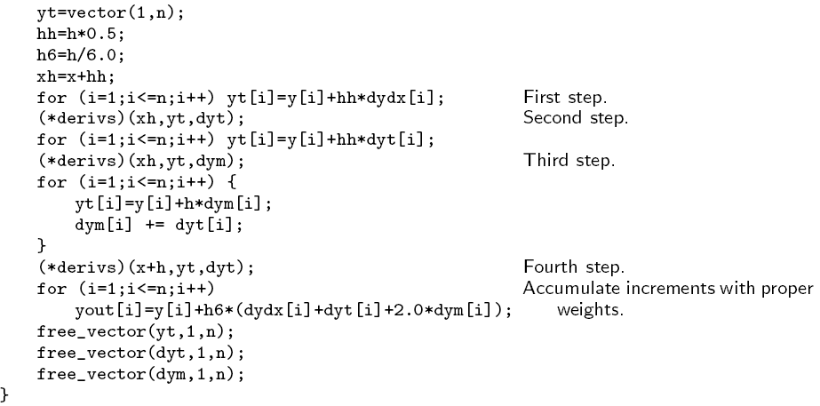
rk4( )
Python code for ODE
from scipy.integrate import ode
solver = ode(f).set_integrator(‘dopri5’)
solver.set_initial_value(y0,t0)
solver.integrate(t+dt)

Slide 12
Some General Concepts
Discretized equation, such as y_{n+1}=y_{n}+hf(x_{n},y_{n}), is consistent, if as h->0, it approaches the original differential equation
The error |y(x_{n+1})-y_{n+1}| =O(h^{k}) in one step from x_{n} to x_{n+1} is called local truncation error
The error |y(x)-y_{n}| for some finite x and initial condition y(0) = y₀ is the global error
The method is convergent if the global error goes to zero as h -> 0 and n -> ∞.

Slide 13
Adaptive Stepsize Control
Estimate local truncation error from difference between one h step and two steps of h/2
Or difference of 4 and 5-th order Runge-Kutta
Increase h if error is small than tolerance, decrease h if error is bigger than tolerance. See NR p.721, odeint() for details.

Slide 14
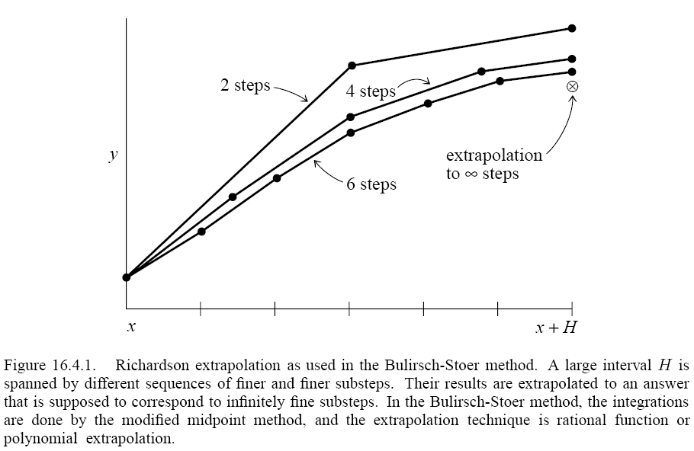
Richardson Extrapolation and Bulirsch-Stoer Method
Take a “large” step size H, consider the answer as an analytic function f(h) of h=H/n. Fit the function by polynomial or rational function interpolation. Choose a method (e.g., midpoint) such that f(h) is even in h. And finally extrapolate to h=0.

Slide 15
Multi-step, Explicit, Implicit, etc
Solving equation y’=f(x,y) is to compute
In general, this results in
Notes:
The integration can be discretized by, e.g., trapzoidal rule. Implicit means that the right-hand side also contain y_{n+1}. Multi-step means that y_{n+1} depends not only y_{n}, but also earlier steps.

Slide 16
Hamiltonian System
The system of equations
has special properties. It is equivalent to Newton’s equation with a potential energy.

Slide 17
Verlet or Störmer Algorithm
Solve
by central difference
Show the error is O(h⁴)
Notes:
Verlet 1960s, but it has a long history.

Slide 18
2-Form and Symplectics
The Hamiltonian dynamics, beside having a conserved energy, also has additional conserved quantities (ω²)^{n},n=1,2,..,N:
A canonical transform is a mapping from (p,q) to (P,Q) such that the form of ω² is the same. I.e.
wedge product:
Notes:
See, e.g., V.I. Arnold, “Mathematical Methods of Classical Mechanics”, 2nd Edition, Springer 1989.

Slide 19
Canonical Transformation
Equivalent condition for canonical mapping z to Z is
where
ω^{2N} means volume element in phase space – Hamiltonian dynamics preserves the volume – Liouville’s theorem.
Notes:
The canonical transform can be defined in several equivalent ways:
(0) The form of the Hamilton’s equation is the same z = J∂H/∂z -> Z = J ∂K/∂Z, where K = H + … and the map z -> Z(z,t) can be parametrically also a function of time t. And the transformation satisfies pdq – H = PdQ – K + dF/dt.
(1) The two form ω² = Σ dq ˄ dp is an invariant (see V.I. Arnold Chap 9 ).
DJ D^{T} = J where D is the Jacobian matrix, it is also true that D^{T}J D = J and det(D) = 1.
the Poisson brackets are invariant, i.e., [A,B] = (∂A/∂z)^{T} J (∂B/∂z) is the same using z or Z.
As an example for canonical transform, we take Z = exp(t [. , G]) z, where t is an arbitrary real parameter. See, e.g., “Classical Mechanics,” Chap 9 of Goldstein et al, 3rd.

Slide 20
Example of Symplectic Algorithm
Euler method is not symplectic
But the following is

Slide 21
Second-Order Symplectic or Velocity Verlet
Combine two half-step size first-order symplectic algorithms, one can obtain:
Symplectic algorithm preserves the symplectic properties of the Hamiltonian system exactly.
Notes:
Show that the second-order symplectic algorithm is equivalent to the simple Verlet method after the variable p is eliminated. General symplectic algorithm can be derived using Poisson brackets for Hamiltonian dynamics and operator splitting methods.

Slide 22
Deriving Symplectic Algorithm
The equation of motion of any dynamic variable A=A(p,q) is dA/dt = - {H,A}. The formal solution is A(t) = exp(-t{H,.})A.
Since H=T+V, we can perform operator splitting (Trotter-Suzuki), A(t) ≈ exp(-t{T,.}) exp(-t{V,.}) A.
Since exp(-{G,.}) is symplectic, the operator splitting is symplectic provided each factor is computed exactly.
Notes:
The Poisson bracket is defined by {A,B} = sum dA/dq dB/dp – dB/dq dA/dp. We define {H, .} A = {H, A}. How to obtain higher order symplectic algorithms, e.g., 4-th order?

Slide 23
Problem set 10 (14 Nov 24)
Show that the last 2nd order symplectic algorithm is indeed symplectic!
Show that the 4-th order Runge-Kutta is equivalent to Simpson rule if y’=f(x,y)=f(x) independent of y.
Verify that the 4-th order Runge-Kutta formula is indeed accurate to 4-th order [Taylor expanding both side of equation (Fig. 16.1.3)]. Do this with Mathematica.

