Slide 1
Molecular Dynamics
Notes:
Good books on this subject are Allen and Tildesley, “Computer Simulation of Liquids”, Frenkel and Smit, “Understanding Molecular Simulations”.

Slide 2
Basic Idea
Solve Newton’s equations of motion
Choose a force field (specified by a potential V) appropriate for the given system under study
Decide a statistical ensemble to use, choose boundary conditions; collect statistics of observables

Slide 3
Commonly Use Force Fields
Lennard-Jones potential
For noble gas and generic fluids
Tersoff, Brenner, Stillinger-Weber, 3-, 4-body potentials
For C, Si, Ge, …
AMBER, CHARMM, GROMOS, MM4, etc
For biomolecules
GULP, LAMMPS, DFT codes (QE), etc
Notes:
LAMMPS at https://lammps.sandia.gov/
Quantum Espresso at https://www.quantum-espresso.org/

Slide 4
Example of potential used in biomolecular modeling
Machine learning based force fields
Notes:
See this review paper for machine learning force fields: https://pubs.acs.org/doi/10.1021/acs.chemrev.0c01111

Slide 5
Ensembles
Micro-Canonical Ensemble
Total energy is fixed, standard Hamiltonian dynamics
Canonical Ensemble
Need to use “thermostat” to fix temperature
Langevin dynamics
Nosé-Hoover
Generalized Langevin
Stochastic velocity rescaling
Notes:
It is also possible to have fixed T, P (pressure), and N.

Slide 6
Langevin Dynamics
How to correctly implement the white noise on computer?
Notes:
ξ is known as white noise because it is delta correlated. We need to consider integral of the noise which is a Gaussian random variable with zero mean and appropriate variance.

Slide 7
Solving the Langevin equation
Notes:
How to solve the Langevin equation to a high order, e.g., 4-th order in h?

Slide 8
Nosé-Hoover Dynamics

Slide 9
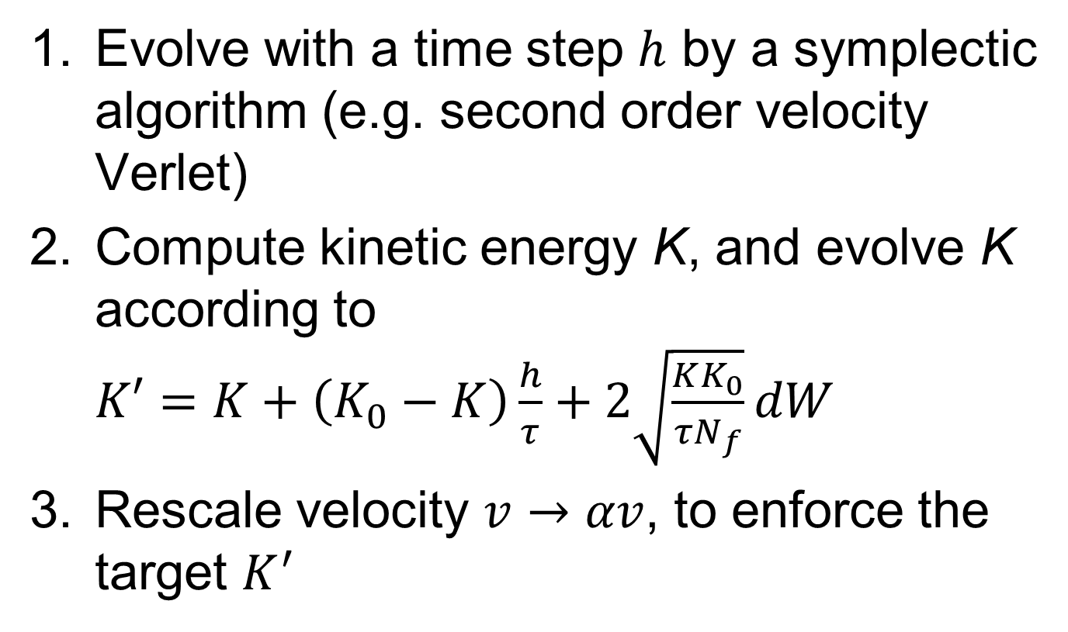
Stochastic Velocity Rescaling for Canonical Ensemble
Evolve with a time step $h$ by a symplectic algorithm (e.g. second order velocity Verlet)
Compute kinetic energy K, and evolve K according to $K′=K+\left(K_{0}−K\right)\frac{h}{τ}+2\sqrt{\frac{KK_{0}}{{τN}_{f}}}dW$
Rescale velocity $v→αv$, to enforce the target $K^{′}$
Notes:
See https://arxiv.org/abs/0803.4060 by Bussi, Donadio, and Parrinello. Here dW is Wiener noise, i.e., a Gaussian random number, with zero mean and variable h. N_f is the number of degree of freedom of the system.

Slide 10
Generalized Langevin
Σ is known as self-energy
Notes:
Here u is defined as sqrt(m)*x (x has dimension of length).

Slide 11
Observables, Statistics
Equilibrium temperature (in micro-canonical ensemble) by the equipartition theorem.
Pressure of a fluid (for pair potential)
Where d is dimension, F_{ij} is the force acting on particle i from particle j.

Slide 12
Transport Coefficients
The diffusion constant can be computed through the velocity correlation function

Slide 13
Transport Coefficients
Thermal conductivity can be computed through energy-current correlation using Green-Kubo formula; or nonequilibrium simulation by directly computing the energy current
Notes:
J is the current density in x-direction integrated over the volume V.

Slide 14
Conductance of graphene strips
Sites 0 to 7 are fixed left lead and sites 28 to 35 are fixed right lead. Heat bath is applied to sites 8 to 15 at temperature T_{L} and site 20 to 27 at T_{R}. Wang, Ni, & Jiang, PRB 2009.

Slide 15
Textbooks on MD
M P Allen & D J Tildesley, “Computer Simulation of Liquids,” (Oxford, 2017)
D Frenkel & B Smit, “Understanding Molecular Simulation,” 3rd (Academic Press, 2023)
A R Leach, “Molecular Modeling, principles and applications,” (Pearson, 2001)
Notes:
The Allen & Tildesley’s book is a classic in the field.

Slide 16
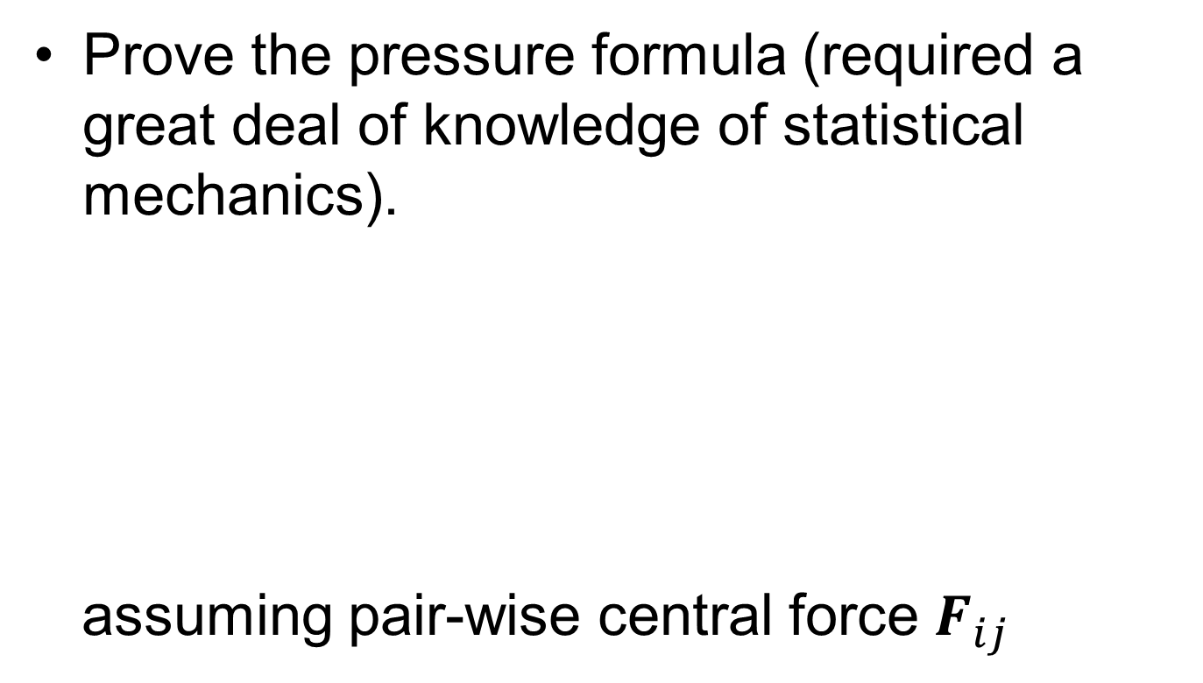
Tutorial Problem Set 12
Prove the pressure formula (required a great deal of knowledge of statistical mechanics).
assuming pair-wise central force $F_{ij}$

