Slide 1
Chapter 4, Integration of Functions

Slide 2
Open and Closed Formulas
Open formulas - use interior points only.
Extended formulas – piecewise sum of integration formula.
x₁=a x₂ x₃ x₄ x₅=b
Closed formula uses end points, e.g.,

Slide 3
Deriving Integration Formulas
Given N function values f_{i}, i=1,2,…,N, at x_{i}, interpolate with N−1 degree polynomial, and integrate the polynomial analytically.
Assuming a form Σw_{i}f_{i}, determine the weights w_{i} by requiring that all polynomials of degree N−1 or less integrate exactly.
Notes:
The methods A and B give identical result.

Slide 4
Closed Newton-Cotes Formulas
Equally spaced abscissas, x_{j}=x₁+(j-1)h
Lagrange’s interpolation formula
Integrating, gives
Where l_{j}(x) is a polynomial of degree N-1 such that l_{j}(x_{j}) = 1 and else l_{j}(x_{k}) = 0 if k ≠ j.
Notes:
Why error is O(h^{N+1})? abscissa = x value = coordinate, ordinate = y value.

Slide 5
Special Cases, N=2,3,4 : the Integration Rules
linear interpolation
Trapezoidal rule
Simpson’s rule
3/8 rule
parabola
cubic
Notes:
We also have the simpler case of N=1, which is the rectangular rule. Trapezoidal [trœpizəidl]. Simpson’rule rule is also called Kepler’s rule.

Slide 6
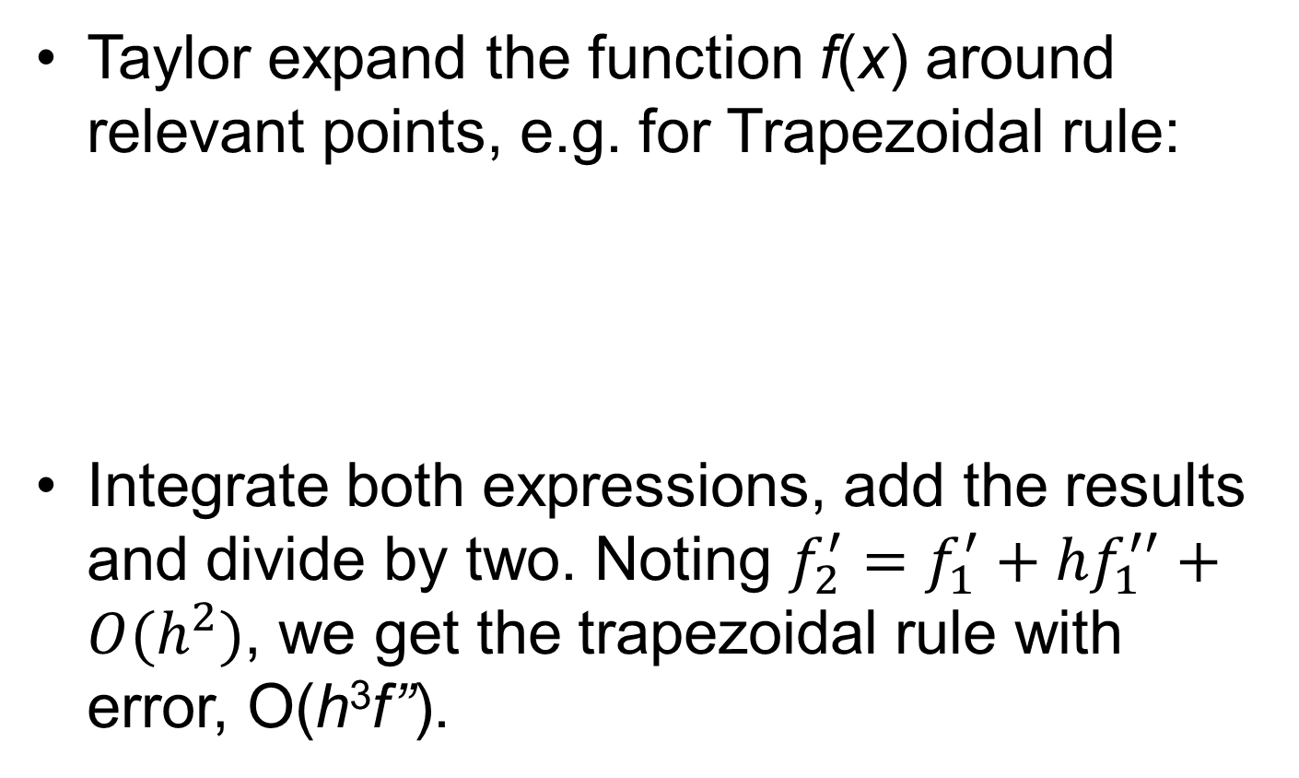
Estimate the Error
Taylor expand the function f(x) around relevant points, e.g. for Trapezoidal rule:
Integrate both expressions, add the results and divide by two. Noting $f_{2}^{′}=f_{1}^{′}+hf_{1}^{′′}+O(h^{2})$, we get the trapezoidal rule with error, O(h³f’’).
Notes:
Why no O(h^2) term?

Slide 7
Open Formula in a Single Interval
These formulas are useful to construct extended formulas with open interval
x₀ x₁ x₂
Open formulas are useful for integrals where the end-point is singular, e.g.,

Slide 8
Extended Formulas
x₁ x₂ x₃ x₄ … x_{N}
Using trapezoidal rule in intervals [x₁,x₂], [x₂,x₃], [x₃,x₄], …, and [x_{N-1},x_{N} ], we get
Using Simpson’s rule in intervals [x₁,x₃], [x₃,x₅], etc, we get
Notes:
For trapezoidal rule, any N is fine. For Simpson’s rule, N must be an odd number.

Slide 9
Trapezoidal Routine
Sequence of points for each iteration n
n = 1
n = 2
n = 3
n = 4
2h_{n}
n = …
Subdivide the intervals and compute f_{i} only at points that have not been computed before.

Slide 10
Recursive Computation of Trapezoidal Sum
If n = 1 (two points, one interval)
else if (n > 1)

Slide 11
trapzd( )
def FUNC(x):
return (x*x)
def trapzd(FUNC, a, b, n, s):
if n==1:
s = 0.5*(b-a)*(FUNC(a)+FUNC(b))
return s
else:
it = 2**(n-2)
d = (b-a)/it
x = a + 0.5*d
sum = 0.0
for j in range(0,it):
sum += FUNC(x)
x += d
s = 0.5*(s + (b-a)*sum/it)
return s
Note: d = 2 h_{n}

Slide 12
qtrap(..) call trapzd(..) until convergence
def qtrap(FUNC, a, b):
EPS = 1.0e-8
JMAX = 20
olds = -1.0e300
s = 0.0
for j in range(1, JMAX):
s = trapzd(FUNC,a,b,j,s)
if (math.fabs(s-olds) < EPS*math.fabs(olds)):
return s
if(s == 0.0 and olds == 0.0 and j > 6):
return s
olds = s
res = qtrap(FUNC,0.0,1.0)
print(res)

Slide 13
Romberg Integration
Compute trapezoidal sum
for different values of h, e.g., h₀, h₀/2, h₀/4, h₀/8, etc.
Extrapolate S(h) in polynomial of h² to h → 0. The justification for this is due to the Euler-Maclaurin formula.

Slide 14
Euler-Maclaurin Summation Formula
The important point is that T(h) is in powers of h².
Notes:
B is called Bernoulli number.

Slide 15
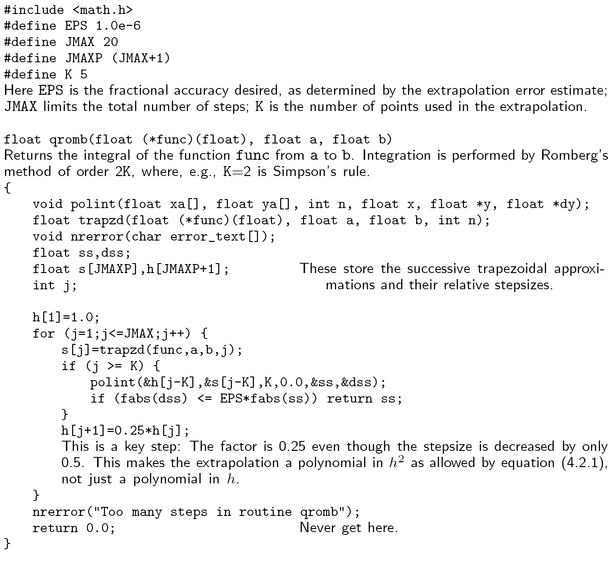
qromb( ) still in C

Slide 16
Integration Use Scipy
from scipy import integrate
x2 = lambda x: x**2
integrate.quad(x2,0,4)
Notes:
The Scipy quad() is actually calling Fortran QUADPACK. Lambda introduces a nameless one-line (pure) function.

Slide 17
Theory of Gaussian Quadrature
Find w_{j} and abscissas x_{j} arbitrarily spaced that integrate exactly for all polynomials f(x) up to degree 2N-1:
where the weight function W(x) is assumed positive and continuous.
Notes:
Note that the right-hand side of the formula does not have the weight function W(x).

Slide 18
Example, 3 points, weight W(x)=1, exact for polynomials up to x⁵
set f(x) =1, x, x², …, x⁵.
How to find the solution of 6 coupled nonlinear equations?

Slide 19
Orthogonal Polynomials
Two polynomials are said orthogonal with respect to a fixed weight function W(x) and fixed interval [a,b], if
is zero.
One can construct the orthogonal polynomial set {p_{j}(x), j=0,1, 2, …} recursively.
Notes:
Index j indicate the degree of polynomial.

Slide 20
Constructing Orthogonal Polynomials
Start with the zeroth order P₀(x)=1
Let P₁(x)=c₀+c₁x, determine the coefficients by requiring <P₀|P₁>=0, For weight W(x)=1 in interval [-1,1], this gives P₁(x)=x
Determine P₂(x)= c₀+c₁x+c₂x² by requiring <P₀|P₂>=0, <P₁|P₂>=0
In general
P_{j+1}(x) = (x-a_{j}) P_{j}(x) – b_{j} P_{j-1}(x)
Notes:
This process is known as Gram-Schmidt orthogonalization (in linear vector spaces). Why P_{j+1} does not depends on P_{j-2} and small index P?

Slide 21
Example of Orthogonal Polynomials
With weight W(x) = 1 in interval [-1,1], the corresponding orthogonal polynomials are the Legendre polynomials:

Slide 22

Abscissas in Gaussian Quadrature
For an N-point integration formula, choose the roots x_{j} of N-th orthogonal polynomial as the abscissas. $p_{N}\left(x_{j}\right)=0$.
Choose w_{j} to satisfy
It turns out that the ‘integration equal to 0’ is true also for i up to 2N-1.

Slide 23
Gaussian integration formula is exact for all polynomials of degree 2N-1
Let f(x) be any polynomial of degree 2N-1, we can write
f(x) = q(x) P_{N}(x) + r(x)
where r(x) and q(x) are degree N-1.
Considering the left- and right-hand side of the integration formula with function f(x), show that they are equal.
Notes:
How to divide in polynomials so that f = qP+r?

Slide 24
It is sufficient to show validity for f(x) = P₀=1,P₁, …,P_{N}, ..,P_{2N-1}. For 1 to N-1, it is equal to 0 by assumption.
For P_{N}, since x_{j} is the roots of P_{N},
For i = N+1,N+2, …,2N-1, we write P_{i}=qP_{N}+r, the first term qP_{N} is 0. Expand r in terms of P₀, P₁, …, P_{N-1}. We need to show coefficient for P₀ is the same on both sides of the equation.
Equality breaks down for P_{2N}
Notes:
For i=2N, the integral on the left side by definition is 0 (since it is orthogonal to P0), but right-side sum w P in general is not 0. The exactness of the integral breaks down.

Slide 25
Solution for the Weight w_{j}
This formula assumes that the polynomials are normalized according to Eqs.(4.5.6) & (4.57), page 149 of NR.
Notes:
NR refers to “Numerical Recipes in C”, 2nd edition.

Slide 26
Reading, References
Read Chapter 4 of NR.
For an in-depth treatment of numerical methods, see, e.g., J. Stoer and R. Bulirsch, “Introduction to Numerical Analysis”.

Slide 27
Problems for Lecture 4 (due 3 Oct 2024)
1. Compute the Euler-Maclaurin summation formula for the first three terms, i.e.,
where h = (x_{N}-x₁)/(N-1). (Hint: Taylor expand & compute recursively.)
2. Use the theory of Gaussian quadrature to find a 3-point integration formula for the weight W(x) = 1 and interval [0, 1]. That is, find the abscissas x_{j} and weights w_{j} such that the formula below is exact for all polynomials of degree 5 or less.

