Slide 1
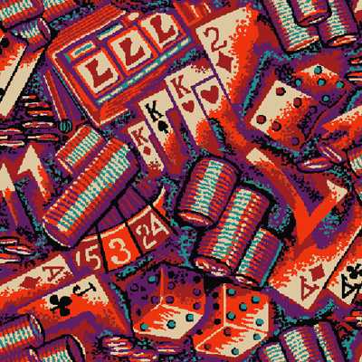
1. What is a Monte Carlo method ?

Slide 2
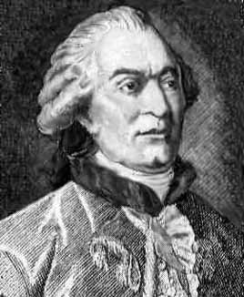
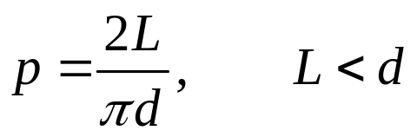
A little history (the Comte de Buffon needle experiment, AD 1777)
L
d
Notes:
Georges Louis Leclerc, Comte de Buffon, (1707-1788) French naturalist and mathematician best known as the creator of the immense Histoire naturelle. In mathematics he is still remembered for his work on probability and his famous needle problem with which in 1777 he computed an approximation for π.
Question: the result probability 2L/(π d) is correct only if L < d. What if L > d?
Question: What if it is rectangular grids a by b ? Answer: [2L(a+b)-L²]/(π a b)

Slide 3
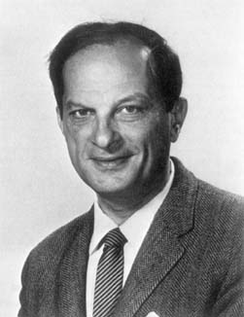
Stanislaw Ulam (1909-1984)
S. Ulam is credited as the inventor of Monte Carlo method in 1940s, which solves mathematical problems using statistical sampling.
Notes:
Stanislaw Ulam, a Polish born mathematician who worked for John von Neumann on the United States’ Manhattan Project during World War II. Ulam is primarily known for designing the hydrogen bomb with Edward Teller in 1951. He invented the Monte Carlo method in 1946 while pondering the probabilities of winning a card game of solitaire.

Slide 4
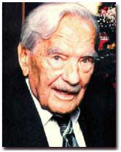
Nicholas Metropolis (1915-1999)
The algorithm by Metropolis (and A Rosenbluth, M Rosenbluth, A Teller and E Teller, 1953) has been cited as among the top 10 algorithms having the "greatest influence on the development and practice of science and engineering in the 20th century."
Notes:
“The code that was to become the famous Monte Carlo method of calculation originated from a synthesis of insights that Metropolis brought to more general applications in collaboration with Stanislaw Ulam in 1949. A team headed by Metropolis, which included Anthony Turkevich from Chicago, carried out the first actual Monte Carlo calculations on the ENIAC in 1948. Metropolis attributes the germ of this statistical method to Enrico Fermi, who had used such ideas some 15 years earlier. The Monte Carlo method, with its seemingly limitless potential for development to all areas of science and economic activities, continues to find new applications.”
From “Physics Today” Oct 2000, Vol 53, No. 10., see also http://www.aip.org/pt/vol-53/iss-10/p100.html.

Slide 5
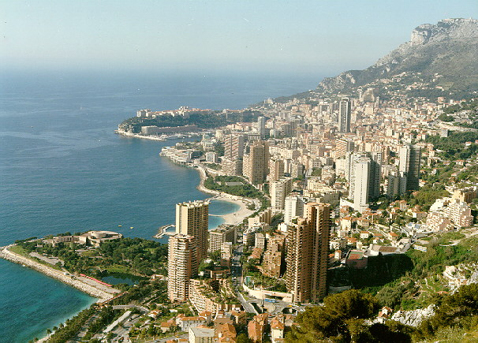
The Name of the Game
Metropolis coined the name “Monte Carlo”, from its gambling Casino.
Monte-Carlo, Monaco
Notes:
“Monte Carlo, in the principality of Monaco, is a favorite port of call for many cruise visitors to the Mediterranean. It is tiny (only three kilometers long - less than two miles) and sits on a large rock named Mont Des Mules overlooking the sea. A road separates Monaco from France, and you hardly realize it when you are moving between the two countries. There are about 30,000 residents of Monaco, of which the citizens, called Monegasques, make up about 25 per cent of the total populace. ”
From http://cruises.about.com/library/weekly/aa021101a.htm

Slide 6
Summary of Monte Carlo Method
Solving mathematical problems (numerical integration, numerical partial differential equation, integral equation, etc) by random sampling
Using random numbers in an essential way
Simulation of stochastic processes

