Slide 1

2. Introduction to Theory of Probability

Slide 2

What is a Probability?
Notes:
Figure from
http://www.usoe.k12.ut.us/curr/science/sciber00/7th/genetics/images/heads.gif

Slide 3
Two Schools
Frequentists: fraction of times a event occurs if it is repeated N times
Bayesians: a probability is a degree of belief
Notes:
Rev. Thomas Bayes (1702-1761) English mathematician and theologian best known for “an Essay Towards Solving a problem in the Doctrine of Chances,” published posthumously (1763), which included both the uncontroversial Bayes’s theorem and a contentious postulate that is fundamental to Bayesian inference.
From “Dictionary of Mathematics”, ed. J. Daintith and R. D. Nelson (1989).

Slide 4
Set-Theoretic Point of View of Probability
Consider a set S. For each subset X of S, we associate a real number
0 ≤ P(X) ≤ 1, such that
P(Ø) = 0, P(S) = 1,
P(A ∪ B) = P(A) + P(B) - P(A ∩ B)
Notes:
This is known as Komogorov axiomatic formulation of probability theory. We need Lebesgue measure theory to make this rigorous.

Slide 5
Venn Diagram
S
∪: union, or
∩: intersection, and
A
A ∩ B
B
P(A ∪ B) = P(A) + P(B) - P(A ∩ B)
Notes:
Set-theoretic Questions:
(1) What is the yellow part (complement of A or B),
(2) The red part ( A – B),
(3) brown part (A and B).

Slide 6
Mutual Exclusion
If two events (subsets) A and B cannot happen simultaneously, i.e.,
A ∩ B = Ø, we say A and B are mutually exclusive events.
For mutually exclusive events,
P(A ∪ B) = P(A) + P(B)
Notes:
For example, throwing a dice, the result is either of 1, 2, 3, 4, 5, or 6. They are mutually exclusive.

Slide 7
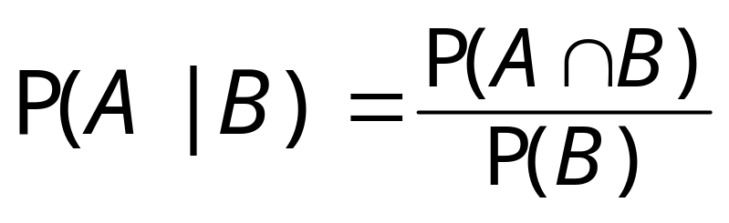
Conditional Probability
We define conditional probability of A given B, as
Assuming P(B) > 0.

Slide 8
Independence
If P(A|B) = P(A) , then we say A is independent of B.
Equivalently,
P(A ∩ B) = P(A) P(B), if A and B are independent.
Notes:
If an event happens through several steps, each is independent of the others, then the probability of the event is the product of individual probabilities.

Slide 9
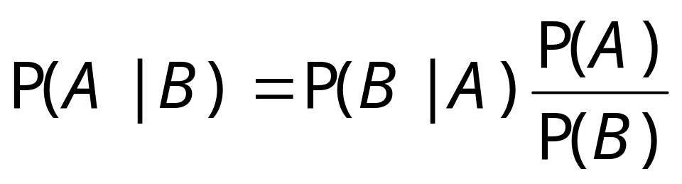
Bayes’s Theorem
This theorem gives the relationship between P(A|B) and P(B|A):
This equation forms the basis for Bayesian statistical analysis.

Slide 10
Random Variable
A variable X that takes “random” values. We assume that it follows a probability distribution.
Discrete variable: p₁, p₂, …
Continuous variable: P(x)dx gives the probability that X falls between x and x +dx.
Notes:
In statistics, we distinguish a random variable X, and its particular concrete value x. X can take many different possible values, but x is just a given number. There are many good books on statistics, e.g., G. Casella and R. L. Berger, “Statistical Inference”, 2nd ed, Duxbury (2002).

Slide 11
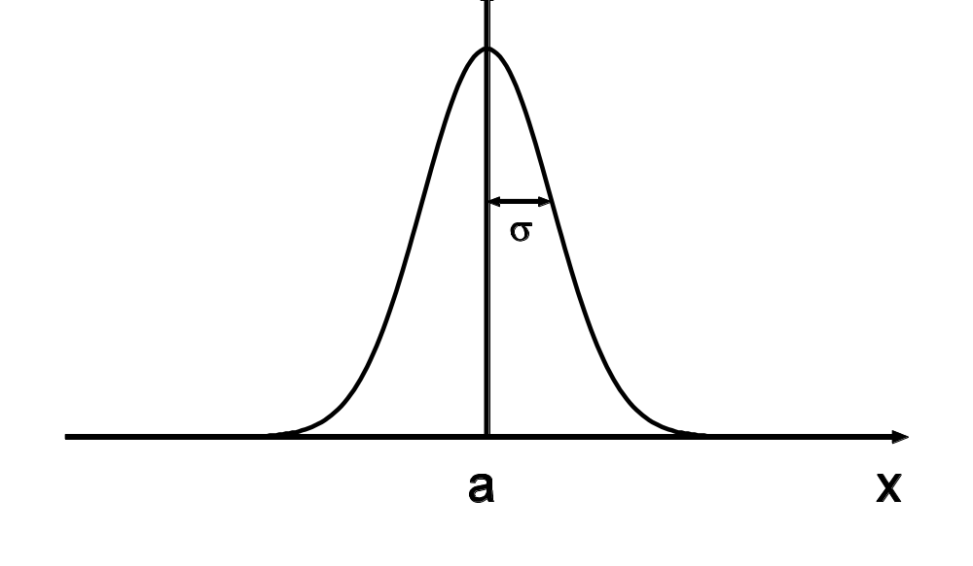
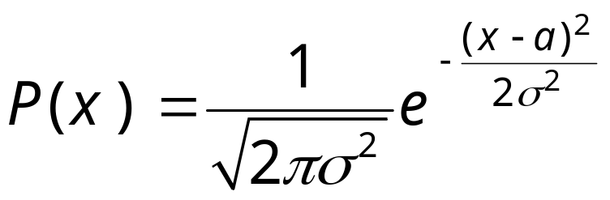
Gaussian Distribution
Notes:
Problem: compute <x^{n}> in the Gasussian distribution for any integer n.

Slide 12
Cumulative Distribution Function
The cumulative distribution function is defined as
F(x) = P(X ≤ x).
This definition applies equally well for discrete and continuous random variables.
Notes:
What does the distribution function F(x) look like for a discrete distribution?
F(x) is monotone increase from 0 to 1 with x and continuous from the right.

Slide 13
Statistic of a Random Variable
Mean <X> = (1/N) ∑ x_{i}
Variance σ² = <X²> - <X>²
Correlation <X Y> - <X><Y>
Notes:
Other higher moments are also useful: skewness <(x -<x>)³>/σ³, kurtosis <(x -<x>)⁴>/σ⁴ – 3. What is skewness and kurtosis for a Gaussian distribution?

Slide 14
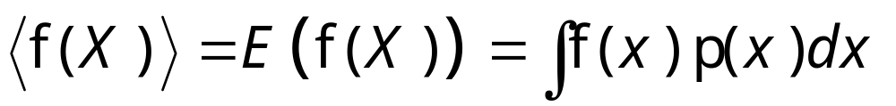
Expectation Value
If the probability distribution is known, the expectation value (average value) can be computed as (for continuous variable)
Notes:
Whether it is discrete or continuous variable, we can express the expectation value as a Stieltjes integral, int f dF.

