Slide 1

3. Random Number Generator

Slide 2


The Roulette and Dice
Mechanical random number generators
Notes:
Roulette picture from
http://www.pierceproductions.net/3D/images/Roulette.JPG
Die picture from
http://blades.netppl.fi/suomi/images/dice.gif

Slide 3
What is a Random Number?
Follow a definite distribution, usually uniform distribution
Uncorrelated
Unpredictable
1
3
0
7
4
Notes:
See D Knuth, “Art of Computer Programming”, Vol 2, for more detailed treatment regarding random numbers.

Slide 4
Pseudo-Random Numbers
Truly random numbers can not be generated on a computer
Pseudo-random numbers follow a well-defined algorithm, thus predictable and repeatable
Have nearly all the properties of true random numbers

Slide 5
Linear Congruential Generator (LCG)
One of the earliest and also fastest algorithm:
x_{n+1} = (a x_{n} + c ) mod m
where 0 ≤ x_{n} < m, m is the modulus, a is multiplier, c is increment. All of them are integers. Choice of a, c, m must be done with special care.
Notes:
Perhaps the first random number generator proposed was that of mid-square by von Neumann, but this method does not work well. The following site points to many random number generators – theory and codes: http://random.mat.sbg.ac.at/links/rando.html

Slide 6
Choice of Parameters
Name | m | a (multiplier) | c | period
ANSI C [rand()] | 2³¹ | 1103515245 | 12345 | 2³¹
Park-Miller NR ran0() | 2³¹-1 | 16807 | 0 | 2³¹-2
drand48() | 2⁴⁸ | 25214903917 | 11 | 2⁴⁸
Hayes 64-bit | 2⁶⁴ | 6364136223846793005 | 1 | 2⁶⁴
(a x + c) mod m
Notes:
The site http://crypto.mat.sbg.ac.at/results/karl/server/server.html
has a comprehensive list of linear generators.

Slide 7
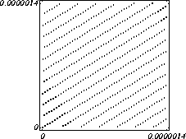
Short-Coming of LCG
When (x_{n},x_{n+1}) pairs are plotted for all n, a lattice structure is shown.
x_{n+1}
x_{n}
Notes:
Why the lattice structure?

Slide 8
Other Modern Generators
Mersenne Twister
  Extremely long period (2¹⁹⁹³⁷-1), fast
Inversive Congruential Generator
  x_{n} = a x_{n+1} + c mod m
  where m is a prime number
  Nonlinear, no lattice structure
Notes:
The site http://www.math.sci.hiroshima-u.ac.jp/~m-mat/MT/emt.html has source code in C for the Mersenne Twister random number generator. For the inversive congruential generator, check up H. Niederreiter.
Three different random number generators are also available (in the file rand.c) at:
http://phyweb.physics.nus.edu.sg/~phywjs/BeijingWorkshop.html

Slide 9
Pick an Integer at Random
Suppose we want to select an integer j from 0 to N-1 with equal probability. This can be done with:
  j = N*ξ;
  where 0 ≤ ξ < 1 is uniformly distributed random number.
  For 2D lattice, we can also do this if we name the lattice site sequentially.

Slide 10
Pick j with Probability P_{j}
Since Σ_{j} P_{j}=1, we pick out j if ξ is in the corresponding interval.
0
P₀
P₁
ξ
1
P=p[0];
j = 0;
ξ = drand64();
while(ξ>P) {++j; P+=p[j]};

Slide 11
Pei Lucheng’s Method
Use j = N*ξ to get an index; pick a final result based on the relative height. This is an O(1) algorithm.
1
4
2
1 2 3 4 5
Notes:
This method is also discussed in Knuth’s book, “The Art of Computer Programming”, 3rd ed, Vol 2, page 120.

Slide 12
Non-Uniformly Distributed Random Numbers
Let F(x) be the cumulative distribution function of a random variable x, then x can be generated from
x = F⁻¹(ξ)
where ξ is uniformly distributed between 0 and 1, and F⁻¹(x) is the inverse function of F(x).
Notes:
This method works only for distribution in one variable.

Slide 13
Proof of the Inverse Method
The Mapping from x to ξ is one-to-one.
The probability for ξ between value ξ and dξ is 1·dξ, which is the same as the probability for x between value x and dx. Thus
dξ = dF(x) = F’(x)dx = p(x)dx,
since F⁻¹ (ξ)=x, or ξ = F(x)

Slide 14
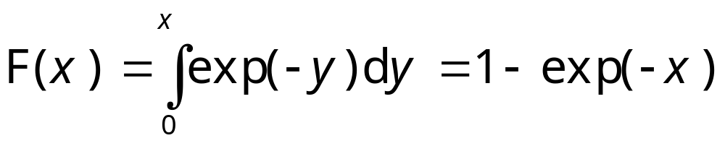
Example 1, Exponential Distribution
P(x) = exp(-x), x ≥ 0, then
So we generate x by
x = -log(ξ)
where ξ is a uniformly distributed random number.
Notes:
Why not x = -log(1-ξ)?

Slide 15
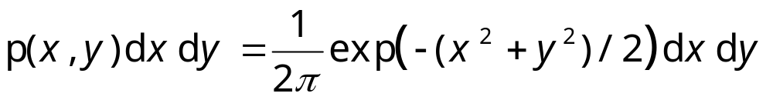
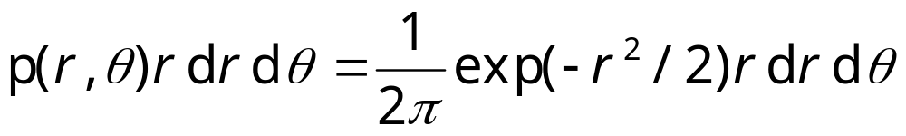
Example 2, Gaussian distribution
Take 2D Gaussian distribution
Work in polar coordinates:
Notes:
dx dy = r dr d theta.

Slide 16
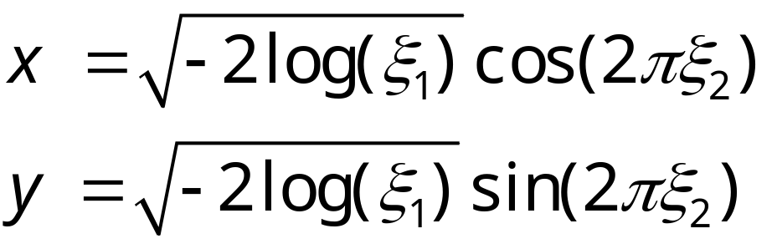
Box-Muller Method
The formula implies that the variable θ is distributed uniformly between 0 and 2π, ½r² is exponentially distributed, we have
ξ₁ and ξ₂ are two independent, uniformly distributed random numbers.

Slide 17
What distribution does X follow?
Take two uniformly distributed, independent random numbers ξ₁ and ξ₂ in (0,1], multiply them and then take natural log:
X = - log(ξ₁ ξ₂)
Notes:
Answer: Gama distribution of degree 2: P(x) = x exp(-x).

