Slide 1

4. Numerical Integration

Slide 2
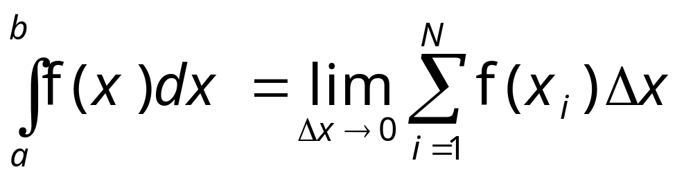
Standard Quadrature
We can find numerical value of a definite integral by definition:
where points x_{i} are uniformly spaced.
Notes:
This is the rectangular rule.

Slide 3
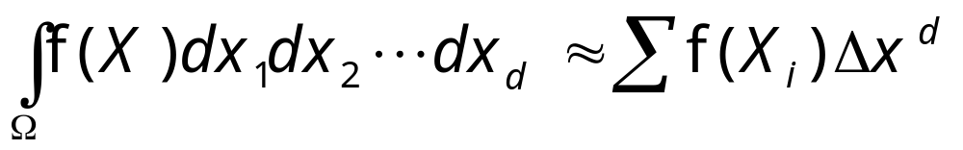
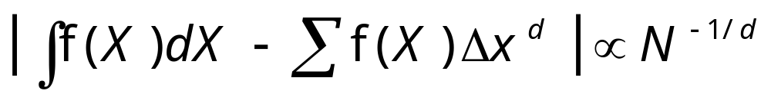
Error in Quadrature
Consider integral in d dimensions:
The error with N sampling points is
Notes:
Proof the error bound! In each small box, we do a Taylor expansion of the function, and compute the difference between the estimate and Taylor series results. The Trapezoidal rule has a better error bound of O(N^{-2/d}). The formula above is a rectangular rule.

Slide 4
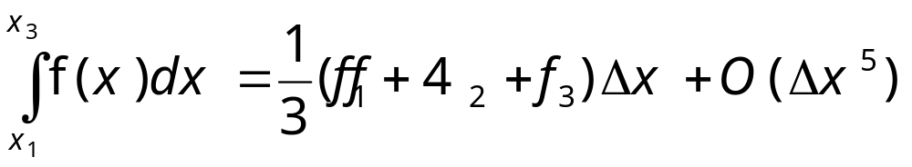
More Accurate Methods
Simpson’s rule
Gaussian quadrature
  Non-uniform x points (abscissa) for higher accuracy.
Notes:
What is the global error (with respect to the number of sampling points N) if Simpson’s rule is used for 1D integration?
See “Numerical Recipes” W H Press et al. for more information.

Slide 5
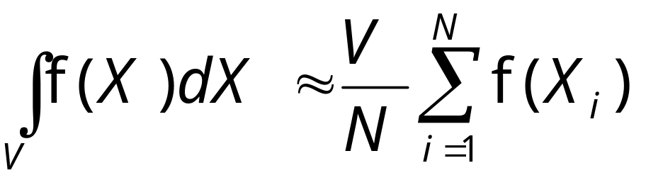
Monte Carlo Estimate of Integrals
We sample the points not on regular grids, but at random (uniformly distributed), then
Where we assume the integration domain is a regular box of V=L^{d}.

Slide 6
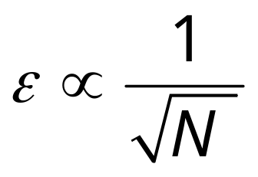
Monte Carlo Error
From probability theory one can show that the Monte Carlo error decreases with sample size N as
independent of dimension d.

Slide 7
Central Limit Theorem
For large N, the sample mean
<f> = (1/N) ∑ f_{i}
follow Gaussian distribution with true mean of f, E(f), and variance
σ² = var(f)/N
where var(f) = E(f ²) – E(f )².
σ is called standard deviation.
Notes:
Law of large numbers: The sample mean converges almost surely to its expectation value.
Chebychev inequality: P{ (E(f)-<f>) > (var(f)/d)^{1/2} } < d, deviation away from standard deviation is small.

Slide 8
Example, Monte Carlo Estimates of π
Throw dots at random:
x = ξ₁, y = ξ₂.
Count the cases, n, that
x² + y² < 1.
Then n/N is an estimate of the value ¼π.
(x,y)
(1,0)
Notes:
How many dots do you need to throw to get a three-digit accuracy of π?

Slide 9
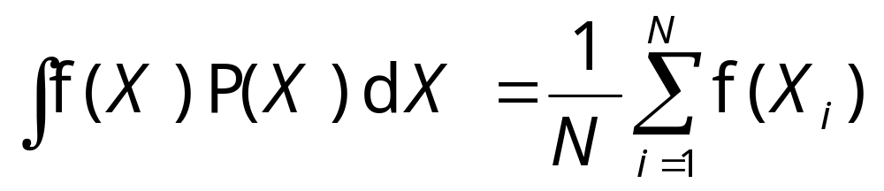

General Monte Carlo
If the samples are not drawn uniformly but with some probability distribution P(X), we can compute by Monte Carlo:
Where P(X) is normalized,
Notes:
Why we do not need P(X) in the summation?

Slide 10
Variance Reduction
Since the error in Monte Carlo decreases slowly as 1/N^{½}, the fundamental research in Monte Carlo method for improving efficiency is to reduce the pre-factor.
The second problem is to develop methods for sampling X from a general distribution P(X).
Notes:
Markov chain Monte Carlo solved the second problem elegantly. Research for efficient sampling is still an active field of research.

Slide 11
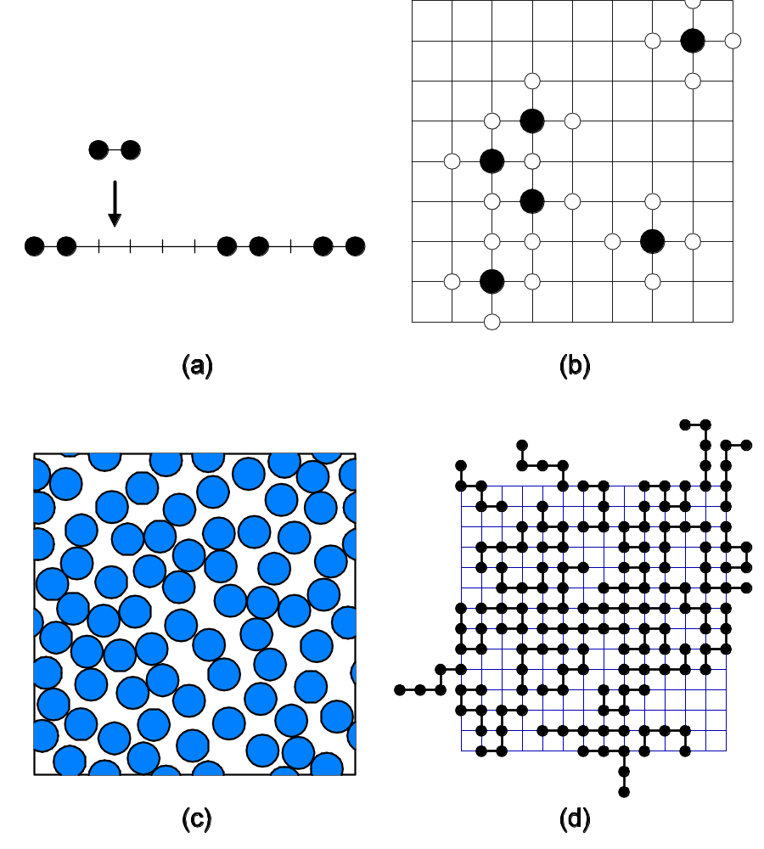
Random Sequential Adsorption
Notes:
For a review in random sequential adsorption, including Monte Carlo simulations, see J S Wang, “Colloids and Surfaces”, 165 (2000) 325.

Slide 12
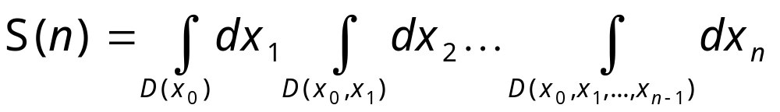
A Non-Trivial Example
In the study of random sequential adsorption, we need to compute the coefficients of a series expansion:
where D(x₀) is a unit circle centered at (0,0), D(x₀,x₁) is the union of circles centered at x₀ and x₁, etc.
Notes:
See the original paper by R Dickman, J S Wang, and I Jensen, “J Chem Phys”, 94 (1991) 8252.
Note that x_{i} = (a,b) is two-dimensional.

Slide 13
RSA: Integral Domains
D(x₀) : |x| < 1
D(x₀,x₁) : |x|<1 or |x-x₁| < 1, x₁∈D(x₀)
D(x₀,x₁,x₂): |x|<1 or |x-x₁|< 1 or |x – x₂| < 1, x₁∈D(x₀) x₂∈D(x₀,x₁),
etc.
|x| is distance
(2-norm).

Slide 14
Monte Carlo Estimates
We sample x₁ uniformly in a box of size 2; sample x₂ uniformly in a box of size 4; and x₃ in size 6, etc.
If x₁∈D(x₀) and x₂∈D(x₀,x₁), x₃∈D(x₀,x₁,x₂), etc, count 1, else count 0.
Answer = count•Volume/N
Notes:
The Volume is actually the hyper-volume (2*4*6*…)²

Slide 15
Results of S(4)
We found Monte Carlo estimates:
S(4)/(π/2)⁴ = 86.016 ± 0.008
Notes:
Problem: implement a program to compute S(n).

