Slide 1

6. Markov Chain

Slide 2
State Space
The state space is the set of values a random variable X can take. E.g.: integer 1 to 6 in a dice experiment, or the locations of a random walker, or the coordinates of set of molecules, or spin configurations of the Ising model.

Slide 3
Markov Process
A stochastic process is a sequence of random variables X₀, X₁, …, X_{n}, …
The process is characterized by the joint probability distribution P(X₀, X₁, …)
If P(X_{n+1}|X₀, X₁,…, X_{n}) = P(X_{n+1}|X_{n}) then it is a Markov process.
Notes:
For simplicity, we consider only discrete state space, X_{n} takes integer vales. Capital letter X denotes a random variable, while lower case x for specific value.
A Markov process remembers only its immediate previous past.
See J R Morris, “Markov Chains” Cambridge, 1997, for a more mathematical treatment.

Slide 4
Markov Chain
A Markov chain is completely characterized by an initial probability distribution P₀(X₀), and the transition matrix W(X_{n}->X_{n+1}) = P(X_{n+1}|X_{n}).
Thus, the probability that a sequence of X₀=a, X₁=b, …, X_{n}= n appears, is
  P₀(a)W(a->b)W(b->c) … W(..->n).
Notes:
The term “stochastic process” refers to general random process (in time), Markov process does not have “long-term” memory. Markov chain refers to discrete state space Markov process. See N G van Kampen, “Stochastic Processes in Physics and Chemistry”, North-Holland, (1981), for more information. See also, J. R. Norris, “Markov Chain”, Cambridge (1997).

Slide 5
Properties of Transition Matrix
Since W(x->y) = P(y|x) is a conditional probability, we must have W(x->y) ≥ 0.
Probability of going anywhere is 1, so
∑_{y} W(x -> Y) = 1.
Notes:
Matrices with such properties are known as stochastic matrices.

Slide 6
Evolution
Given the current distribution, P_{n}(X), the distribution at the next step,
n +1, is obtained from
P_{n+1}(Y) = ∑_{x} P_{n}(X) W( X -> Y)
In matrix form, this is P_{n+1} = P_{n} W.
Notes:
Why this is so? All of these equations are based on the fact of conditional probability:
P(A,B) = P(B) P(A|B), and marginal probability P(A) = ∑_{B} P(A,B).

Slide 7
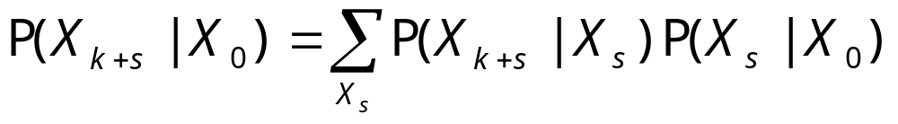
Chapman-Kolmogorov Equation
We note that the conditional probability of state after k step is P(X_{k}=b|X₀=a) = [W^{k}]_{ab}. We have
which, in matrix notation, is W^{k+s}=W^{k} W^{s}.
Notes:
The subscript in X is step or time. [W]_{ab} means the (a,b) element of matrix W.
Andrei Nikolaevich Kolmogorov (1903-1987) is a Russian mathematician best known for his work in probability theory and turbulence.

Slide 8
Probability Distribution of States at Step n
Given the probability distribution P₀ initially at n = 0, the distribution at step n is
P_{n} = P₀ W^{n} (n-th matrix power of W)

Slide 9

Example: Random Walker
A drinking walker walks in discrete steps. In each step, he has ½ probability walk to the right, and ½ probability to the left. He doesn’t remember his previous steps.
Notes:
Picture from http://spaceplace.jpl.nasa.gov/walker.gif
What is the variable X? What is the transition matrix W?
At time t=0, the walker is at origin, what is the probability that he do a left-left-right move?

Slide 10
The Questions
Under what conditions P_{n}(X) is independent of time (or step) n and initial condition P₀? And approaches a limit P(X)?
Given W(X->X’), compute P(X)
Given P(X), how to construct W(X->X’) ?

Slide 11
Some Definitions: Recurrence and Transience
A state i is recurrent if we visit it infinite number of times when n -> ∞.
P(X_{n} = i for infinitely many n) = 1.
For a transient state j, we visit it only a finite number of times as n -> ∞.

Slide 12
Irreducible
From any state I and any other state J, there is a nonzero probability that one can go from I to J after some n steps.
I.e., [W^{n}]_{IJ} > 0, for some n.

Slide 13
Absorbing State
A state, once it is there, can not move to anywhere else.
Closed subset: once it is in the set, there is no escape from the set.

Slide 14
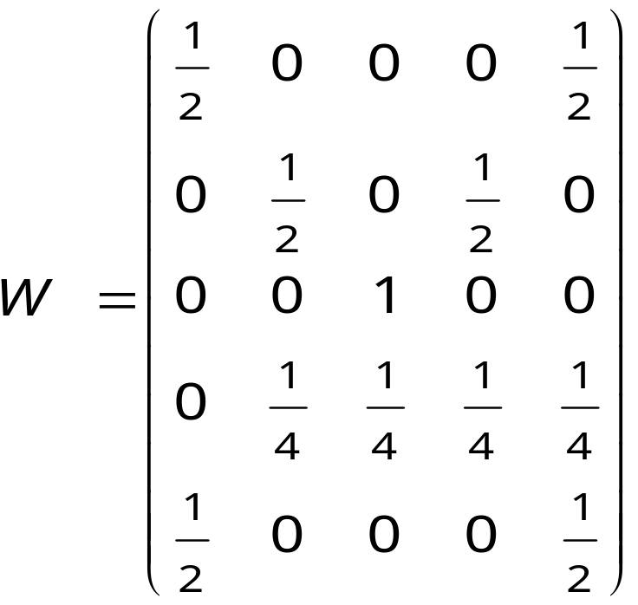
Example
1
2
1/2
1/2
1/4
1/2
1/4
4
5
1/4
3
{1,5} is closed, {3} is closed/absorbing.
It is not irreducible.

Slide 15
Aperiodic State
A state I is called aperiodic if
[W^{n}]_{II} > 0 for all sufficiently large n.
This means that probability for state I to go back to I after n step for all n > n_{max} is nonzero.
Notes:
A periodic state would be that it cannot go to that state every p > 1 steps regularly.

Slide 16
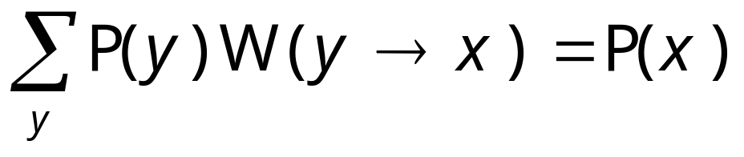
Invariant or Equilibrium Distribution
If
we say that the probability distribution P(x) is invariant with respect to the transition matrix W(x->x ’).

Slide 17
Convergence to Equilibrium
Let W be irreducible and aperiodic, and suppose that W has an invariant distribution p. Then for any initial distribution,
P(X_{n}=j) -> p_{j}, as n -> ∞ for all j.
This theorem tell us when do we expect a unique limiting distribution.

Slide 18
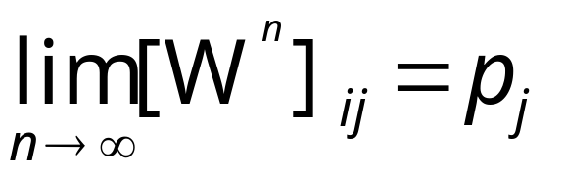
Limit Distribution
One also has
independent of the initial state i, such that P = P W, [P]_{j} = p_{j}.

Slide 19
Condition for Approaching Equilibrium
The irreducible and aperiodic condition can be combined to mean:
For all state j and k,
[W^{n}]_{jk} > 0 for sufficiently large n.
This is also referred to as ergodic.
Notes:
See the book of J R Norris for proofs of all the theorems quoted.

Slide 20
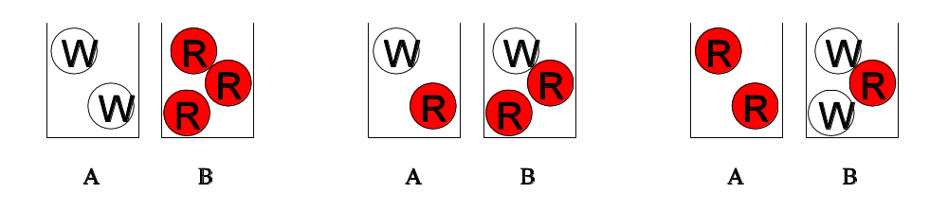
Urn Example
There are two urns. Urn A has two balls, urn B has three balls. One draws a ball in each and switches them. There are two white balls, and three red balls.
What are the states, the transition matrix
W, and the equilibrium distribution P?
Notes:
Example taken from L E Reichl, “A Modern Course in Statistical Physics”, Edward Arnold (1980), page 164-165.

Slide 21
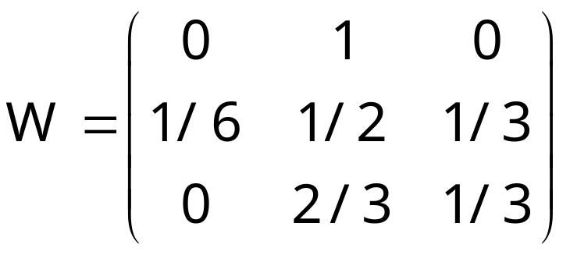
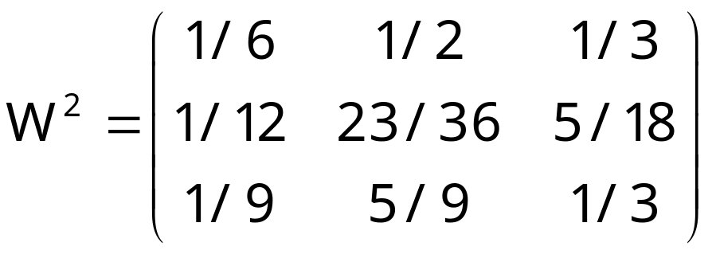
The Transition Matrix
1
1/6
1
3
1/3
2
2/3
Note that elements of W² are all positive.
Notes:
W thus is irreducible and ergodic.

Slide 22
Eigenvalue Problem
Determine P is an eigenvalue problem:
P = P W
The solution is
P₁ = 1/10, P₂ = 6/10, P₃ = 3/10.
What is the physical meaning of the above numbers?

Slide 23
Convergence to Equilibrium Distribution
Let P₀ = (1, 0, 0)
P₁ = P₀ W = (0, 1, 0)
P₂ = P₁ W = P₀ W² = (1/6,1/2,1/3)
P₃ = P₂ W = P₀ W³ = (1/12,23/36,5/18)
P₄ = P₃ W = P₀ W⁴ = (0.106,0.587,0.3)
P₅ = P₄ W = P₀ W⁵ = (0.1007, 0.5986, 0.3007)
. . .
P₀ W∞ = (0.1, 0.6, 0.3)

Slide 24
Time Reversal
Suppose X₀, X₁, …, X_{N} is a Markov chain with (irreducible) transition matrix W(X->X’) and an equilibrium distribution P(X), what transition probability would result in a time-reversed process Y₀ = X_{N}, Y₁=X_{N-1}, …Y_{N}=X₀?

Slide 25
Answer
The new W^{R} should be such that
P(x) W^{R}(x->x’) = P(x’)W(x’->x) (*)
Original process
P(x₀,x₁,..,x_{N}) = P(x₀) W(x₀->x₁) W(x₁->x₂) … W(x_{N-1}->x_{N})
must be equal to reversed process
P(x_{N},x_{N-1},…,x₀) = P(X_{N}) W^{R}(X_{N}->X_{N-1}) W^{R}(x_{N-1}->X_{N-2}) … W^{R}(x₁->x₀).
The equation (*) satisfies this.

Slide 26
Reversible Markov Chain
A Markov chain is said reversible if it satisfies detailed balance:
P(X) W(X -> Y) = P(Y) W(Y ->X)
Nearly all the Markov chains used in Monte Carlo method satisfy this condition by construction.
Notes:
That is, in reversible Markov chain, W^{R}=W. This means that one can not distinguish statistically a chain running forward from running backward.

Slide 27
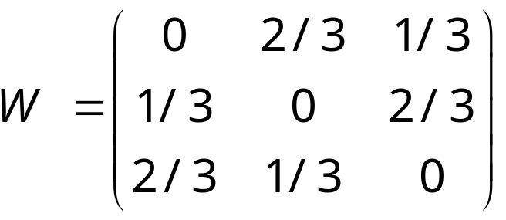
An example of a chain that does not satisfy detailed balance
1
2/3
2/3
1/3
1/3
1/3
3
2
Equilibrium distribution is
P=(1/3,1/3,1/3).
The reverse chain has transition matrix W^{R} = W^{T} (transpose of W). W^{R} ≠ W.
2/3
Notes:
Example taking from J R Morris, “Markov Chains”, page 48-49. Is the urns example reversible Markov chain?

Slide 28
Realization of Samples in Monte Carlo and Markov Chain Theory
A Monte Carlo sampling do not deal with probability P(X) directly, rather the samples, when considered over many realizations, following that distribution.
Monte Carlo generates next sample y from the current x, using the transition probability W(x -> y).

