Slide 1

7. Metropolis Algorithm

Slide 2
Markov Chain and
Monte Carlo
Markov chain theory describes a particularly simple type of stochastic processes. Given a transition matrix, W, the invariant distribution P can be determined.
Monte Carlo is a computer implementation of a Markov chain. In Monte Carlo, P is given, we need to find W such that P = P W.

Slide 3
A Computer Simulation of a Markov Chain
Let ξ₀, ξ₁, …, ξ_{n} …, be a sequence of independent, uniformly distributed random variables between 0 and 1
Partition the set [0,1) into subintervals A_{j} such that |A_{j}|=(p⁰)_{j}, and A_{ij} such that |A_{ij}|=W(i ->j), and define two functions:
G₀(u) = j if u ∈A_{j}
G(i,u) = j if u ∈A_{ij}, then the chain is realized by
4. X₀ = G₀(ξ₀), X_{n+1} = G(X_{n},ξ_{n+1}) for n ≥ 0
Notes:
By |A| we mean the length of the real set A, or measure of A. The above formulation is given in J R Norris.
What does this say is that the current random variable X_{n+1} is determined by the previous value of the random X_{n} and a random number ξ. The proposal is in fact a bit naïve, as the state space is large, and the proposed operations are too expensive to do on a computer.
However, the formulation is useful for proving theorems, such as the “perfect sampling” algorithm.

Slide 4
Partition of Unit Interval
u
A₁
A₂
A₃
A₄
0
p₁
p₁+p₂
p₁+p₂+p₃
1
A₁ is the subset [0,p₁), A₂ is the subset [p₁, p₁+p₂), …, such that length |A_{j}| = p_{j}.

Slide 5
Markov Chain
Monte Carlo
Generate a sequence of states X₀, X₁, …, X_{n}, such that the limiting distribution is given by P(X)
Move X by the transition probability
W(X -> X’)
Starting from arbitrary P₀(X), we have
P_{n+1}(X) = ∑_{X’} P_{n}(X’) W(X’ -> X)
P_{n}(X) approaches P(X) as n go to ∞
Notes:
The limit exists and is unique as long as W is ergodic.

Slide 6
Necessary and sufficient conditions for convergence
Ergodicity
  [W^{n}](X - > X’) > 0
  For all n > n_{max}, all X and X’
Detailed Balance
P(X) W(X -> X’) = P(X’) W(X’ -> X)
Notes:
It is sufficient that P = P W.

Slide 7
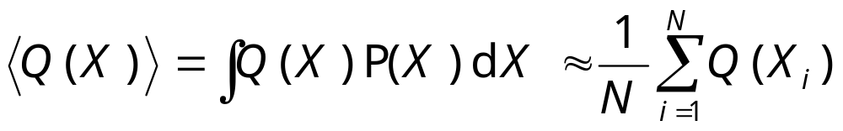
Taking Statistics
After equilibration, we estimate:
It is necessary that we take data for each sample or at uniform interval.

Slide 8
Choice of Transition Matrix W
The choice of W determines an algorithm. The equation
P = PW or P(X)W(X->X’)=P(X’)W(X’->X)
has (infinitely) many solutions given P.
Any one of them can be used for Monte Carlo simulation (provided W is ergodic).
Notes:
However, the efficiency depends on the choice of W.

Slide 9
Metropolis Algorithm (1953)
Metropolis algorithm takes
W(X->X’) = T(X->X’) min(1, P(X’)/P(X))
where X ≠ X’, and T is a symmetric stochastic matrix
T(X -> X’) = T(X’ -> X)
Notes:
T is not fixed and is usually zero unless X’ is in a “neighborhood” of X.
Show that detailed balance equation is satisfied.
Peskun has a theorem which says, in some sense, Metropolis rate min(1, …) is most efficient. P Peskun, Biometrika, 60 (1973) 607.

Slide 10
The Paper (42500 citations up to 2020)
THE JOURNAL OF CHEMICAL PHYSICS VOLUME 21, NUMBER 6 JUNE, 1953
Equation of State Calculations by Fast Computing Machines
NICHOLAS METROPOLIS, ARIANNA W. ROSENBLUTH, MARSHALL N. ROSENBLUTH, AND AUGUSTA H. TELLER,
Los Alamos Scientific Laboratory, Los Alamos, New Mexico
AND
EDWARD TELLER, * Department of Physics, University of Chicago, Chicago, Illinois
(Received March 6, 1953)
A general method, suitable for fast computing machines, for investigating such properties as equations of state for substances consisting of interacting individual molecules is described. The method consists of a modified Monte Carlo integration over configuration space. Results for the two-dimensional rigid-sphere system have been obtained on the Los Alamos MANIAC and are presented here. These results are compared to the free volume equation of state and to a four-term virial coefficient expansion.
1087
Notes:
The citations are google scholar counts.

Slide 11
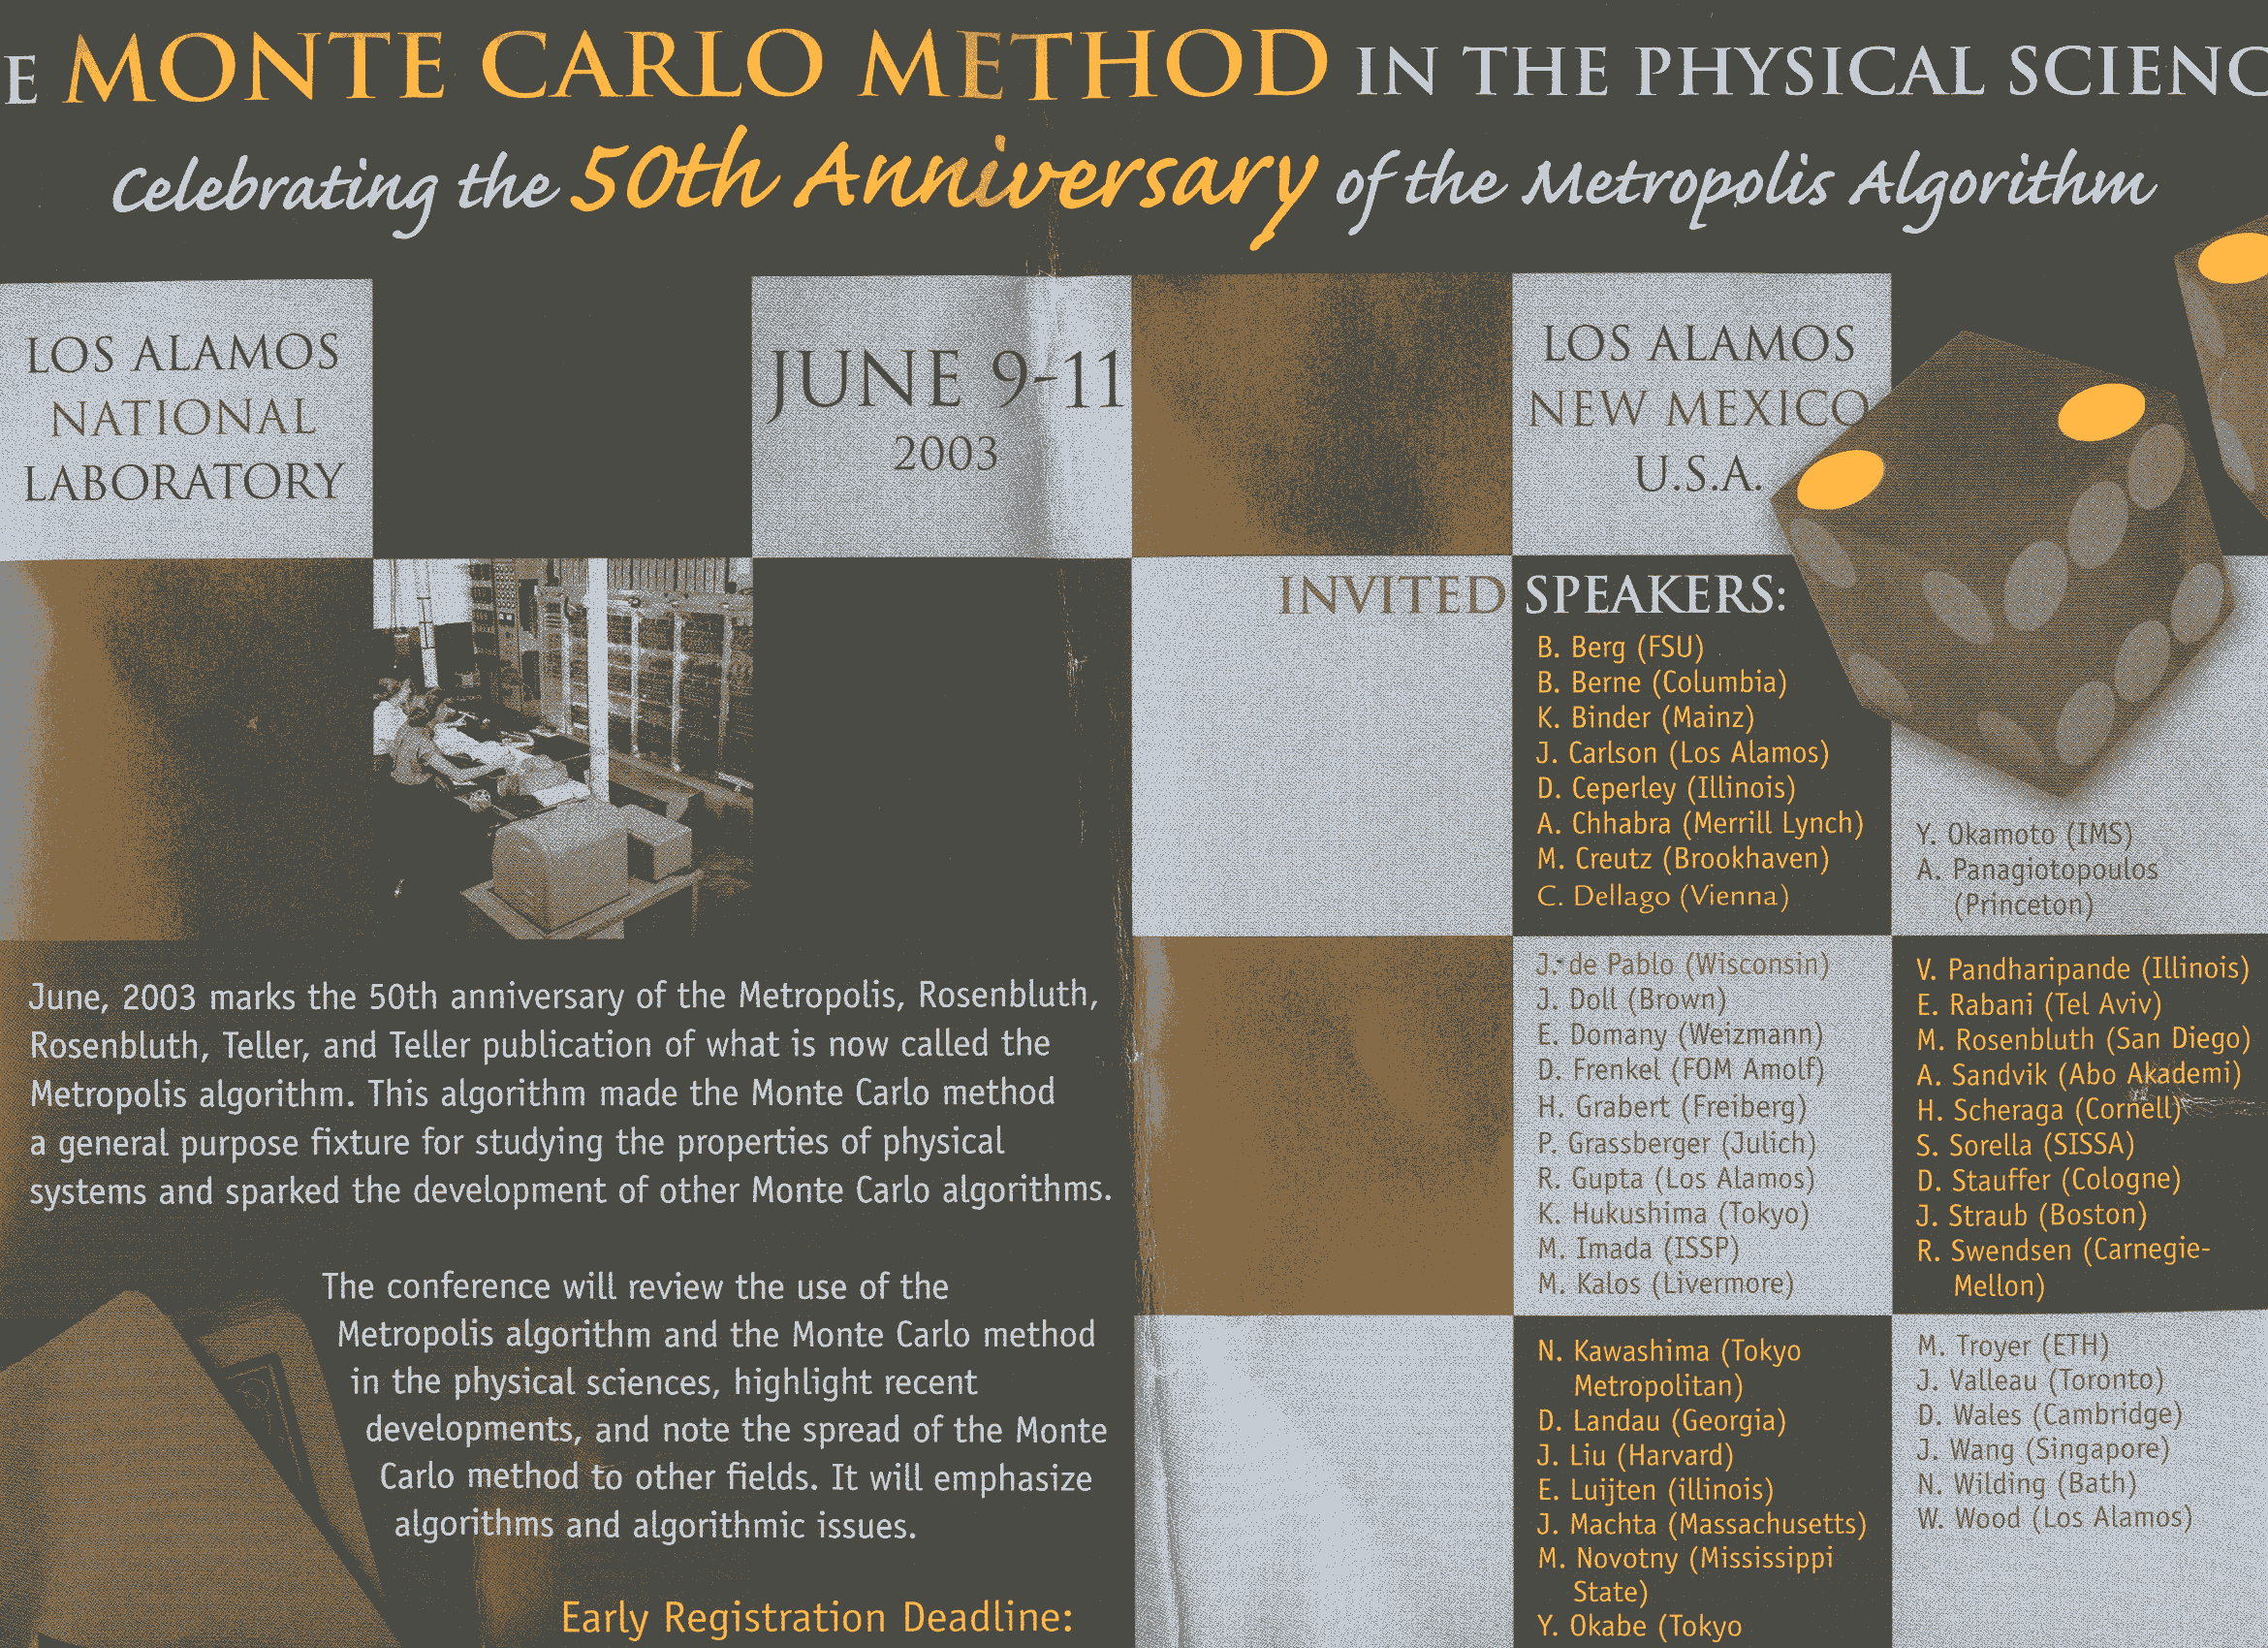
Notes:
I was one of the speakers on this conference.

Slide 12
Model Gas/Fluid
A collection of molecules interacts through some potential (hard disc is treated), compute the equation of state: pressure P as function of particle density ρ=N/V.
(Note the ideal gas law) PV = N k_{B}T
Notes:
P is pressure, V is volume, N is number of molecules or atoms, T is temperature, and k_{B} is Boltzmann constant.

Slide 13
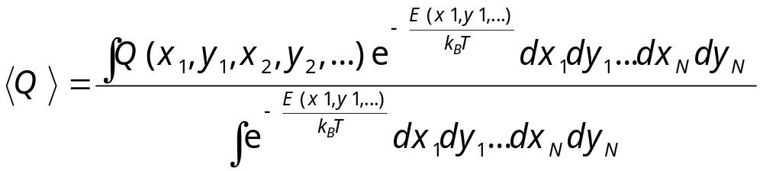
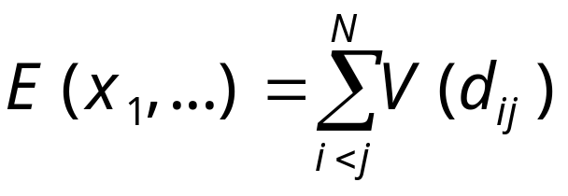
The Statistical Mechanics Problem
Compute multi-dimensional integral
where potential energy
Notes:
Using 2D disks as an example.

Slide 14
Importance Sampling
“…, instead of choosing configurations randomly, …, we choose configuration with a probability exp(-E/k_{B}T) and weight them evenly.”
- from M(RT)² paper
Notes:
Note that P(X) = exp(-E/kT)/Z, the normalization factor Z is not known, but it is not needed in Metropolis algorithm. The authors called this new method modified Monte Carlo, as appose to simple sampling.

Slide 15
The M(RT)²
Move a particle at (x,y) according to
x -> x + (2ξ₁-1)a, y -> y + (2ξ₂-1)a
Compute ΔE = E_{new} – E_{old}
If ΔE ≤ 0 accept the move
If ΔE > 0, accept the move with probability exp(-ΔE/(k_{B}T)), i.e., accept if
ξ₃ < exp(-ΔE/(k_{B}T))
Count the configuration as a sample whether accepted or rejected.
Notes:
M(RT)² standards for Metropolis, Rosenbluth, Rosenbluth, Teller, and Teller.
a is some number, adjusted to have about 50% acceptance rate.
In M(RT)², the acceptance probability is min(1, P(E_{new})/P(E_{old})). What is T(x->y) then?

Slide 16
A Priori Probability T
What is T(X->X’) in the Metropolis algorithm?
And why it is symmetric?

Slide 17
The Calculation
Number of particles N = 224
Monte Carlo sweep ≈ 60
Each sweep took 3 minutes on MANIAC
Each data point took 5 hours
Notes:
Typical modern calculation takes 10⁶ of sweeps and still hours to days to complete. Number of particles can be 1000 to a million.

Slide 18
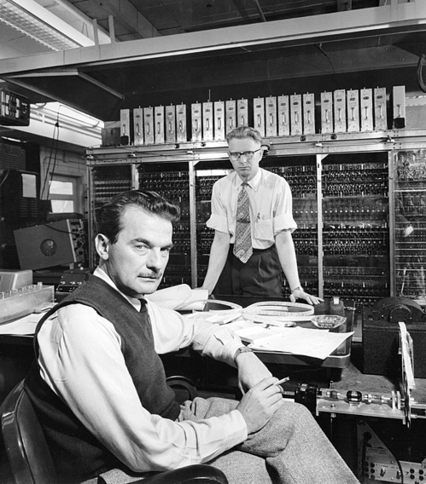
MANIAC the Computer and the Man
Seated is Nick Metropolis, the background is the MANIAC vacuum tube computer
Notes:
Mathematical Analyzer Numerator Integrator and Computer--a low-tech name for what was in its time a very high-tech piece of equipment. MANIAC was a computer built at the Los Alamos Scientific Laboratory in the late 1940's and early 1950's. It's mostly remembered today for its use in the development of the hydrogen bomb.
Picture from http://www.ominous-valve.com/maniac.html

Slide 19
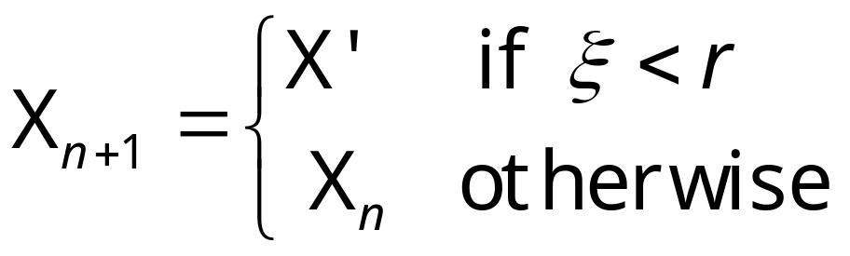
Summary of Metropolis Algorithm
Make a local move proposal according to T(X_{n} -> X’), X_{n} is the current state
Compute the acceptance rate
r = min[1, P(X’)/P(X_{n})]
Set

Slide 20
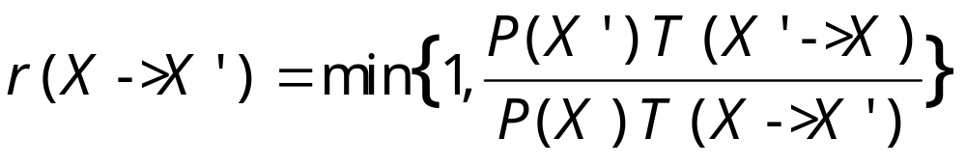
Metropolis-Hastings Algorithm
where X≠X’. In this algorithm we remove the requirement that
T(X->X’) = T(X’->X)
Notes:
W K Hastings generalized Metropolis rate in 1970, see Biometrika, 57 (1970) 97. Again the formula do not apply when X = X’.

Slide 21
Why Work?
We check that P(X) is invariant with respect to the transition matrix W. This is easy if detailed balance is true. Take
P(X) W(X -> Y) = P(Y) W(Y->X)
Sum over X, we get
∑_{X}P(X)W(X->Y) = P(Y) ∑_{X}W(Y-X) = P(Y)
∑_{X} W(Y->X) = 1, because W is a stochastic matrix.
Notes:
Invariance means, P = P W, in matrix notation.

Slide 22
Detailed Balance Satisfied
For X≠Y, we have W(X->Y) = T(X->Y) min[1, P(Y)T(Y->X)/(P(X)T(X->Y)) ]
So if P(X)T(X->Y) > P(Y)T(Y->X), we get P(X)W(X->Y) = P(Y) T(Y->X), and P(Y)W(Y->X) = P(Y) T(Y->X)
Same is true when the inequality is reversed.
Detailed balance means P(X)W(X->Y) = P(Y) W(Y->X)
Notes:
What is W(X->X)? I.e. the diagonal term?

Slide 23
Ergodicity
The unspecified part of Metropolis algorithm is T(X->X’), the choice of which determines if the Markov chain is ergodic.
Choice of T(X->X’) is problem specific. We can adjust T(X->X’) such that acceptance rate r ≈ 0.23
Notes:
The term “ergodic” is also used for other meaning: time average is equal to phase space average.

Slide 24
Gibbs Sampler or Heat-Bath Algorithm
If X is a collection of components, X=(x₁,x₂, …, x_{i}, …, x_{N}),
and if we can compute
P(x_{i}|x₁,…,x_{i-1},x_{i+1},..,x_{N}),
we generate the new configuration by sampling x_{i} according to the above conditional probability.
Notes:
Gibbs sampler appears popular in the statistics community.

