Slide 1
Luminos: We help the blind see
Slides Designer: Pratham Manoj
Developed by Bernard Lim, Guo Yong, Horstann Ho, Pratham Manoj, and Shaowei

Slide 2
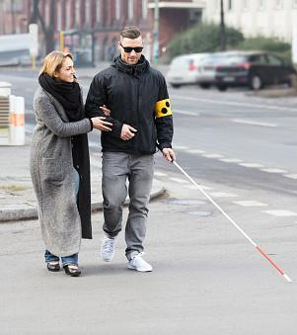
Meet Sam.
His visual impairment makes it a pain in everyday life to navigate his own surroundings.
It gets all the more difficult when he’s all by himself, with no one to help him, exposing him to road hazards and physical injury.

Slide 3
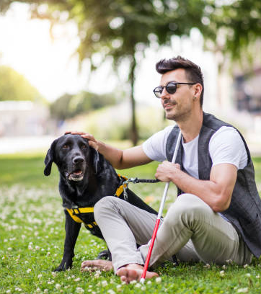
But wait…
What if there was a device that could help Sam detect objects around him in real-time and tells him what he’s looking at?

Slide 4


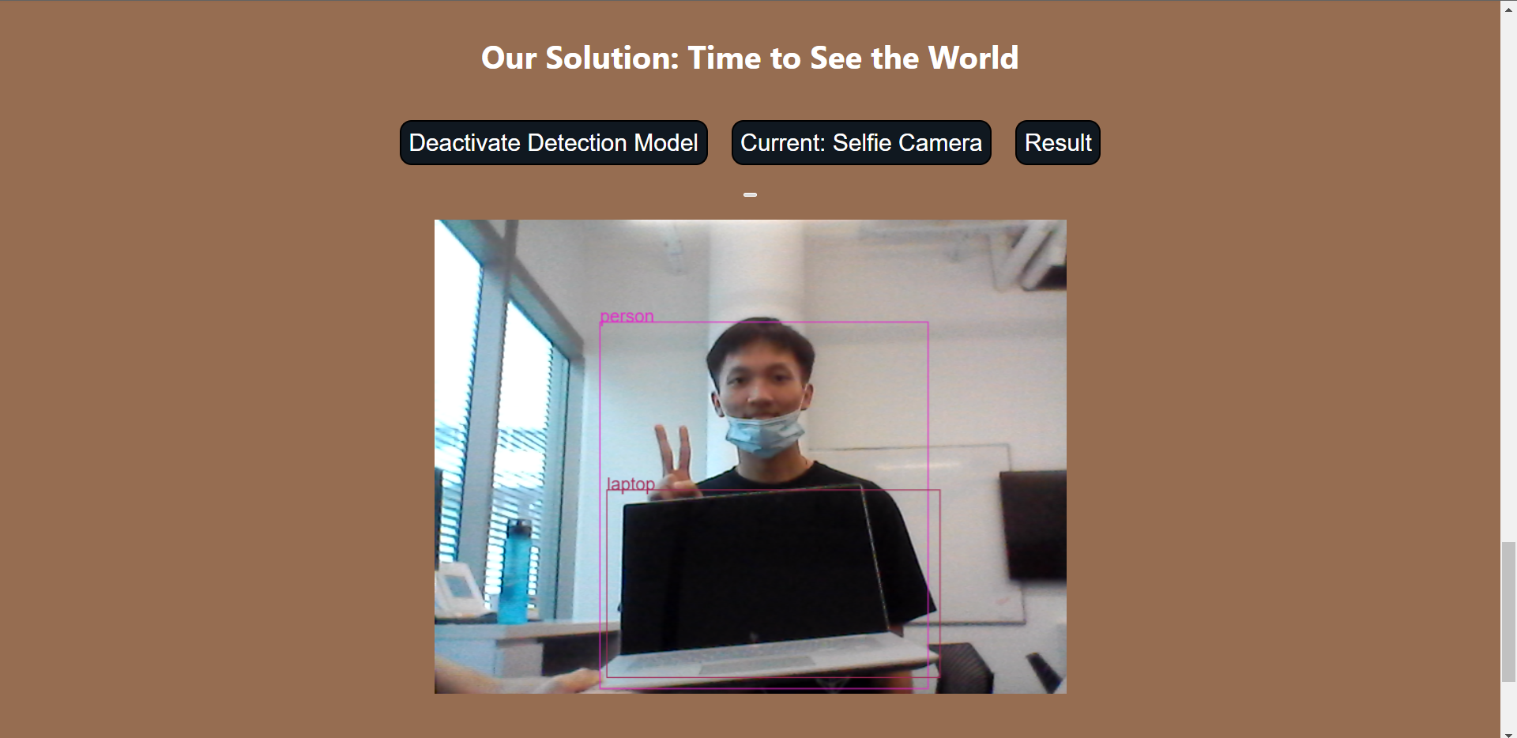
That’s exactly what our model does!
Our hack
A DL model that identifies objects from a real time camera feed and reads out what they are.

Slide 5
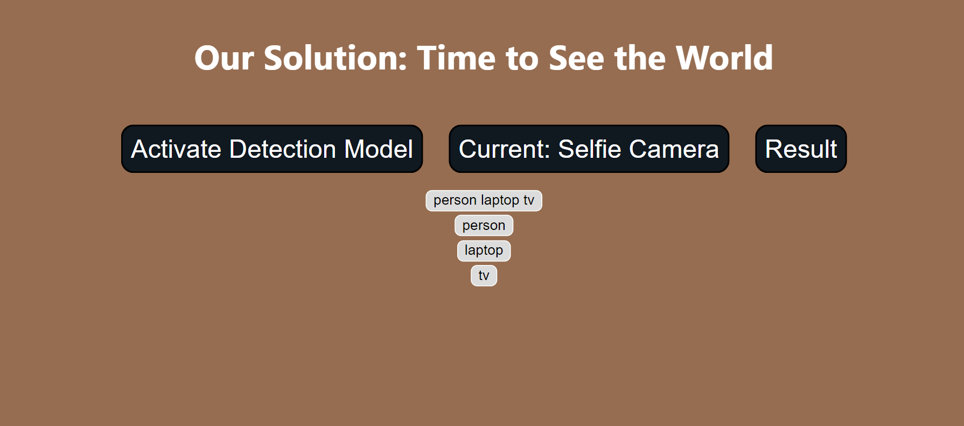
Scanning the room
The result
Just click on the Result button for the items to be read out loud. Of course, the idea is to make this feature automatic; this is just a prototype.

Slide 6
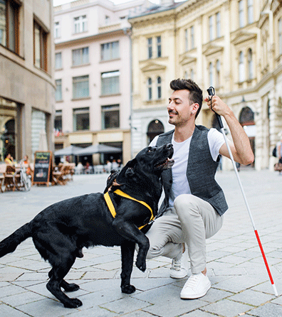
This helps Sam to …
Identify hazards like stairs and incoming vehicles.
Find his house keys or white cane in a room.
Know where his specific kitchen and food items are
All without external aid!

Slide 7
How does it work?
Our prototype uses an ssd (single shot detection) model to identify objects in videos. The cool thing about ssd is that it can detect multiple objects in a single frame, unlike other models that are commonly used for such purposes.
The exact model we’re using is called the ssd_mobilenet_v1 from the Tensorflow object detection API.
The Tensorflow object detection API is just a framework that lets developers make and deploy object detection ml models.

Slide 8
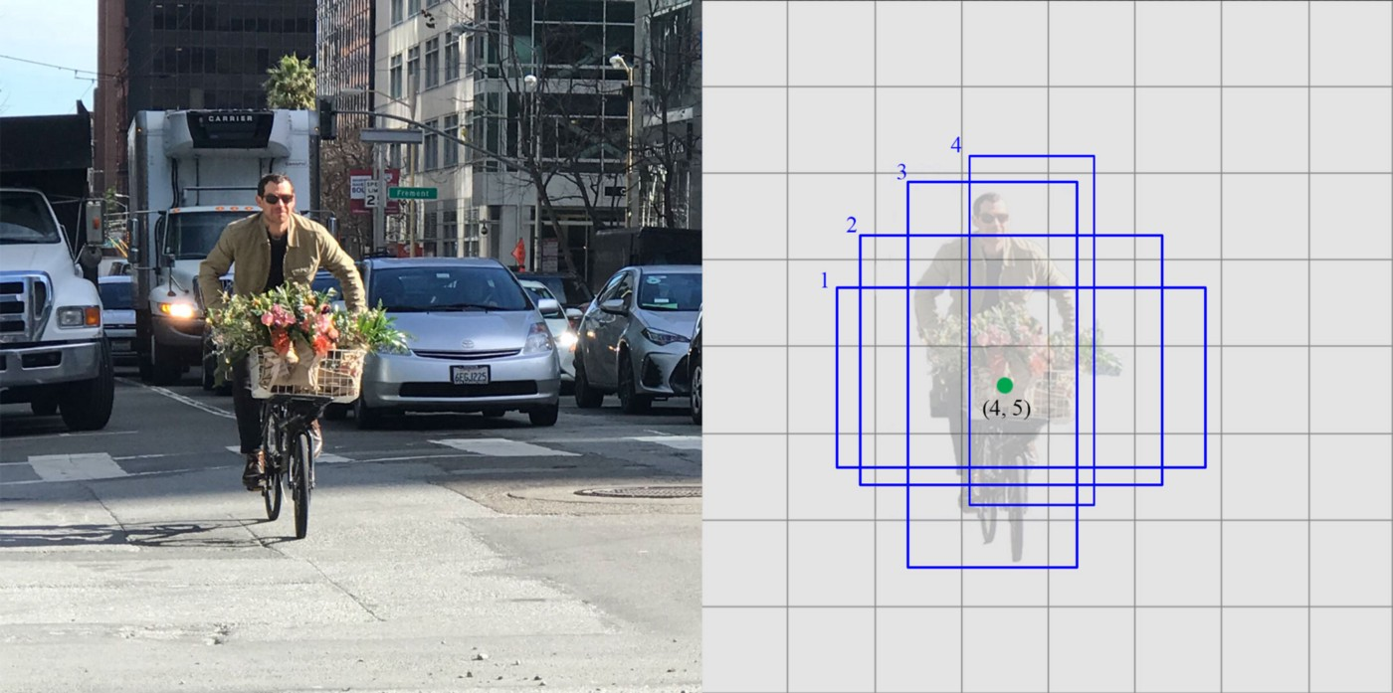
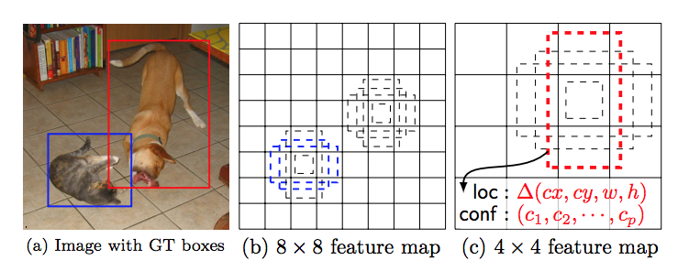
But what exactly is an ssd model?
Essentially, ssd splits each frame up into boxes. It then uses boundary boxes to classify objects in that frame. Although this is similar to what an r-cnn does, ssd uses low-resolution images to speed up the process considerably.

