Slide 1

17/11/2020

Slide 2
5 – Software Design
Lab session 6

Slide 3
Outline labs
Part A: UML diagrams Sessions 1 – 2
Part B: Design Patterns Session 3 – 5
Part C: Project Session 6 – 9

Slide 4
Part C: Project
Money tracker

Slide 5
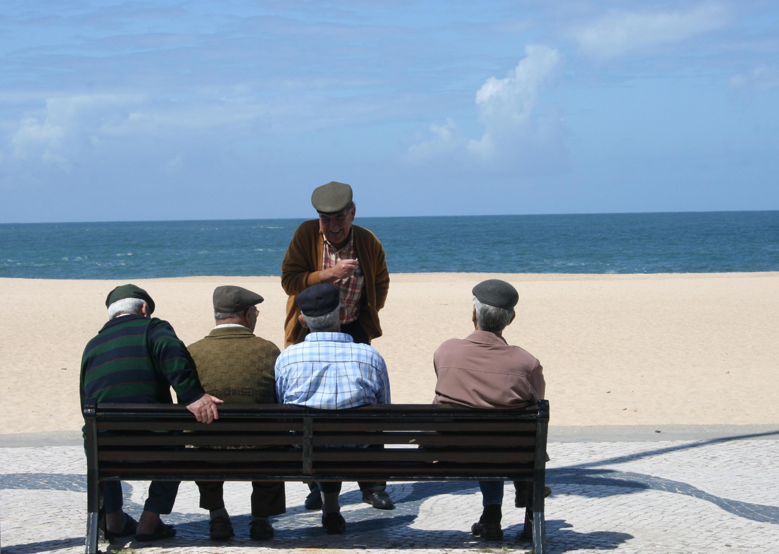
Money Tracker
Travelling in a group
Person A pays dinner for whole group
Person B pays movie tickets
Person C pays lunch for everyone, but each of them eats something different
How much do they need to pay to each other?

Slide 6
Money Tracker
Functional Requirements
People could be added or removed from application
At the end of the trip, a global bill should be made, telling who should pay who and how much
Functional GUI
The fact that it works, is top priority
How it looks like, is lowest priority

Slide 7
Money Tracker
Functional Requirements
Each person can input his/her ticket
They need to fill in: - Themselves as person who paid - How much they paid
Tickets for different kinds of events:
Airplane tickets, restaurant bills, taxi payments, concerts, …
Feel free to add more kinds
At least two different kinds of tickets:
Everybody should pay the same: ticket is split evenly
Everybody had something different: ticket is not split evenly

Slide 8
Money Tracker
Non-functional Requirements
Single database for Persons
Single database for Tickets
Made with Design Patterns
All seen in the lab sessions: Singleton, Observer, Abstract Factory, MVC
At least one of the theory sessions: Strategy, Decorator, Command, Adapter, Façade, Proxy, Iterator, State, Template Method, Composite
UML diagrams
Class diagram of whole application (GUI and “Jstuff” can be abstracted to just a GUI class
Use Case diagram of application
Sequence Diagram of process when a user clicks “calculate for whole trip”
Tests
Unit tests for at least one class
At least one integration test

Slide 9
Execution
Groups of 2 students is debatable What if one falls out?
-> Project alone, but you may share ideas It’s still your own project!
Using code of others:
From fellow students: not recommended -> only grades on what is yours, not from others
From internet: feel free to reuse code -> give credit! (credits: websites, names, YouTube-links, …)
Try to use Git
It’s for your own safety
In case you don’t know Git: an introduction (https://www.youtube.com/watch?v=SWYqp7iY_Tc)

