Slide 1


Split the bill
A product by:
Jaro Helsen

Slide 2
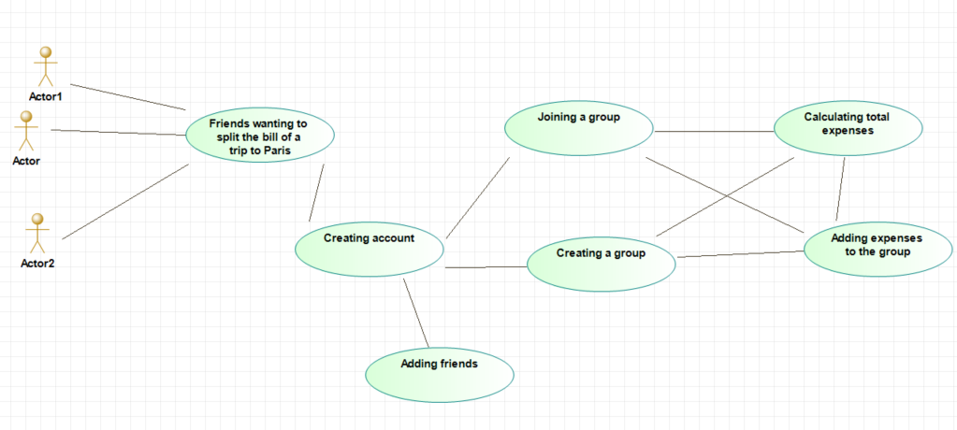
It’s that easy
Create an account
Add friends
Start a group
You’re ready to go!

Slide 3

Patterns
Factory
Observer
Singleton
Strategy
MVC
Facade

Slide 4
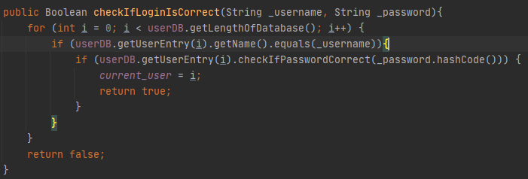
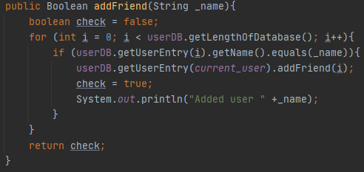
In the picture
Hashed passwords
Friends!

Slide 5
The end
Any questions?

