Slide 1
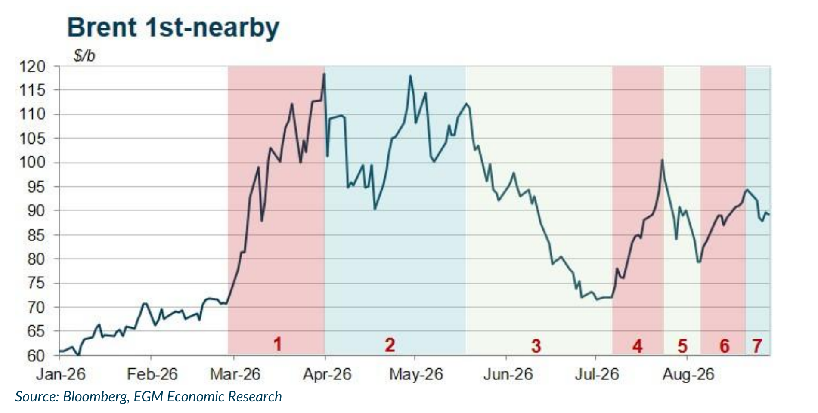
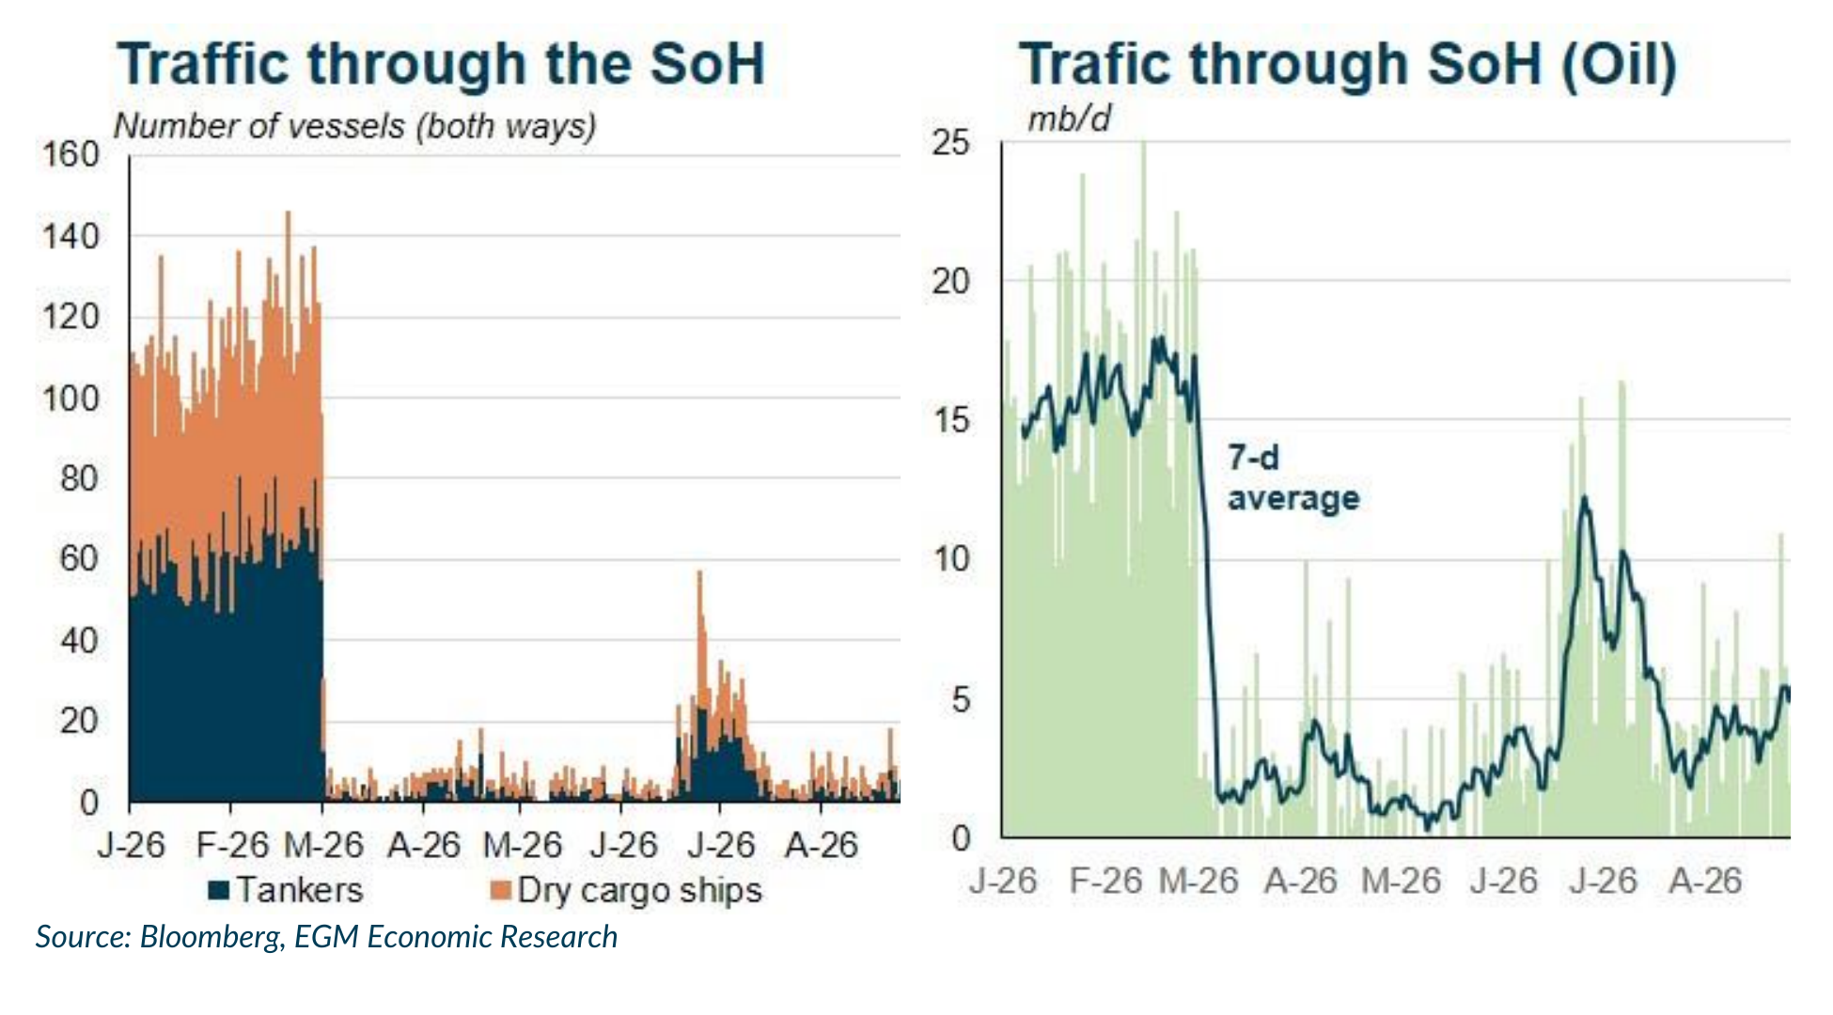
Oil: Persistent supply disruptions keep Brent near $90/b
• August was volatile: Brent fell to $78/b on renewed diplomatic hopes, rebounded to nearly $95/b as tensions returned, and ended around $90/b. Despite weak Chinese demand, restricted Hormuz flows, Russian refinery outages and longer shipping routes kept the physical market tight and product prices elevated.
• Price dynamics: Brent fell from $90.12/b at end-July to $78.11/b on 5 August as diplomatic hopes improved, then rebounded to $94.83/b on 21 August when tensions returned. Renewed hostilities kept prices close to $90/b at month-end, well above pre-war levels.
• Physical market: Hormuz flows remain highly uncertain because most vessels sail AIS-off. Ship-tracking services point to 2-6 mb/d, versus 8-15 mb/d for US/Goldman estimates. Ship-to-ship transfers, Red Sea rerouting and Russian refinery disruptions are especially restrictive for products, helping diesel outperform crude.
• Outlook: Weak Chinese demand and the exceptional mid-August US stock build limited the rally, but did not remove the supply deficit. The IEA/EGM balance still implies stock draws of 1.8 mb/d in Q3 and 1.2 mb/d in Q4; the deficit narrows, but prices should remain firm.
15

