Slide 1
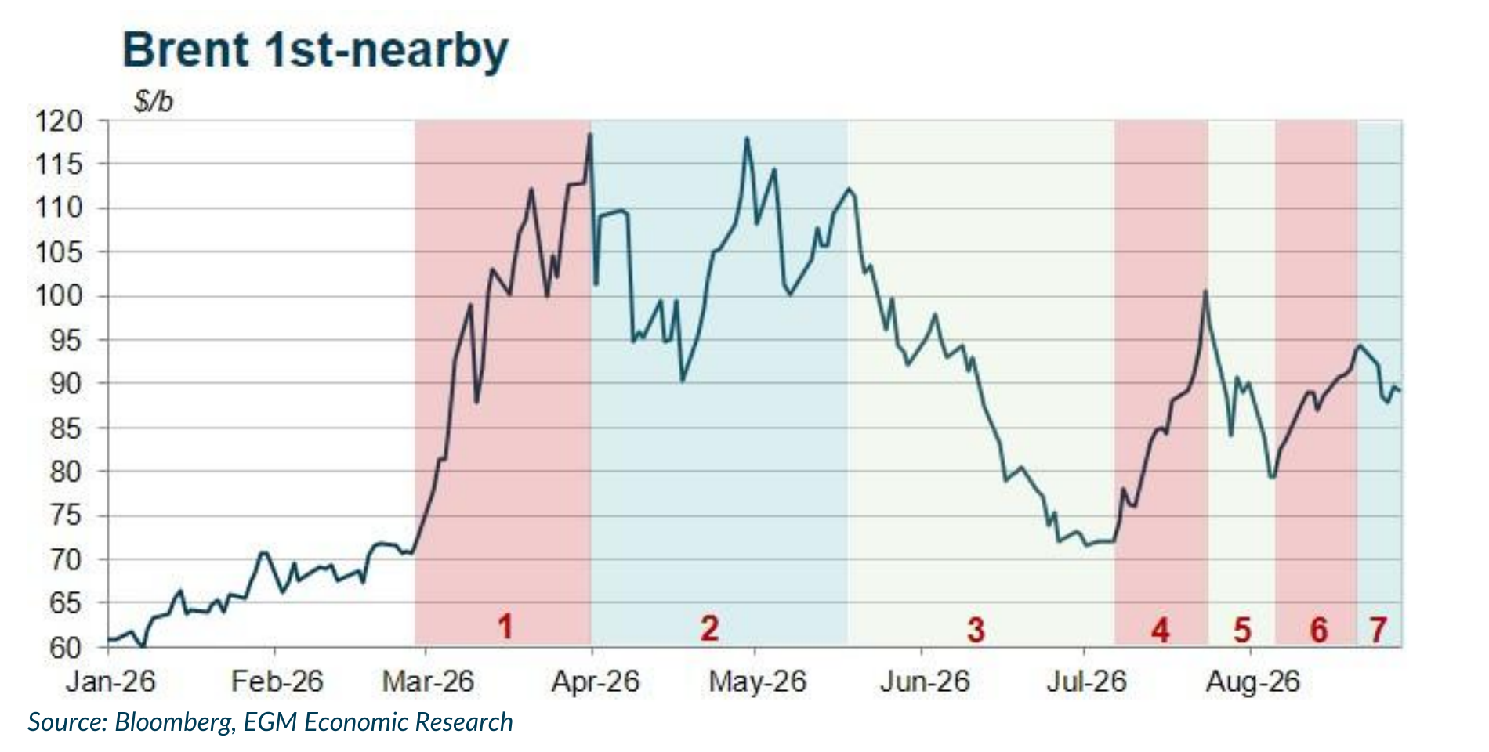
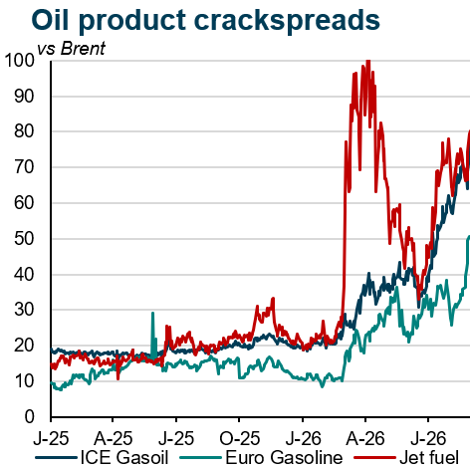
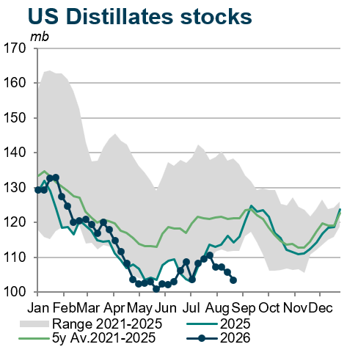
Oil: A drawn-out crisis keeps crude high and products tight
• Main message: there is no short-term exit from the crisis. Escalation risks have receded, making sustained high prices more likely than an extreme spike, while exceptionally wide product cracks leave diesel, jet fuel and gasoline exposed to further gains.
• Political scenario: Renewed hostilities have not materially raised the risk of uncontrolled escalation. Unable to secure a quick outcome, Washington has shifted to economic strangulation; however, China is unlikely to comply and can use rare-earth leverage. Tehran, meanwhile, can wait for a possible US policy shift after the November midterms. With neither side under immediate pressure to compromise, a near-term settlement looks unlikely.
• Product squeeze: Jet and ICE gasoil cracks are now around $70–80/b over Brent, with gasoline near $50/b, versus roughly $15–25/b before the conflict. Outright jet and diesel prices are therefore close to twice the crude price. US distillate stocks have fallen to around 103 mb, about 20% below January and beneath the 2021–25 seasonal range, increasingly constraining US export capacity.
• Outlook: The most likely scenario is prolonged but contained tension: crude remains high without an extreme spike, while refined products face further upside. Lower US exports would tighten Atlantic and Asian markets. The resulting energy-price pressure would slow disinflation and keep upward pressure on interest rates.
Sources: EGM Economic Research; U.S. EIA.
15

