Slide 1
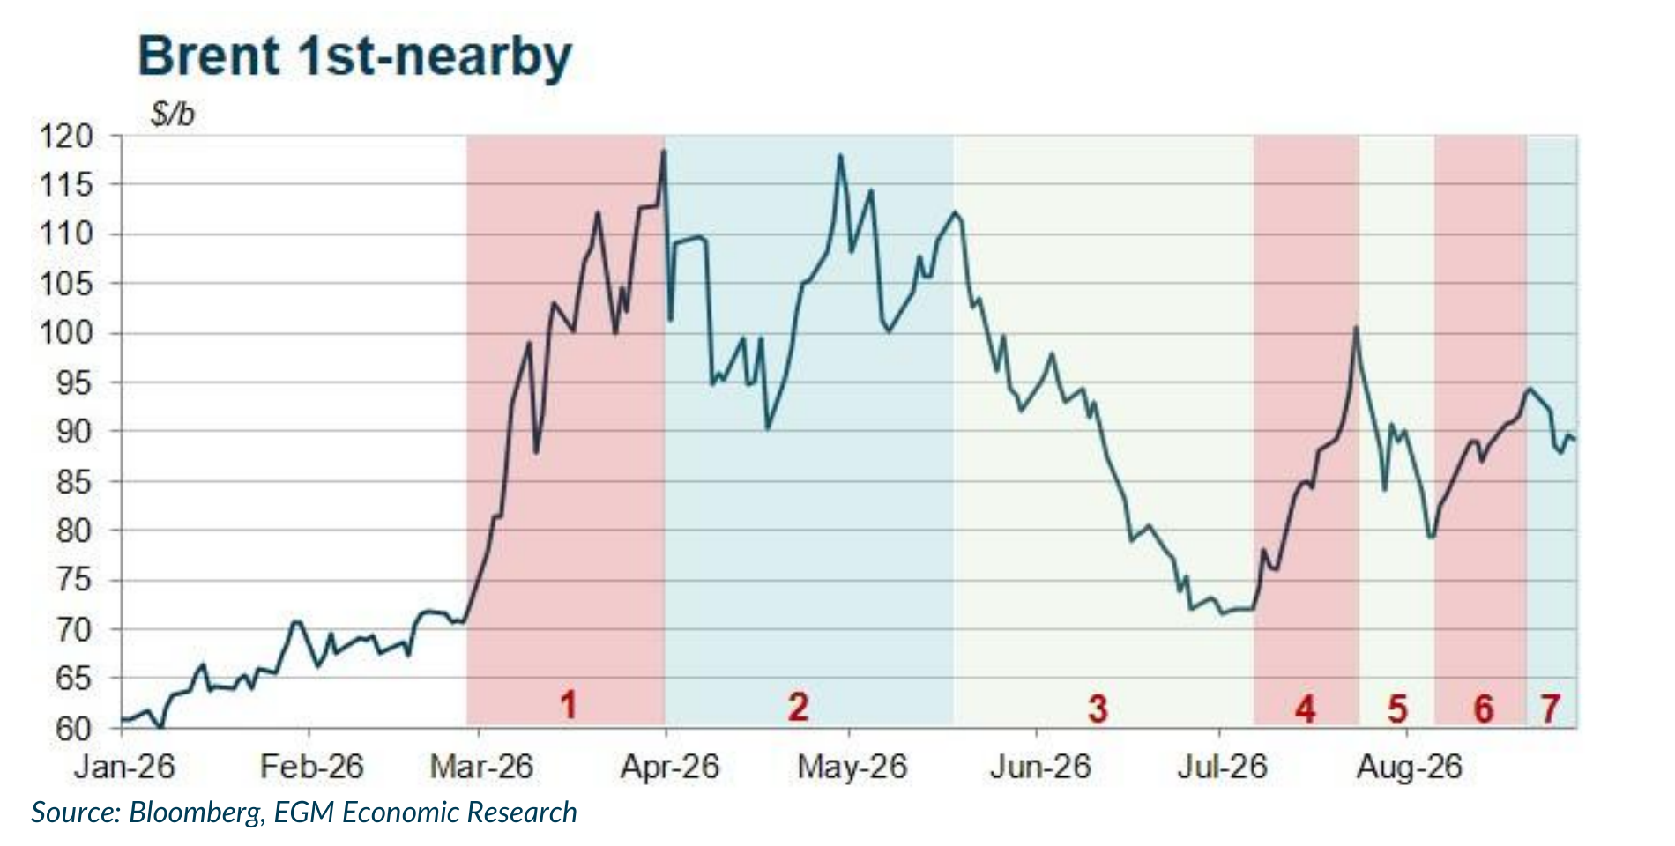
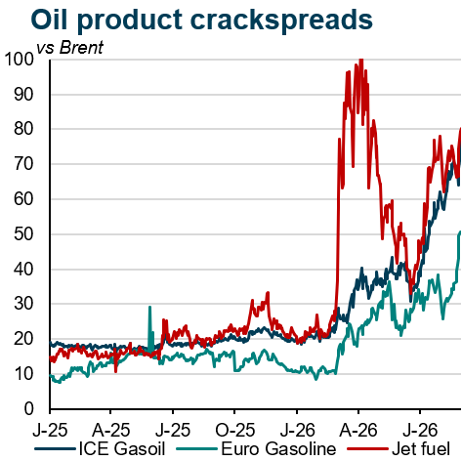
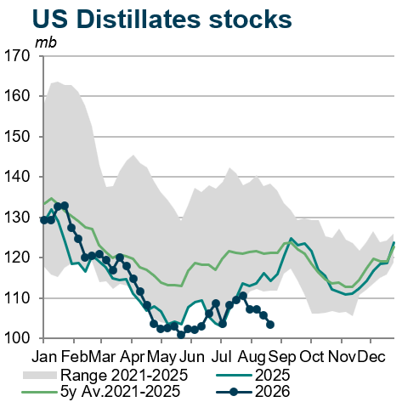
Oil: Persistent tensions keep crude high and product markets tight
• There is no short-term exit from the crisis. Escalation risks have receded, making sustained high prices more likely than an extreme spike, while exceptionally wide product cracks leave diesel, jet fuel and gasoline exposed to further gains.
• Price dynamics: Brent fell below $80/b on diplomatic hopes, then rebounded toward $95/b as hostilities resumed. Escalation risks now look more contained, but a near-term settlement remains unlikely: Washington has shifted toward economic pressure, China is unlikely to comply, and Tehran can wait for a possible US policy change after the November midterms. This raises the probability of durably elevated prices without an extreme spike.
• Physical market: Jet and ICE gasoil cracks are now around $70–80/b over Brent, with gasoline near $50/b, versus roughly $15–25/b before the conflict. Outright jet and diesel prices are therefore close to twice the crude price. US distillate stocks have fallen to around 103 mb, about 20% below January and beneath the 2021–25 seasonal range, increasingly constraining US export capacity.
• Outlook: The most likely scenario is prolonged but contained tension: crude remains high without an extreme spike, while refined products face further upside. Lower US exports would tighten Atlantic and Asian markets. The resulting energy-price pressure would slow disinflation and keep upward pressure on interest rates.
Sources: EGM Economic Research; U.S. EIA.
15

