Slide 1
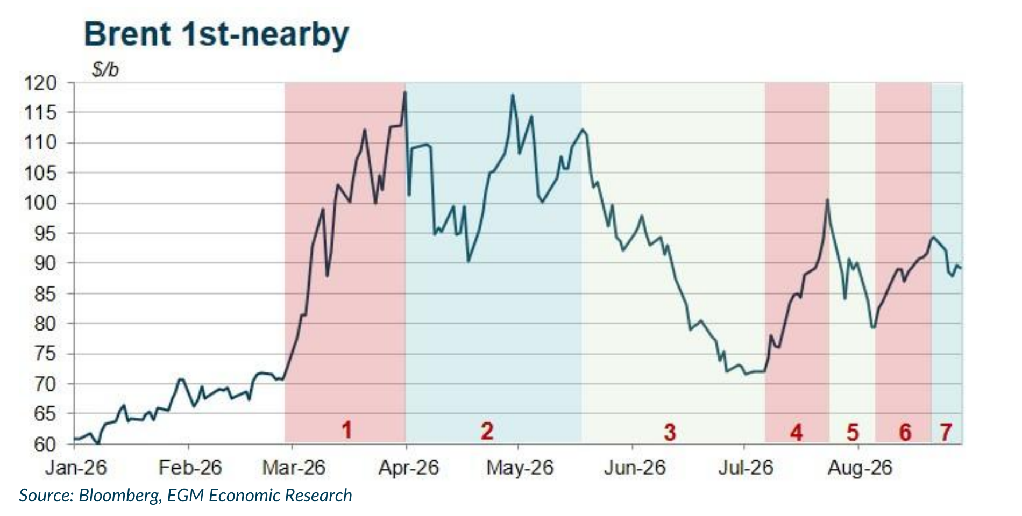
Oil: A drawn-out crisis keeps crude high and products tight
• Main message: there is no short-term exit from the crisis. The risk of a sudden escalation has receded, but a drawn-out conflict keeps crude expensive and leaves diesel, jet fuel and gasoline exposed to sharper increases.
• Political scenario: Renewed hostilities have not materially raised the risk of uncontrolled escalation. Unable to secure a quick outcome, Washington has shifted to economic strangulation; however, China is unlikely to comply and can use rare-earth leverage. Tehran, meanwhile, can wait for a possible US policy shift after the November midterms. With neither side under immediate pressure to compromise, a near-term settlement looks unlikely.
• Product squeeze: In the week to 21 August, NY ULSD traded at 2.02x Brent and US Gulf Coast jet at 1.75x, compared with 1.46x and 1.31x on average in January-February. US distillate and gasoline stocks have fallen 20% and 15% since early January, narrowing the capacity to sustain exports and raising risks for Europe and Asia unless Chinese diesel exports rise.
• Outlook: The most likely scenario is prolonged but contained tension: crude remains high without an extreme spike, while refined products face further upside. Lower US exports would tighten Atlantic and Asian markets. The resulting energy-price pressure would slow disinflation and keep upward pressure on interest rates.
Spot product prices / Brent
U.S. product stocks (2 Jan = 100)
Sources: U.S. EIA; EGM calculations. Product prices converted at 42 gal/bbl. Week ending 21 Aug. 2026.
15

