Slide 1
Monogdb or Mongoosejs
Pavel Kyurkchiev
PhD. candidate
@pkyurkchiev

Slide 2


Slide 3
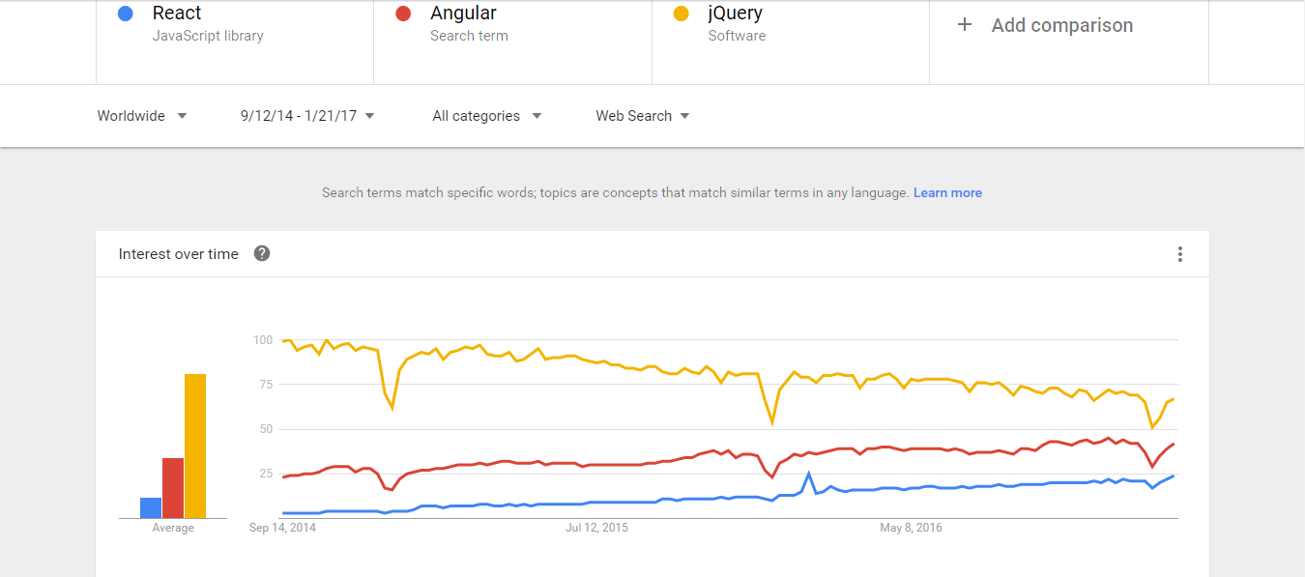

Slide 4
NoSql

