Slide 1
Build Angular 2 Apps
Pavel Kyurkchiev
PhD. candidate
@pkyurkchiev
https://github.com/pkyurkchiev

Slide 2


Slide 3

Notes:
Build from scratch
More faster
What phone you have before 5 years, ago

Slide 4
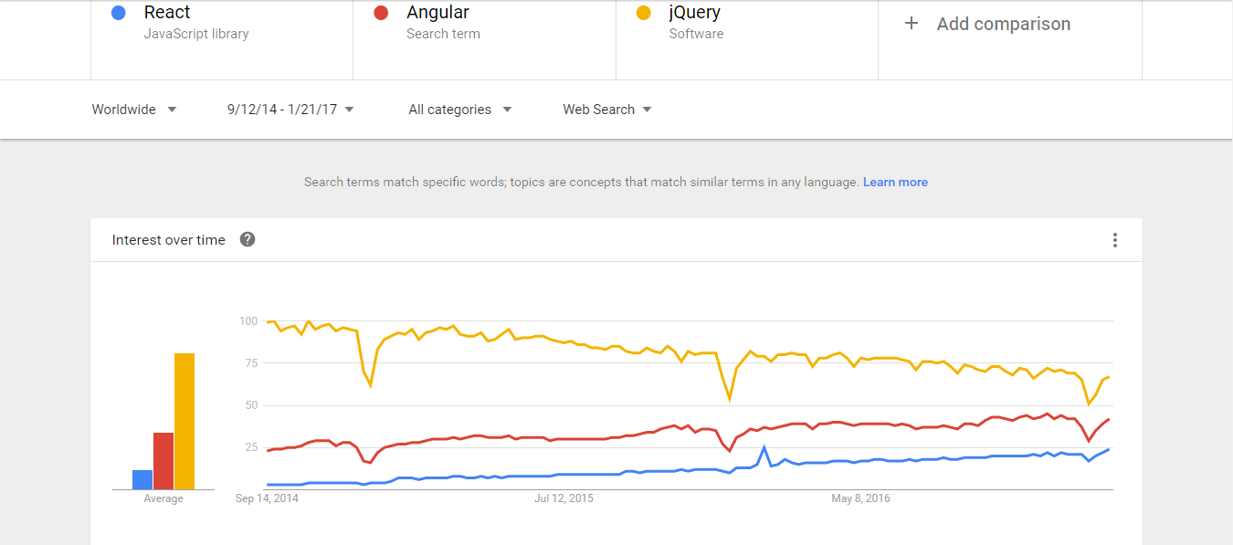

Slide 5
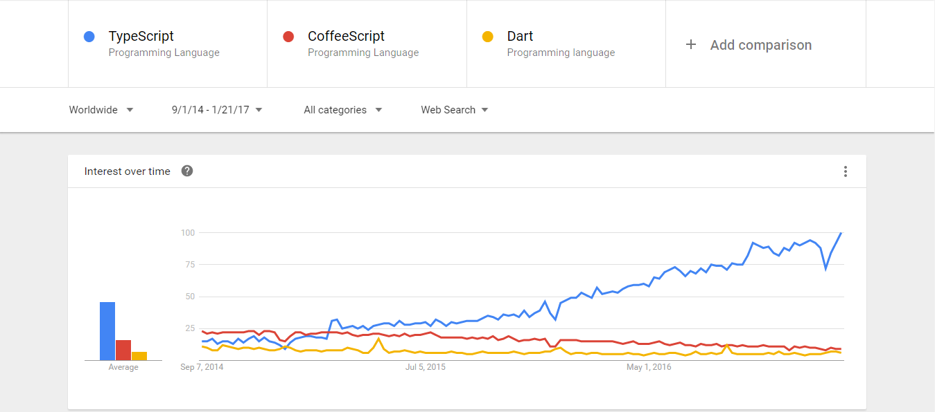

Slide 6
Deliver Optimized and Smaller Code to the Clients
Tree Shaking
Offline Compilation
Our App
Min

Slide 7
TypeScript -types -annotations
ES6 -classes -modules
ES5

Slide 8
Familiar Concepts
Services
Components
HTTP
Events
Data Binding

Slide 9
Components
A component contains application logic that controls a region of the user interface that we call a view.

Slide 11
App from Components
App Components
Header Component
Nav
Component
Content Component
Footer Component

Slide 12
demo Components

Slide 13
Templates
Templates are mostly HTML, with a little help from Angular. They tell Angular hot to render the Component.

Slide 15
Connecting the Component to its Template
<>
Component
Template

Slide 17
Templates Contain Other Components
Root
Component
Root
Template
<>
Child A
Component
Child A
Template
Child B
Component
Child B
Template
<>
<>
Grandchild
Component
Grandchild
Template
<>

Slide 18
Metadata links the Template to the Component
Component
Metadata
<>
Template

Slide 19
Demo templates

Slide 20
Data Binding
We use data binding to help coordinate communication between a Component and its Template.

Slide 21
{{ expression }}
Interpolation
[property] = “expression”
One Way Binding
(event) = “statement”
DOM
Event Binding
Component
[(ngModel)] = “property”
Two Way Binding

Slide 23
Benefits of Angular 2 Unidirectional Data Flow
Easies 3-rd party widget integration
No more $apple
No more repeated digest cycles
No more watchers
No more performance issues with digest cycle and watcher limits

Slide 24
Demo data Binding

Slide 25
Angular Modules
We use NgModule to organize our application into cohesive blocks of related functionality.

Slide 26
Angular Modules Organize Functionality
Angular Module
Component
{ }
Component
{ }
Component
{ }
Service
{ }

Slide 27
Roles of Angular Models
Import other Angular Modules
Identify Components Pipes, and Directives
Export its features
Provide services to injectors
Can be eagerly or lazily loaded

Slide 28
Every app begins with one Angular Module

Slide 29
Services
Angular 1
Angular 2
Factories
Services
Providers
Class
Constants
Values

Slide 31
Demo Modules

Slide 32
Dependency Injection
Injector
{ }
Dependency Injection is how we provide an instance of a class to another Angular feature.
{ }

Slide 33
When we inject a service, Angular searches the appropriate injectors for it
Component

