Slide 1
Mongodb or Mongoosejs OR Mongojs
Pavel Kyurkchiev
PhD. candidate
@pkyurkchiev
https://github.com/pkyurkchiev

Slide 2
NoSQL
Database provides a mechanism for storage and retrieval of data which is modeled in means other than the tabular relations used in relational databases.

Slide 3
Types of NoSQL Databases
Key-value stores
Wide-column stores
Document databases
Graph databases
Notes:
Key-value stores are the simplest. Every item in the database is stored as an attribute name (or "key") together with its value. Riak, Voldemort, and Redis are the most well-known in this category.
Wide-column stores store data together as columns instead of rows and are optimized for queries over large datasets. The most popular are Cassandra and HBase.
Document databases pair each key with a complex data structure known as a document. Documents can contain many different key-value pairs, or key-array pairs, or even nested documents. MongoDB is the most popular of these databases.
Graph databases are used to store information about networks, such as social connections. Examples are Neo4J and HyperGraphDB.

Slide 4


Slide 5
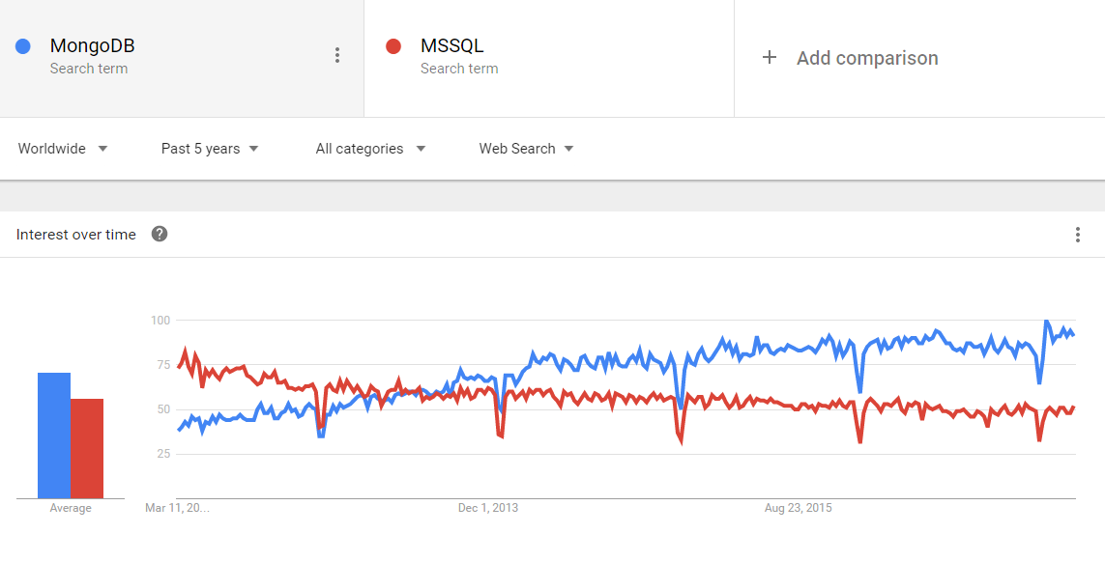

Slide 6
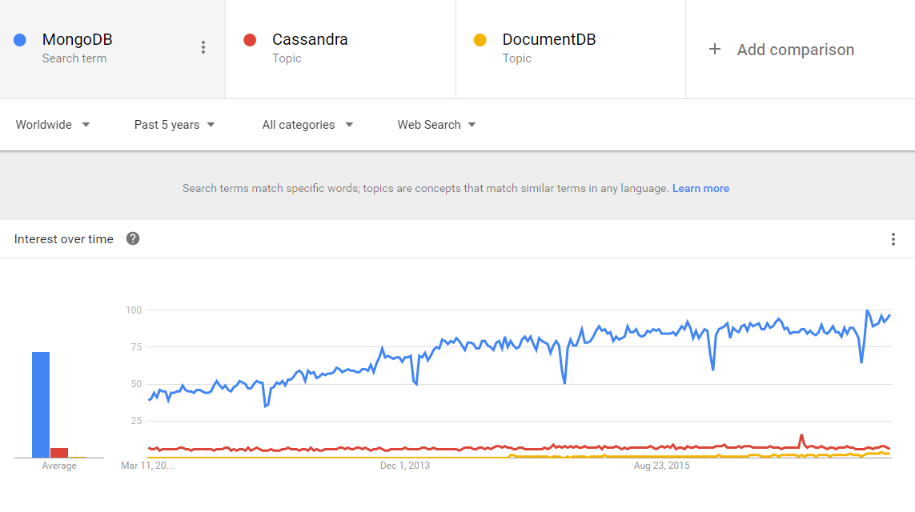

Slide 7
MongoDB is a…
Open source
Document oriented
Non-relational & Schema-less
Scalable
High performance
Full featured
… database

Slide 8
Open source
Source and supported drivers are open source and hosted at Github:
https://github.com/mongodb

Slide 9
Languages compatibility
C
C++
C#
Java
Perl
PHP
Erlang
Python
Motor
Ruby
Scala
Go
NodeJS

Slide 10
Document oriented
SQL Terms/Concepts
MongoDB Terms/Concepts
database
database
tables
collections
rows
documents BSON
columns
fields
join
embedding/link

Slide 11
Non-relational & Schema-less
RDBMS
User
Hobbies
Addresses

Slide 12
Non-relational & Schema-less
Non-Relational Data Model
User
With MonogDB we can store related content in the same document
Hobbies
Addresses

Slide 13
Full featured
Geospatial features
Geospatial indexes to support geographic data scructures
GeoJson
2d support for Flat/ Euclidean place disctance calculation

Slide 14
Full featured
Management Service
Service status monitoring
Custom, metrics-based alert
Fully managed backups
…

Slide 15
How to use mongoDB with NodeJS?
Mongoose
MongoJS

Slide 16
MongoJS
The official MongoDB Node.js driver provides both callback based as well as Promised based interaction with MongoDB allowing applications to take full advantage of the new features in ES6. The 2.x series of the driver is powered by a brand new core driver and bson library.

Slide 17
Demo MongoJS
ex6

