Slide 1
Intro to nodejs
Pavel Kyurkchiev
PhD. candidate
@pkyurkchiev

Slide 2
What is NodeJS
Allow you to build scalable network applications using JavaScript on the server-side.

Slide 3
NodeJS
V8 JavaScript Runtime

Slide 5
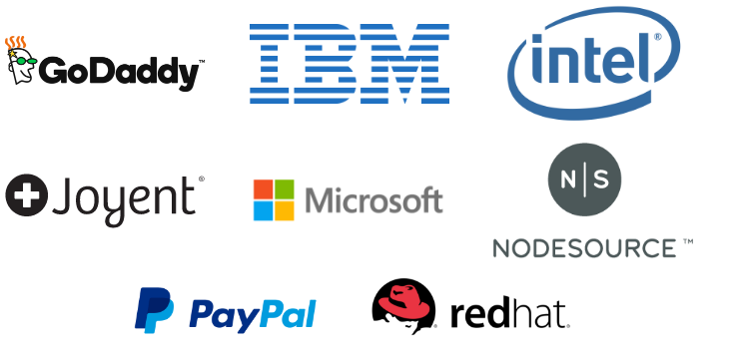
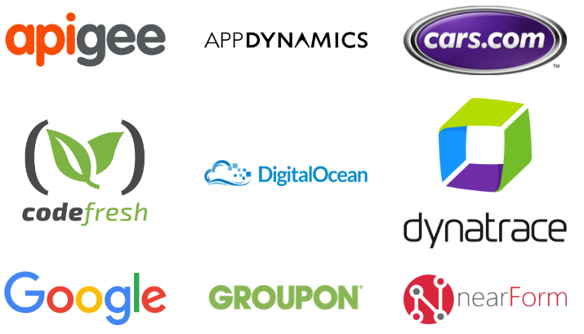

Slide 6
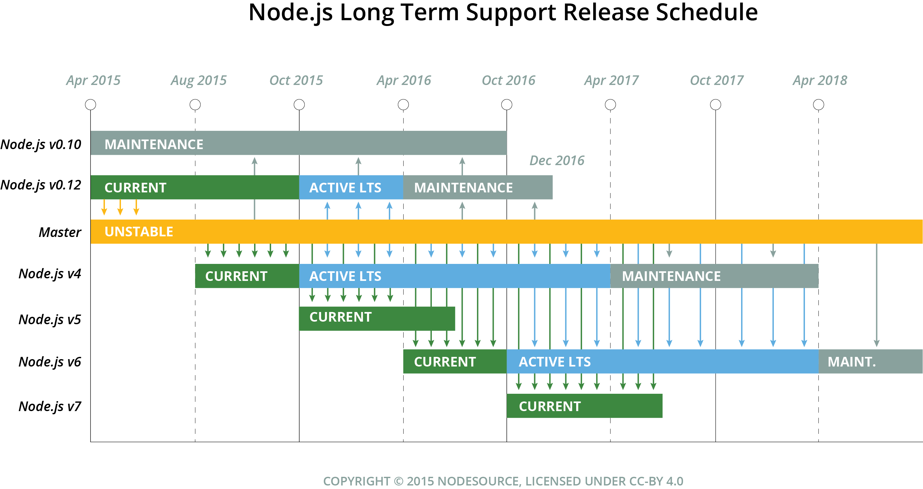

Slide 7
APPLICATION
NODE.JS
BINDINGS
(NODE API)
LIBUV
(ASYNCHRONOUS I/O)
JAVASCRIPT
EVENT QUEUE
WORKER THREADS
BLOCKING OPERATION
V8
(JAVASCRIPT ENGINE)
FILE
NETWORK
OS OPERATIONS
EVENT LOOP
PROCESS
EXECUTE CALLBACK

Slide 8
What is JavaScript?
JavaScript (JS) is a lightweight, interpreted, programming language with first-class functions. JS is a prototype-based, multi-paradigm, dynamic scripting language, supporting object-oriented, imperative, and declarative (e.g. functional programming) styles.

Slide 9
Node Package Manager (NPM)
NPM is the default package manager for the JavaScript runtime environment Node.js and allows users to consume and distribute JavaScript modules that are available on the registry.

Slide 10
Unit testing
Mocha – JavaScript test framework
Chai – assertion library
Request – created request to APIs
The TDD (Test-Driven Development) method is the most commonly used approach when testing node applications.

