Slide 1
Multi-robots navigation in cluttered and dynamic environments
Bruno BORGES DA COSTA, Camilla CARTA, Alexis DEWAELE and Yoann LAPIJOVER

Slide 2
Summary
Introduction
Methodology
Results
Discussion
Conclusion

Slide 3
Introduction

Slide 4
Methodology

Slide 5

1) Reynold’s Rules
Cohesion Rule
$$c\left[i\right]=\frac{1}{N−1}\sum_{j≠i}^{N}{x_{j}}$$

Slide 6
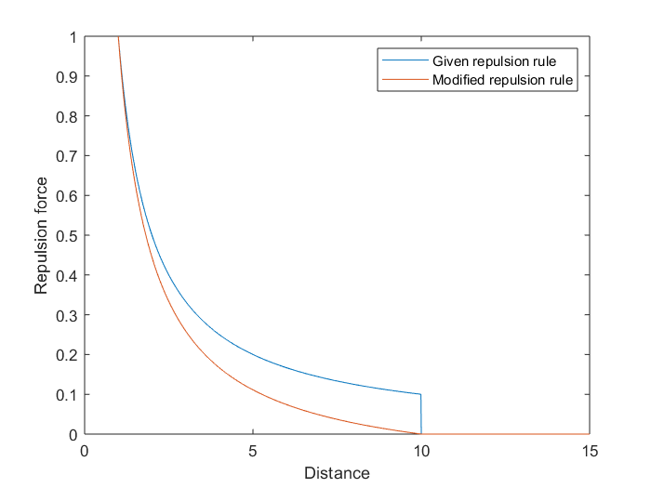
Separation Rule
TODO : insert formula
Modified Repulsion Rule

Slide 7
Velocity Rule
TODO

Slide 8

2) Wheel Speed Computation
If the bearing of the robot is greater than $π/2$, then : $w=max_speed$ and $u=0$
If the bearing of the robot is lower than $−π/2$, then : $w=−max_speed$ and $u=0$
Otherwise :
$w=bearing∗max_speed∗2/π$
$u=\left\|speed\right\|∗\frac{π/2−\left|bearing\right|}{π/2}$

Slide 9

3) Braitenberg
$$σ+=ω_{i}∗sensor_value_{i}$$
Where $σ$ is the newly computed Braitenberg value and $ω_{i}$ is the $i^{th}$ weight from the labs and $sensor_value_{i}$ is the value given by the $i^{th}$ sensor.

Slide 10

4) Metrics
Alignment Metrics
$$o\left[t\right]=\frac{1}{N}\left|\sum_{k=1}^{N}{e^{iψ_{k}[t]}}\right|$$

Slide 11

Cohesion Metrics
$$c\left[t\right]={\left(1+\frac{1}{N}\sum_{k=1}^{N}{dist\left(x_{k}\left[t\right],{\overline{x}}_{k}\left[t\right]\right)}\right)}^{−1}$$

Slide 12

Velocity Metrics
$$v\left[t\right]=\frac{1}{v_{max}}max\left(proj_{Φ}\left(\overline{x}\left[t\right]−\overline{x}[t−1]\right), 0\right)$$

Slide 13
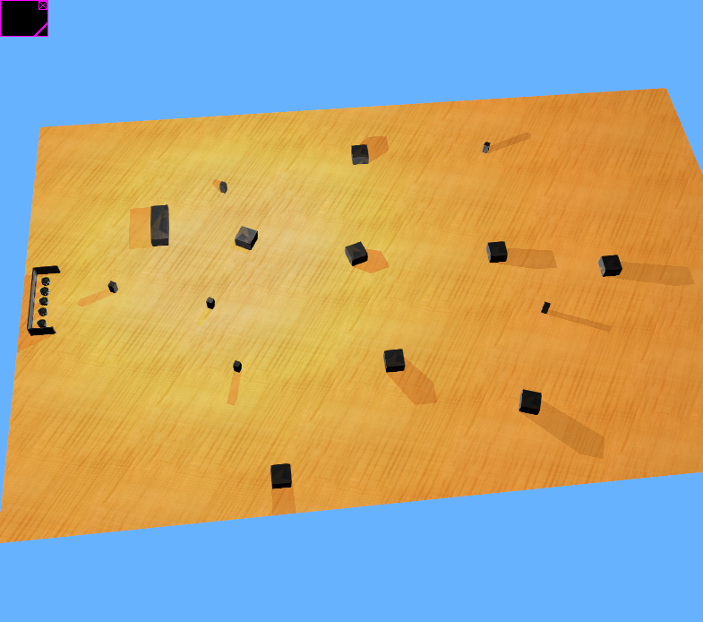
4) Experimental Setup
Simulation in Webots
First Scenario : Cluttered Environment

Slide 14
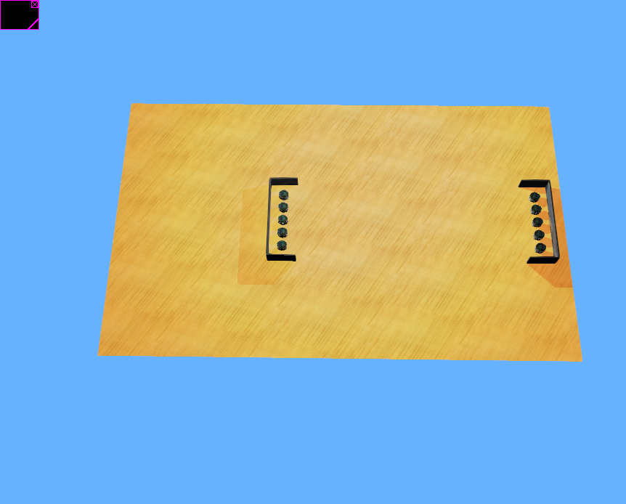
Second Scenario : Dynamic Environment

Slide 15
Real Experiments

Slide 16
Results

Slide 17
discussion

Slide 18
conclusion

