Slide 1
Hardware Software project
Selected Benchmarks:
AES(Advanced Encryption Standard)
MDP (Markov decision process)
Presented By: Yoav Gold

Slide 2

Agenda
Background & overview
Pyperformance suite
How Python runs ?
AES Benchmark
MDP Benchmark
Summary and questions
background
Observations and initial results
My optimizations
Evaluations and results
Hardware accelerator

Slide 3

Background
Pyperformance suite is the official Python benchmarking suite maintained by the Python Software Foundation (PSF).
It provides a standardized collection of real-world Python workloads to evaluate the performance of:
The Python interpreter and runtime (CPython, PyPy, etc.)
Optimizations, libraries, or hardware changes that impact execution speed.

Slide 4
Background
Pyperformance includes dozens of benchmarks, that can be grouped by the following domains:
Category | Example Benchmarks | What It Measures
Cryptography | crypto_pyaes | AES encryption speed and memory use
Data Structures | mdp, deepcopy, unpack_sequence | Algorithmic efficiency and object handling
Serialization | json_dumps, pickle, pickle_dict | Encoding/decoding and I/O performance
File & Path Ops | pathlib | Filesystem and string manipulation
System & Memory | gc_collect, logging | Garbage collection and logging overhead
*highlighted in yellow the benchmarks I picked for this project

Slide 5

Background
How python runs code?
Python takes the native code we write, and feed him into three steps

Slide 6
Background
Parsing - The interpreter parses your Python source into an Abstract Syntax Tree (AST)
for i in range(5): ...
Compiling - The AST is compiled into bytecode, which is platform-independent instruction set (not assembly!)
LOAD CONST CALL FUNCTION ...
The Python Virtual Machine (PVM) interprets each bytecode instruction (one at a time!) and performs the actual work.
LOAD CONST CALL FUNCTION ...
Python takes the native code we write, and feed him into three steps

Slide 7

Background
The Python interpreter is the heart of how python works
Acts as the runtime environment that executes the bytecode.
Handles complex stuff behind the scene:
Memory management (via garbage collector)
Interface with C / Fortran extensions (NumPy, Scipy, etc.’)
Byte code itself is a portable ISA, which is being executed by the PVM.
The PVM works on a classic “fetch–decode–execute” scheme.
Each byte code (and we will see examples later) can be translated into many assembly instructions.
Fetch
Decode
Execute
Read the next bytecode instruction
Identify the operation
Run the corresponding C function
*assuming we use cpython and not PyPy/ Jython/ other Interpreter Implementation

Slide 8




AES benchmark

Slide 9
background
AES – Advanced Encryption Standard is a symmetric block-cipher that is widely used to secure digital data.
It was established in 2001.
AES operates on fixed data blocks of 128 bits and supports key lengths of 128/192/256 bits. AES basically repeats 4 major functions for encryption: sub bytes, shift rows, mix columns, and XOR with some subset of the key.
I picked AES due to its enormous usage and popularity worldwide.
using ChatGPT I asked: "roughly, how much data is being encrypted and decrypted per day using AES?“ > 33 EB/day!
AES offers different types of modes, such as ECB, CBC, CFB ,OFB, CTR

Slide 10
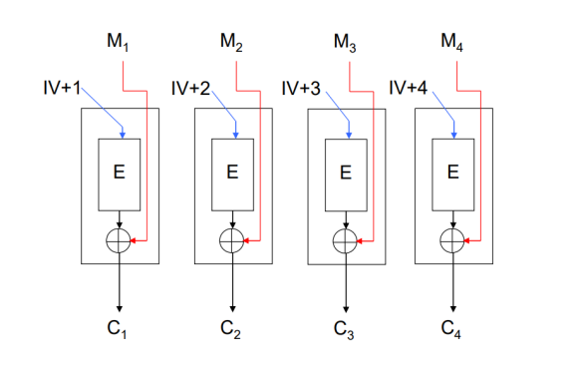
background
AES offers different types of modes, such as ECB, CBC, CFB ,OFB, CTR

Slide 11

Observations and initial results
Pyperformance benchmark evaluates the AES as follows:
Initialize a dummy text, with roughly 23k bytes.
Uses a 128-bit key
The benchmark runs on a loop with the following steps:
Creates an AES object – CTR mode. 2.
Encrypt the dummy text 3.
Decrypt the dummy text back to clear text. 4.
Destroys the AES object for the next loop.
In addition, the benchmark makes sure that the clear text is equal to the decrypted text.

Slide 12
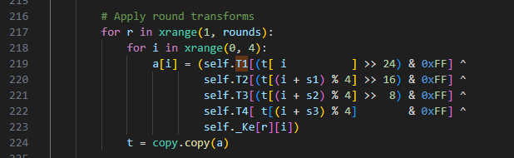
Observations and initial results
Lines 219 – 224 contribute 73%~ of the total runtime of the benchmark !!

Slide 13
Observations and initial results
Lines 219 – 224 contribute 73%~ of the total runtime of the benchmark !!
The original code is using a very popular approach called T tables lookup. T tables lookup is a precomputed lookup tables, where each entry corresponds to the result of applying all of AES operations (subBytes, shiftrows, mix columns) to an input byte. Which in result, reduces the computation time. Thus, it is no surprise that most of the work is inside this loop.

Slide 14
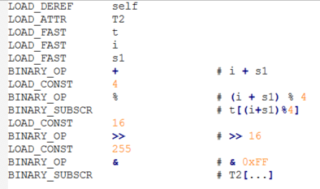
My optimizations
I made two versions of optimizations:
One that does not require any “new library” – pure python understanding and optimizations
Second that is more comprehensive, contains JIT code, and NumPy arrays usage.
Let's examine the byte code for one of the hot lines in the benchmark:
self.T2[(t[(i + s1) % 4] >> 16) & 0xFF]

Slide 15
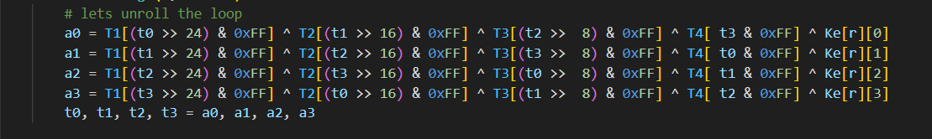

My optimizations
Fetch the needed attributes before the for loop – removes 2-byte code from the hot program lines
Unroll the inner loop – avoid fragmented instruction fetch + remove branches and for loop overhead, avoid copy

Slide 16
My optimizations
For the second version, I made usage of NumPy + Numba – which enables JIT – Just in time compile.
Numba uses LLVM to turn Python code into a very optimized machine code. This should give us a decent boost in performance, this boost "bypasses" the need to go line by line with the interpreter, injecting machine code (pure assembly) directly into the CPU.
Also, to make thing fast, I’m using NumPy arrays – which are built in C/C++ - much faster the Python lists, better for Numba to optimize.

Slide 17
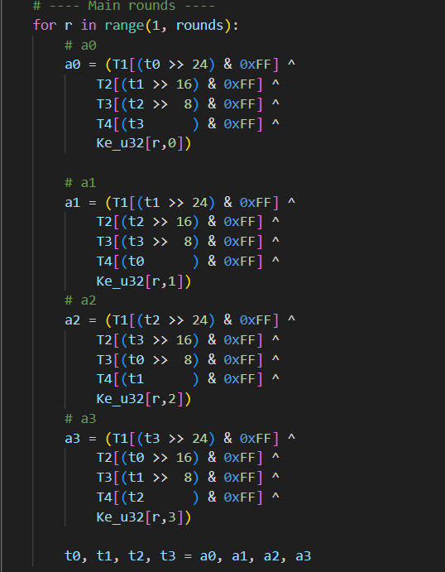
My optimizations
Main optimizations are the same, but now we JIT compile this hot function + use NumPy arrays.
Remember this?
a0 = T1[t0>>24] ^ T2[t1>>16] ^ T3[t2>>8] ^ T4[t3] ^ Ke[r,0]

Slide 18
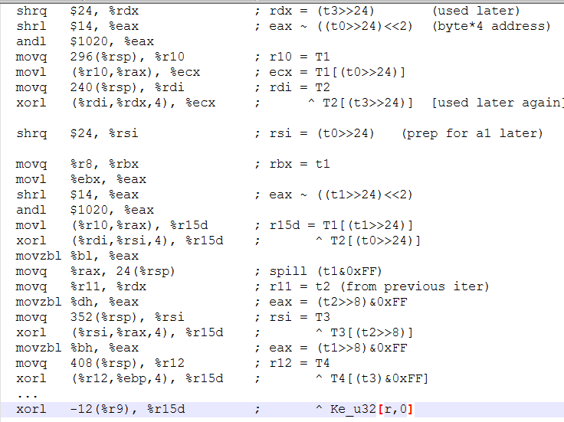
My optimizations
a0 = T1[t0>>24] ^ T2[t1>>16] ^ T3[t2>>8] ^ T4[t3] ^ Ke[r,0]
The entire one inner loop iteration (which is not unrolled) contains just 27 assembly instructions!!
The original byte code had roughly 1,500–3,100 CPU assembly instructions *(according to ChatGPT)

Slide 19
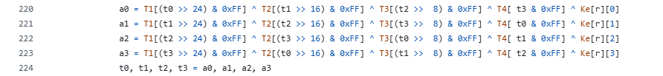
Results
To gather the results properly, what I did was to create a script with three stages:
Run the benchmark to create flame graph.
Run perf stat for 5 times (to avoid noise) – between each run I flush the caches.
Run the benchmark using pyperformnace wrappers (to make sure everything is valid ☺)

Slide 20
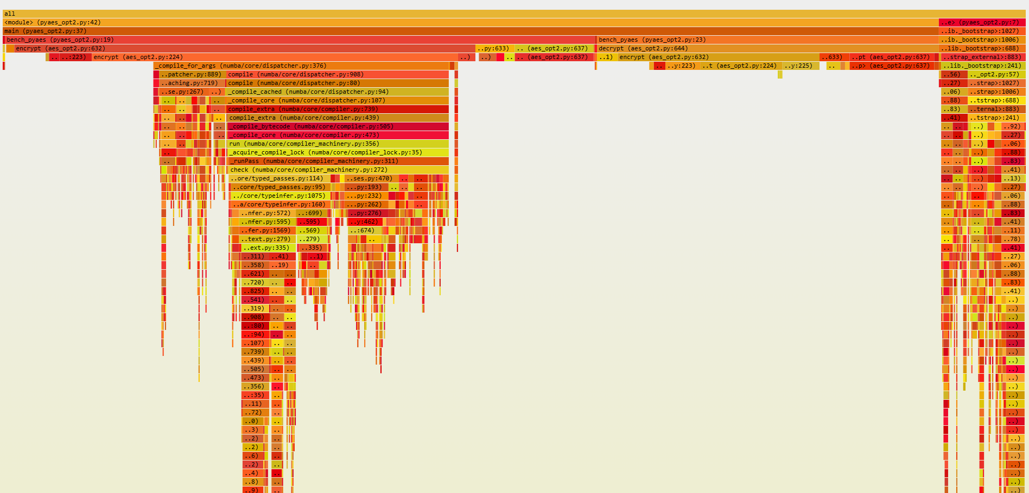
Results

Slide 21
Results
- Second version speed up is 9.5x!
First version speed up is 1.33x!
IPC for the second version is ~half from the clean. (can be mainly explianed via the unique flame graph we got, and the increase in page faults, LLC loads, context switches (going back and forth from LLVM > C > Python)
DTLB loads decreased dramatically, ITLB loads increased by quite a bit.
Instructions count decreased by > 10x!
 | pyaes_clean | pyaes_opt | pyaes_opt2
time | 60.18 | 45.35 | 6.31
instructions | 372,868,099,444 | 293,980,849,497 | 38,831,029,761
cycles | 156,219,787,035 | 117,723,432,614 | 30,675,604,409
IPC | 2.39 | 2.50 | 1.27
context-switches | 184.00 | 153.60 | 725.00
page-faults | 12991.80 | 5660.80 | 35100.80
branches | 94,858,787,161 | 75,801,414,107 | 8,699,136,704
branch-misses | 311,479,352 | 219,708,360 | 36518528.20
L1-dcache-loads | 87,130,684,252 | 64,014,087,531 | 8,836,779,338
L1-dcache-load-misses | 444,117,324 | 323,044,504 | 254,816,828
LLC-loads | 26636483.40 | 19675232.40 | 28637104.00
LLC-load-misses | 167637.00 | 128563.20 | 1112054.60
dTLB-loads | 87,135,513,438 | 64,052,016,711 | 8,966,818,319
dTLB-load-misses | 4,693,632.40 | 4,265,469.40 | 3,415,343.80
iTLB-loads | 5,186,091.80 | 2,090,725.20 | 36,975,271.80
iTLB-load-misses | 1053577.20 | 604830.80 | 4181043.00
Speedup | 1.00 | 1.33 | 9.54

Slide 22
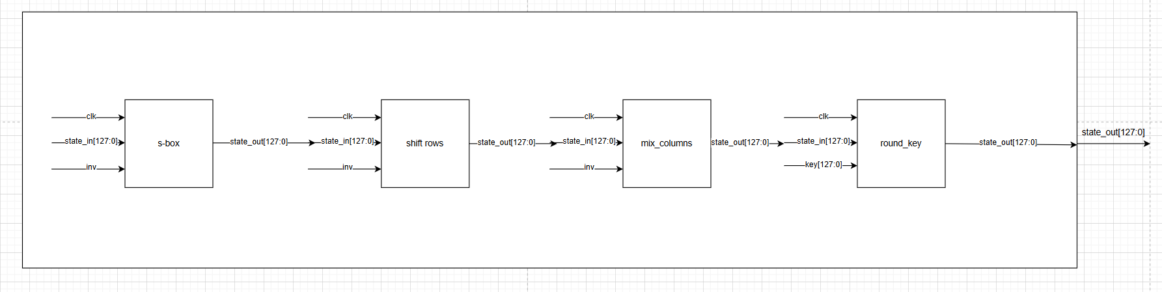
Hardware solution
For AES, I would like to present an end-to-end hardware accelerator that will opt to be embedded on top x86 AES ISA.
The S-box implementation will be based on ROM. Meaning that we will have 16 independent S-boxes, that is done to support 16 bytes per round. Each S-box operates on 8 bits input. On a fully pipelined path, it should take 1 cycle (each cycle the 16 s-boxes produce the output of 128-bit input)

Slide 23
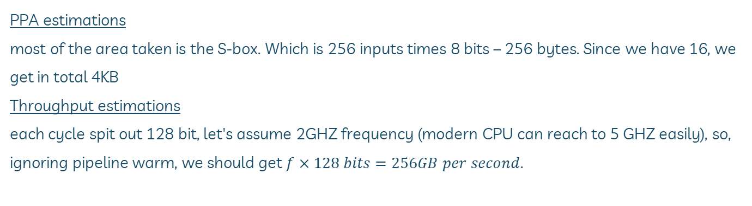
Hardware solution
PPA estimations
most of the area taken is the S-box. Which is 256 inputs times 8 bits – 256 bytes. Since we have 16, we get in total 4KB
Throughput estimations
each cycle spit out 128 bit, let's assume 2GHZ frequency (modern CPU can reach to 5 GHZ easily), so, ignoring pipeline warm, we should get $f×128 bits=256GB per second$.

Slide 24

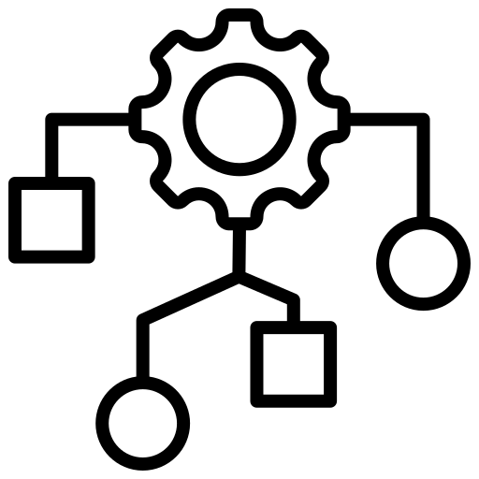
MDP benchmark

Slide 25
background
This benchmark is a pure python dynamic-programming simulation of a simplified battle which is being simulated as a Markov Decision Process.
It uses the value iteration algorithm, to solve the MDP problem.
It models combat turns as state transitions with probabilities, evaluates optimal choices under uncertainty, and computes the player’s win probability to a target tolerance.
MDP has vast number of applications on itself – robotics, machine learning, finance, games.

Slide 26
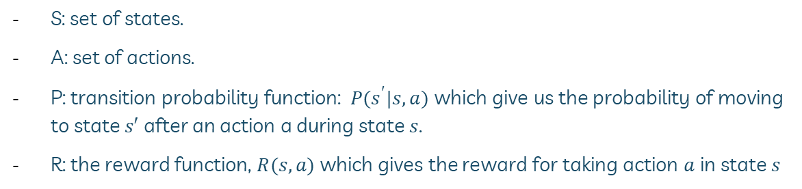
background
The game is modeled as a directed acyclic graph, that includes abstract states like:
A state for each fighter HP / stats, and whose turn it is now
Actions which transform a state into next states with some probability functions for example damage randomness, critical hit chance, etc'.
The benchmark evaluates the win probability from the initial state, by going over the state graph, until the estimate is "close enough"
S: set of states.
A: set of actions.
P: transition probability function: $P(s^{′}|s,a)$ which give us the probability of moving to state $s′$ after an action a during state $s$.
R: the reward function, $R(s,a)$ which gives the reward for taking action $a$ in state $s$

Slide 27
Observations and initial results
The main code can be divided into three main parts:
State representation defines the game state using namedtuple objects – like Pokemon's HP, stats, and status.
Action and transition logic: _applyAction and getSuccessors functions define the main core logic. They also calculate the probability outcome for each possible move. This is basically building the transition probability matrix.
Value iteration: the evaluate method does the main heavy lifting. It initializes the values for win (1) and losing (0) and then it iteratively computes the probability of winning for all of the states

Slide 28
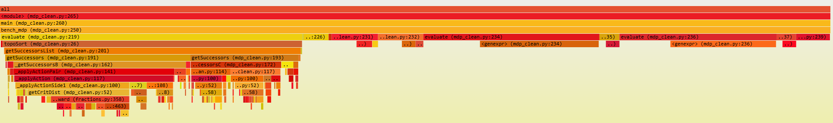
Observations and initial results
Topological sort for all of the nodes from the root states – using an iterative DFS algorithm (roughly 36%! Of the entire program run time), also a lot of the time is being spent on the Fraction Python module
Main evaluate logic – huge while loop that loops through to the states until convergence

Slide 29
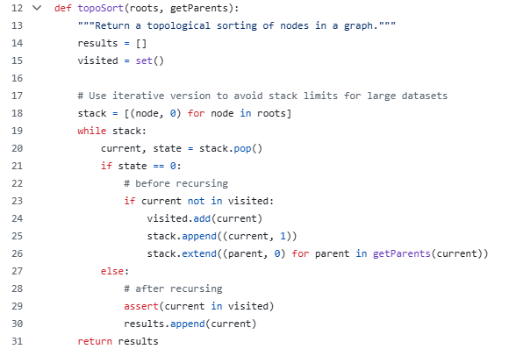
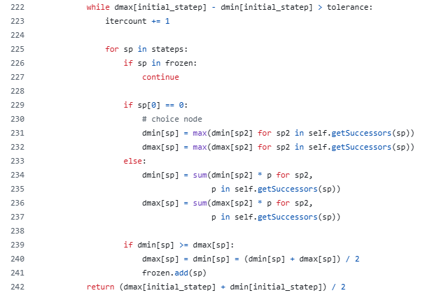
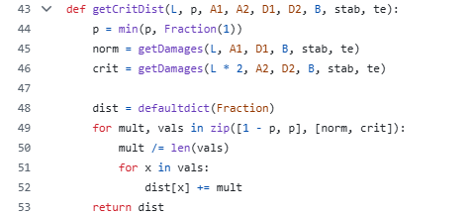
Observations and initial results
Topological sort for all of the nodes from the root states – using an iterative DFS algorithm (roughly 36%! Of the entire program run time), also a lot of the time is being spent on the Fraction Python module
Main evaluate logic – huge while loop that loops through to the states until convergence

Slide 30
My optimizations
I made three versions of optimizations:
Removal of the Fraction module usage, adding caching to hot function calls
Extends the first version, while also restructure the graph creation to happen only once.
Like the second version, but with the re – addition of the fraction module.

Slide 31
My optimizations
Removal of the Fraction module usage, adding caching to hot function calls

Slide 32
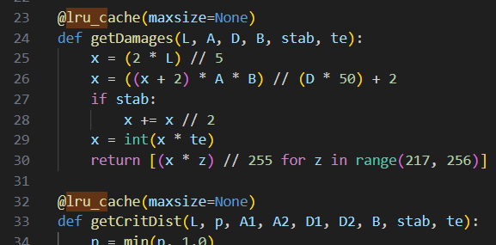
My optimizations
Removal of the Fraction module usage, adding caching to hot function calls

Slide 33
My optimizations
For the second and third versions, I re created the graph creation, and now it is completely python arrays based. Unlike the previous version that was reliant on a lot of dictionary, which are less optimal in the memory layout, and, slower to index.

Slide 34
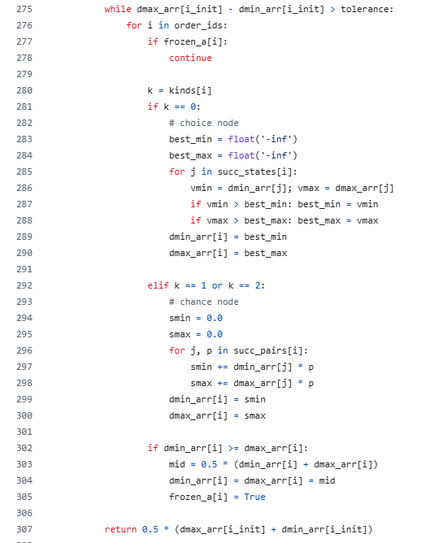
My optimizations

Slide 35
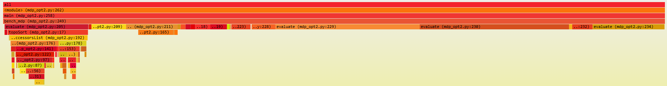
Results
To gather the results properly, what I did was to create a script with three stages:
Run the benchmark to create flame graph.
Run perf stat for 5 times (to avoid noise) – between each run I flush the caches.
Run the benchmark using pyperformnace wrappers (to make sure everything is valid ☺)
We can see that the amount of time spent on toposort function has decreased by quite a bit (36% ->12%!)
Also, we see that we have a small improve on the evaluate while loop (thanks to the caching, 3% -> 1.5-2%~)

Slide 36
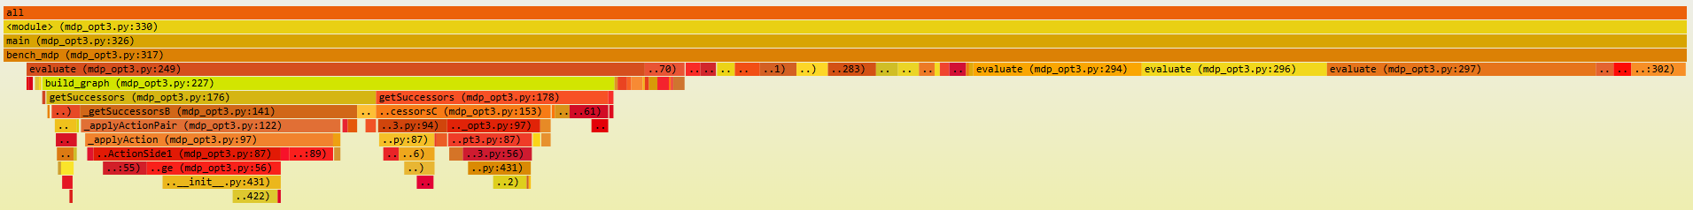
Results
For the second version, the topo sort bottleneck almost gone (we now do it on arrays!)
The build graph takes some decent time, but we will see a huge improvement that justify it.
We not build the graph only once!

Slide 37
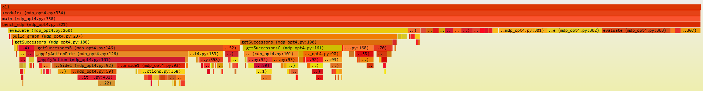
Results
For the third version, we see a similar picture to the previous one, but the re-addition of fraction module made things a bit slower..

Slide 38
Results
 | mdp_clean | mdp_opt | mdp_op3 | mdp_opt2
time | 89.12 | 49.17 | 23.85 | 16.68
instructions | 472,798,271,875 | 268,486,449,356 | 129,175,090,586 | 94,424,121,599
cycles | 231,334,954,673 | 127,634,468,823 | 61,884,809,547 | 43,292,747,562
IPC | 2.04 | 2.10 | 2.09 | 2.18
context-switches | 261.00 | 152.00 | 78.00 | 60.00
page-faults | 5971.00 | 6424.00 | 6791.00 | 7486.00
branches | 112,590,248,650 | 63,217,148,827 | 30,662,176,589 | 22,294,886,655
branch-misses | 847,069,184 | 427,698,832 | 225,468,079 | 145,791,914
L1-dcache-loads | 127,674,335,928 | 70,781,229,380 | 36,903,230,679 | 27,084,594,396
L1-dcache-load-misses | 2,460,060,767 | 921,255,002 | 769,171,203 | 356,565,880
LLC-loads | 294,814,849 | 235,675,242 | 157,876,992 | 129,009,581
LLC-load-misses | 1,278,518.00 | 581,456.00 | 859,491.00 | 678,415.00
dTLB-loads | 127,698,191,835 | 70,744,535,008 | 36,833,951,064 | 27,216,481,664
dTLB-load-misses | 56683536.00 | 17230771.00 | 14644673.00 | 8839893.00
iTLB-loads | 108,064,221 | 14,744,982.00 | 44,608,244.00 | 11,861,893.00
iTLB-load-misses | 2,233,451.00 | 1,011,329.00 | 1,949,767.00 | 729,008.00
Speedup | 1.00 | 1.81 | 3.74 | 5.34
Only removing the Fraction module, we gain 1.81x speedup!
Version 2 gives a 5.34x speedup! And improves on all of the metrics. Loses to version 1 only on LLC load misses.
Version 3 can tell us how much the Fraction module costs.

Slide 39
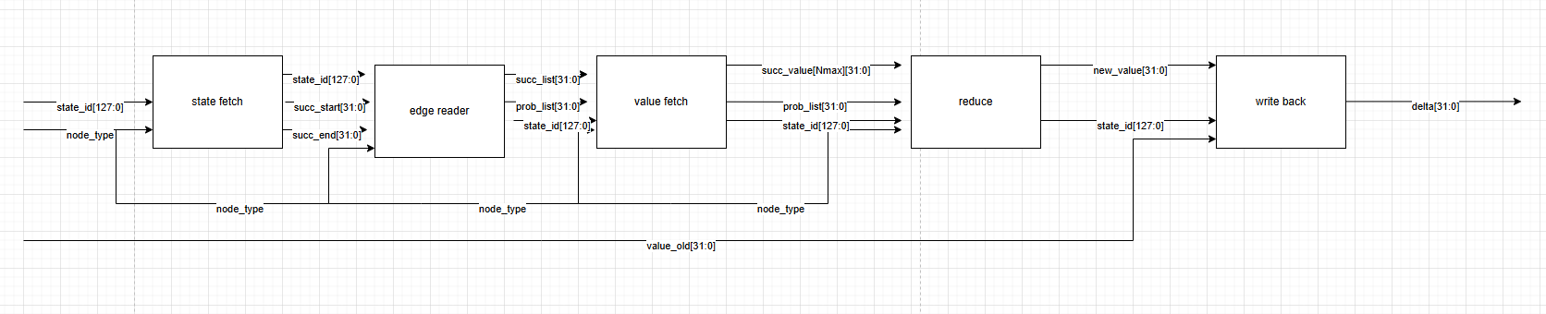
Hardware solution
I suggest building a hardware accelerator for the value iteration part (the big while loop which took the most amount of time), based on version number 2. we will store the successor list on an SRAM.
Reading the node according to ID
Getting the edges (SRAM)
Reading the values for edges
Value update
Write back to memory

Slide 40

Thanks!
Any questions?

