Slide 1
DATA ANALYTICS HACKATHON • WOOBLE IPL CRUNCH '26
IPL CRUNCH '26
What Actually Wins IPL Matches?
Yobin Bangera
Python
Pandas
Power BI
DAX

Slide 2

COMPETITION OVERVIEW
About the Hackathon
Organized By
Challenge Objective
Wooble — IPL Crunch '26
Data Analytics Challenge
Analyze 5 seasons of IPL data to uncover match-winning patterns, player impact, toss strategy, and phase-based insights.
Toss Impact Analysis
Phase Intelligence
Player Analytics
Hidden Patterns
Submission Requirements
1. Charts & Visualizations
2. Python/Excel Workflow
3. Dashboard/Presentation
4. One Surprising Finding

Slide 3
BUSINESS PROBLEM
Key Questions Solved
01
Does winning the toss really help?
Toss decision vs match outcome across 342 matches
02
Which phase impacts victory the most?
Powerplay • Middle Overs • Death Overs
03
Who are the most impactful players?
Batters, bowlers & match-defining performances
04
What hidden patterns influence victories?
Correlations, KPIs & surprising data insights

Slide 4
DATASET OVERVIEW
Data Overview
342
120K
4K+
Matches Analyzed
Total Runs Scored
Wickets Tracked
Dataset
Scale
IPL Ball-by-Ball Data | Seasons: 2022 – 2026
342 Matches • 120K+ Runs • 4K+ Wickets • 5 Seasons
Data Fields Included
Batter
Bowler
Runs
Wickets
Overs
Toss Decisions
Match Results
Venues

Slide 5
DATA PREPARATION
Python-Based Data Cleaning
Cleaning Steps
Custom KPIs Engineered
01 Missing value handling
Dot Ball %
Strike Rate
Bowling pressure metric
Batting aggression index
02 Team name standardization
Economy Rate
Boundary %
03 Data type corrections
Runs conceded per over
Fours & sixes per innings
04 Duplicate removal
Toss Win %
Chase Success %
05 Match phase creation
Toss to result correlation
Chasing team win rate
06 KPI engineering
# Phase Momentum Metrics also engineered for Powerplay, Middle & Death overs

Slide 6
DATA ENGINEERING
Processing Pipeline
▶
▶
▶
▶
▶
Raw
JSON/CSV
Python
Cleaning
Feature
Engineering
KPI
Creation
CSV
Export
Power BI
Dashboard
Libraries & Tools Used
Pandas
NumPy
Matplotlib
Google Colab
Data manipulation & analysis
Numerical computing
Exploratory visualizations
Interactive development

Slide 7
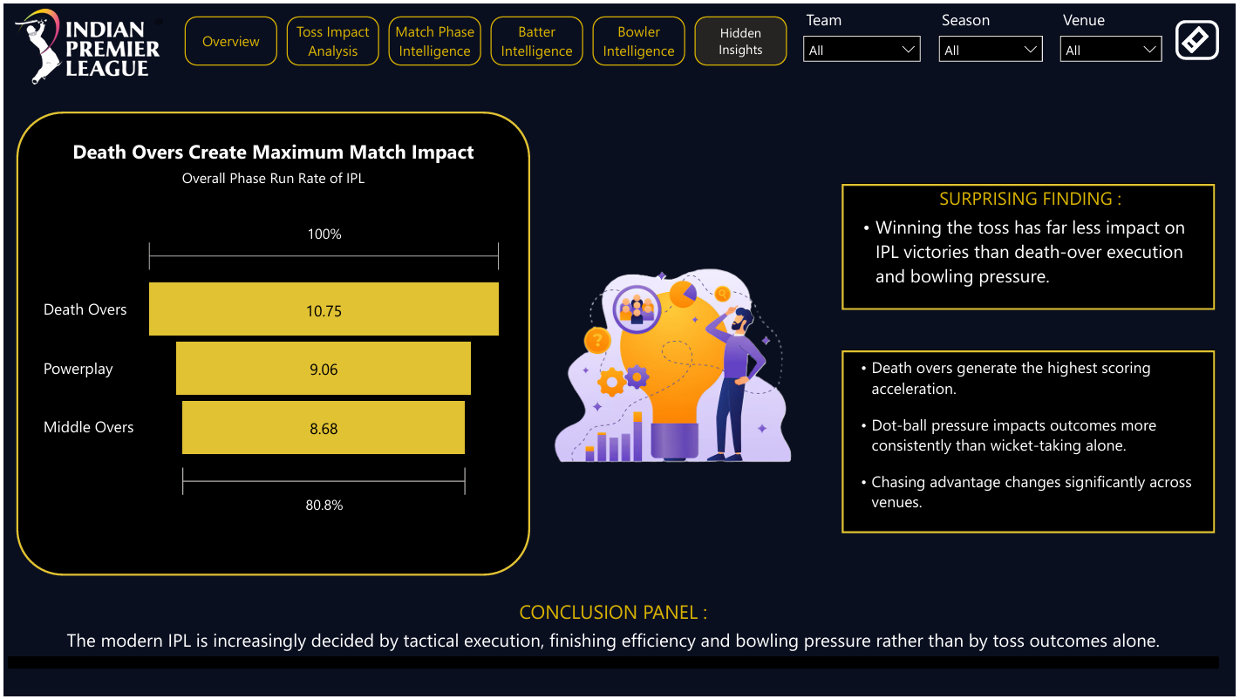
DASHBOARD DESIGN
Dashboard
Power BI — IPL Analytics Dashboard
Multi-Page Navigation
342
120K
50.9%
49.1%
Matches
Runs
Chase Win
Toss Win
Dynamic Slicers
Cross - Filtering
Executive KPI Cards

Slide 8
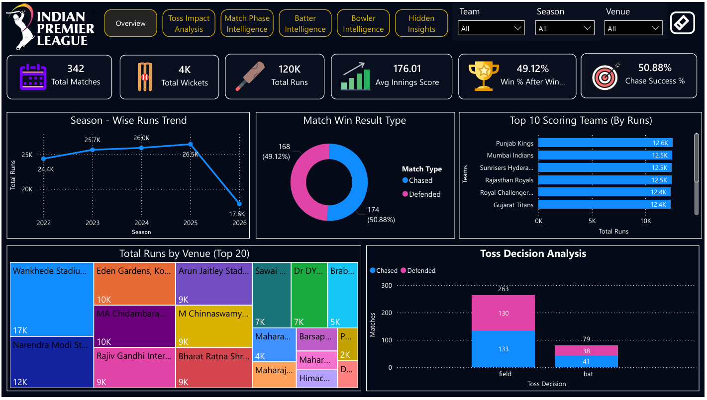
TOURNAMENT INTELLIGENCE
Tournament Overview
342
120K
176
50.9%
Total Matches
Total Runs
Avg Innings Score
Chase Success %
Key Insight
Scoring trends increased significantly over seasons, highlighting the aggressive modern IPL batting evolution. Average team score rose from 2022 to 2025.

Slide 9
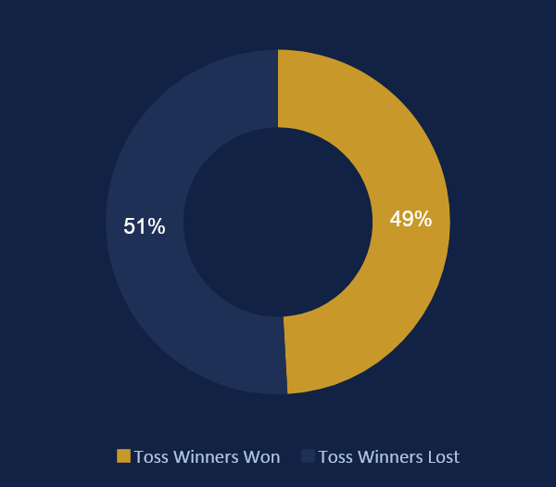
TOSS IMPACT ANALYSIS
Does Winning the Toss Matter?
49.1%
50.9%
Toss Winners Won
Chasers Won
Strategic Insights
Toss-winning teams won only 49.12% of matches — barely better than a coin flip.
Chasing teams won 50.88%, making 'field first' the dominant modern IPL strategy.
Toss advantage is overrated compared to tactical execution.

Slide 10
PHASE INTELLIGENCE
★ KEY FINDING: Death Overs had the highest scoring acceleration and strongest match influence
Which Phase Wins Matches?
POWERPLAY
MIDDLE
OVERS
DEATH
OVERS
Overs 1–6
Overs 7–15
Overs 16–20
7.8
1.2
7.2
1.8
11.4
2.1
Run Rate
Wkts/Match
Run Rate
Wkts/Match
Run Rate
Wkts/Match
High pressure opening phase — teams look to accelerate without losing wickets. A strong powerplay sets the platform for the innings.
Consolidation meets calculated risk. Middle-over bowlers apply dot-ball pressure while batters look for boundaries.
Highest scoring phase. Death-over execution determines match outcomes — highest run acceleration & wicket density.

Slide 11
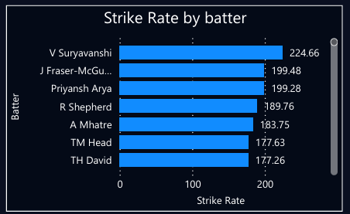
BATTER INTELLIGENCE
Batting Performance Hub
148.6
52.3%
120K+
13.4
Strike Rate
Avg top-5 batters
Boundary %
Runs from boundaries
Total Runs
5-season aggregate
6s per Match
Avg sixes per game
Batting Insights
01
Modern IPL rewards aggressive, boundary-focused batting
02
Elite batters balance consistency with acceleration
03
Team dependency on top-3 batters is significant

Slide 12
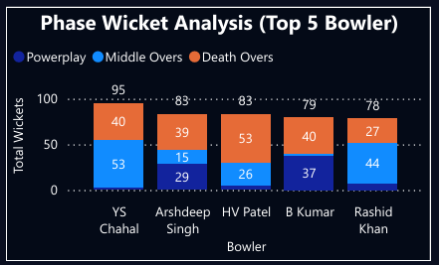
BOWLER INTELLIGENCE
Bowling Pressure Analysis
38.4%
8.6
4K+
7.2
Dot Ball %
Bowling pressure index
Economy Rate
Runs per over
Total Wickets
5-season aggregate
Extras/Match
Avoidable runs
Bowling Insights
01
Dot-ball pressure impacts outcomes more than wickets alone
02
Death-over bowlers carry the highest risk and reward
03
Extras are an underrated metric — a silent match-turner

Slide 13
SURPRISING FINDING
Hidden Insight
"Winning the toss has far less impact on IPL victories than death-over execution and bowling pressure."
Supporting Evidence
49.1%
10.75
38.4%
Toss Win Rate
Death Over RR
Dot Ball %
Below the expected 50% threshold — toss advantage is negligible
Highest run rate phase — death overs determine match fate
Bowling pressure strongly correlated with match victories

Slide 14
BUSINESS IMPACT
Why This Project Matters
Skills Demonstrated
Real-World Applications
1. Data Storytelling
Team Strategy Optimization
Data-driven team selection & match planning
2. Sports Analytics
Player Scouting
Analytics-based talent identification
3. Predictive Thinking
Performance Analytics
4. KPI Design
Individual & team performance benchmarking
5. Dashboard Intelligence
Match Planning
Opponent-specific tactical preparation

Slide 15
FINAL CONCLUSION
What Truly Wins IPL Matches?
Tactical Execution
Death-Over Efficiency
Smart game plans > luck
Final overs determine winners
Middle-Over Control
Bowling Discipline
Stability breeds victory
Dot balls create pressure
"Data challenges assumptions — and reveals what truly wins matches."

Slide 16
THANK YOU
IPL Crunch '26 — Data Analytics Hackathon
Yobin Bangera
Python
Pandas
Power BI
DAX
Wooble • IPL Crunch '26 • Data Analytics Hackathon

