Slide 1

Jetpack Joyride is an endless runner where you fly a jetpack. Collect Coins and avoid deadly obstacles. Keep going for as long as you can and pick up power-ups along the way.!
You can fly using the space button, collect different styles with different features.
If you hit an obstacle you will return to the original skin, if you already using the first character you will lose the game.
Game Tips:
Wait for the missiles to lock on before moving
The ceiling and floor are the safest places to run

Slide 2

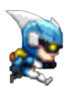
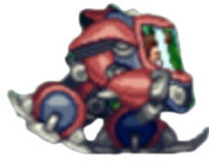



elements
Taking the power up gift will randomly allow the player to change gravity or to become a tank with the ability to be hit once.
You must collect as many coins as possible.
If you collect a PIGGY, you will get the number of coins it contains.
If you collect the SPEEDY, GIFT you will become fast and protected for 15 seconds.

Slide 3


elements
The missile is a guided missile, you must dodge it. If the player is hit, he will die.
Before the missile is launched, an alert will appear and indicating the location from which the missile will arrive.
If the player collides with the laser, the player will be electrocuted and die.

