Slide 1
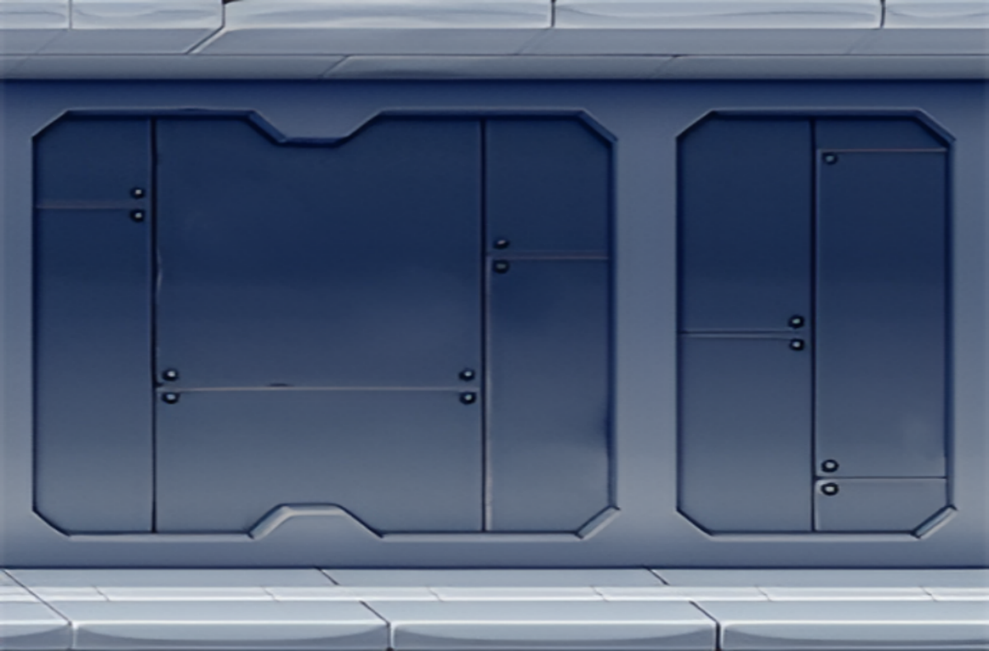
-click anywhere on the window to return to the game menu-
Jetpack Joyride is an endless runner where you fly a jetpack. Collect Coins and avoid deadly obstacles. Keep going for as long as you can and pick up power-ups along the way!
You can fly using the space button, collect different styles with different features.
If you hit an obstacle you will return to the original skin, if you already using the first character you will lose the game.
Game Tips:
Wait for the missiles to lock on before moving
The ceiling and floor are the safest places to run

Slide 2
click anywhere on the window to return to the game menu-
Jetpack Joyride is an endless runner where you fly a jetpack. Collect Coins and avoid deadly obstacles. Keep going for as long as you can and pick up power-ups along the way!
You can fly using the space button, collect different styles with different features.
If you hit an obstacle you will return to the original skin, if you already using the first character you will lose the game.
Game Tips:
Wait for the missiles to lock on before moving
The ceiling and floor are the safest places to run

Slide 3
Jetpack Joyride is an endless runner where you fly a jetpack. Collect Coins and avoid deadly obstacles. Keep going for as long as you can, and pick up power-ups along the way!
Features
Run, dodge, and collect
Run endlessly avoiding homing missiles and lasers. Pick up as many coins as you can and travel the furthest distance possible without dying.
Buy upgrades to improve survivability
Use your coins to buy upgrades like little stomper, rocket boost, armor, and a gravity suit. Each upgrade item gives you an extra layer of protection and a unique ability.
Power-up your rocket man
As you get further you'll find power-ups like extra speed and a piggy bank that spills coins everywhere. You can also find upgrade items throughout the map as well as at the beginning.
Game Tips
Wait for the missiles to lock on before moving
The ceiling and floor are the safest places to run

