Slide 1
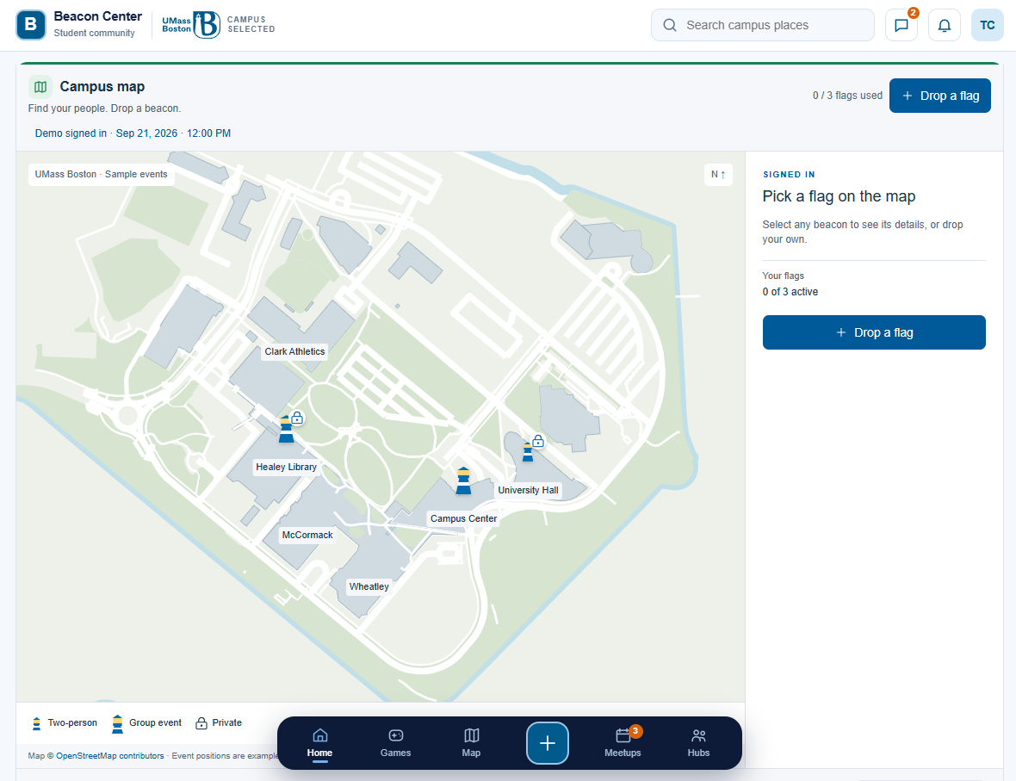
Beacon Center: screenshot to code
Exact names in the uploaded HTML. # = element ID . = CSS class () = JavaScript function
Page header
header.topbar
.topbar-inner
Brand, search and account display.
Campus map section
section#campus-map
#beaconMap is the widget root.
Includes the map and side panel.
Bottom navigation
nav.dock
Each button uses .dock-btn.
Actions use data-* attributes.
1 / 7
Notes:
Sources: uploaded beacon-center-homepage-mobile(1).html, Beacon Center Homepage Code Guide(1).pdf, and Screenshot 2026-09-30 010042(1).png. Exact selectors and behavior verified against HTML. Proposed backend names are suggestions, not existing implementation.

Slide 2
Header: branding, search and account
The search works locally. Messages and notifications currently display a placeholder toast.
Brand and campus
Search input
Message and bell
Student avatar
.brand
.brand-mark / .brand-name
.campus-badge
The campus badge is a static display.
[data-search-input]
Inside .search
Enter calls searchMap(text), then beaconMap.
focusPlace(name).
.icon-btn
data-action="chat"
data-action="notifications"
Both call showPlaceholder(). .badge holds the fixed 2.
.avatar
TC is fixed sample text.
This element is a <div> with no profile click handler.
2 / 7
Notes:
Sources: uploaded beacon-center-homepage-mobile(1).html, Beacon Center Homepage Code Guide(1).pdf, and Screenshot 2026-09-30 010042(1).png. Exact selectors and behavior verified against HTML. Proposed backend names are suggestions, not existing implementation.

Slide 3
Map toolbar: title, status and flag action
This screenshot shows the signed-in demo state. A fresh page initially shows #bcStart.
Title and status
Flag count
Drop a flag
.bcToolbar contains the h1.
#bcStatus displays the blue status line.
announce(message) updates that line.
#bcCount
renderMarkers() sets the text using myFlags().length and maxFlags (3).
#bcDrop
.bcButton.bcPrimary
Click calls showCreateForm(). The form appears in #bcPanel.
3 / 7
Notes:
Sources: uploaded beacon-center-homepage-mobile(1).html, Beacon Center Homepage Code Guide(1).pdf, and Screenshot 2026-09-30 010042(1).png. Exact selectors and behavior verified against HTML. Proposed backend names are suggestions, not existing implementation.

Slide 4
Map: labels, markers and private flags
The map drawing is SVG. Places and events are JavaScript data in the same HTML file.
Place label
.bcPlace inside #bcLabels
data-place="Healey Library"
renderLabels() reads places.
Event marker
.bcMarker inside #bcMarkers
data-event stores the event ID.
Click calls showSummary(id).
Private two-person flag
.bcP2p changes marker size.
.bcPrivateBadge draws the lock.
events: type and visibility.
4 / 7
Notes:
HTML map script sections 2, 5 and 6. The underlying map is .bcBase within .bcMap. Event popup #bcPopup is hidden in this screenshot and opens through showSummary(id), then showDetail(id). Demo filtering shows all events to any signed-in demo user; private markers are not proof of server authorization.

Slide 5
Side panel: the signed-in screen
showHome() creates this panel content after the demo sign-in.
Panel container
aside#bcPanel.bcSide
JavaScript variable: panel
showHome() fills panel.innerHTML.
Your flags row
.bcRow, created by rowHtml()
Count: myFlags().length
Limit: maxFlags
Panel flag button
#bcHomeDrop
Calls showCreateForm().
Form ID: #bcCreate
5 / 7
Notes:
Sources: uploaded beacon-center-homepage-mobile(1).html, Beacon Center Homepage Code Guide(1).pdf, and Screenshot 2026-09-30 010042(1).png. Exact selectors and behavior verified against HTML. Proposed backend names are suggestions, not existing implementation.

Slide 6
Bottom navigation: scroll links and actions
The center + button opens the map’s flag flow. Games, Meetups and Hubs are placeholders.
Home and Map
Center + button
Other destinations
data-scroll="top"
data-scroll="campus-map"
scrollToSection(id) scrolls.
setActiveNav(id) applies .is-active.
.dock-create
data-action="create"
actions.create calls
window.beaconMap.create().
Guests see showLogin().
data-action="games"
data-action="meetups"
data-action="hubs"
showPlaceholder() uses #toast.
.dock-count is the fixed 3.
6 / 7
Notes:
Source HTML bottom nav and final page script. The Home/Map callout spans both scroll buttons and the intervening Games button; Games uses data-action="games" and is a placeholder as documented in the third callout.

Slide 7
Backend connections: proposed Flask names
No Flask routes, database models or API requests appear in the supplied HTML. These are suggested names.
Sign-in and profile
Current: signedIn, showLogin(), .avatar
Proposed: reuse Beacon Center’s existing session and user identity.
Load map flags
Current: events, places, renderMarkers()
Proposed: GET /api/map/events and GET /api/map/places
Create or remove a flag
Current: #bcSubmit, events.push(flag), #bcRemove
Proposed: POST /api/map/events and DELETE /api/map/events/<id>
Accept a two-person invite
Current: #bcConsent sets e.consent = true
Proposed: POST /api/map/events/<id>/accept
The server should check ownership, group membership, consent and flag limits. The current demo shows every event to any signed-in demo user.
7 / 7
Notes:
Sources: uploaded beacon-center-homepage-mobile(1).html, Beacon Center Homepage Code Guide(1).pdf, and Screenshot 2026-09-30 010042(1).png. Exact selectors and behavior verified against HTML. Proposed backend names are suggestions, not existing implementation.

