Slide 1


HeavyHub
Powering Fields. On Demand.
Transforming heavy equipment access for India's agricultural sector through an intelligent rental platform
Team:
Notes:
1

Slide 2
The Challenge
Limited Access
Prohibitive Costs
Farmers and contractors struggle to access heavy-duty machinery like tractors, harvesters, and JCBs when needed most
Purchasing equipment requires ₹5–50 lakh investment, far beyond reach for small and medium farmers
Unorganised Rentals
Idle Assets
Existing rental systems lack transparency in pricing, availability tracking, and quality assurance
Equipment sits unused 40–60% of time, causing financial losses for owners with high maintenance costs
Notes:
2

Slide 3
Market Opportunity
140M
<15%
~50%
18%
Active Farmers
Tractor Ownership
Utilisation Rate
GDP Contribution
India's agricultural workforce requiring machinery access
Low equipment penetration creates massive rental demand
Average machinery sits idle most of time, waiting to be used
Agriculture's economic importance driving equipment needs
Target Segments: Small farmers • Construction contractors • Equipment owners • Rural entrepreneurs
Notes:
3

Slide 4





Intelligent Machinery Network
Platform Overview
An on-demand rental platform for heavy-duty and agricultural vehicles, operating like modern car-sharing services but designed specifically for rural and construction needs
Equipment Range
Rent tractors, harvesters, JCBs, and specialised agricultural machinery
Operator Included
Option to book experienced operators alongside equipment for seamless operations
Real-Time Tracking
Live availability tracking and location monitoring through mobile platform
Transparent Pricing
Clear, upfront pricing with no hidden charges or middleman markups
Notes:
4

Slide 5





Value Proposition
Eliminate Investment
Remove need for ₹5–50 lakh upfront capital expenditure
Maximise Utilisation
Increase machine usage from 40% to 80%+ through shared access
Mobile-First Access
Easy booking and management through smartphone platform
Direct Connection
Reduce dependency on traditional middlemen and brokers
Notes:
5

Slide 6
Competitive Advantage
Operator + Equipment Model
Hyperlocal Network
Unlike self-drive systems, we provide skilled operators ensuring proper usage and reducing damage risk
Village-level availability tracking ensures equipment reaches remote areas within hours
IoT-Ready Tracking
Smart Dynamic Pricing
GPS, fuel monitoring, and usage analytics provide real-time safety and operational insights
AI-powered pricing based on demand, seasonality, and equipment availability optimises revenue
"Not just rental - an intelligent machinery network"
Notes:
6

Slide 7

Platform Experience
Web & Mobile Interface
Interactive map showing nearby available vehicles
Booking system with calendar and pricing
Live GPS tracking during equipment use
Operator details and ratings
Secure payment integration
Usage analytics and notifications
Notes:
7

Slide 8




Technical Stack
Core Platform
IoT Integration Layer
GPS Tracking
Frontend
Real-time movement monitoring with geofencing alerts
React.js for responsive web and mobile interfaces
Fuel Monitoring
Simulated data tracking consumption patterns
Backend
Node.js with Express for API handling
Usage Analytics
Hours used, distance covered, and operational efficiency
Database
Abuse Detection
MongoDB for flexible data management
Automated alerts for misuse or unauthorised usage
Maps
Google Maps API for location services
Notes:
8

Slide 9
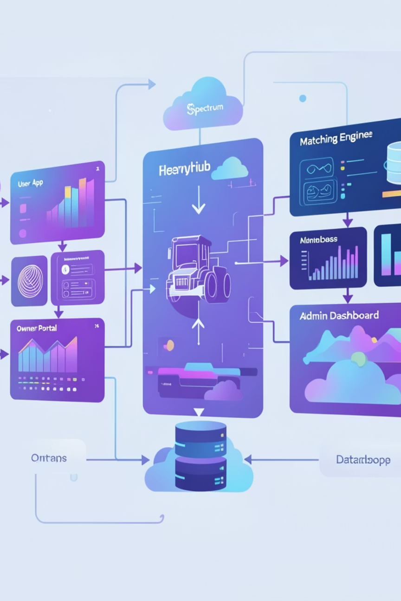





System Architecture
User App
Booking interface and live equipment tracking
Owner Portal
List vehicles and manage availability
Matching Engine
Smart pricing and demand pairing
Admin Dashboard
Analytics and system monitoring
Notes:
9

Slide 10
SWOT Analysis
Strengths
Opportunities
Solves genuine rural equipment access problem
Scalable platform architecture with growth potential
Asset-light business model reduces capital requirements
IoT-enabled monitoring increases trust
Growing agri-tech market with increasing adoption
Government support schemes for farmers
Expansion to construction and infrastructure sectors
Partnerships with equipment manufacturers
Weaknesses
Threats
Logistics complexity in rural areas
Network dependency in low-connectivity regions
Operator training and quality control challenges
Local unorganised rental competitors
Trust and maintenance concerns
Potential imitation by larger players
Notes:
10

Slide 11




Market Feasibility
TARGET AUDIENCE
MARKET DEMAND
COMPETITION
Farmers
Contractors
Equipment owners
Increasing need for affordable mechanization
Rapid growth in agri-tech startups
Fragmented local rentals
No dominant digital platform
Huge gap in organized marketplace
Notes:
11

Slide 12






Financial Viability
Revenue Model
Cost Factors
Commission per booking
Subscription for owners
Platform development
Marketing & onboarding
Premium features (analytics, priority listing)
Maintenance support
Notes:
12

Slide 13




Future Scope
AI-based demand prediction
Predictive maintenance
Loan/EMI integration for owners
Expansion to logistics & mining sector
Notes:
13

Slide 14



Conclusion
Solves a real, large-scale problem
Bridges gap between supply and demand
Scalable across India
"Empowering farmers through accessible technology"
Notes:
14

Slide 15



Call to Action
We need:
Technical mentorship
Initial funding
Field partnerships
Notes:
15

Slide 16

Thank You
Driving the future of agriculture and infrastructure
Notes:
16

