Slide 1

EMPLOYEE
MANAGEMENT
SYSTEM

Slide 2

DEPARTMENT OF INFORMATION TECHNOLOGY
SHAH & ANCHOR KUTCHHI ENGINEERING COLLEGE
CHEMBUR , MUMBAI - 400088. 2021-22
Title : Employee Management System by Class – SE 5
Student Names | Roll No.
VIKAS GUPTA | 16
VIBHUTI KHOT | 30
SARTHAK PEDNEKAR | 48
YOGESH TIWARI | 60
Under the guidance of,
Mr. Manish Bhelande and Ms. Vaishali korade

Slide 3
Introduction
Employee management system is a project which aims in developing a computerized system to maintain all the daily work of Employees.
It has a facility of admin login through which the admin can monitor the whole system.
Admin modules are add new employee , update employee and delete employee.
Overall this project of ours is being developed to help the company to maintain the employee’s information in the best way possible and also reduce the human efforts.

Slide 4
Literature Review
Page No. | Paper Name | Publication year | Author | Methodology
1 | Analysis of big data and cloud computing technology based on the lending library. | 2022 | Xia Zhan | The paper discuss the design help of intelligent library and purposes relevant optimization suggestions to meet the needs of different service objects
2 | Management System of Student Borrowing and Reading in University Library. | 2022 | Jiapeng Li, China | The management system realizes the library's identity authentication function for college students' readers and the realization of the corresponding management work through the identification of readers' fingerprints.

Slide 5
Problem Statement
A number of current systems lack employee self-service meaning employees are not able to access and manage their personal information directly without having to go through their HR departments or their managers.

Slide 6
Objectives
This project aims to simplify the task of maintaining record of the employees of company.
It manages all the information of particular employee and their project. The project is built at administrative end but it is accessible to administrator and employees.
The objective of this project is to provide a comprehensive approach towards the management of employee informationIt tracks all the imp details about the employee.
Expanded Accuracy and Delicacy.

Slide 7
SOFTWARE USED
Python IDLE and Notepad
MySQL

Slide 8
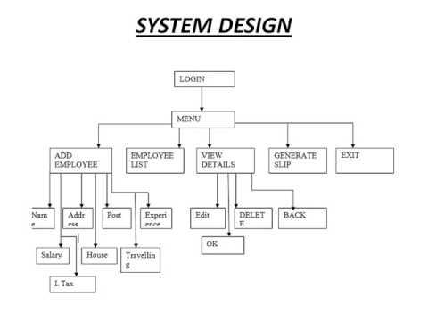
DATA FLOW DIAGRAM

Slide 9
USE CASE DIAGRAM
An actor could be the end-user of the system or an external system.
Use case diagram consists of use cases and actors and shows the interaction between them. The key points are:
The main purpose is to show the interaction between the use cases and the actor
To represent the system requirement from user's perspective.
The use cases are the functions that are to be performed in the module.

Slide 10
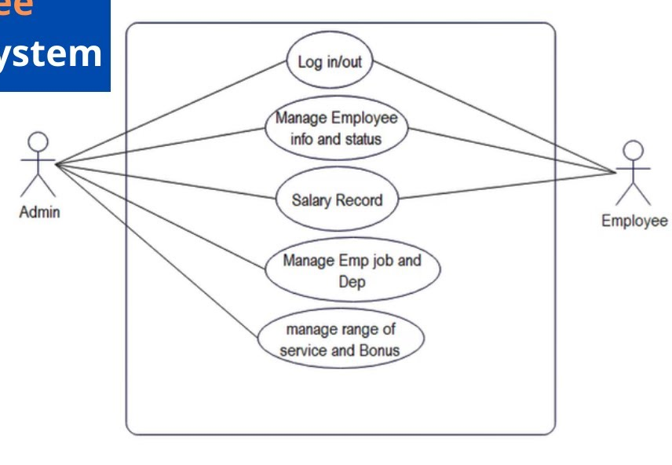
USE CASE DIAGRAM

Slide 11
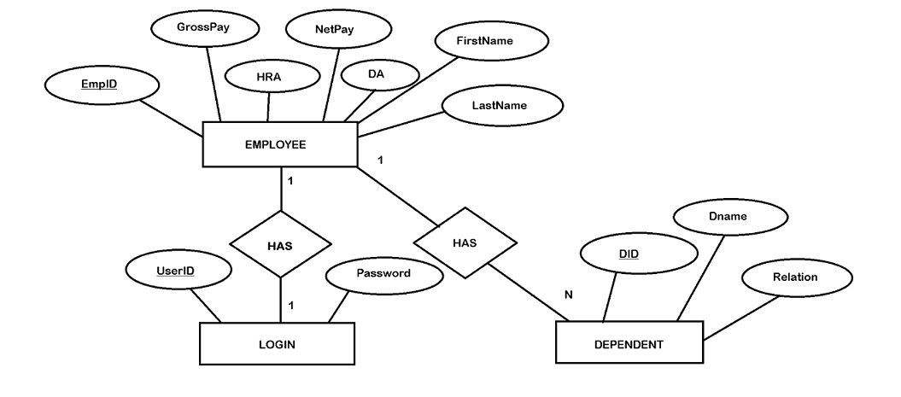
ER DIAGRAM

Slide 12
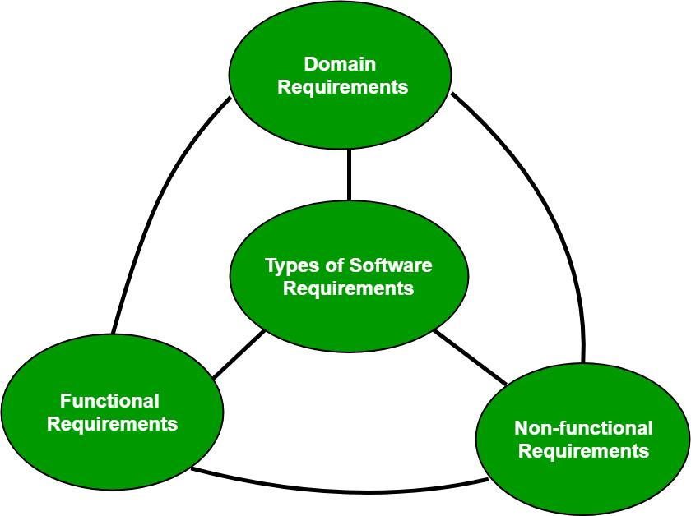
Requirements of Software
This project is been developed with the help of Python in frontend and MySQL as backend.
So for code in Python we used python IDLE and notepad, it need system with minimum Pentium 2 266 MHz processor.
And for SQL it need My sql workbench in system with Intel Core or Xeon 3GHz processor.

Slide 13
Advantages
1. Simple & Easy to Use 2. Improved engagement and productivity
3. Highly Secure, Scalable & Reliable 4. Innovation 5. Safe and centralized employee data 6. Cost-effective 7. Error-free

Slide 14
Conclusion
The project entitled “Employee Management System" is developed using Python Tkinter as front end and Mysql database in back end to computerize the process of online management of employees. This project covers only the basic features required.

Slide 15
Future Scope
This desktop application involves almost all the basic features of the Employee management.
The future implementation will help for the employees and chatting with website administrator.

Slide 16
Result
Note:(take Screen shots of your outputs)

Slide 17
REFERENCES
• www.java.sun.com/docs/books/tutorial
• Kathy Sierra book
• Wrox Professional Java
• www.javatpoint.com

Slide 18

THANK YOU
Thank You

