Slide 1
Understanding ARM Instruction Set Architecture (ISA) using ARM Simulator
Dr. Hari T.S. Narayanan
Notes:
Pre-requisite: A good understanding of one of the processor architecture!
Objective of this presentation is two fold:
Learn ARM ISA
Learn to write code with ARM ISA

Slide 2
Pre-Requisite
High School Computer Science
  Arithmetic and Logic Unit (ALU)
  Memory, Registers
  C Programming
  Compiler
  Assembly Level Language
  Assembler
  Machine Code

Slide 3
Importance of Instruction Set
Computer Organization course presents the design and development of Computing components (Memory, ALU, I/O Ports, Bus, etc)
Computer Architecture course on the other hand
  Defines the interfaces between various components within a Processor
  Defines programmers’ interface to a Processor using Instruction Set Architecture (ISA)
Notes:
High end Programmers who develop compilers, Kernels, Drivers, VMs, Interpretters, libraries, performance enhancing codes

Slide 4
The ARM Instruction Set Architecture
Most of this material is taken from ARM University
Why ARM ISA in Computer Organization Course; that too at the start?

Slide 5
Advanced RISC Machine (ARM)
ARM family includes 8/16/32/64 bits processors
Different versions of ARM processors share the same machine Instruction Set
We will be studying 32-bit ARM processor using a ARM Simulator application, ARMSim#
ARMSim# © R. N. Horspool, W. D. Lyons, M. Serra Department of Computer Science, University of Victoria – Why ARMSIM#?
Notes:
A32 (or ARM): a 32-bit fixed length instruction set, enhanced through the different architecture variants. Part of the 32-bit architecture execution environment now referred to as AArch32.
T32 (Thumb) introduced as a 16-bit fixed-length instruction set, subsequently enhanced to a mixed-length 16- and 32-bit instruction set on the introduction of Thumb-2 technology. Part of the 32-bit architecture execution environment now referred to as AArch32.
A64 is a 64-bit fixed-length instruction set that offers similar functionality to the ARM and Thumb instruction sets. Introduced with ARMv8-A, it is the AArch64 instruction set.

Slide 6
Main features of the ARM Instruction Set
All instructions are 32 bits long.
ARM processor supports 8/16/32/64 bits data values
ARM processor executes instructions in a 3-Stage pipeline.
Most of the ARM instructions executed in a single cycle.
Every instruction can be conditionally executed.
ARM uses load/store architecture (Register-Register Architecture)
Notes:
All instructions are 32 bits long. ARM processor supports 8/16/32/64 bits data values
ARM processor executes instructions in a 3-Stage pipeline.
Most of the ARM instructions executed in a single cycle.
Every instruction can be conditionally executed.
ARM uses load/store architecture
Data processing instructions act only on registers (Register-Register Architecture)
3-operand format
Combined ALU and barrel shifter for high speed bit manipulation
Specific memory access instructions with powerful auto-indexing addressing modes.
32 bit and 8-bit data types and also 16-bit data types on ARM Architecture v4.
Flexible multiple register load and store instructions

Slide 7
Interrupt, Interrupt Handling, and Polling
In program in execution can be Interrupted by an I/O device or a Timer
CPU suspends the current program*, handles the Interrupting I/O
Once the I/O is completed CPU continues with the suspended program
The interrupt handling itself can be Interrupted by another higher priority I/O device
Interrupt Handler is the piece of code that process the I/O or timer
Interrupt is an efficient alternative to Polling or Busy waiting
Interrupt is not the only thing that can alter the flow of execution of a program

Slide 8
Processor Modes
The ARM has six operating modes:
  User (unprivileged mode under which most tasks run)
  FIQ (entered when a high priority (fast) interrupt occurs)
  IRQ (entered when a low priority (normal) interrupt occurs)
  Supervisor (entered on reset and when a Software Interrupt instruction is executed)
  Abort (used to handle memory access violations)
  Undef (used to handle undefined instructions)
Notes:
Why modes: Multiple modes are created to enable different behaviour of the Microprocessor with minimum delay. Simply by changing the mode to Supervisory mode, certain privileged instructions could be executed. If different modes were not there such execution will invoice too much overhead!
Use Multipurpose furniture as an example to explain the modes of a processor

Slide 9
Addressing
ARM includes capability to address byte, half word, and full word (32 bits)
ARM instructions are always 32 bits in size, data can be of 8/16/32 bits
This means, addresses of instructions start from 0 and increase in steps of 4
Instructions are loaded from Word boundary – Instruction Offset
Default Instruction offset is 0
Program Counter is initialized to 0 when the processor is reset
The least significant 2 -bits of Program Counter are always 0
This reduces the number of bits required to store address and address offset of instructions

Slide 10
Registers
Registers are high speed and low capacity (8/16/32, …) memory
ALU operates on data in Data Registers –r0, r1,…, r12
There are other special purpose Registers; each with specific role
Examples: Program Counter (PC); Process Status Register (PSR)
Register File and Register banks are physical and logical grouping of Registers respectively
ARM supports 37 Registers in all

Slide 11







Register Banks
37 Registers
r0-r12,sp-um, lr-um, pc, cpsr
r0-r12, sp-sm, lr-sm, pc, cpsr, spsr-sm
18 General Purpose Registers: r0 – r12, r8fm-r12fm (fm stands of FIQ Mode)
1 Program Counter: pc
6 Stack Pointer (sp): sp-xx
6 Link Register (lr): lr-xx
1 Current Program Status Register: cpsr
5 Saved Program Status Register: spsr-xx
User mode (um)
Bank – 17 regs
Supervisor mode (sm)
Bank – 18 regs
r0-r7, r8fm-r12fm, sp-fm, lr-fm, pc, cpsr, spsr-fq
r0-r12,sp-nm, lr-nm, pc, cpsr, spsr-nm
FIQ mode (fm)
Bank – 18 regs
Undefined mode (nm)
Bank – 18 regs
r0-r12, sp-im, lr-im, pc, cpsr, spsr-im
r0-r12,sp-am, lr-am, pc, cpsr, spsr-am
IRQ mode (im)
Bank – 18 regs
Abort mode (am)
Bank – 18 regs
6 Register Banks
Notes:
This slide shows the registers visible in each mode - basically in a more static fashion than the previous animated slide that is more useful for reference.
The main point to state here is the splitting of the registers in Thumb state into Low and High registers.
ARM register banking is the minimum necessary for fast handling of overlapping exceptions of different types (e.g. ABORT during SWI during IRQ). For nested exceptions of the same type (e.g. re-entrant interrupts) some additional pushing of registers to the stack is required.

Slide 12
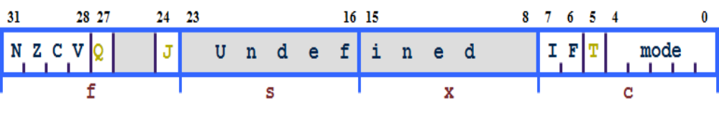
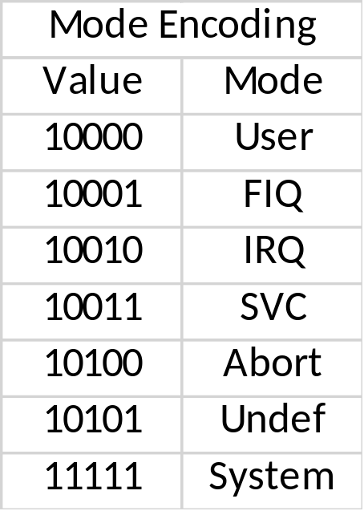
Program Status Registers (PSR)
Condition code flags
  N = Negative result from ALU
  Z = Zero result from ALU
  C = ALU operation Carried out
  V = ALU operation oVerflowed
Interrupt Disable bits.
  I = 1: Disables the IRQ.
  F = 1: Disables the FIQ.
Mode bits
  Specify the processor mode
Carry versus overflow!
Notes:
Green psr bits are only in certain versions of the ARM architecture
ALU status flags (set if "S" bit set, implied in Thumb state).
Sticky overflow flag (Q flag) is set either when
saturation occurs during QADD, QDADD, QSUB or QDSUB, or
the result of SMLAxy or SMLAWx overflows 32-bits
Once flag has been set can not be modified by one of the above instructions and must write to CPSR using MSR instruction to cleared
PSRs split into four 8-bit fields that can be individually written:
Control (c) bits 0-7
Extension (x) bits 8-15 Reserved for future use
Status (s) bits 16-23 Reserved for future use
Flags (f) bits 24-31
Bits that are reserved for future use should not be modified by current software. Typically, a read-modify-write strategy should be used to update the value of a status register to ensure future compatibility. Note that the T/J bits in the CPSR should never be changed directly by writing to the PSR (use the BX/BXJ instruction to change state instead).
However, in cases where the processor state is known in advance (e.g. on reset, following an interrupt, or some other exception), an immediate value may be written directly into the status registers, to change only specific bits (e.g. to change mode).
New ARM V6 bits now shown.

Slide 13
Hands-on Exercises
Copy ARM Simulator (Armsim#) folder
Install ARM Simulator
Check if the Simulator installed correctly
Start the simulator
Load a sample program (test.s)
Explore the features of the Simulator

Slide 14
Ex 1: Installing ARMSim
Install ARMSim 1.91 from ARMSim folder that you copied from my public folder
Note: This simulator (Windows, Linux and Mac versions available) can also be downloaded from: http://armsim.cs.uvic.ca/Downloads.html.
Override your Anti-virus, if the download fails for some reason
The file is about 1300 KB
Follow the default install options. ARMSim installs in few seconds.
The Simulator is installed in “C:/Program Files (x86)/University of Victoria”
There will be short cut installed on your desktop
Launch the simulator to validate your installation

Slide 15
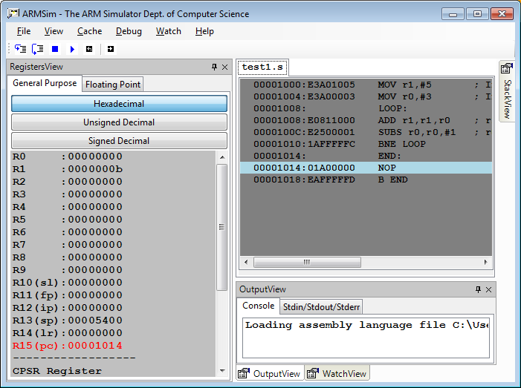
Ex 2: Understanding ARM Simulator UI
Once you successfully launch ARM Simulator
Go to “File” menu and using “Load” option, load test1.s file
Note: If the test.s is not loaded it will not be possible to view the register contents.
Views
Registers
Instructions & Instruction Encoding
Menu items (Note: Watch & Cache later)
Register
View
Code View
Output
View
Notes:
SL Register R10 Stack Limit Register
FP Register R11 Frame Pointer Register
IP Register R12 Index Pointer?

Slide 16
Ex 3: User Mode Bank Registers
Observe the contents of r0 (R0) to r12 (R12)
R13 is Stack Pointer (SP)
R14 is Link Register (LR)
R15 is Program Counter (PC)
Current Process Status Register (CPSR) is shown with its bit map
Correlate R15 (PC) content with Code View instruction address, and memory content in memory view

Slide 17
Exception Handling
Exceptions are events that interrupt the flow of currently running program
Exceptions are handled by exception specific code
This code is loaded (context Switched) and given control after completing the current instruction.
The Context Switching is realized by h/w (processor core)
Vector table is an important data structure used in Context Switching
Some Exceptions are: I/O and Timer Interrupts, Reset, SWI

Slide 18
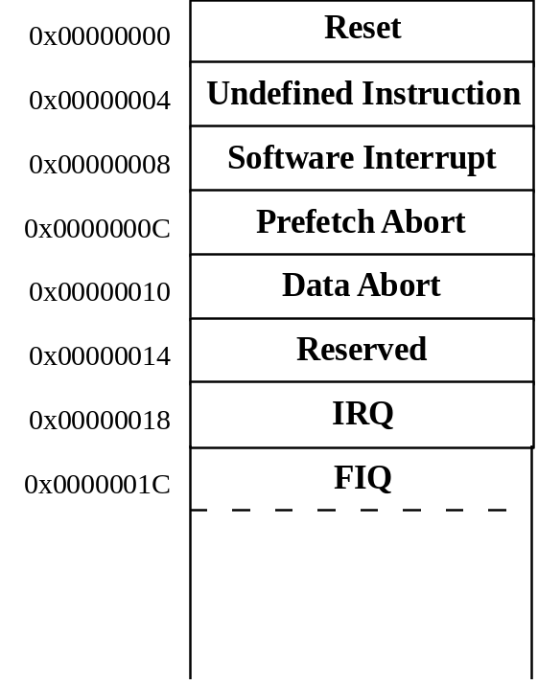
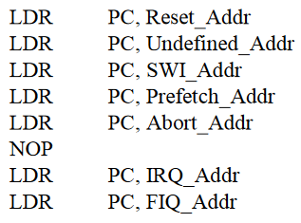
Exception Handling and the Vector Table
When an exception occurs, the core:
  Copies CPSR into SPSR_<mode>
  Sets appropriate CPSR bits (especially the mode)
  Maps in appropriate banked registers
  Stores the “return address” in LR_<mode>
  Sets PC to vector address
    For instance for Software Interrupt PC is set to 0x00000008
To return, exception handler (sw) needs to:
  Restore CPSR from SPSR_<mode>
  Restore PC from LR_<mode>
http://osnet.cs.nchu.edu.tw/powpoint/Embedded94_1/Chapter%207%20ARM%20Exceptions.pdf
Notes:
LDR versus MOV
MOF immediate operands are limited to 8 bit value
LDR immediate operand can be full size (16/32 bits) depending upon the ARM Processor
Values from memory can be moved to Register with LDR
MOV is restricted to move between registers
SPSR – Stored Program Status Register
Exceptions, in order serviced, are:
Reset - supervisor mode
Data abort - abort mode
External Fast Interrupt Request - FIQ mode (eg DMA)
External Interrupt Request - IRQ mode
Instruction Prefetch abort - abort mode
Software Interrupt (SWI)- supervisor mode (typically used to extend operating system)
Undefined instruction - undefined mode
Only one memory location for each vector
Each vector contains branch to that particular exception handler
FIQ vector is last one. This allows its handler to be run sequentially from that address, removing need for branch and its associated delays. Important because speed is essential for FIQ.
Interrupt routine’s responsibility to clear interrupt condition.
Can return using one instruction
See exception handling module for details.

Slide 19
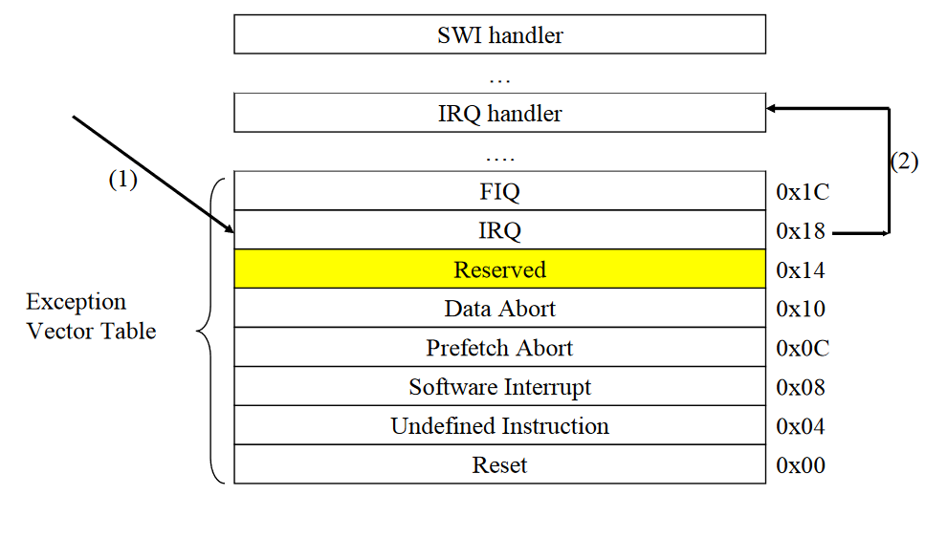
Memory Map
Memory map describes how the memory is organized
  Where the Vector Table is
  Where the handlers are
  Where OS tables are
  Where the user programs are loaded
…

Slide 20
Branching to Absolute Address
Load the PC with the absolute address of the instruction to be executed!
This could be done only in certain modes – example SWI (Supervisory)
Example:
  ldr pc, = 0X3000

Slide 21
The Instruction Pipeline
In order to increase the instruction throughput ARM uses a 3-stage pipeline
PC points to the instruction being fetched, rather than pointing to the instruction being executed.
Note: This will impact the relative addressing
Instruction fetched from memory
PC
FETCH
1000
PC - 4
996
DECODE
Decoding of registers used in instruction
Register(s) read from Register Bank
Shift and ALU operation
Write register(s) back to Register Bank
PC - 8
EXECUTE
992
Notes:
Each instruction is one word (or 32 bits)
Thus each stage in pipeline is one word
In other words 4 bytes, hence the offsets of 4 and 8 used here.
Most instructions execute in a single cycle
Helps to keep the pipeline operating efficiently - only stalls if executing instruction takes several cycles.
Thus every cycle, processor can be loading one instruction, decoding another, whilst executing a third.
Typically the PC can be assumed to be current instruction plus 8
Cases when not case include
When exceptions taken the address stored in LR varies - see Exception Handling module for more details.
When PC used in some data processing operations value is unpredictable - see datasheet

Slide 22
Branching Instruction with Offset
The ARM supports B(ranch) instructions with offset address (rather than absolute address)
The target address to branch is computed at execution using an offset (actual offset*4) & Program Counter (PC) Value:
target address = PC + offset x 4;
= (branch instruction address + 8) + (offset << 2 )
Similarly the offset address can be computed from target and branch instruction address as follows:
Offset = (target address – PC) / 2
  = (target address - (branch instruction address +8)) >> 2
AND R1, R2
PC
FETCH
PC - 4
ADD R1, R2
DECODE
B +10
EXECUTE
PC - 8
Notes:
1000 BR 1048 Relative Address
Offset = (Target – PC) << 2
Offset = (Target – (PC+8)) << 2
Offset = (1048 – 1008) << 2 = 10
1000 BR 400 Relative Address
Offset = (Target – PC) << 2
Offset = (Target – (PC+8)) << 2
Offset = (400 – 1008) = -608 << 2 = -152
Each instruction is one word (or 32 bits)
Thus each stage in pipeline is one word
In other words 4 bytes, hence the offsets of 4 and 8 used here.
Most instructions execute in a single cycle
Helps to keep the pipeline operating efficiently - only stalls if executing instruction takes several cycles.
Thus every cycle, processor can be loading one instruction, decoding another, whilst executing a third.
Typically the PC can be assumed to be current instruction plus 8
Cases when not case include
When exceptions taken the address stored in LR varies - see Exception Handling module for more details.
When PC used in some data processing operations value is unpredictable - see datasheet

Slide 23
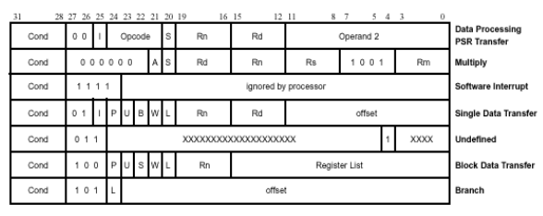
Instruction Encoding for Some ARM Instruction Types
Immediate Operand Bit
(24 bits)
31
28
8
4
0
CPSR
N
Z
C
V
I F T
Mode
Notes:
Every instruction can be conditionally executed

Slide 24
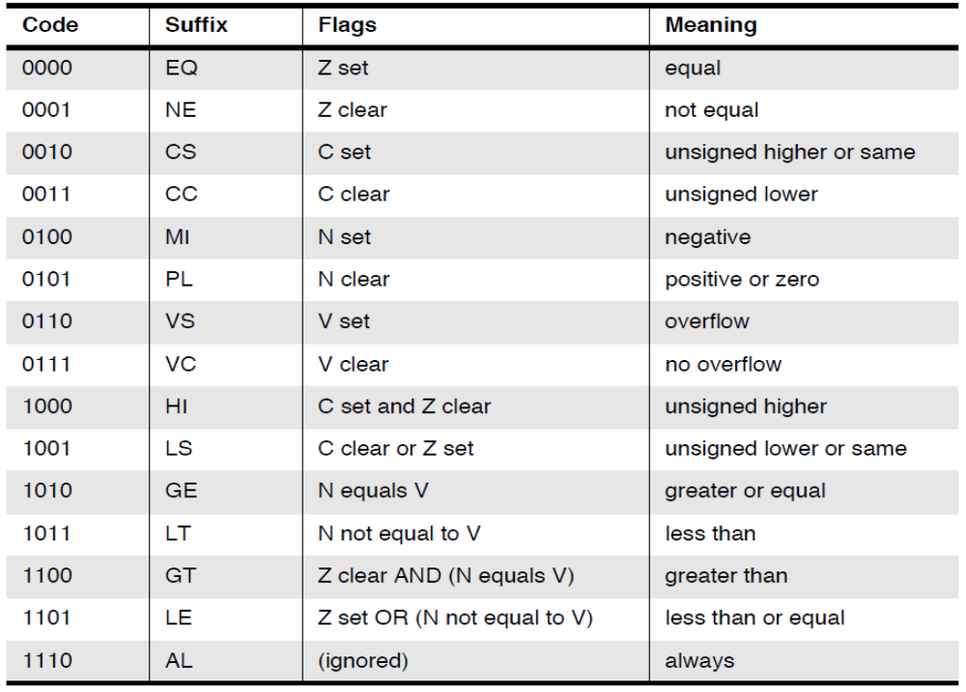
The CPSR and Condition Field
31
28
8
4
0
CPSR
N
Z
C
V
I F T
Mode
Notes:
4 bit Condition Field refers to the values of the appropriate bits in the CPSR, as indicated on slide.
Most instructions assembled with default condition code "always" (1110, AL).
This means the instruction will be executed irrespective of the flags in CPSR.
The "never" code (1111, NV) is reserved.
This family of conditions will be redefined for future use in other ARM devices.
Use MOV r0, r0 as NOP operation.
Conditional instructions aids code density
remove need for many branches (discussed earlier)

Slide 25
Conditional Execution
Most processors allow only branches to be executed conditionally.
However by reusing the condition evaluation hardware, ARM effectively increases number of instructions.
  All instructions contain a condition field which determines whether the CPU will execute them.
  Non-executed instructions soak up 1 cycle.
    Still have to complete cycle so as to allow fetching and decoding of following instructions.
This removes the need for many branches, which stall the pipeline (3 cycles to refill).
  Allows very dense in-line code, without branches.
  The Time penalty of not executing several conditional instructions is frequently less than overhead of the branch or subroutine call that would otherwise be needed.

Slide 26
Using and updating the Condition Field
To execute an instruction conditionally, simply postfix it with the appropriate condition:
  For example an add instruction takes the form:
    ADD r0,r1,r2 ; r0 = r1 + r2 (ADDAL)
  To execute this only if the zero flag is set:
    ADDEQ r0,r1,r2 ; If zero flag set then r0 = r1 + r2
By default, data processing operations do not affect the condition flags (apart from the comparisons where this is the only effect).
To cause the condition flags to be updated, the S bit of the instruction needs to be set by postfixing the instruction (and any condition code) with an “S”.
  For example to add two numbers and set the condition flags:
    ADDS r0,r1,r2 ;
    r0 = r1 + r2 ; ... and set flags

Slide 27
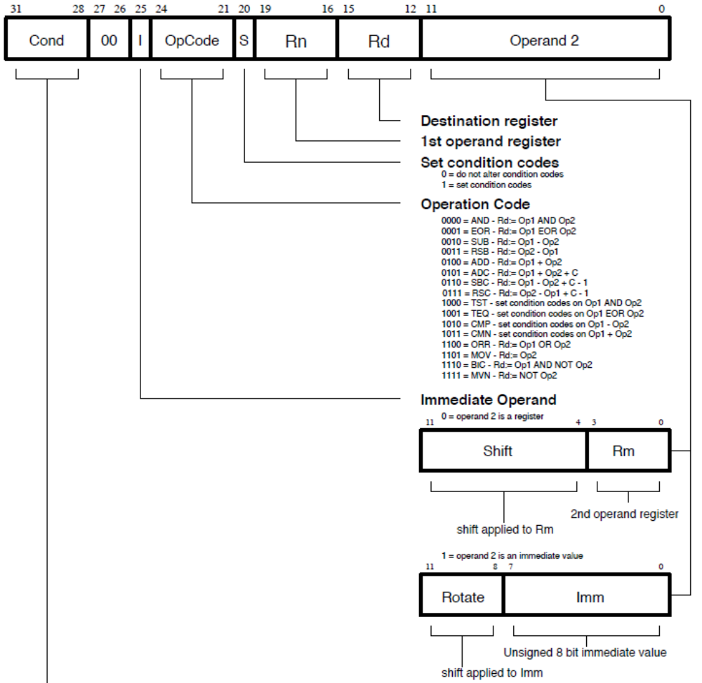
 Ex 4: PC, Address, Memory & Instruction
Add r1, r1, r0
Binary representation of the above Add instruction
1110 00 0 0100 0 0001 0001 00000000 0000
Notes:
Note:
For Shift, no immediate operand – Rn, Rd, Rm
For rotate, there is no 2nd operand – Only operand 1 and Destination registers

Slide 28
Branch instruction
B{<cond>} label ; versus Branch with Link
The offset for branch instructions is calculated by the assembler:
  By taking the difference between the target instruction and the branch instruction address minus 8 (to allow for the pipeline). Then right shift the result by 2 positions.
  This gives a range of ± 32 Mbytes.
40
BEQ 100
44
31
28
27
25
24
23
0
48
Cond 1 0 1 L Offset
Link bit 0 = Branch
1 = Branch with link
Condition field
100
-------
104
…
Notes:
Branch instructions are PC-relative rather than absolute:
Branch instructions’ encoding contain a signed 2's complement 24 bit offset which is calculated by the assembler from the destination label given in the source code.

Slide 29
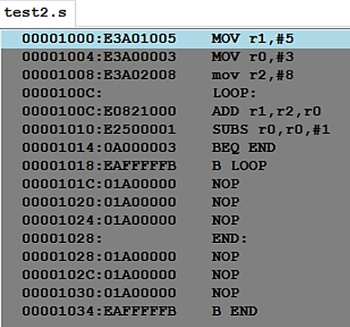
Ex 6: Branch Example (Forward Branch) 
The target address to branch is computed as a function offset address with respect to Program Counter (PC) Value
target address
= PC + offset*4
= (branch instruction address + 8) + (offset << 2 )
Similarly the offset address can be computed from target and branch instruction addresses as follows:
  offset
  = (target address – PC) >> 2
  = (target address - (branch instruction address +8)) >> 2
Branch Instruction address: 0x1010; Target Address: 0x1024
  Offset = ?; From offset compute Target Address
  Now using this offset and Branch instruction address find target address
Note: use test2.s
Test2.s
Notes:
+100 bytes from current instruction

Slide 30
Ex 7: Branch Example (Backward Branch) 
The target address to branch is computed as a function offset address with respect to Program Counter (PC) Value
target address
= PC + (offset address)
= (branch instruction address + 8) + (offset << 2 )
Similarly the offset address can be computed from target and branch instruction addresses as follows:
  offset
  = (target address – PC) << 2
  = (target address - (branch instruction address +8)) >> 2
Branch Instruction address: 0x1014; Target Address: 0x1008
  Offset = ?; From offset compute Target Address
  Now using this offset and Branch instruction address find target address
Notes:
+100 bytes from current instruction

Slide 31
Branch instruction with Link
Branch with Link : BL{<cond>} sub_routine_label
40
CALL 100
44
48
31
28
27
25
24
23
0
Cond 1 0 1 L Offset
Link bit 0 = Branch
1 = Branch with link
Condition field
100
-------
104
Sub-
Routine
…
RET
Notes:
Offset computation is similar to Branch instruction
Additionally, the "Branch with link" instruction implements a subroutine call by writing PC-4 into the LR of the current bank.
To return from subroutine, simply need to restore the PC from the LR:
The "Branch" instruction does not affect LR.
Branch instructions are PC-relative rather than absolute:
Branch instructions’ encoding contain a signed 2's complement 24 bit offset which is calculated by the assembler from the destination label given in the source code.

Slide 32
Data processing Instructions
Largest family of ARM instructions, all sharing the same instruction format.
Contains:
  Arithmetic operations
  Comparisons (no results - just set condition codes)
  Logical operations
  Data movement between registers
Remember, this is a load / store architecture
  These instruction only work on registers, NOT memory.
They each perform a specific operation on one or two operands.
  First operand always a register - Rn
  Second operand sent to the ALU via barrel shifter.
We will examine the barrel shifter shortly.

Slide 33
Arithmetic Operations
Operations are:
  ADD operand1 + operand2 ; operand1 is Rn
  ADC operand1 + operand2 + carry
  SUB operand1 - operand2
  SBC operand1 - operand2 + carry -1
  RSB operand2 - operand1
  RSC operand2 - operand1 + carry - 1
Syntax:
  <Operation>{<cond>}{S} Rd, Rn, Operand2 ; Rd is destination register
Examples
  ADD r0, r1, r2
  SUBGT r3, r3, #1
  RSBLES r4, r5, #5
Notes:
Usage
The ADD instruction adds the values in Rn and Operand2.
The SUB instruction subtracts the value of Operand2 from the value in Rn.
The RSB (Reverse SuBtract) instruction subtracts the value in Rn from the value of Operand2. This is useful because of the wide range of options for Operand2.
You can use ADC, SBC, and RSC to synthesize multiword arithmetic (see Multiword arithmetic examples).
The ADC (ADd with Carry) instruction adds the values in Rn and Operand2, together with the carry flag.
The SBC (SuBtract with Carry) instruction subtracts the value of Operand2 from the value in Rn. If the carry flag is clear, the result is reduced by one.
The RSC (Reverse Subtract with Carry) instruction subtracts the value in Rn from the value of Operand2. If the carry flag is clear, the result is reduced by one.
In certain circumstances, the assembler can substitute one instruction for another. Be aware of this when reading disassembly listings. See Instruction substitution for details.
Condition flags

Slide 34
Comparisons
The only effect of the comparisons is to
  UPDATE THE CONDITION FLAGS. Thus no need to set S bit.
Operations are:
  CMP operand1 - operand2, but result not written
  CMN operand1 + operand2, but result not written
  TST operand1 AND operand2, but result not written; Bitwise AND
  TEQ operand1 EOR operand2, but result not written; Bitwise EXOR
Syntax:
  <Operation>{<cond>} Rn, Operand2
Examples:
  CMP r0, r1
  TSTEQ r2, #5

Slide 35
Logical Operations
Operations are:
  AND operand1 AND operand2
  EOR operand1 EOR operand2
  ORR operand1 OR operand2
  BIC operand1 AND NOT operand2 [Bit Clear when operand2 = opearand1]
Syntax:
  <Operation>{<cond>}{S} Rd, Rn, Operand2 ; Rd ← Rn op Operand2
Examples:
  AND r0, r1, r2
  BICEQ r2, r3, #7
  EORS r1,r3, r0

Slide 36
Data Movement
Operations are:
  MOV Rd, operand2
  MVN Rd, NOT operand2
Note that these instruction make no use of operand1.
Syntax:
  <Operation>{<cond>}{S} Rd, Operand2
Examples:
  MOV r0, r1
  MOVS r2, #10
  MVNEQ r1, #0

Slide 37
The Barrel Shifter
The ARM doesn’t have actual shift instructions.
Instead it has a barrel shifter which provides a mechanism to carry out shifts as part of other instructions with second operand
Barrel shifter performs shift operations faster than regular shifter
So what operations does the barrel shifter support?

Slide 38
Barrel Shifter - Left Shift
Shifts left by the specified amount (multiplies by powers of two) e.g.
  LSL #5 = multiply by 32
CF is Carry Flag bit
Logical Shift Left (LSL)
CF
Destination
0
Notes:
Effectively x 2^{n.}
bits of operand shifted left by specified number of bits.
Zeros are inserted into the right most end of the word
last bit removed from the left most end placed in carry flag (CF).
LSL #0 does nothing and is the default shift if none is specified.

Slide 39
Barrel Shifter - Right Shifts
Shift Right - Logical
Shifts right by the specified unsigned amount (divides by powers of two) e.g.
LSR #2 = divide by 4
Shift Right - Arithmetic
Shifts right (divides by powers of two) and preserves the sign bit, for 2's complement operations. e.g.
ASR #2 = divide by 4
7 | 6 | 5 | 4 | 3 | 2 | 1 | 0 | Comment
0 | 0 | 1 | 0 | 0 | 0 | 0 | 0 | Representing 32
 |  |  |  |  |  |  |  | Do LSR 1
0 | 0 | 0 | 1 | 0 | 0 | 0 | 0 | This is 16
 |  |  |  |  |  |  |  | Do LSR 1
0 | 0 | 0 | 0 | 1 | 0 | 0 | 0 | This is 8
0
0
7 | 6 | 5 | 4 | 3 | 2 | 1 | 0 | Comment
1 | 1 | 1 | 0 | 0 | 0 | 0 | 0 | Representing -32 in 2s complement
 |  |  |  |  |  |  |  | Do ASR 1
1 | 1 | 1 | 1 | 0 | 0 | 0 | 0 | This is -16 in 2s complement form
 |  |  |  |  |  |  |  | Do ASR 1
1 | 1 | 1 | 1 | 1 | 0 | 0 | 0 | This is -8 in 2s complement form
Notes:
The key difference between LSR and ASR is the retention AND right shift of sign bit.
Arithmetic Shift Left is similar: the sign bit is replicated, other bits move to their left, 0 introduced at the least significant bit.
======
LSR moves each bit of the register (Rm) to the right by the specified amount.
eg / LSR #5
all bits are moved 5 places to right (i.e. into less significant positions).
most significant positions then filled with zeros
least significant five bits of Rm are removed. The last of these five bits becomes the shifter Carry output, and may set the CPSR's C flag (when the ALU operation is in the logical class).
An LSR 0 is translated into an LSR 32, to put bit 31 of the word into the carry flag.
ASR similar to LSR except that
high bits are filled with bit 31 of Rm (the sign bit) instead of zeros.
This preserves the sign in 2's complement notation.
eg/
Divide a 2's complement number 10000010B (or -126) in Ra by 2.
MOV Ra, Ra, ASR #2
From Ra=10000010B we get RA=11000001B (or - 63)
An ASR #0 is translated into an ASR #32, to propagate bit 31 of the word into every bit in the word as well as the carry flag.

Slide 40
Barrel Shifter - Rotations
Rotate Right
Rotate Right (ROR)
• Similar to an ASR but the bits wrap around as they leave the LSB and appear as the MSB.
e.g. ROR #4
Note the last bit rotated is also used as the Carry Out.
Rotate Right Extended (RRX)
• This operation uses the CPSR C flag as a 33rd bit.
Rotates right by 1 bit. Encoded as ROR #0.
Destination
CF
Rotate Right through Carry
Destination
CF
Notes:
Rotate Right (ROR), and Rotate Right Extended (RRX) operations
used to manipulate the bits in a register without destroying those bits.
move each bit of the register (Rm) by the specified amount.
eg/ ROR #5
all bits moved 5 places to the right (i.e. into less significant positions).
However, rather than being discarded the bits shifted out are then rotated back to other high of the register
in ROR the bit previously at [0] is rotated to the MSB, [31]
In RRX - Carry flag included as a 33rd bit in the operation. Bit 0 becomes the Carry out, while the C becomes the MSB
RRX actually encoded as ROR #0
Example of use: in random number generator given in datasheet
.

Slide 41
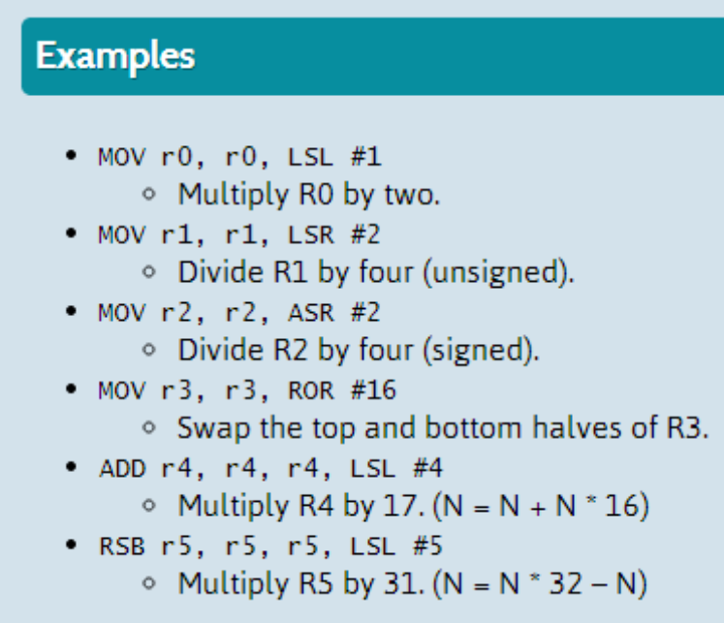
Using the Barrel Shifter: The Second Operand
Operand 1
Operand 2
Register, optionally with shift/ROR operation applied.
Shift range is 0 to 31
ROR range 2,4,6, …, 30
Barrel Shifter
Immediate value
ALU
Result

Slide 42
Ex - Using Shifted Register 
Using a multiplication instruction to multiply by a constant means first loading the constant into a register and then waiting a number of internal cycles for the instruction to complete.
A more optimum solution can often be found by using some combination of MOVs, ADDs, SUBs and RSBs with shifts.
  Multiplications by a constant equal to a ((power of 2) ± 1) can be done in one cycle.
Example: r0 = r1 * 5 ; MUL R1, R1, #5
Example: r0 = r1 + (r1 * 4)
      ADD r0, r1, r1, LSL #2
Example: r2 = r3 * 105
Example: r2 = r3 * 15 * 7
Example: r2 = r3 * (16 - 1) * (8 - 1)
 RSB r2, r3, r3, LSL #4 ; r2 = r3 * 15
 RSB r2, r2, r2, LSL #3 ; r2 = r2 * 7
Notes:
Main use for a shifted register is to provide inline multiplication (and division)
Using one or more instructions with shifted registers.
This can often be quicker than using MUL instruction, though not as flexible.
Need to know constant at compile / assemble time.
The problem of finding the optimum sequence becomes more difficult as constant becomes larger.
No known algorithm to solve this problem quickly.
C compiler restricts amount of searching it does in order to minimise impact on compile time
Has cut-off so that uses normal MUL once number of instructions used in squence passes a limit.
Sequences could otherwise become very long.

Slide 43
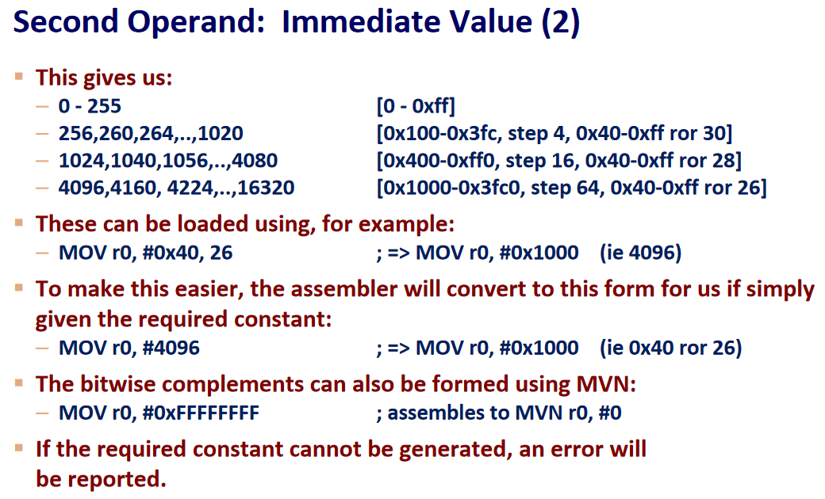
Large constants with limited size of Immediate Value
Immediate operand size is 12 bits.
Out of this, the least significant 8 bits are used for constant value
Rest of the 4 bits are used of ROR
Value 1 in these bits code ROL 2
Value 2 in these bits code ROL 4
…
Value 15 in these bits code ROL 30
Notes:
8 bits for data
4 bits for rotation – 0 to 15, 0 is 0, 1 is 2, 2 is 4, 3 is 6, and 15 is 30
Only those even numbered RORs are permitted
Note ROR 30 is same ROL (32-30) for a 32 bit register
With 8 bit immediate constants ROR of 0 we have values 0 to 255
With 8 bit immediate constants ROL of 2 we have values some overlapping values up to 63, then unique values starting from 64 (0X40) – 0x100 to 0X3FC
With 8 bit immediate constants ROL of 4 we have values some overlapping values up to 63, then unique values starting from 0X40 – 0X400 – 0Xff0
…

Slide 44
Notes 
ROR 30 is same ROL (32-30)
ROR 0 gives us constants 0 – 255 (0000 0000 to 1111 1111)
ROR 30 or ROL 2 gives constants 256, 260, … 1020 (0100 0000 to 0xFF)
ROR 28 or ROL 4 gives constants 1024, 1040, … , 4080
ROR 26 or ROL 6 gives constants 4096, 4128, … , 10208
And so on … till ROR 2

Slide 45
Load / Store Instructions
The ARM is a Load / Store Architecture:
  Does not support memory to memory data processing operations.
  Must move data values into registers before using them.
This might sound inefficient, but in practice isn’t:
  Load data values from memory into registers.
  Process data in registers using a number of data processing instructions which are not slowed down by memory access.
  Store results from registers out to memory.
The ARM has three sets of instructions which interact with main memory. These are:
  Single register data transfer (LDR / STR).
  Block data transfer (LDM/STM).
  Single Data Swap (SWP).
Notes:
All instructions other than these can only use values in registers

Slide 46
Load and Store
The memory location to be accessed is held in a base register
  STR r0, [r1] ; Store contents of r0 to location pointed to
  ; by contents of r1.
  LDR r2, [r1] ; Load r2 with contents of memory location
  ; pointed to by contents of r1.
r0
Memory
Source
Register
for STR
0x5
r1
r2
Base
Register
0x200
Destination
Register
for LDR
0x200
0x5
0x5

Slide 47
Load/Store variations & Syntax
The basic load and store instructions are:
  Load and Store Word or Byte
    LDR / STR / LDRB / STRB
ARM Architecture Version 4 also adds support for half words and signed data.
  Load and Store Half word
    LDRH / STRH
  Load Signed Byte or Half word - load value and sign extend it to 32 bits.
    LDRSB / LDRSH
All of these instructions can be conditionally executed by inserting the appropriate condition code after STR / LDR.
  e.g. LDREQB
Syntax:
  <LDR|STR>{<cond>}{<size>} Rd, <address>

Slide 48
Exercise
Write ARM code snippet that store some data in 5 consecutive half words starting from memory address 0x2000 and retrieve those 5 half words and print the content on stdout

Slide 49
Load and Store with Indexing
As well as accessing the actual location contained in the base register, these instructions can access a location offset from the base register pointer.
This offset can be
  An unsigned 12bit immediate value (ie 0 - 4095 bytes).
  A register, optionally shifted by an immediate value
This can be either added or subtracted from the base register:
  Prefix the offset value or register with ‘+’ (default) or ‘-’.
This offset can be applied:
  before the transfer is made: Pre-indexed addressing
    optionally auto-incrementing the base register, by postfixing the instruction with an ‘!’.
  after the transfer is made: Post-indexed addressing
    causing the base register to be auto-incremented.

Slide 50
Load and Store Word Pre-indexed Addressing
r0
Source
Register
for STR
Memory
Example: STR r0, [r1,#12]!
To auto-pre- increment base pointer to 0x20c use: STR r0, [r1, #12]!
To auto-pre-decrement base pointer to 0x1f4 use: STR r0, [r1,#-12]!
Immediate operand can be a shifted Register!
0x5
Offset
12
0x20c
0x5
r1
Base
Register
0x200
0x200

Slide 51
Load and Store Word Post-indexed Addressing
Example: STR r0, [r1], #12
To auto-post-increment the base register to location 0x1f4 instead use:
  STR r0, [r1], #-12
Memory
Updated
Base
Register
r1
Offset
r0
Source
Register
for STR
0x20c
12
0x20c
0x5
r1
0x200
0x5
Original
Base
Register
0x200

Slide 52
Code Snippets Pre-Indexing and Post-Indexing
Develop ARM assembly code snippet that does Pre-indexing and Post-indexing. Demonstrate this with ARM Simulator
Use Data Cache for various Block size to show how mis-rate decreases with larger block size
Also justify the hit and miss count for instruction cache

Slide 53
Swap Instructions
Atomic operation of a memory read followed by a memory write which moves byte or word quantities between registers and memory.
Syntax:
  SWP{<cond>}{B} Rd, Rm, [Rn]
Thus to implement an actual swap of contents make Rd = Rm.
The compiler cannot produce this instruction.
Interrupting an Instruction
1
Rn
temp
2
3
Memory
Rm
Rd
Notes:
Used to move a byte or word quantity from a source register (Rm) to external memory, located by base register Rn
Stores the old memory contents in the destination register (Rd).
Instruction is indivisible - LOCK output goes high to signify to an external MMU or processors that the instruction is uninterruptable.
SWP is used to implement semaphores providing a mutual exclusion between the processor and other devices trying to access memory - originally added by Acorn for use in a multiprocessor system.

Slide 54
Software Interrupt (SWI)
31
28
27
24
23
0
Cond
1 1 1 1
Comment field (ignored by Processor)
In effect, a SWI is a user-defined instruction.
It causes an exception trap to the SWI hardware vector (thus causing a change to supervisor mode, plus the associated state saving), thus causing the SWI exception handler to be called.
The handler can then examine the comment field of the instruction to decide what operation has been requested.
By making use of the SWI mechanism, an operating system can implement a set of privileged operations which applications running in user mode can request.
See Exception Handling Module for further details.

Slide 55
Exception Handling and the Vector Table
When an exception occurs, the core:
  Copies CPSR into SPSR_<mode>
  Sets appropriate CPSR bits
  Maps in appropriate banked registers
  Stores the “return address” in LR_<mode>
  Sets PC to vector address
    For instance for Undefined instruction PC is set to 0x00000008
To return, exception handler needs to:
  Restore CPSR from SPSR_<mode>
  Restore PC from LR_<mode>
Notes:
Exceptions, in order serviced, are:
Reset - supervisor mode
Data abort - abort mode
External Fast Interrupt Request - FIQ mode (eg DMA)
External Interrupt Request - IRQ mode
Instruction Prefetch abort - abort mode
Software Interrupt (SWI)- supervisor mode (typically used to extend operating system)
Undefined instruction - undefined mode
Only one memory location for each vector
Each vector contains branch to that particular exception handler
FIQ vector is last one. This allows its handler to be run sequentially from that address, removing need for branch and its associated delays. Important because speed is essential for FIQ.
Interrupt routine’s responsibility to clear interrupt condition.
Can return using one instruction
See exception handling module for details.

Slide 56
Assembler Directives
Hello: .asciz "Hello Class\n“
.equ SEG_A, 0x80
.equ Ten, 10
.set counter, 1
.set counter, counter+1
Address: .word 0
.align
Reference: https://community.arm.com/processors/b/blog/posts/useful-assembler-directives-and-macros-for-the-gnu-assembler
Notes:
To create an equate, which is a symbol that is used only while assembling your code, you can use the .equ directive:
.equ lives,3
...once the symbol is defined, its value can not be changed in the remaining part of the source code.
On the other hand –set directive allows the symbol values to be updated

Slide 57
SWI – ARMSIM Specific I/O
There are two plugins with ARMSIM
  Basic I/O Plugin
    File I/O
    Memory management
  Embest Board Plugin
    LED
    Keypad
    Buttons
    LED Number Segment
    The I/O with SWI is unique to ARMSim – this is NOT a standard practice

Slide 58
Printing a Character & a string to STDOUT 
Hello: .asciz "Hello Class!\n"
mov r0, #'1'
swi 0x00
mov r0,#':'
swi 0x00
ldr r0, =Hello
swi 0x02
End:
b End

Slide 59
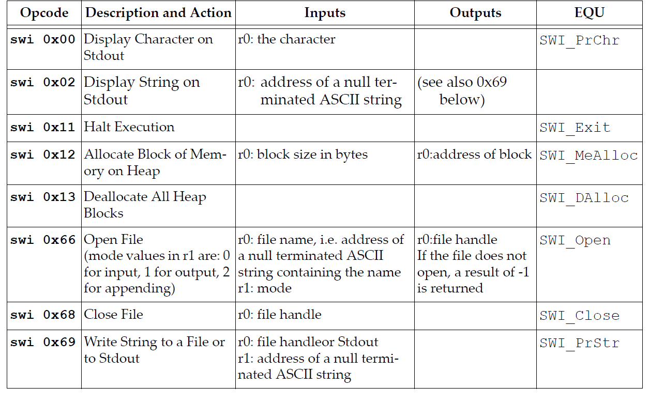
SWI Comment Field Encoding for ARMSim

Slide 60
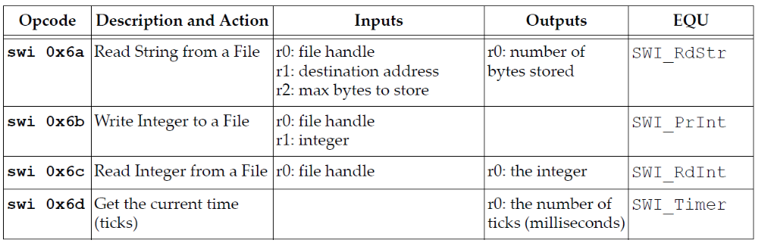
SWI Comment Field Encoding for ARMSim

Slide 61
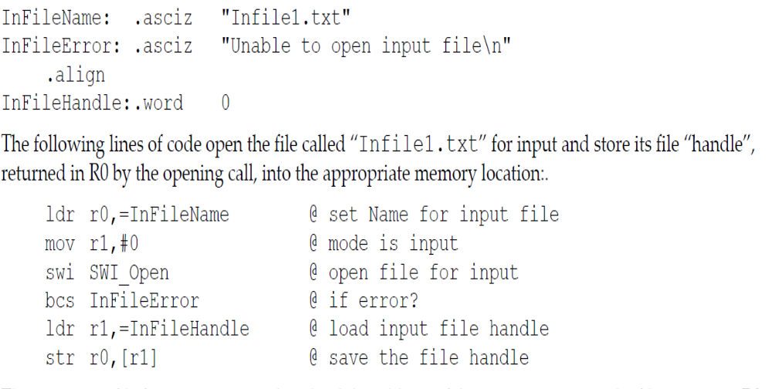
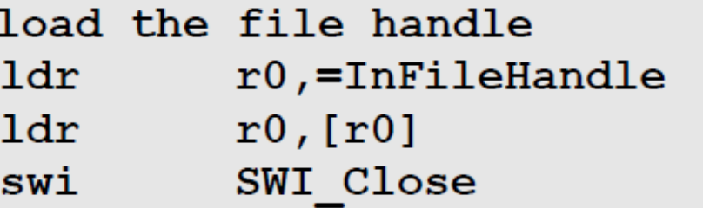
File Open & Close
File Close

Slide 62
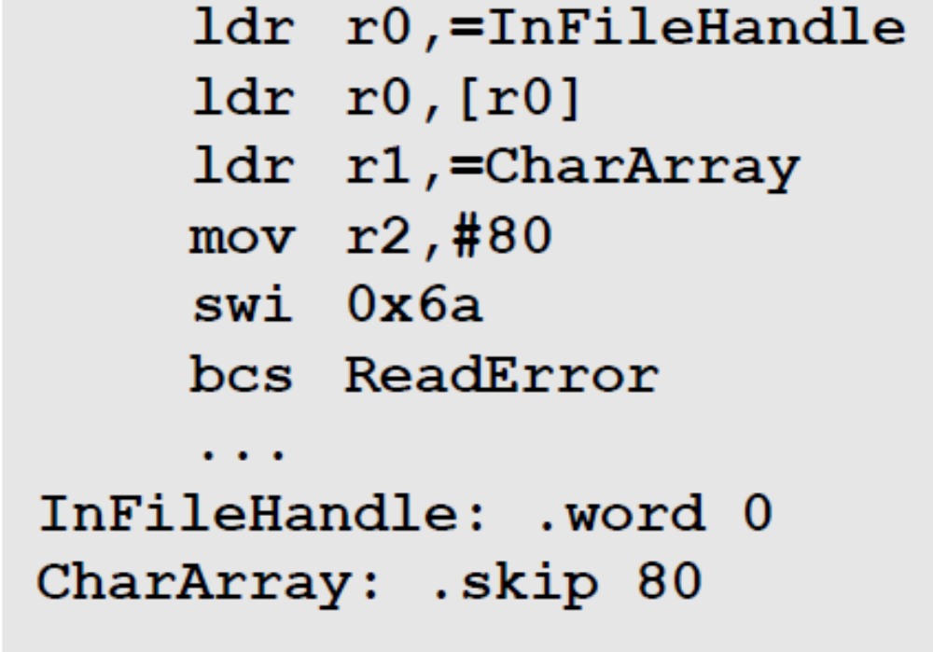
File Input

Slide 63
Exercise
Read Section 9 of ARMSim User Guide with objective to write code for Embest Board Plugin
This section will not be taught in the class – you are on your own!
A similar exercise on Cache performance measurement with ARMSIM will be given in four weeks now.

Slide 64
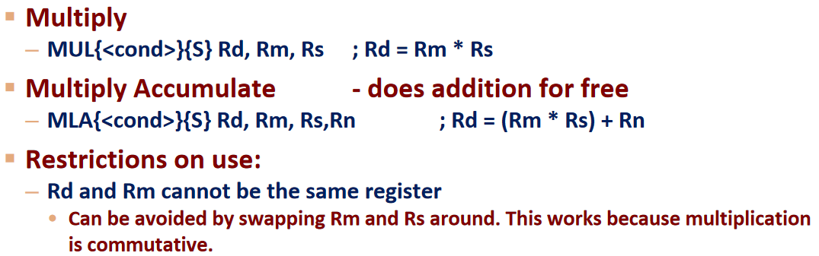
Multiplication Instruction
ARM implement Booth’s algorithm for multiplication
Long and Accumulate options are supported
Syntax for non-long multiplication:

Slide 65
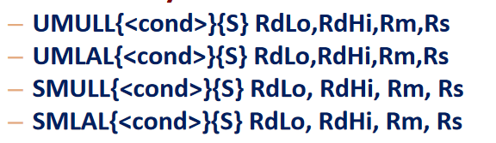
Syntax for Long Multiplication 
64 bit result
Unsigned Long and Accumulate
Signed Long and Accumulate

Slide 66
Using Link Register
start: MOV r0, #10 ; Set up parameters
MOV r1, #3
BL add ; Call subroutine
ret: …
…
…
SWI 0x11
add: ADD r0, r0, r1 ; Subroutine code
BX lr ; Return from subroutine

Slide 67
Using Stack
subroutine PUSH {r5-r7,lr} ; Push working registers and lr
; code
BL somewhere_else
; code
POP {r5-r7,pc} ; Pop working registers and pc

Slide 68
What is not discussed?
Block Transfer
Writing C code, Compiling it for ARM
ARM and Thumb coexistence

