Slide 1
The effect of marriage on Nippon Professional Baseball players’ Salaries
Econ dept.
Chang Yi-Huai
Chen Yu-chia

Slide 2
Introduction and causal inference
We would like to know whether getting married has impact on baseball players’ performance or income, and we choose Nippon Professional Baseball League as our research object.
We focus on the impact on players’ wages, and we expect that marriage would have positive impact on players’ wages.

Slide 3
Empirical method and datasets
Method : Difference-in-Differences
Fixed effext Model :
ln(Wage) = β₁TREAT_{it}+β_{DID}MAR_{it}+β₃X_{it}+α_{i}+δ_{t}+ε_{it}
Datasets : We include all NPB players’ statistics during 2014 to 2019, and we collect more than 100 players who got married during this period.

Slide 4
Treatment and Outcome Variables
The treatment variable will be whether players get married during the period in our dataset.
We also generate year dummy variables to construct the interaction term of treatment variable and year dummies. (MAR)
The coefficient of the interaction term will be our DID estimates.
The outcome variable will be the salary that players have got in the season.
We separate pitchers and fielders to estimate.

Slide 5
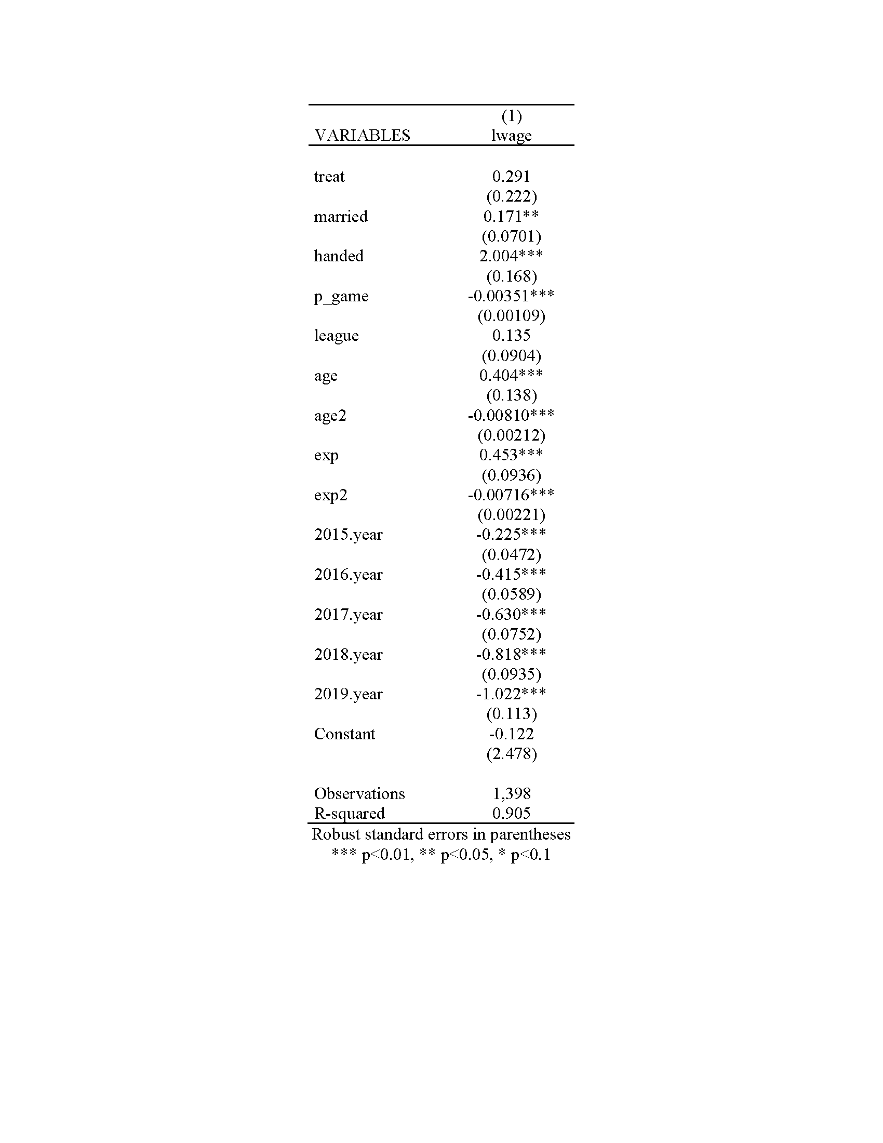
Estimate result-pitcher

Slide 6
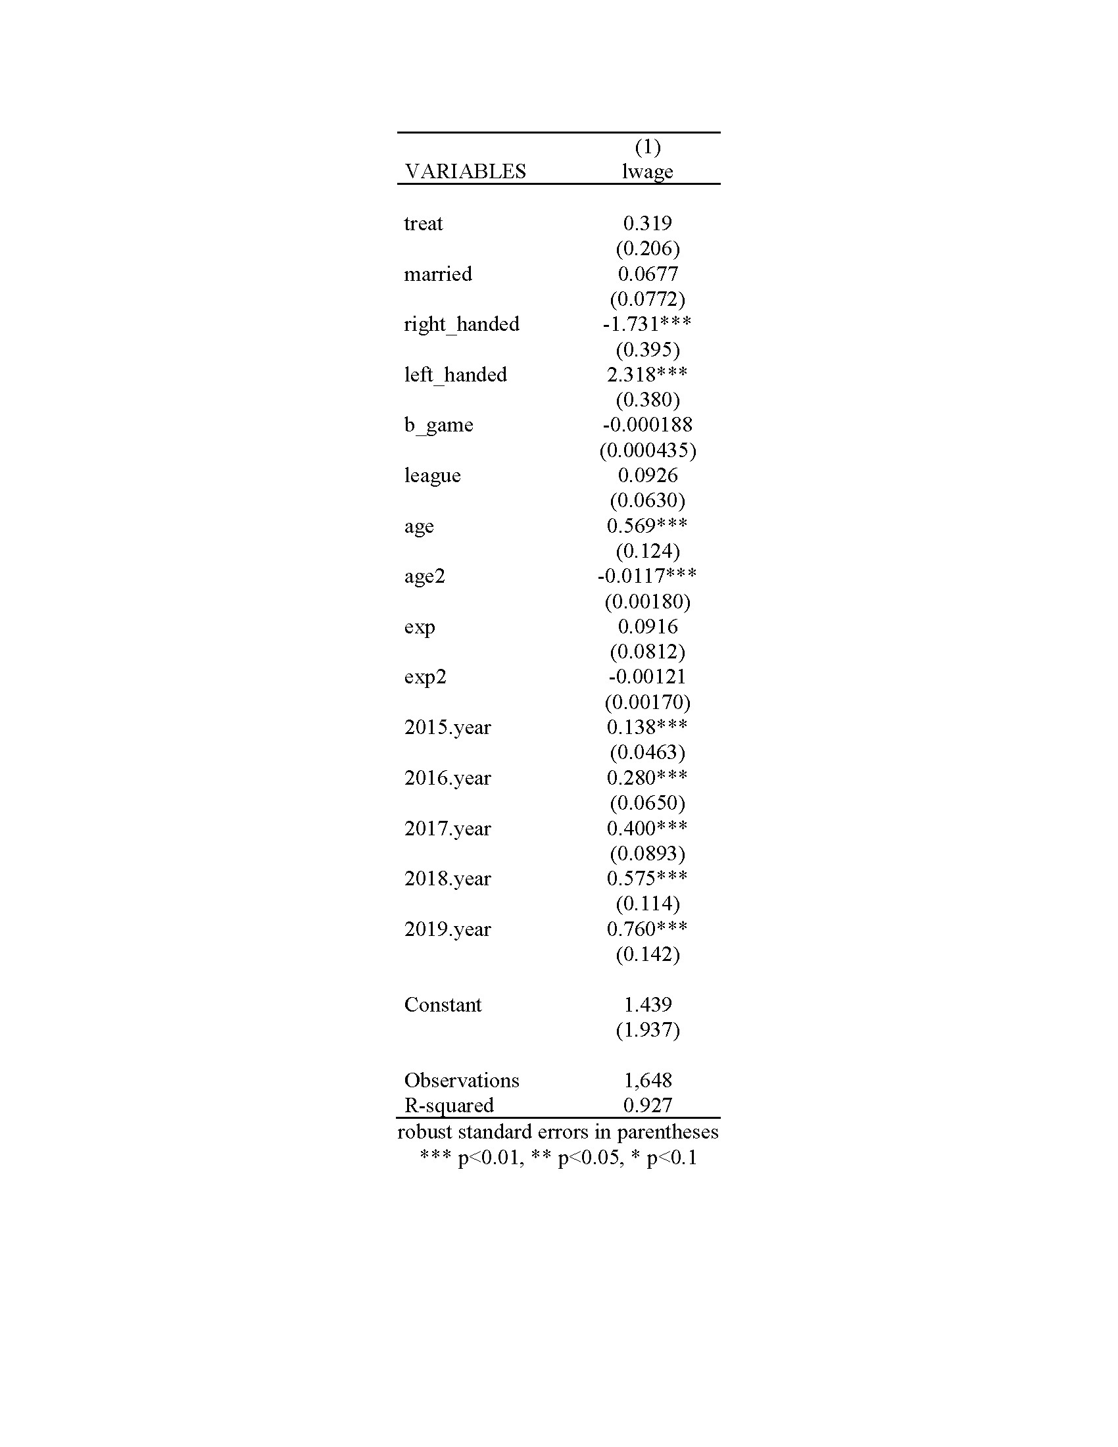
Estimate result-fielder

Slide 7
Improvement
Adding players’ fielding positions.
Excluding the outliers.
To find other good controls to represent players’ performance.

