Slide 1
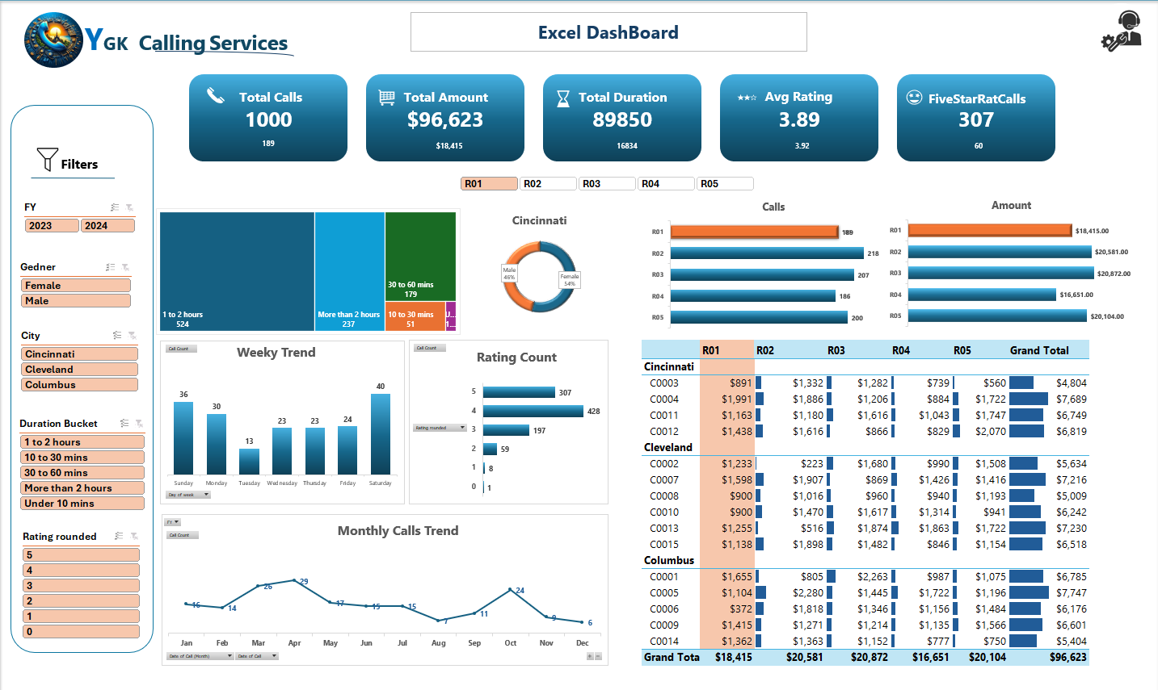

Slide 8


YGK
Calling Services
Call Center Data Analysis

Slide 9

About YGK Calling Services
Established: 2010
Location: Headquartered in Hyderabad, with operations in multiple locations across the country.
Services: YGK Calling Services specializes in providing inbound and outbound customer support for various industries including telecommunications, banking, and e-commerce
Mission: To deliver seamless customer support experiences and enhance customer satisfaction for our clients
Team: Over 500 trained customer service agents handling more than 50,000 calls per month.

Slide 10
Business Problem/Context
Problem Statement:
The company has not yet fully leveraged this valuable data to gain insights
They need a systematic way to analyze the data and make informed decisions to improve operations and customer satisfaction.
Goal
To create an Excel dashboard to help the management team analyze trends and performance metrics from 2023 and 2024 data.
Objective
To develop a comprehensive Excel dashboard that will provide key insights into the data.

Slide 11

Key Variables
Representatives
R01
R02
R03
R04
R05
City
Columbus
Cleveland
Cincinnati
1 to 2 hours
10 to 30 mins
30 to 60 mins
More than 2 hours
Under 10 mins
Duration Bucket

Slide 12
Key Measures
Total Calls
Total Amount
Total Duration
Average Rating
Five Star Rating Call Count
Number of calls Made
Purchase Amount by Customers
Time Spent by Representatives with Customers
AVG Rating given by Customers
Five star Rate given by Customers

Slide 13
Key Learnings
Excel Shortcuts
Data Visualization
Pivot Tables
Data Modelling
Conditional Formatting
Usage of slicers
Hyperlink

