Slide 1
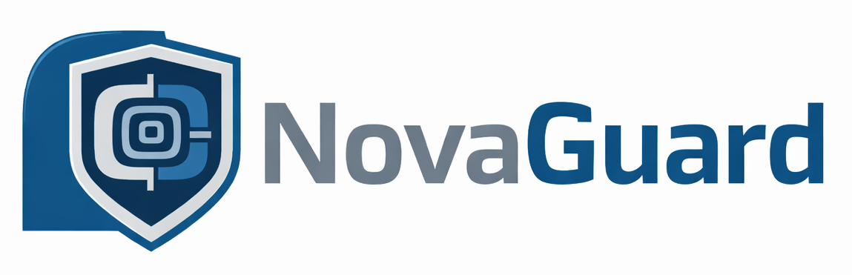
AI-Powered Predictive Maintenance System for Precision Manufacturing
Yogananda Manjunath
MS Data Science, University of New Haven

Slide 2
The Problem
How is data used to predict Machine Failure?
1. Unexpected machine breakdowns cause costly downtime
2. Maintenance is reactive or wasteful
3. No early warning system on the floor
4. Manual tracking misses failure patterns

Slide 3
The Solution
Real-time sensor data analysis with ML
Trained on 10,000 industrial data points
97% failure prediction accuracy
Simple dashboard for operators
Clear risk levels: Low / Medium / High

Slide 4
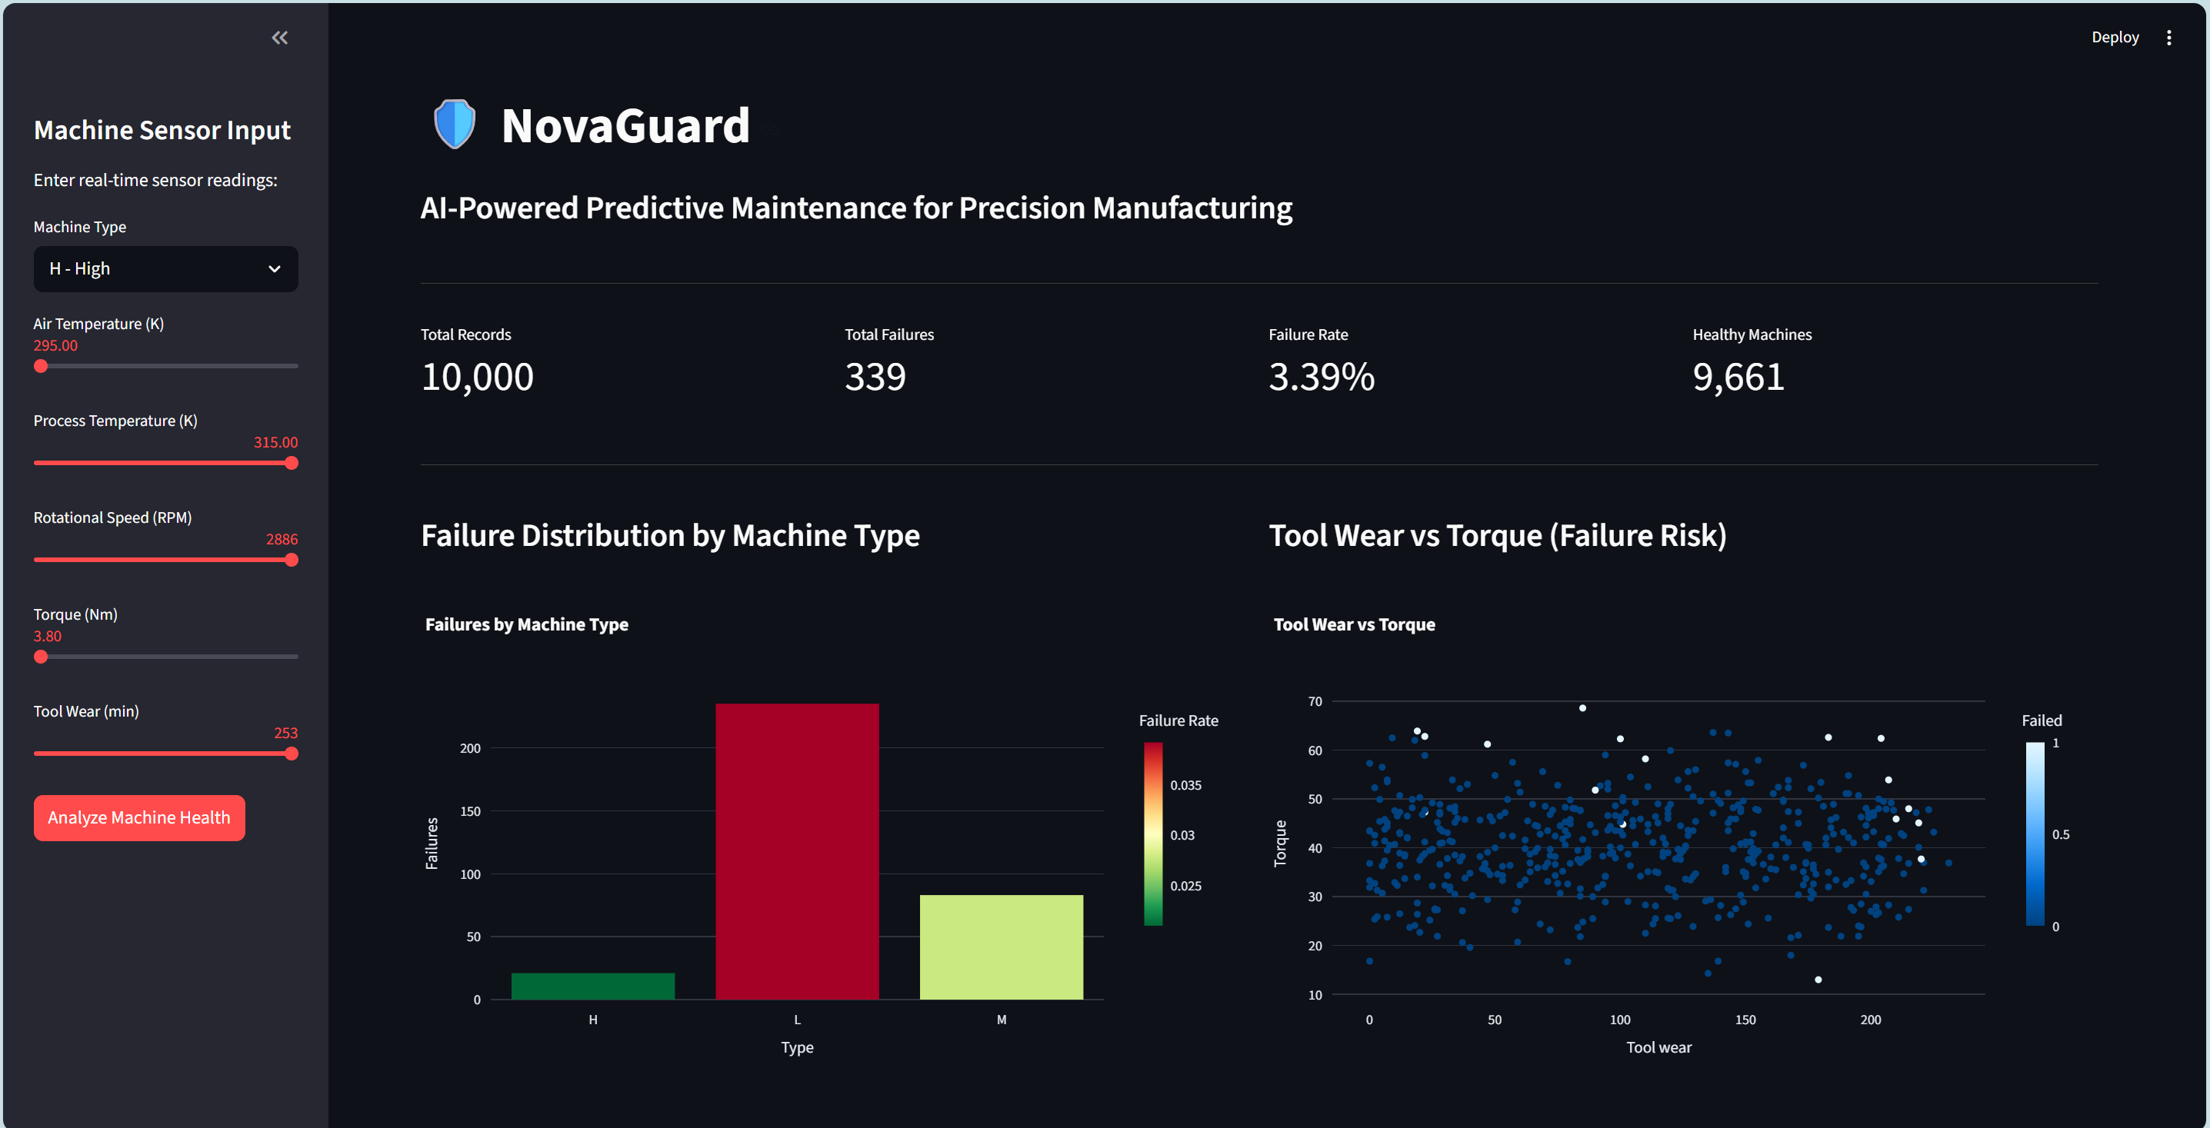
NovaGuard in Action

Slide 5
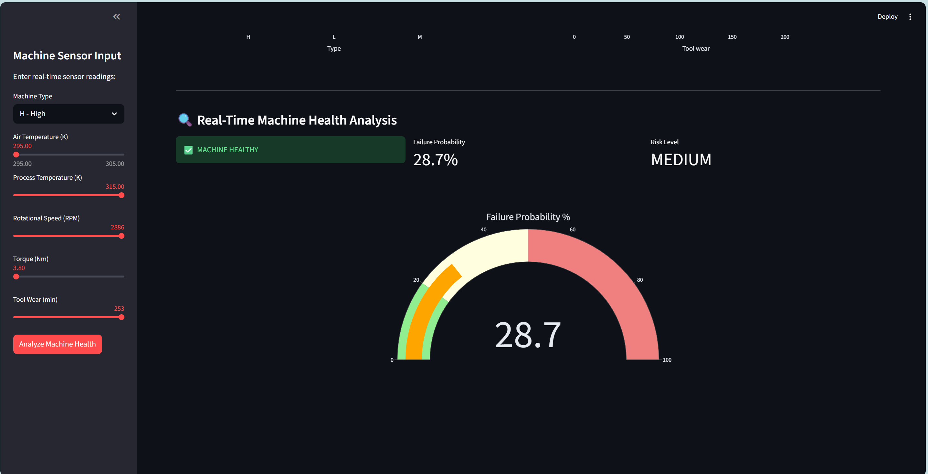
NovaGuard in Action

Slide 6
Let’s Build This Together
Ready to learn, build and deploy at Novo Precision
Ready to support data-driven manufacturing
Github - https://github.com/Yogananda16/NovaGuard
LinkedIn - https://www.linkedin.com/in/yogananda-manjunath-827113227/
Portfolio - https://yogananda16.github.io/yogananda-portfolio-latest/

Slide 7
Thank you

