Slide 1
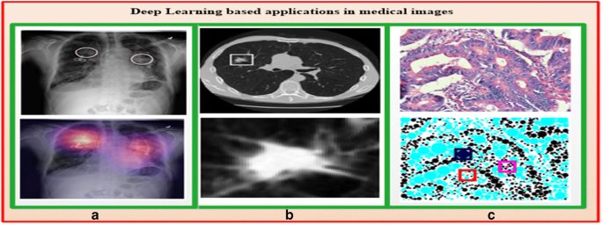
Deep Learning Enabled Medical Image Analysis using Embedded System for Enhanced Diagnosis
Authors:
J.Davis Niranjan(Dept of IT)
S.Dhivya (Dept of ECE)
R.Yoganathan(Dept of IT)
Guide:
Mrs.R.Shirley Josephine Mary
(AP/IT)

Slide 2
ABSTRACT
This system leverages deep learning algorithms deployed on embedded systems to analyze medical images and provide automated disease diagnosis. By integrating advanced deep learning techniques with cloud connectivity, our system aims to improve the accuracy and efficiency of disease diagnosis in medical imaging. We present the design, implementation, and evaluation of the system, demonstrating its effectiveness in enhancing diagnostic capabilities and potentially revolutionizing healthcare delivery in the field of medical imaging and disease diagnosis.

Slide 3
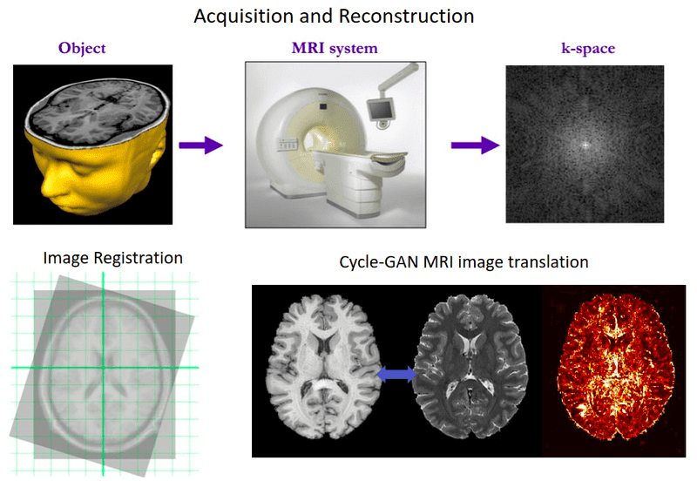
OBJECTIVE
To Develop Deep Learning Inference Engine: A robust inference engine using TensorFlow Lite or PyTorch Mobile for efficient model execution on embedded processors should be created.
To Select Embedded Hardware Platform: Suitable platforms like ARM processors or FPGAs with adequate computational power should be selected.
To Implement Deep Learning System on Hardware: The system, integrating the inference engine with the selected platform should be deployed.
To Optimize Performance: Fine-tune the system for efficient inference on embedded hardware.
To Validation and Testing: To Verify functionality, accuracy, and reliability through rigorous testing under various real-world scenarios for medical image analysis.

Slide 4
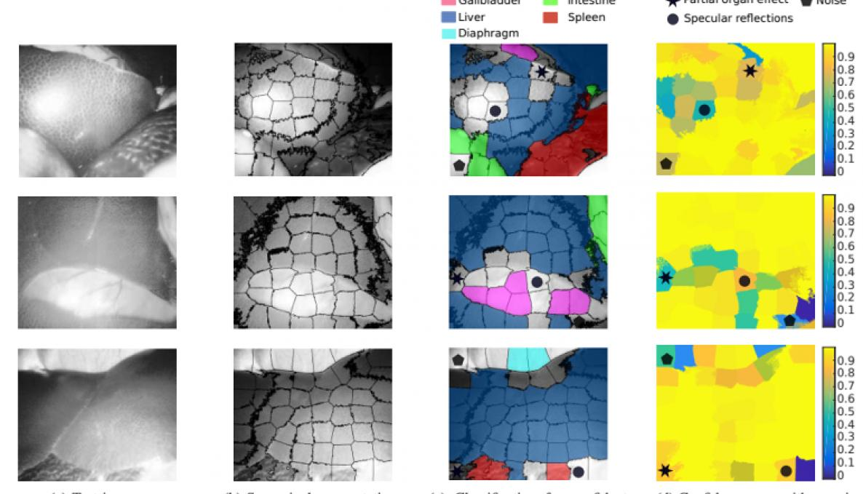
PROBLEM STATEMENT
Innovative solution for efficient Medical Imaging Analysis and diagnosis using Deep Learning Algorithm as a Embedded System.

Slide 5
INTRODUCTION
Challenges in Medical Imaging Interpretation: Manual analysis is time-consuming, error-prone, and leads to interpretation variability, impacting diagnosis efficiency.
Leveraging Deep Learning Technology: Deep learning algorithms offer potential for automating analysis and improving diagnostic accuracy.
Introduction of Deep Learning System: Tailored for medical imaging, it integrates with X-ray, MRI, and ultrasound devices for real-time analysis.
Design and Implementation: The system's architecture, development, and integration processes ensure seamless operation within medical imaging environments.
Effectiveness and Evaluation: Evaluation highlights improved diagnostic accuracy and efficiency, showcasing the system's transformative impact on medical image analysis.

Slide 6
LITERATURE SURVEY
Korfiatis et al. (2017): MRI ResNet50 Acc: 94.9% Reduced the pre-processing computational overhead in molecular biomarkers prediction.
Aghdam et al. (2018): rs-fMRI & sMRI DBN depth 3 Acc: 65.56%; Sen: 84%; Spe:32.96%;F1 score: 74.76% Exploit the abstract high-level features to classify autism spectrum disorders.
Zhang et al. (2018): Colonoscopic images extracted from videos Regression-based CNN Pre: 88.6%,Recall: 71.6% Spatial features learning, object detection with ResYOLO, refining the detection results via Efficient Convolution Operators for detection of Polyp during colonoscopy.

Slide 7
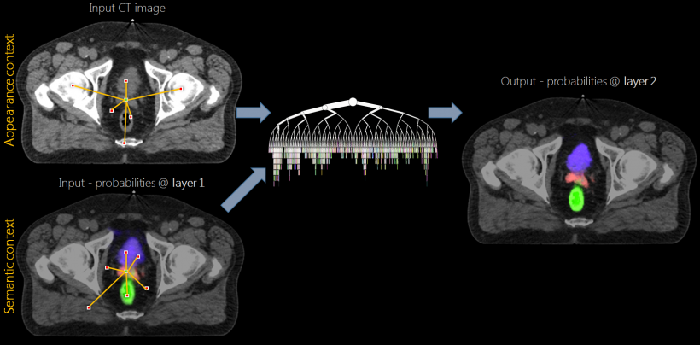
EXISTING SYSTEM
Ovarian Cancer Research: Implementation of deep learning for diagnosis and prognosis prediction, advancing ovarian cancer detection.
Deep Learning Advancements: Progress in medical image analysis due to deep learning, supported by numerous studies.
Algorithm Effectiveness: Deep learning excels in tasks like segmentation, detection, and classification in medical imaging.
Modality-Specific Models: Tailored deep learning models for X-ray, MRI, and image enhancement, improving diagnostic accuracy.
Limitations and Needs: Existing models limited by high-performance computing; demand for embedded systems in medical imaging rising.

Slide 8
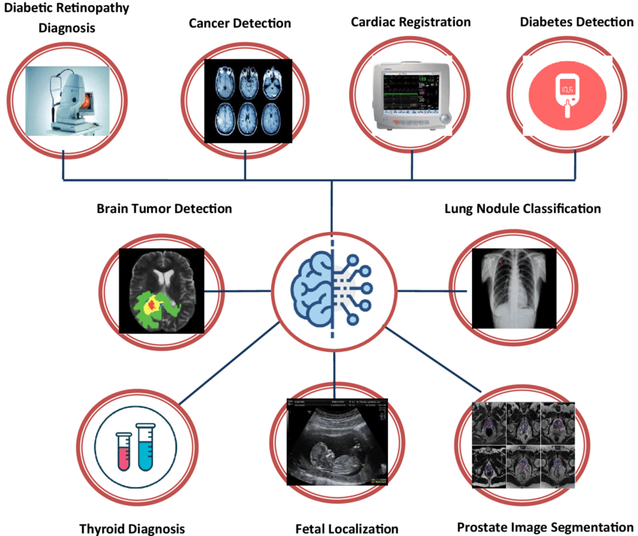
PROPOSED METHODOLOGY
Device Deployment: Compact device interfaces directly with MRI/CT/X-ray machines, serving as a bridge to cloud-based resources.
Data Exchange and Analysis: Device establishes secure cloud connection, accessing vast medical imaging dataset for comparison.
Embedded Deep Learning: Utilizing embedded deep learning algorithms to compare images, detect anomalies, and assist in diagnosis.
Clinical Input Integration: Allows healthcare professionals to input patient history and clinical information manually for context.
Decision Making: Device identifies discrepancies, formulates diagnosis or treatment plans based on findings, and ensures accuracy through trained algorithms.

Slide 9
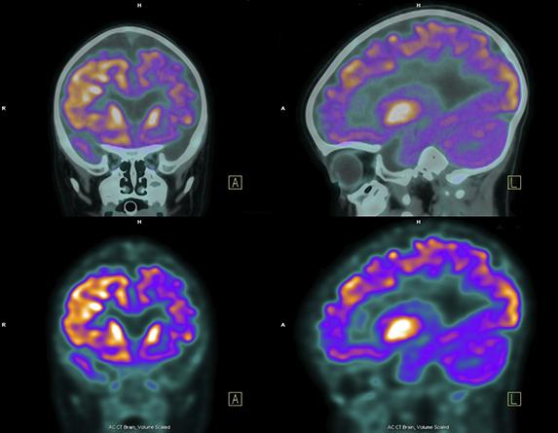
EXPERIMENTAL RESULTS
Dataset Description: Evaluation conducted on diverse medical image dataset, covering conditions like pneumonia, fractures, and tumors.
Performance Comparison: Deep Learning System's diagnostic accuracy and efficiency compared against manual interpretation by expert radiologists.
Key Metrics: Evaluation based on sensitivity, specificity, and processing time to assess system effectiveness in disease diagnosis.
Results: Deep Learning System achieves high accuracy comparable to or better than human experts, with low latency and high throughput for real-time analysis.
Clinical Trial Outcome: Experimental results indicate system's effectiveness in detecting and diagnosing diseases from medical images.

Slide 10
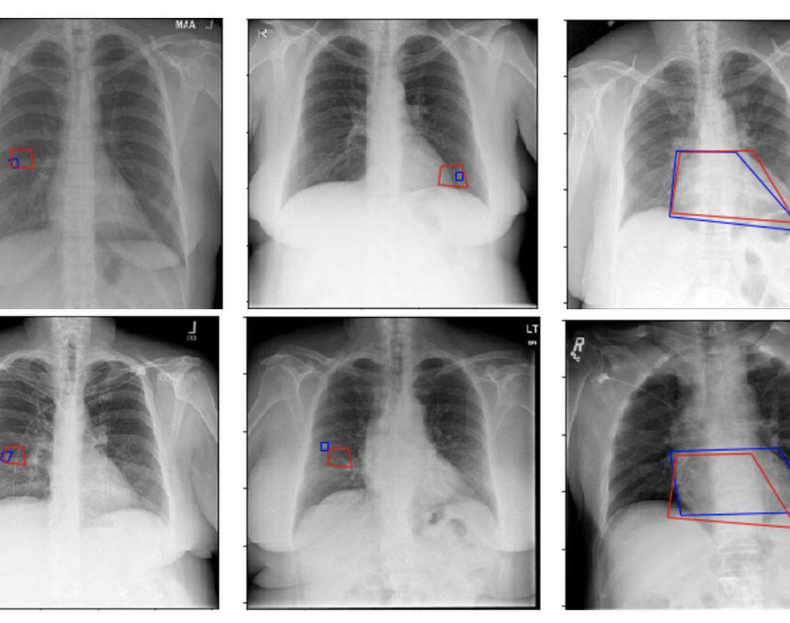
CONCLUSION
System Overview: Deep Learning System presented as a solution for automated medical image analysis and diagnosis using embedded hardware.
Effectiveness Validation: Evaluation results confirm the system's effectiveness in enhancing diagnostic accuracy and efficiency.
Promise for Healthcare: Deep Learning System offers a promising solution to enhance healthcare delivery and improve patient outcomes.
Future Enhancements: Plans include expanding capabilities by incorporating additional imaging modalities, supporting a wider range of diseases, and optimizing for clinical deployment.

Slide 11
REFERENCES
Joshi, K. K., Gupta, K. K., & Agrawal, J. (2020). A Review on Application of Machine Learning in Medical Diagnosis.
Marakala, V., Sriramakrishnan, G. V., Jakka, G., Shingadiya, C. J., Widiastuti, H. P., & Ortiz, G. G. R. (2022). Use of Deep Learning Application in Medical Devices.
Yu, Q., Liang, K., Xiao, H., Chen, W., & Meng, Z. (2022). Research Progress of Deep Learning in Diagnosis and Treatment of Ovarian Tumor.
Charleen, C., Angelica, C., Purnama, H., & Purnomo, F. (2021). Impact of Computer Vision With Deep Learning Approach in Medical Imaging Diagnosis.
Baker, Q. B., Swedat, S., & Aleesa, K. (2023). Automatic Disease Diagnosis System Using Deep Q-Network Reinforcement Learning.
Kumar, A., Jain, D., Singh, P., & Das, S. (2023). Heart Disease Diagnosis using Deep Learning.
Rana, M., & Bhushan, M. (2022). Advancements in Healthcare Services using Deep Learning Techniques.

