Slide 1
GRAPH THEORY & SOCIAL NETWORKS
Group 2
Ankit Kumar (20bds009) Sankeesa Anshu(20bds047)
Tapan (20bds059)
Hari Teja(20bds061)
Yogesh Shinde (20bds065)

Slide 2
Election Result Prediction using Twitter Sentiment Analysis & Network Visualization
Election Result Prediction using sentiment analysis of the political twitter data
Visualizing the twitter social network with respect of election perspective

Slide 3
Data Collection
Lok Sabha Election 2019 Period was from 11 April to 19 May
Election Campaign almost started from the 1st jan 2019
Collected the tweet with particular user and timestamp using keywords and popular hashtags

Slide 4
Keywords and Hashtags
Key words
Narendra
Modi
Rahul
Gandhi
BJP
INC
Hashtags
#LokSabhaElections2019
#IndianElection2019
#NarendraModi
#RahulGandhi
#BJP
#INC

Slide 5
THE GENERAL TWEETS WITH COMMON WORDS AND MOST USED HASHTAG Without Replies
THE GENERAL TWEETS WITH COMMON WORDS AND MOST USED HASHTAG With Replies
TWEETS WITH POPULAR HASHTAGS
TWEETS WITH POPULAR HASHTAGS with replies
#LokSabhaElections2019 with replies
Tweets of Modi
Tweets of Rahul Gandhi

Slide 6
Concatenated data sets to obtain final data set
Common keywords along with hashtags
TWEETS WITH POPULAR HASHTAGS
#LokSabhaElections2019

Slide 7
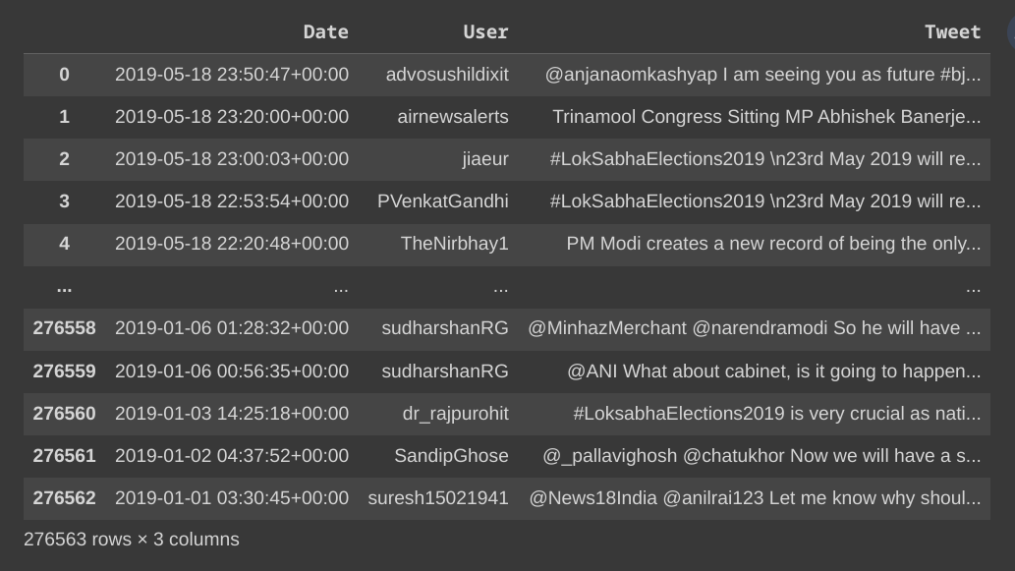
Data

Slide 8
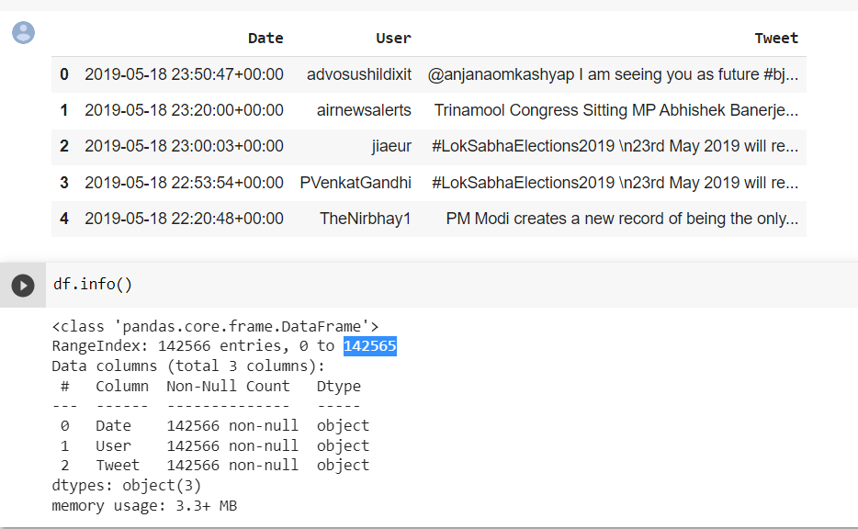
Data cleaning
Removing of duplicate rows
We got 142565 data points
data

Slide 9
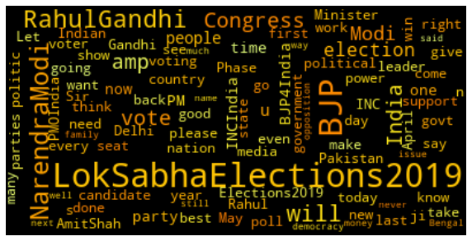
Data

Slide 10
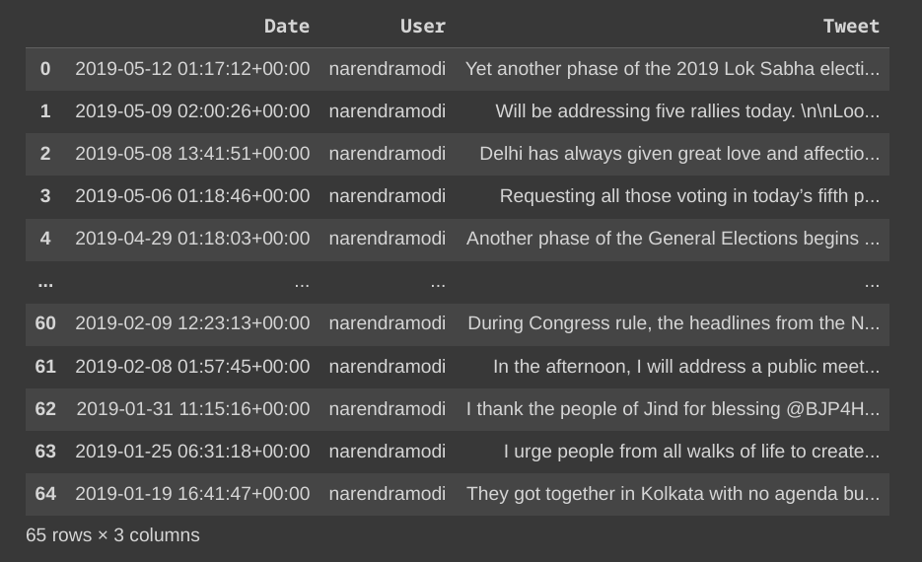
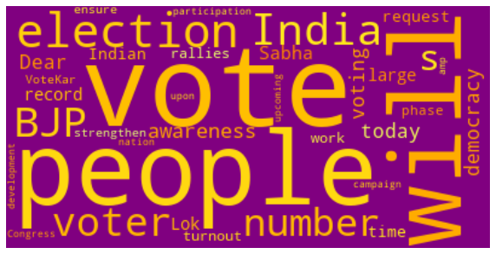
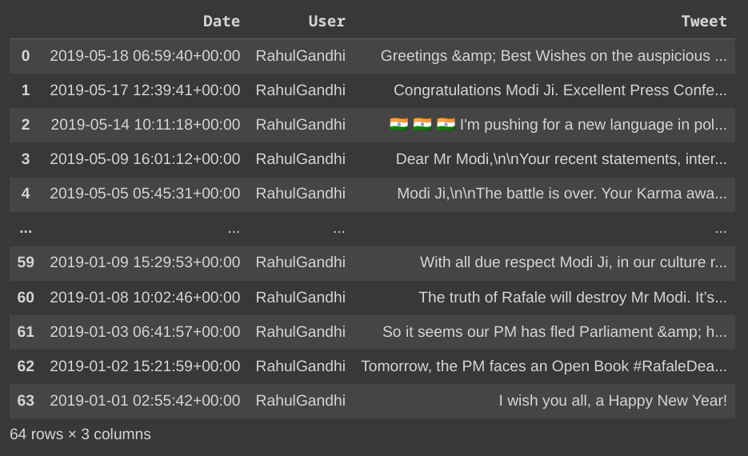
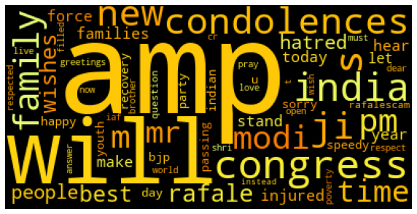
Data

Slide 11
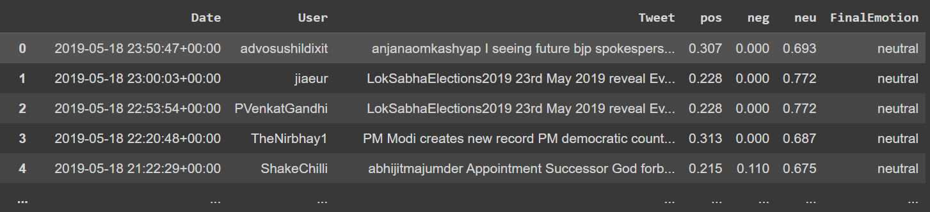
Sentiment analysis on tweets

Slide 12
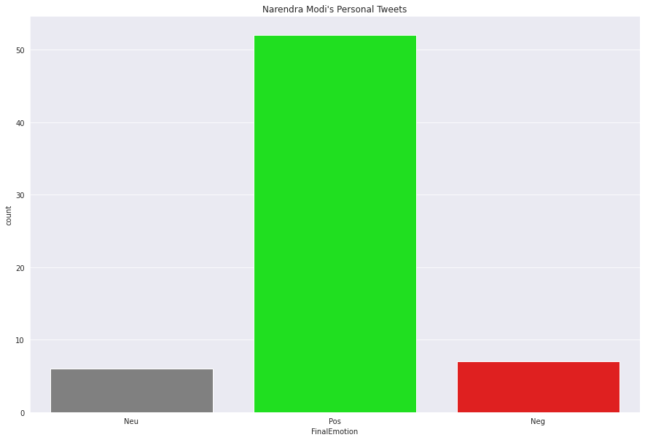
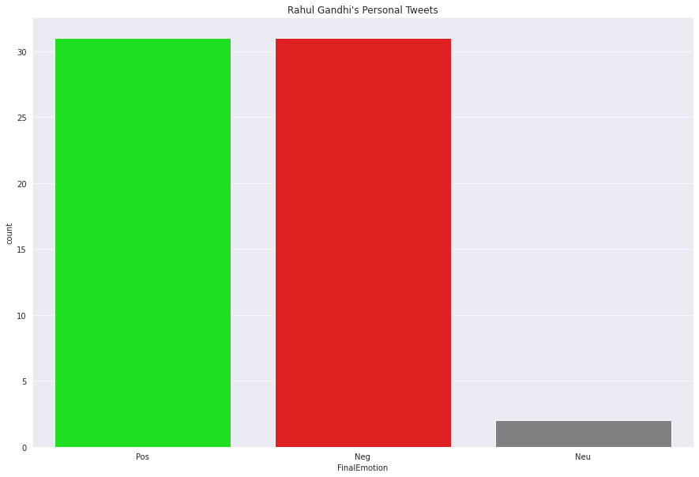
Bert
80%
50%

Slide 13
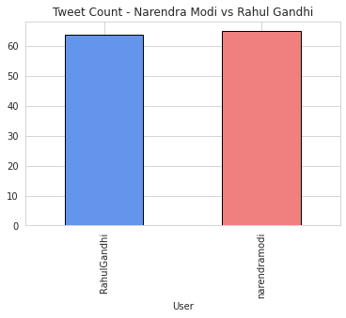
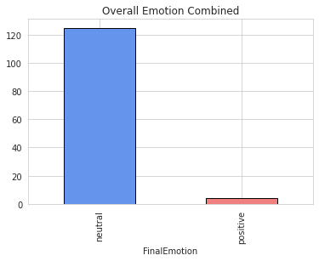
Vader Sentiment

Slide 14
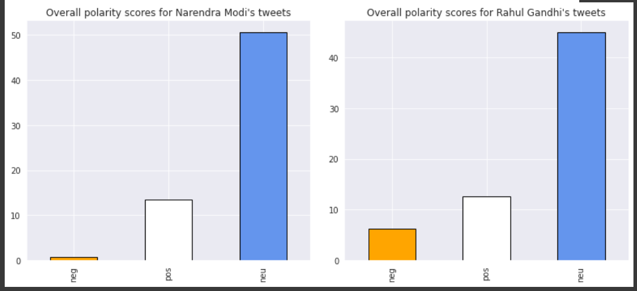
Vader Sentiment

Slide 15
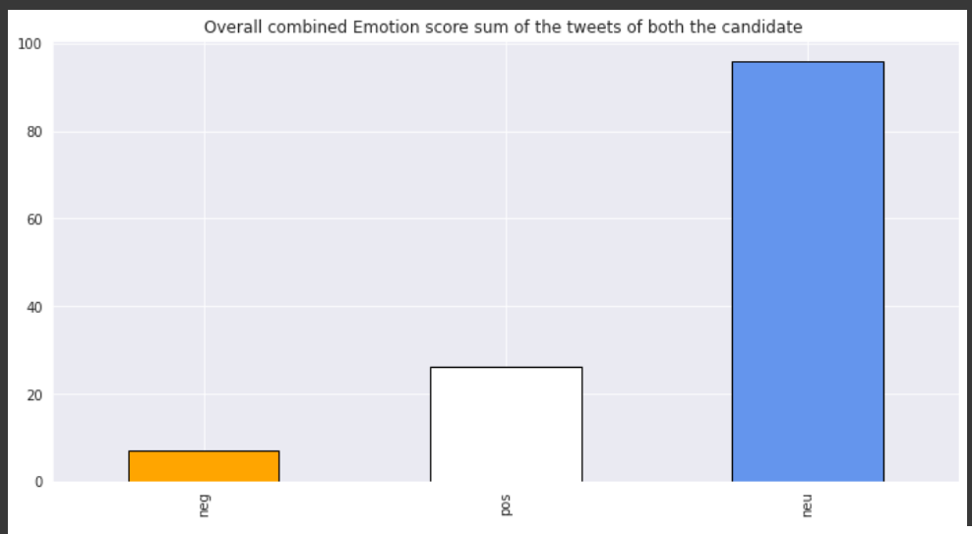

Slide 16
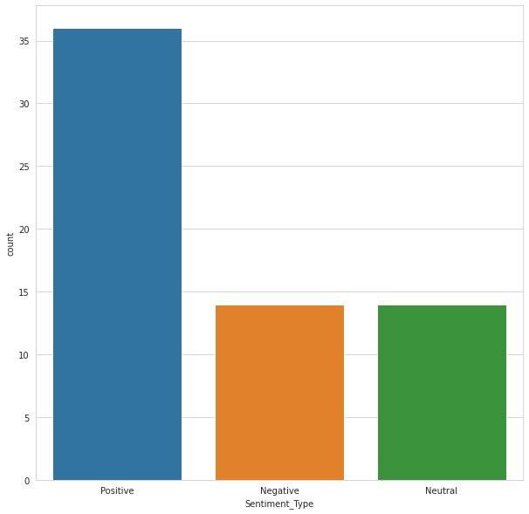
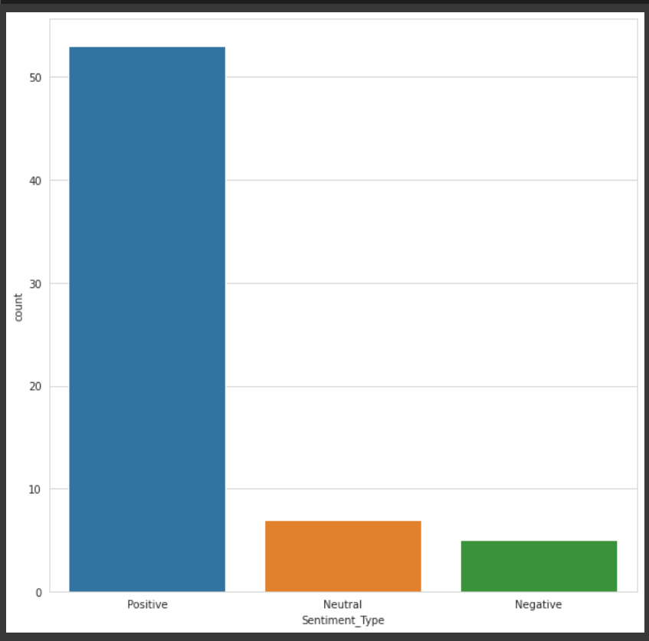
TextBlob
Rahul Gandhi
Narendra Modi

Slide 17
Tweets Mentioning Modi and Gandhi

Slide 18
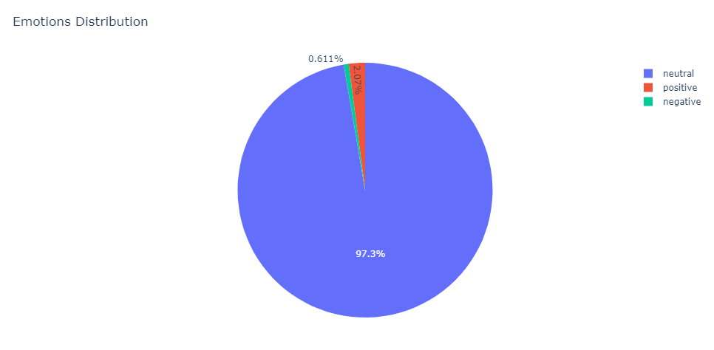
Namo
*Vader Sentiment

Slide 19
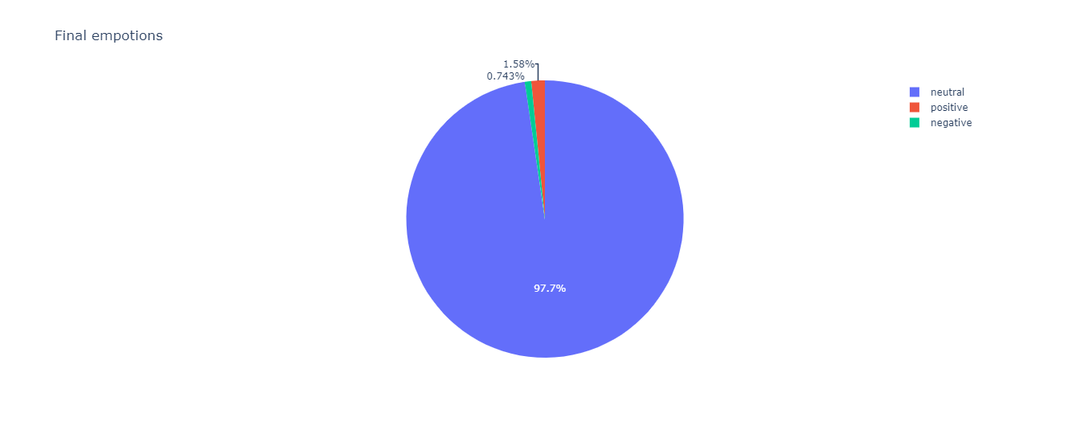
Rahul Gandhi
*Vader Sentiment

Slide 20
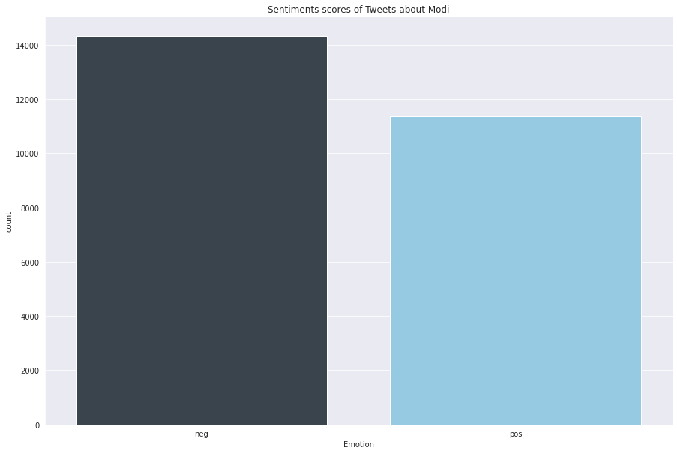
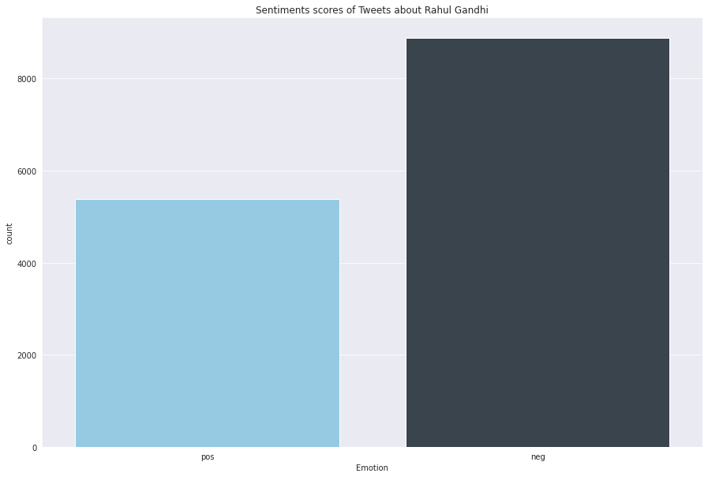
Narendra Modi
Rahul Gandhi
56%
44%
38%
62%
25688
*Flair
14261

Slide 21
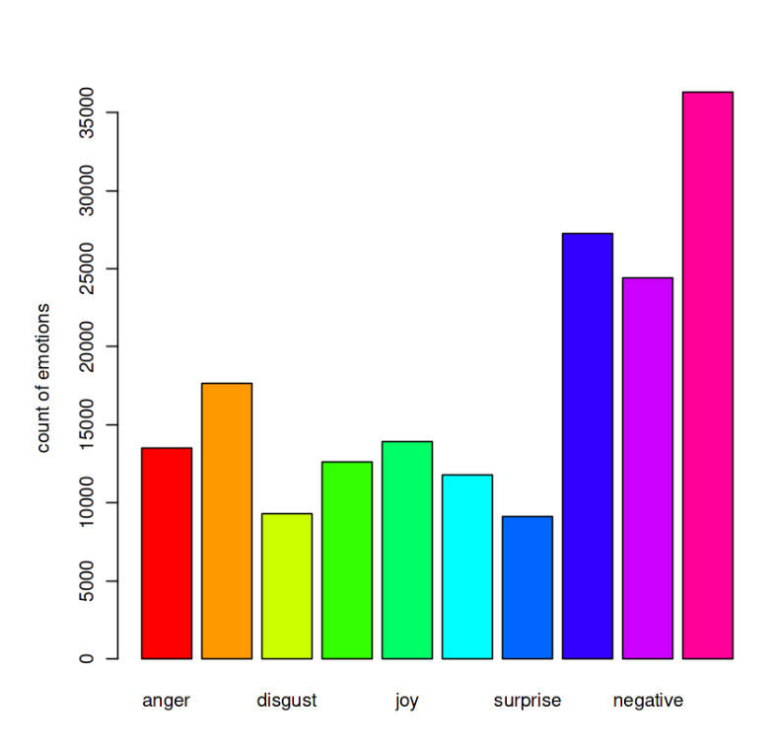
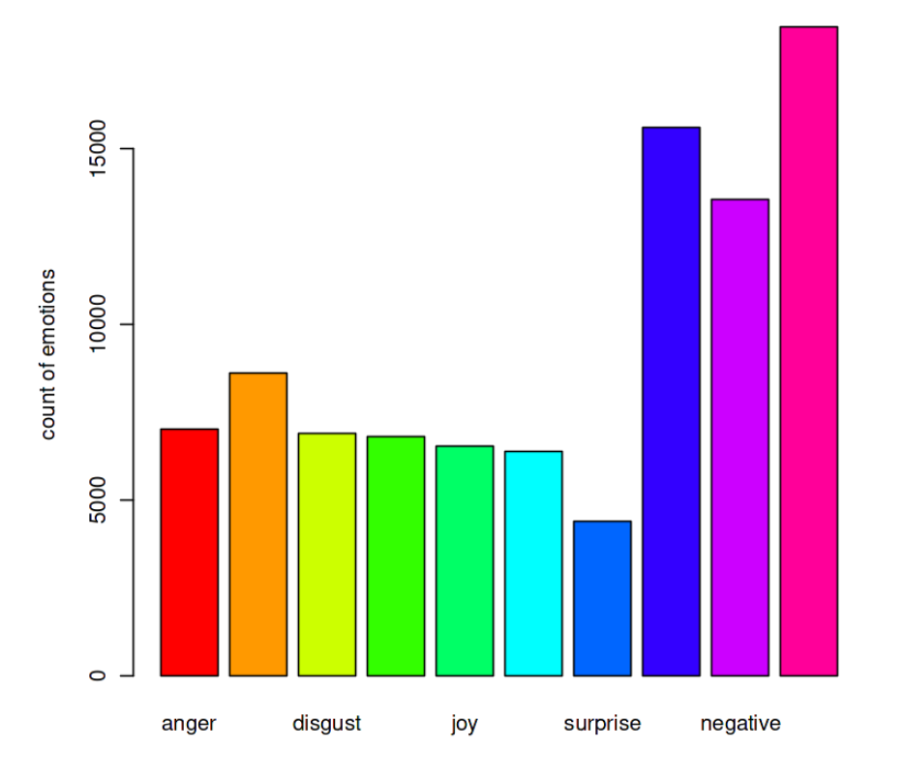
Get_nrc_sentiment
Narendra Modi
Rahul Gandhi

Slide 22
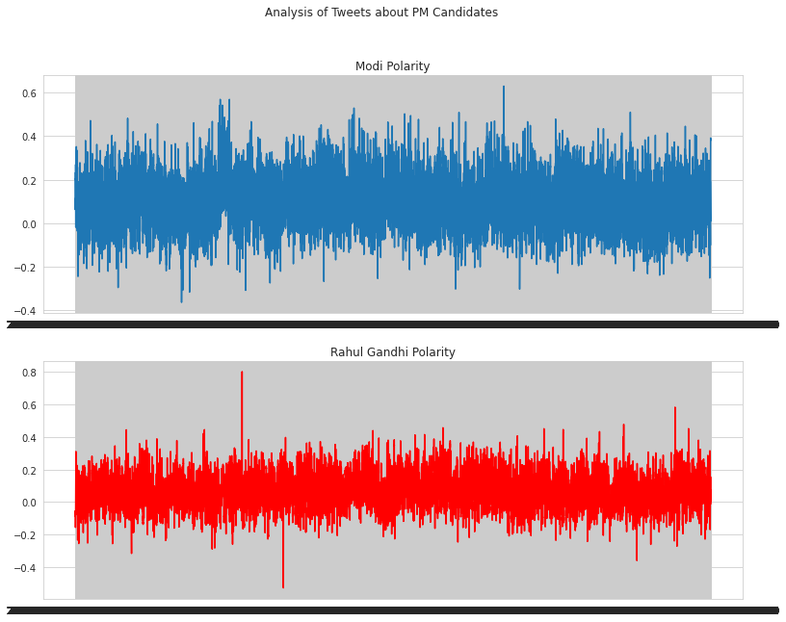

Slide 23
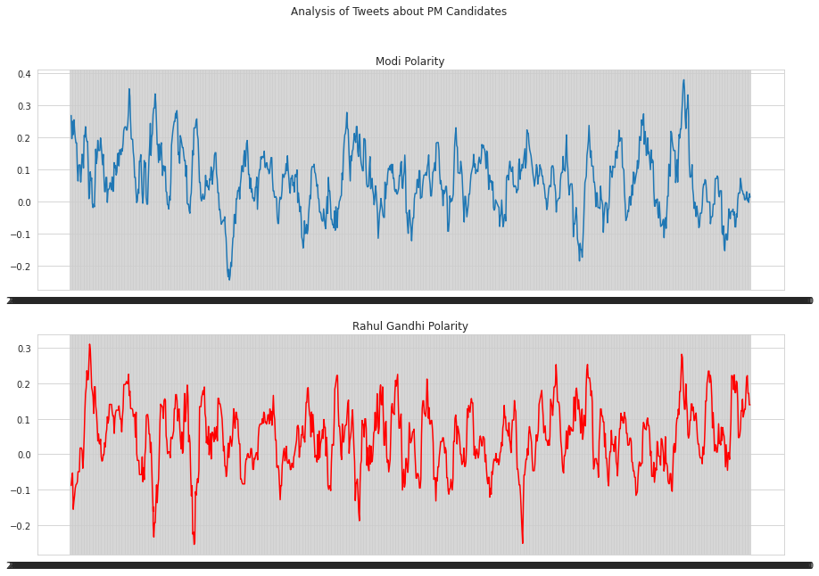

Slide 24
Analysis Insights
If we see by using Vader Sentiments on raw data, we see that positive tweets percentage for Narendra Modi is more than Rahul Gandhi (though slightly)
No. of tweets mentioning about Rahul Gandhi (14261) is very less than Narendra Modi(25688)
If we see analysis with get_nrc_sentiment we see there is sudden difference between Disgust and joy curve in Narendra Modi but it almost same in case of Rahul Gandhi

Slide 25
Conclusion :
 | Flair |  | Vader Sentiment
 | Positive Sentiment | Negative Sentiment | Positive Sentiment | Negative Sentiment
Narendra Modi | 56% | 44% | 2.07% | 0.611%
Rahul Gandhi | 38% | 62% | 1.58% | 0.743%

Slide 26
Network Analysis

Slide 27
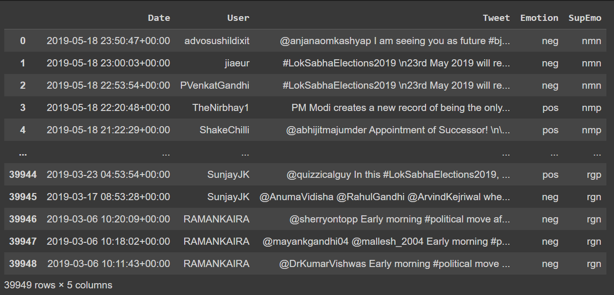

Slide 28
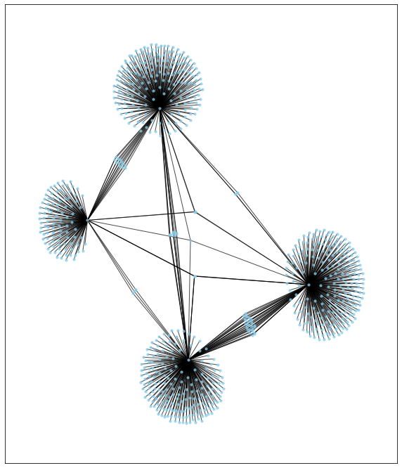

Slide 29
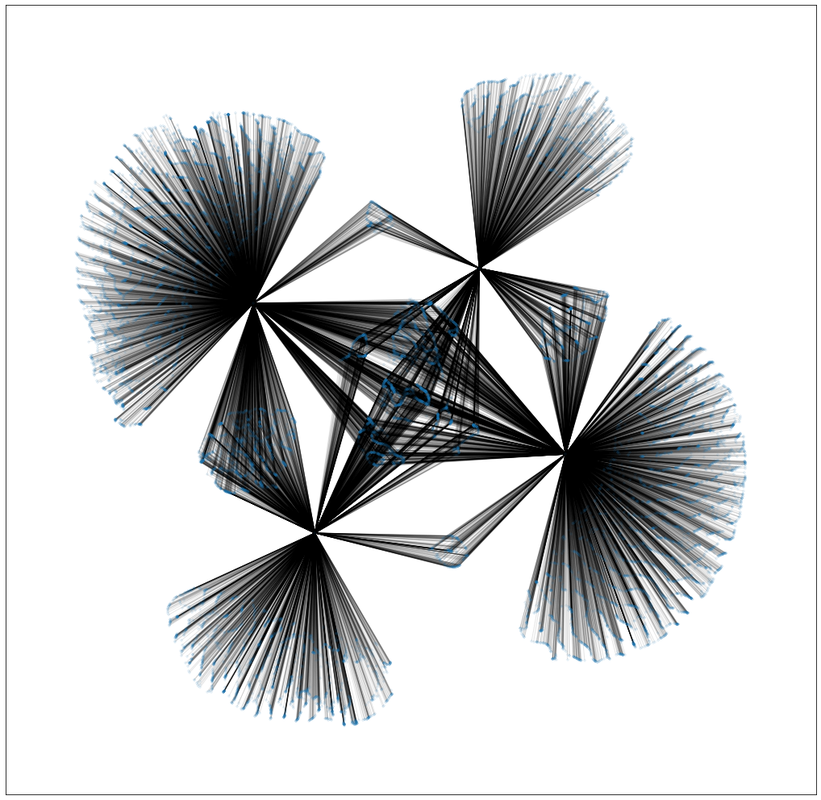
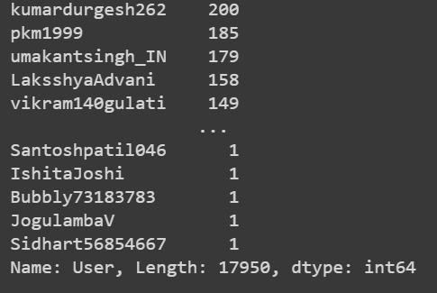
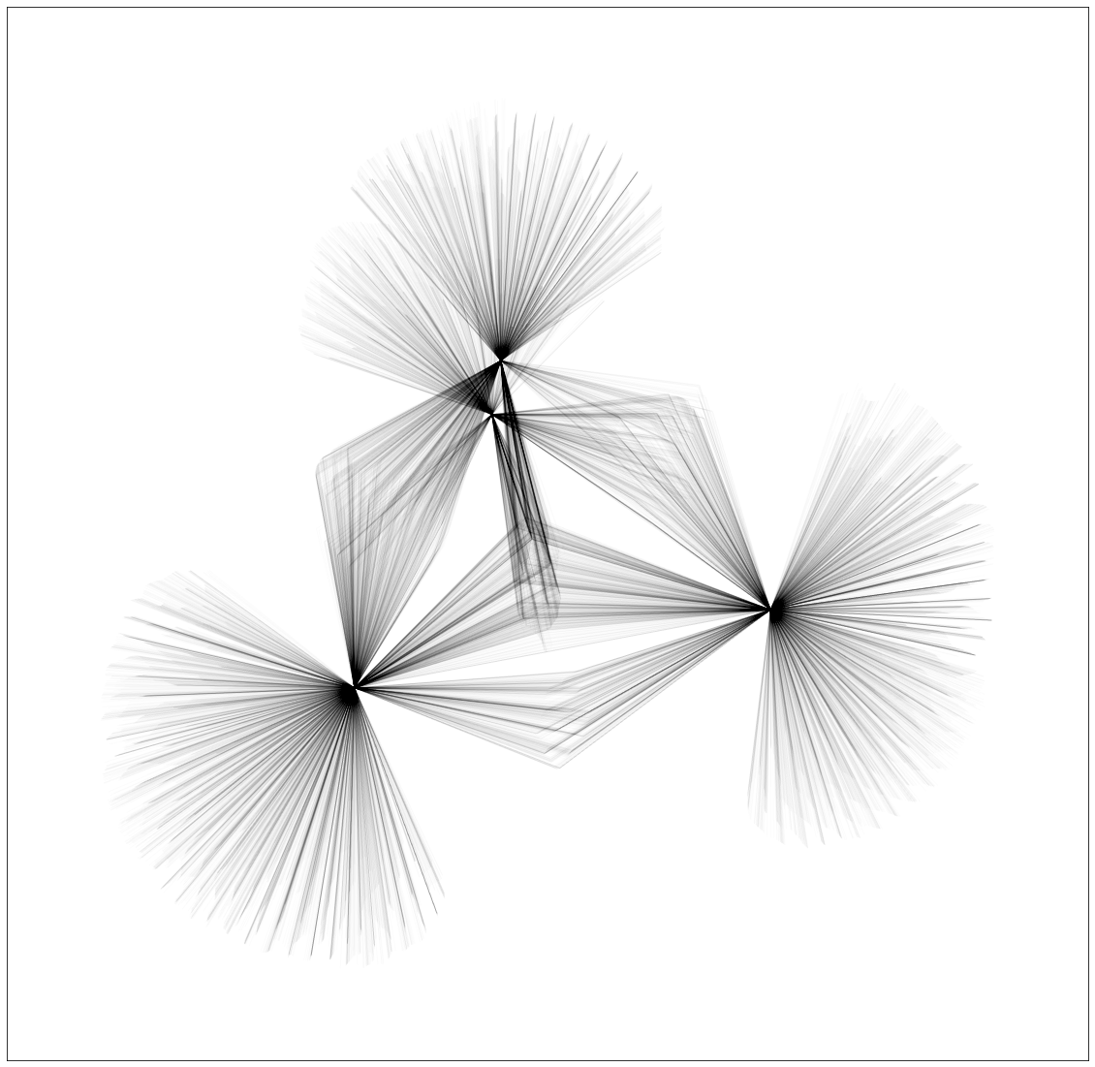

Slide 30
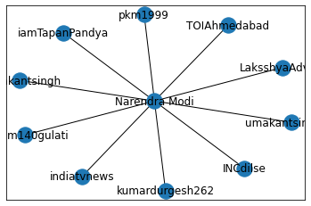
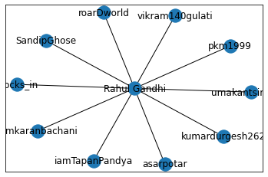
Top 10 people who tweeted the most on Narendra Modi and Rahul Gandhi

Slide 31
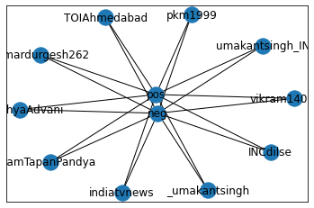
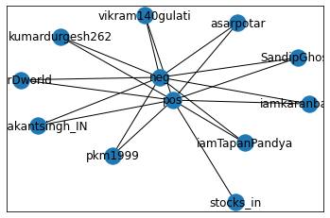
Positive and Negative tweets on Narendra Modi and Rahul Gandhi
Narendra Modi
Rahul Gandhi

Slide 32
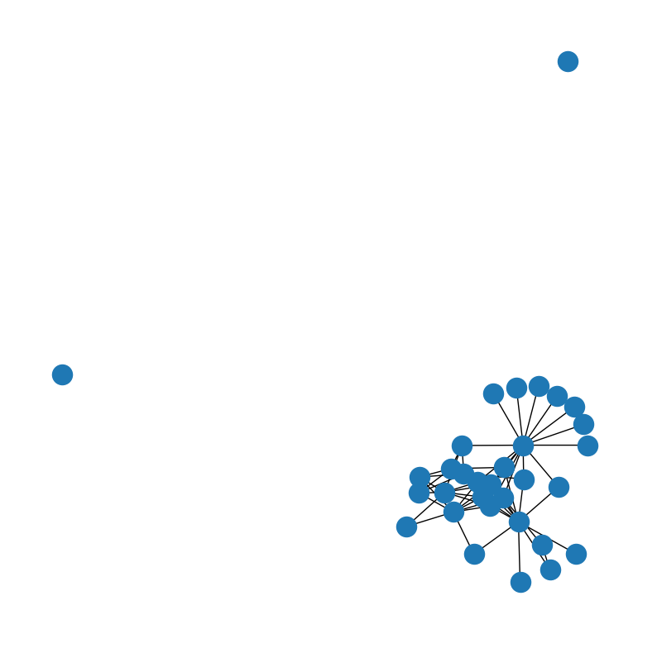
GRAPH AFTER TRIMMING ALL THE NODES WITH DEGREE LESS THAN 170

Slide 33
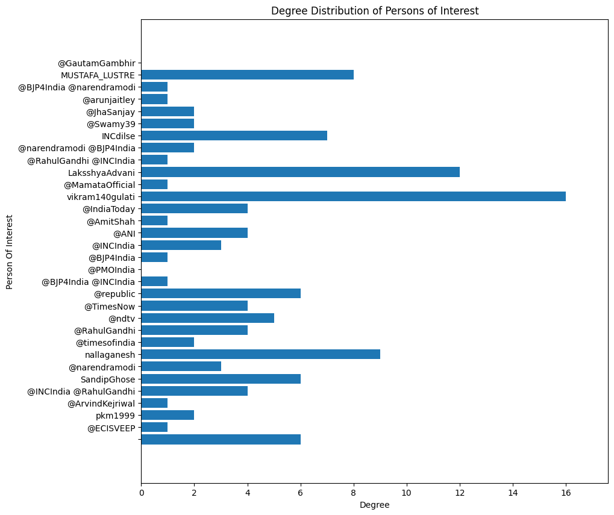
PLOT OF DEGREE DISTRIBUTION

Slide 34
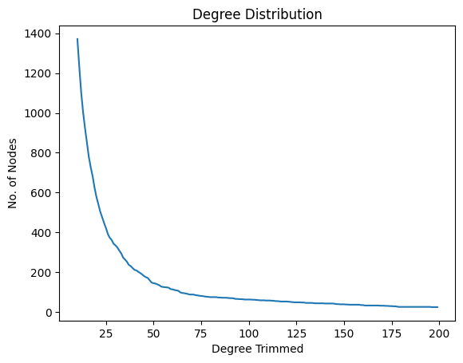
SIMPLE PLOT OF NODE VS DEGREE TRIMMED

Slide 35
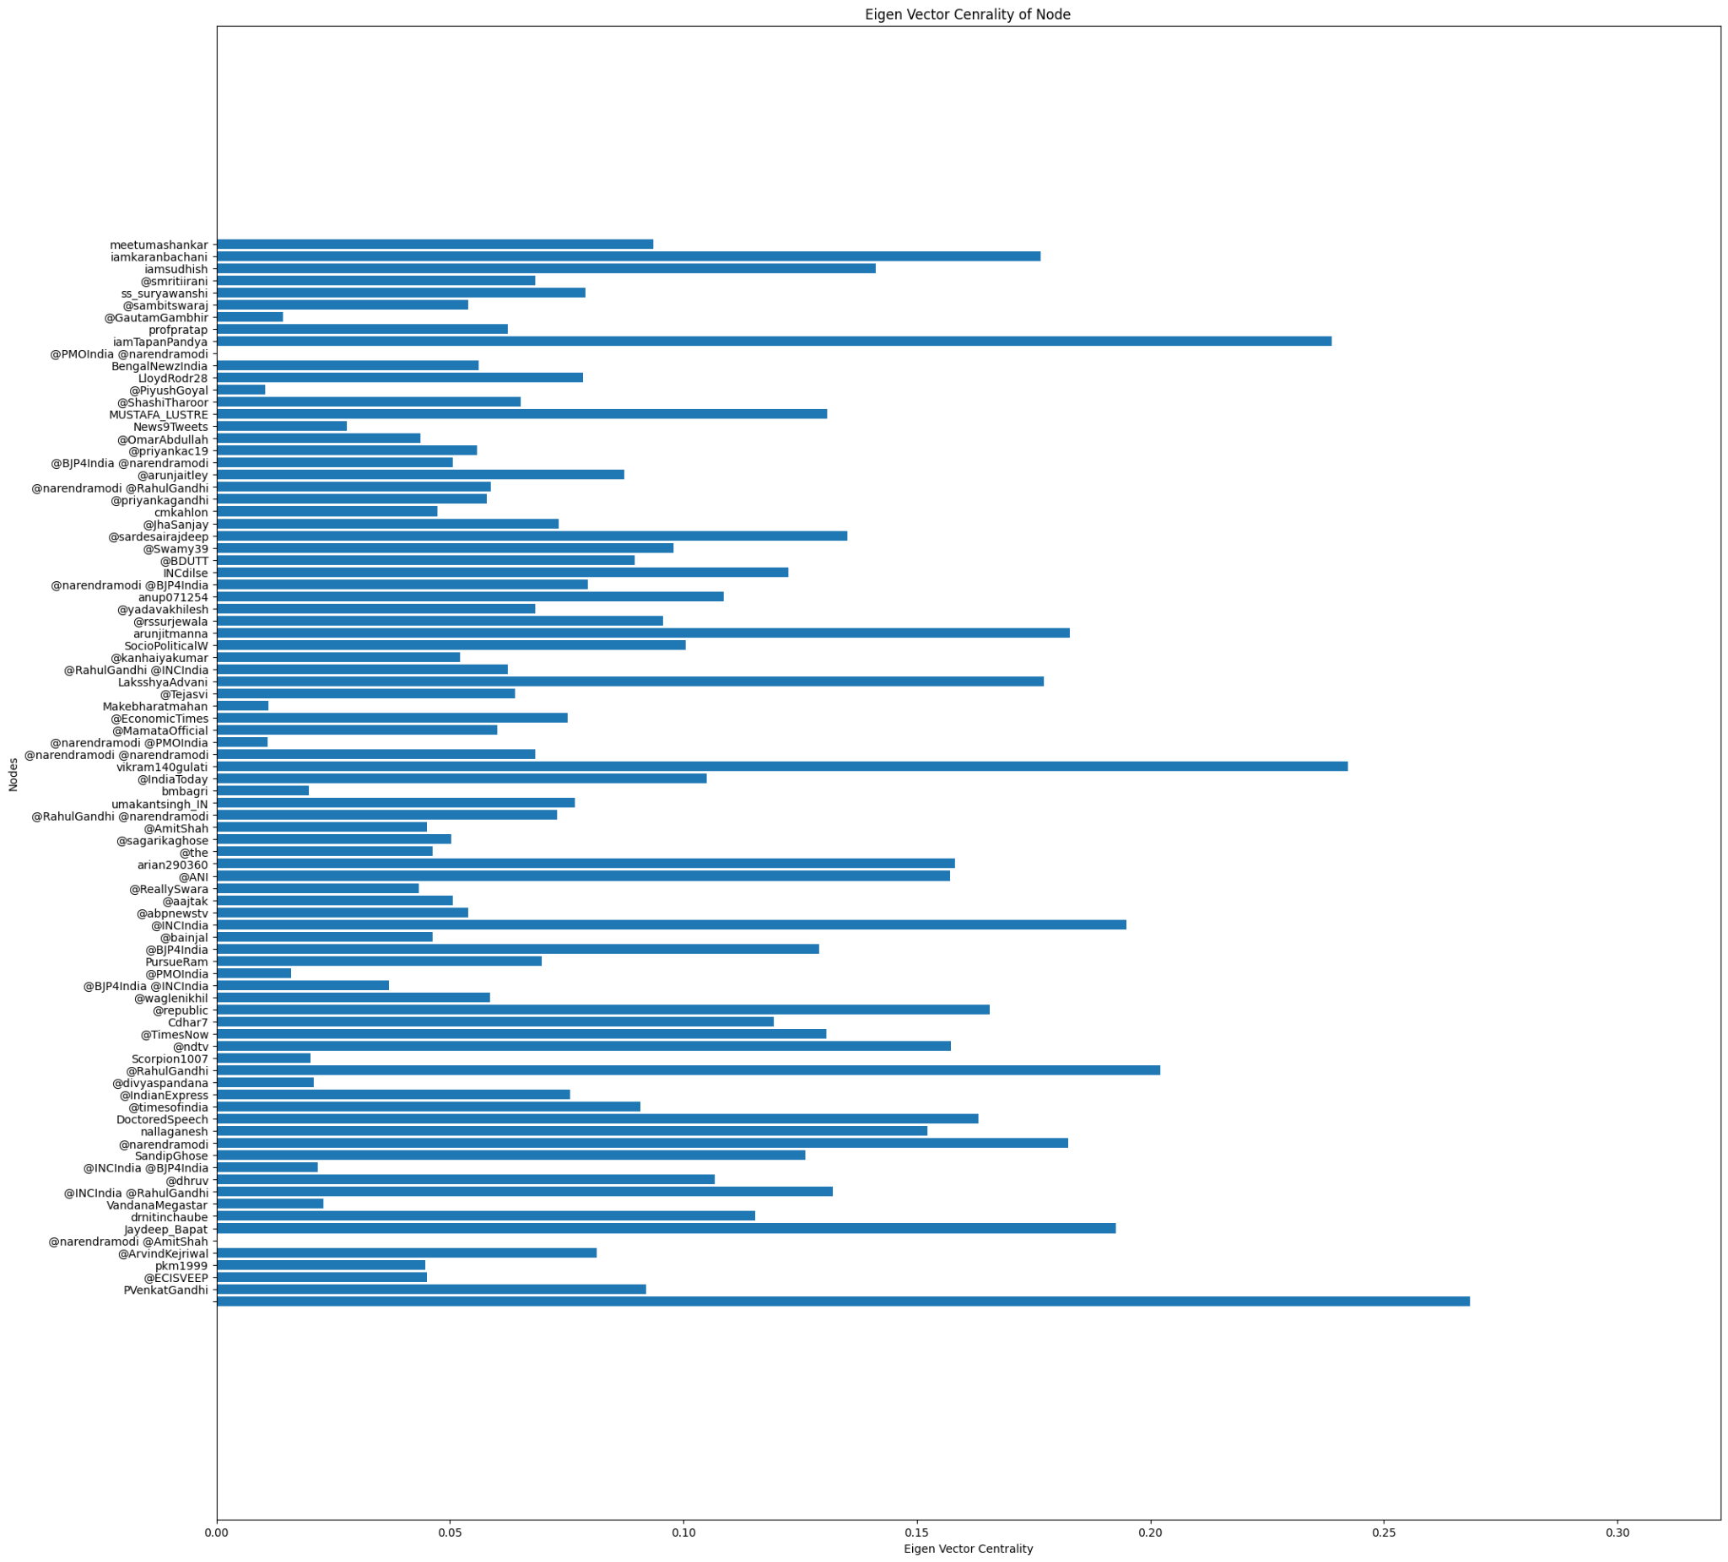
EIGENVECTOR CENTRALITY CURVE

Slide 36
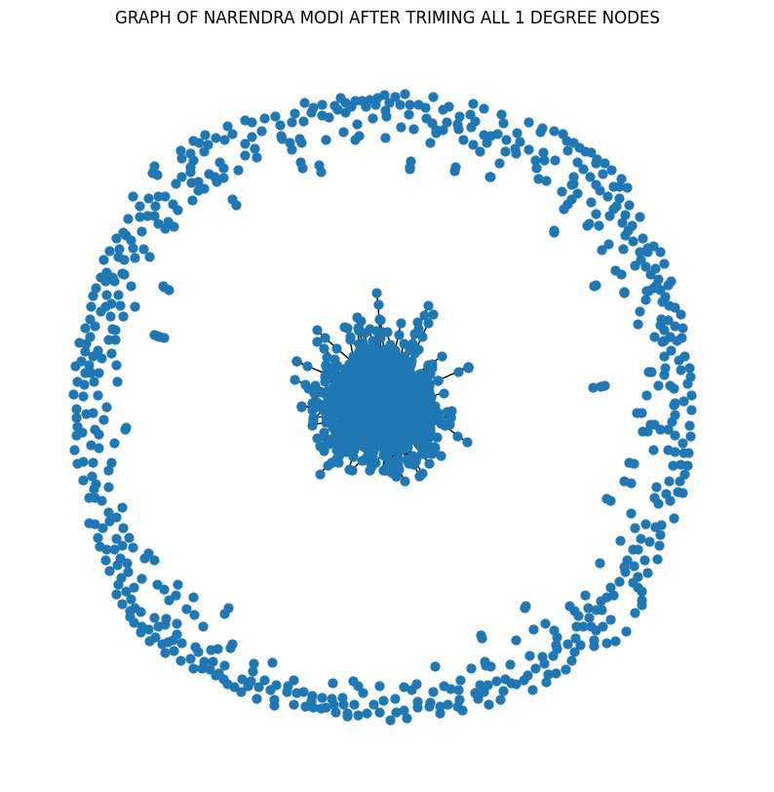
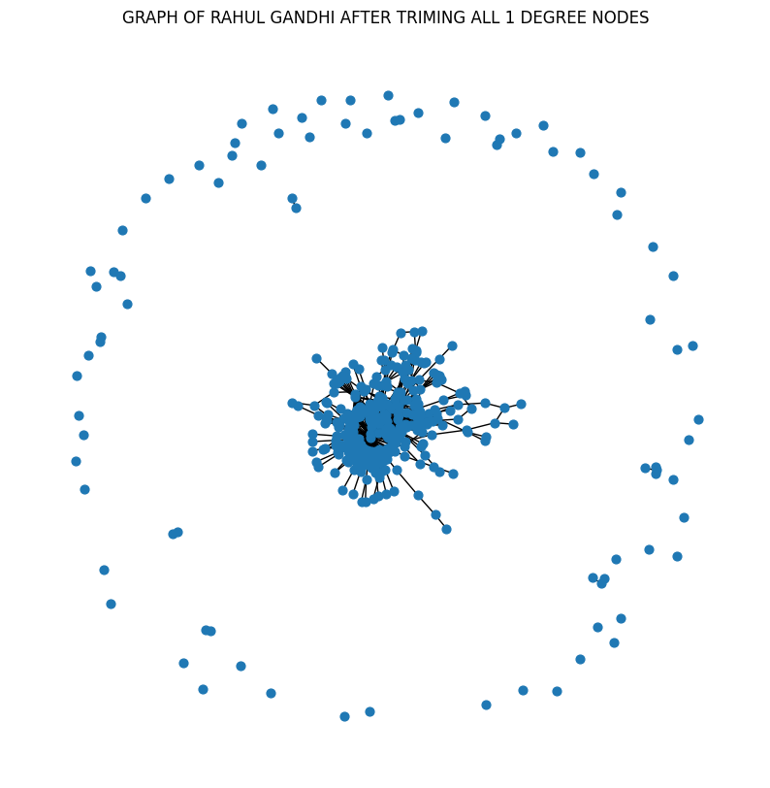
GRAPHS OF BOTH LEADERS AFTER REMOVING ALL 1 DEGREE NODES

Slide 37
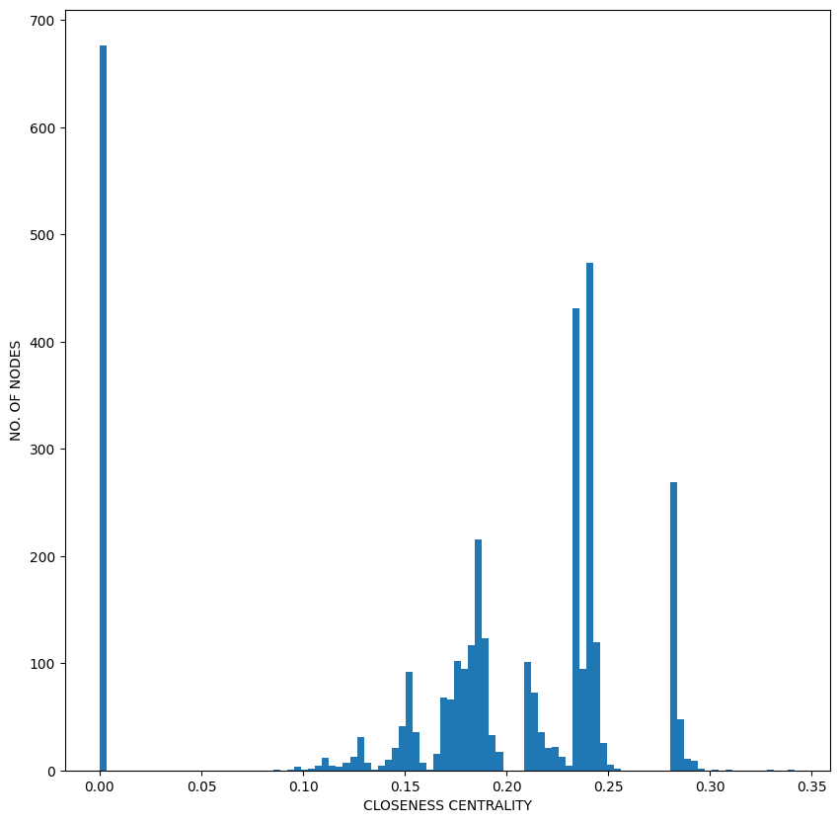
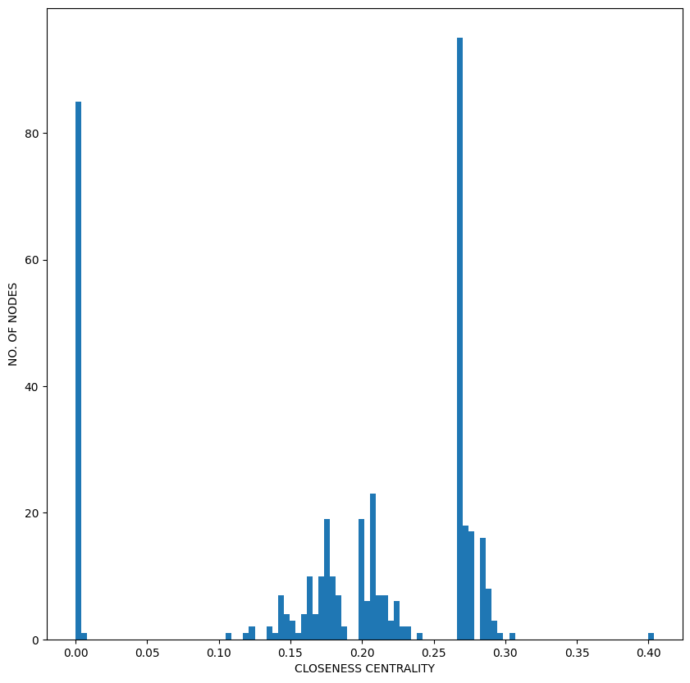
CLOSENESS CENTRALITY PLOT FOR BOTH THE LEADERSO

