Slide 1

NAAN MUDHALVAN DATASCIENCE FUDAMANETAL PROJECT
PROJECT TITLE:
TUMOR CLASSIFICATION
PRESENTED BY:
M.YOGESH
REG NO: 912321105025
SACS M.A.V.M.M. ENGINEERING COLLEGE
III YR EEE DEPT

Slide 2

Project statement:
Project Statement: "Developing an Automated Tumor Classification System"
Introduction: The goal of this project is to
design and implement an automated tumor classification system using machine learning techniques. This system will analyze medical imaging data, such as MRI or CT scans, to classify tumors into different categories, aiding medical professionals in accurate diagnosis and treatment planning.

Slide 3

Project solution:
Project Solution: "Automated Tumor Classification System using Machine Learning"
Solution Overview: The proposed solution involves developing an automated tumor classification system leveraging machine learning algorithms. The system will analyze medical imaging data, such as MRI or CT scans, to classify tumors into different categories, assisting medical professionals in accurate diagnosis and treatment planning.

Slide 4

System approach
Building the proposed solution would involve a combination of data processing, pyth0n programming and visualization skills.
System requirements:
Hardware :
A computer with sufficient processing power, preferably with multiple cores or a GPU for faster training of machine learning models.
Adequate RAM to handle the size of the dataset and computational requirements.
Software:
- An operating system compatible with the required python libraries (e.g., windows,linux,macOS).

Slide 5

System approach – CONT.
Library Requirements:
Data processing and analysis:
Pandas : For data manipulation and analysis.
Numpy : For numerical operations on data.
Data visualization:
Matplotlib and seaborn: For creating visualizations to understand data patterns.
Plotly or Bokeh: Interactive visualization libraries for more complex visualizations.

Slide 6

ALGORITHM & DEPLOYMENT
Algorithm selection
Data exploration :
Explore the movie rating structure, features and variables.
Identify potential patterns, correlations and outliners.
Problem formulation:
Define the problem: Predict optimal booking times, likelihood of special requests based on historical data.
Algorithm selection:
Regression tasks(e.g., predicting daily rates)
Consider linear regression, decision tree, or ensemble methods
classification tasks(e.g., predicting special requests);
Consider logistic regressive, decision trees or random forests.

Slide 7

ALGORITHM & DEPLOYMENT
Data input:
Data collection:
Gather historical data including booking dates ,special requests,and relevant details.
Data cleaning:
Handle missing values, outliners, and any inconsistencies in the dataset.
Convert categorical variables into numerical representation through encoding techniques.
Feature Engineering:
Create new features or modify existing ones based on domain knowledge.
Extract meaningful information from date variables, such as day-of-week or month.

Slide 8

ALGORITHM & DEPLOYMENT
Training process:
Data splitting:
Divide the dataset into training and testing sets to evaluate the model’s performance.
Feature scaling:
Standardize or normalize numerical features to ensure they have consistent scale.
Modeling training:
Use the selected algorithm to train the model on the all sites scores dataset.
Adjust hyperparameters to optimize model performance.
Model evaluation:
Evaluate the model on the dataset using appropriate metrics(e.g., Mean Squared Error for regression,accuracy,precision, recall for classification).
Fine-tune the model if necessary.

Slide 9

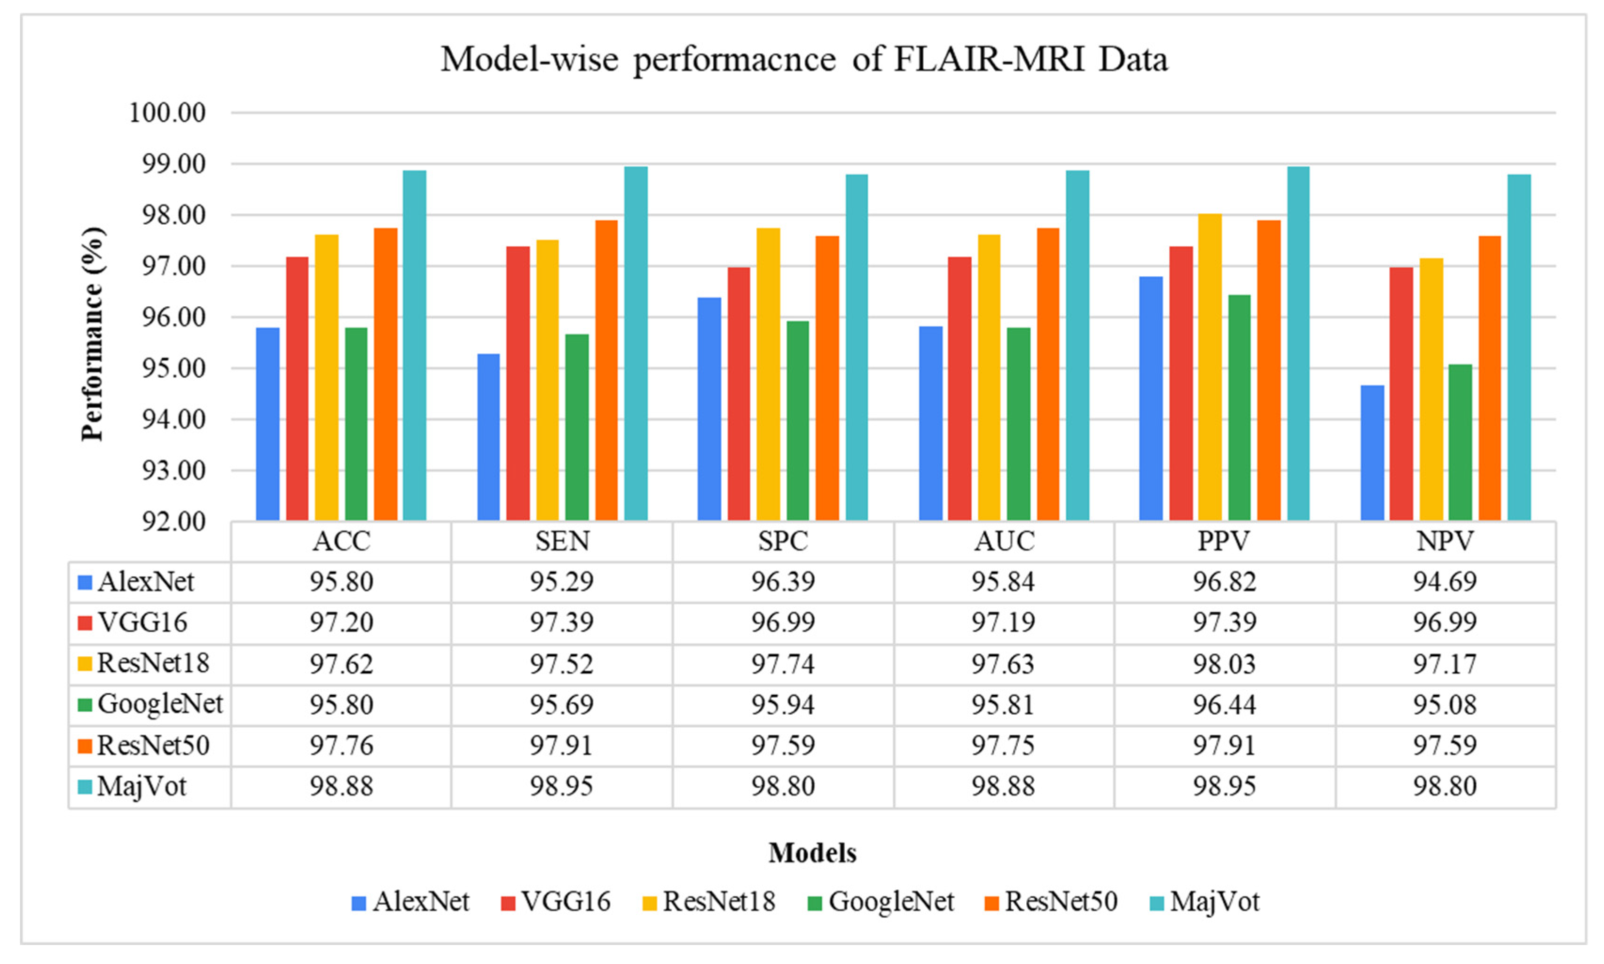
Result:

Slide 10

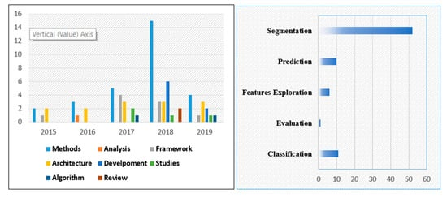
Cont.....

Slide 11
Conclusion:
In conclusion, tumor classification plays a crucial role in diagnosing and treating various types of cancer. By accurately categorizing tumors based on their histological, molecular, and genetic characteristics, medical professionals can tailor treatment plans to individual patients, improving outcomes and prognosis. Continued advancements in technology and research are enhancing our understanding of tumor classification, paving the way for more personalized and effective therapies in the fight against cancer.

Slide 12

THANK YOU

