Slide 1


Slide 2

Agenda
Problem Statement
Data Description
Objective Key Metrics and Visualizations
Subjective Question for Insights

Slide 3

Problem Statement
You are hired as a data analyst at Chinook, and your objective is to analyze music record sales data to gain insights and make recommendations for the company's strategy in the physical music market.

Slide 4
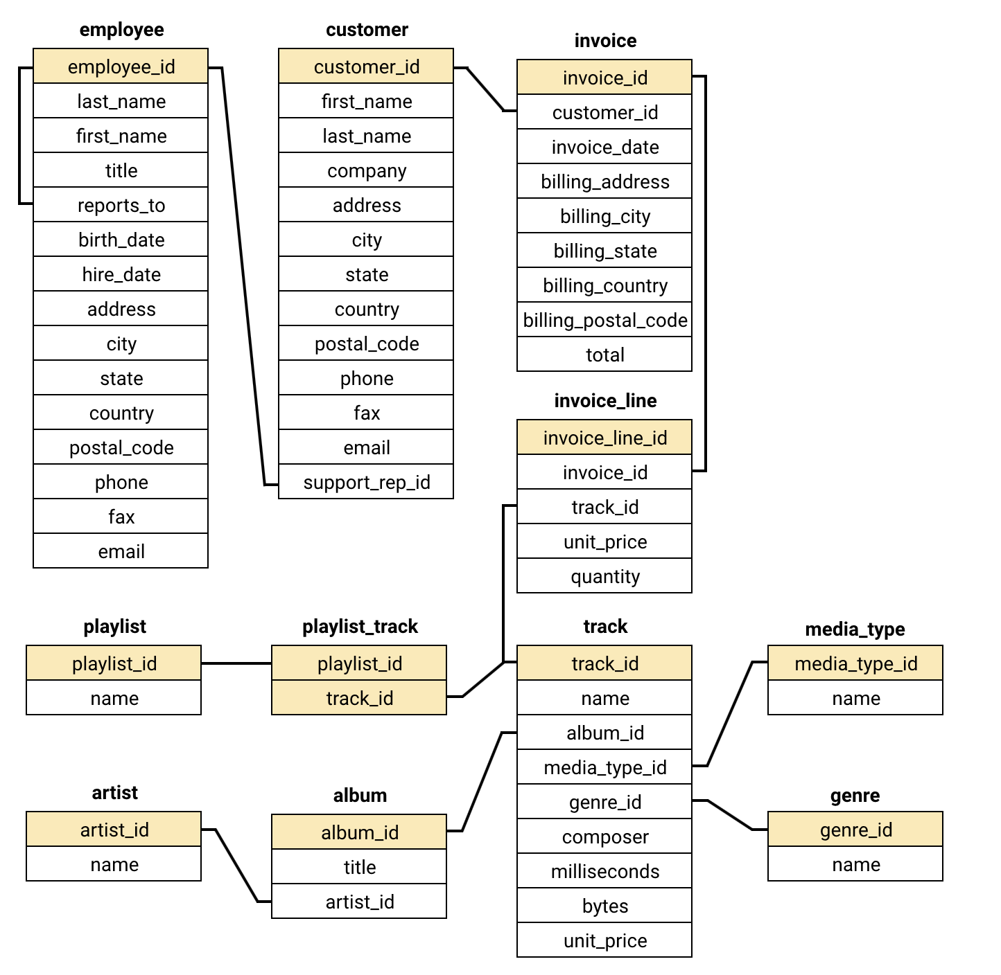
Database Schema

Slide 5
Data Description
customer:
customer_id: Unique identifier assigned to each customer.
first_name: The given name or first name of a customer.
last_name: The surname or family name of a customer.
company: The name of the company associated with a customer.
address: The street address of a customer's location.
city: The city where a customer is located.
state: The state or province where a customer is located.
country: The country where a customer is located.
postal_code: The postal or zip code of a customer's address.
phone: The phone number of a customer.
fax: The fax number associated with a customer.
email: The email address of a customer.
support_rep_id: The employee ID of the support representative assigned to a customer.
invoice_line:
invoice_line_id: Unique identifier assigned to each line item on an invoice.
invoice_id: The invoice ID to which the line item belongs.
track_id: The ID of the track or product included in the line item.
unit_price: The price per unit for the line item.
quantity: The quantity of units for the line item.

Slide 6
Data Description
invoice:
invoice_id: Unique identifier assigned to each invoice.
customer_id: The customer ID associated with the invoice.
invoice_date: The date when the invoice was generated or issued.
billing_address: The street address used for billing purposes.
billing_city: The city used for billing purposes.
billing_state: The state or province used for billing purposes.
billing_country: The country used for billing purposes.
billing_postal_code: The postal or zip code used for billing purposes.
total: The total amount due on the invoice.
playlist:
playlist_id: Unique identifier assigned to each playlist.
name: The name or title of the playlist.
playlist_track:
playlist_id: The ID of the playlist to which the track belongs.
track_id: The ID of the track included in the playlist.
genre:
genre_id: Unique identifier assigned to each genre.
name: The name or description of the genre (e.g., rock, pop, classical).

Slide 7
Data Description
track:
track_id: Unique identifier assigned to each track or song.
name: The title or name of the track.
album_id: The ID of the album to which the track belongs.
media_type_id: The ID of the media type associated with the track.
genre_id: The ID of the genre associated with the track.
composer: The name of the composer or artist who composed the track.
milliseconds: The duration of the track in milliseconds.
bytes: The file size of the track in bytes.
unit_price: The price per unit for the track.
album:
album_id: Unique identifier assigned to each album.
title: The title or name of the album.
artist_id: The ID of the artist associated with the album.
artist:
artist_id: Unique identifier assigned to each artist.
name: The name of the artist.
media_type:
media_type_id: Unique identifier assigned to each media type.
name: The name or description of the media type (e.g., MPEG audio file, AAC audio file).

Slide 8
Data Cleaning & Preparation
Before initiating the analysis, a preliminary data quality assessment was conducted to identify missing values, duplicate records, and potential inconsistencies. Core transactional fields such as invoice_date, total, track_id, and customer_id were found to be complete and reliable, ensuring the accuracy of sales and customer behavior analysis.
Some optional attributes in the customer table, including state, fax, phone and company, contained missing values. These fields were not critical to the scope of the analysis and were therefore retained without modification.
Duplicate checks were performed using grouping techniques. Repeated entries, such as multiple purchases of the same track within a single invoice, were expected business scenarios rather than data quality issues. Overall, the dataset was well structured and

Slide 9
OBJECTIVE KEY METRICS AND VISUALIZATIONS

Slide 10
Customer Demographic Distribution
The Graph provides us with the information about the Customer distribution across all the countries
USA have the highest no.of customers with count as 13 and followed by Canada, Brazil and France.
Countries like Germany, UK, Czech Republic, Portugal and India have moderate no.of customers with count of 2 to 4.
While most of the countries have only a single customer.

Slide 11
Top 10 Countries in terms of Revenue
The Graph provides us with the information about the top 10 music sales revenue across all the countries
USA have the highest sales revenue with 1040.5$ and followed by Canada, Brazil and France.
Countries like Germany, UK and Czech Republic have little high sales revenue from 245$ to 335$.
While other 3 countries have moderate sale revenue from 115$ to 185$.

Slide 12
Top 5 Genres in USA in terms of Revenue
From the Graph we can get the insights about the Top 5 Genres in USA in terms on sales revenue
The Rock genre has the highest sales revenue with 555$ which is also most popular genre in USA.
Alternative & Punk and Metal have almost same revenue by which we can say that both are equally popular in USA.
While R&B/Soul and Blues gernes have moderate sales revenue with 52$ and 36$.

Slide 13
Top 5 Artists in USA in terms of Revenue
From the Graph we can get the insights about the Top 5 Artistd in USA in terms on sales revenue
Van Halen is the top artist in USA with 525$ total revenue and 43 with total purchase.
The artists Eric Clapton and Nirvana was almost same in terms of total revenue and purchases.
While The Rolling Stones and Marvin Gaye have moderate sales of 385 to 400$ with 37 and 26 total purchases.

Slide 14
Top 5 Tracks in USA in terms of Revenue
The Graph provide us with information about Top 5 tracks in USA in terms of sales revenue.
War Pigs being the top track with 62 $ which is from Rock genre.
Scentless Apprentice have little higher sales revenue of 45$ with 2nd top selling track in USA.
While the other 3 tracks have almost same sales revenue with 38 and 37$ sales and holding 3rd, 4th and 5th places in USA.

Slide 15
Top 5 Tracks in USA in terms of Revenue
The Graph provide us with information of the customer churn rate.
A customer is considered churned if the customer hasn’t made any purchase in the last 6 months.
There are total of 59 customers out of which 16 customers are churn which is 27% of total this is a big problem to the music store in terms of customer retention and sales.
While 43 customers are active music store also must focum on the customer favorite genre, artist and albums to keep then engaged with the music store.

Slide 16
Subjective Analysis for Insights

Slide 17
Recommendation of Top 3 Albums based on Genre Sales
Rock dominates the chart, appearing in 3 of the top 5 albums and contributing the highest sales/revenue, indicating strong and consistent customer demand.
R&B/Soul shows steady performance, reflecting a loyal but niche audience.
Alternative & Punk demonstrates moderate engagement, appealing to specific listener segments but with lower overall impact than Rock.

Slide 18
Recommendation of Top 3 Albums based on Genre Sales
Are You Experienced? (Rock)
  Highest overall performance and strong repeat purchase behavior
  Ideal for primary advertising investment
From the Muddy Banks of the Wishkah (Live) (Rock)
  Consistently high engagement and popularity among Rock listeners
  Suitable for continued promotion and bundling strategies
The Doors (Rock)
  Strong brand recognition and steady sales performance
  Effective for reinforcing Rock-focused marketing campaigns

Slide 19
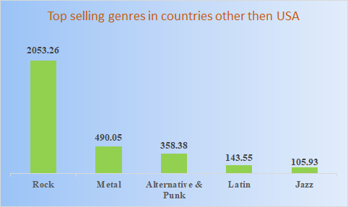
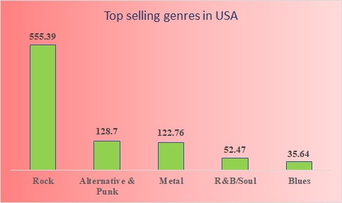
Top Selling Genres in Countries other than USA
From the charts we can observe some similarities between them, such as Rock genre being the most selling not only in USA but also in other countries as well.
Metal and Alternative & Punk were in the 2nd and 3rd place in other countries but where as in USA the positions got swapped that is Alternative & Punk was at 2nd and Metal was at 3rd place.
When it comes to 4th and 5th place it belongs to Latin and Jazz genres in other countries, In USA 4th and 5th position was taken by R&B/Soul and Blues.

Slide 20
Customer Purchasing Behaviour Analysis
I have broke the data for Long-team as 3/4th and for New as 1/4th the data and we can see same patterns were followed by avg_purchase_frequency, avg_basket_size and avg_total_amount for long team customers as well as new customers.
We can see that the 3 behaviours are following same pattern I can say that Long-term customer retention and loyalty towards Chinook Music Store is high.
The average no.of purchases by the customers in every year being the same says that the Chinook Music Store was able to satisfy the customer music needs to gain their loyalty.

Slide 21
Customer Regional Market Analysis
Many countries like Australia, Finland, Hungary, Italy, Poland have a single customer with multiple invoices and with 0 churn percentage.
Countries with less churn percentage such as USA with 23% have 13 customers and Canada with 12.5% with 8 customers, this shows that this countries have very good retention rate with more customers.
Countries with little higher churn percentage like India with 50%, Germany with 60% and United Kingdom with 33% have more then 3 customers, they should focus on customer retention rather then attracting new customers.

Slide 22
Customer Regional Market Analysis
Argentina, Austria, Belgium, Chile etc have 100% churn percentage with only single customer with very less order repetition.
Recommendations
Chinook Music store must focus on customer retention in countries with moderate churn rate and few customers like Germany, United Kingdom and India.
Countries with 0% churn rate with single customer must focus on attracting new customers and with very high product publicity and recommendations on basis of customer likings.
Countries with high and very high churn rate such as Brazil, Argentina, Austria much clearly focus on customer retention also on product recommendation and new gaining new customers.

Slide 23
Customer Purchasing Behaviour Analysis
Low-risk customers outperform high-risk customers across all key metrics, including total spending, number of orders, and average order value.
Low-risk customers have a higher average total spend (~82.7) and more frequent purchases (~10.9 orders), indicating strong engagement and loyalty.
High-risk customers show lower spending (~72.9) and fewer orders (~9.1), suggesting reduced engagement and a higher likelihood of churn.
The average order value is also slightly higher for low-risk customers, reinforcing their higher lifetime value.

Slide 24
Customer Lifetime Value Model
Active customers contribute significantly higher lifetime value compared to churned customers across all key metrics.
Active customers show much higher total spending (~3525) and greater order volume (~456 orders), indicating strong engagement and long-term loyalty.
Churned customers have substantially lower spending (~1184) and fewer total orders (~158), reflecting declining engagement before churn.
The customer count is higher among active customers, highlighting the importance of retention in sustaining overall revenue.

Slide 25
Recommendations
Strengthen loyalty programs for high Customer Lifetime Value customers to maximize lifetime value and sustain engagement.
Re-engage high value customers (e.g., customers like Manoj Pareek) through personalized email offers, curated playlists, or exclusive discounts.
Bundle high performing genres such as Rock, Alternative, and Metal into subscriptions or promotional packages to increase average revenue per user.
Prioritize top performing countries like the Czech Republic and Ireland with localized campaigns and tailored promotions.
Launch win back campaigns for mid-value churned customers using limited-time offers, personalized content, or genre based recommendations.
Implement early churn detection by monitoring declining purchase frequency and engagement to proactively retain customers.

Slide 26
Conclusion
The analysis reveals clear patterns in customer purchasing behavior, regional trends, and genre preferences, enabling more targeted business decisions.
Rock and Alternative genres dominate sales across multiple regions, particularly in high performing countries, highlighting strong cross selling potential.
High Customer Lifetime Value customers demonstrate consistent engagement and higher purchase frequency, making them critical to long-term revenue stability.
A noticeable share of valuable customers has churned, indicating gaps in retention and re-engagement strategies.
Differences in purchasing behavior across regions and customer segments emphasize the need for segmented and region specific strategies rather than uniform marketing approaches.

Slide 27


