Slide 1
Cartpole Balancing using
Reinforced Learning
Major Project on
Sharoon Saxena Yogender Singh
0902IT151045 0902IT151060

Slide 2
Overview
What is Reinforced Learning
Brute Force Approach
Weighed Vector Approach
Neural Network Approach
Reinforced Approach

Slide 3
Reinforced Learning
A self learning agent that interacts witht the environment by taking actions depending on its state.
Each action taken, causes the change in state of agent’s state and giving a positive or negative reward.
Depending on the Nature of Reward, Agent might repeat or avoid certain behaviours.

Slide 4
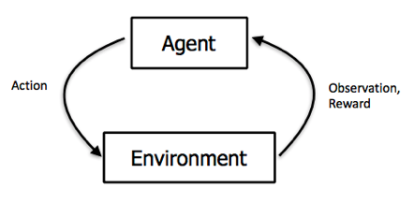
Reinforced Learning: Cart Pole
Until episode ends
Agent observes environment
Agent takes action
Observe Reward from last step
Observe the new state of
environment
Take next Action

Slide 5
Reinforced Learning
Fundamentally contains 3 components
Environment
Agent
Policy

Slide 6
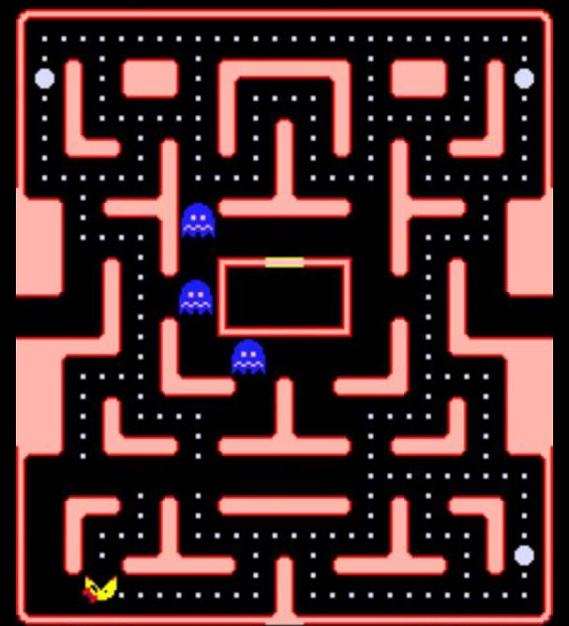
Reinforced Learning: Components
Environment
Finite
Well defined

Slide 7
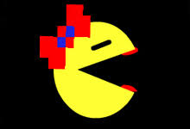
Reinforced Learning: Components
Agent
Interacts with environment
Receives positive or negative reward

Slide 8
Reinforced Learning: Components
Policy:
Earn as many Points
Avoid being eaten
Rewards are given on the basis of Policy.

Slide 9
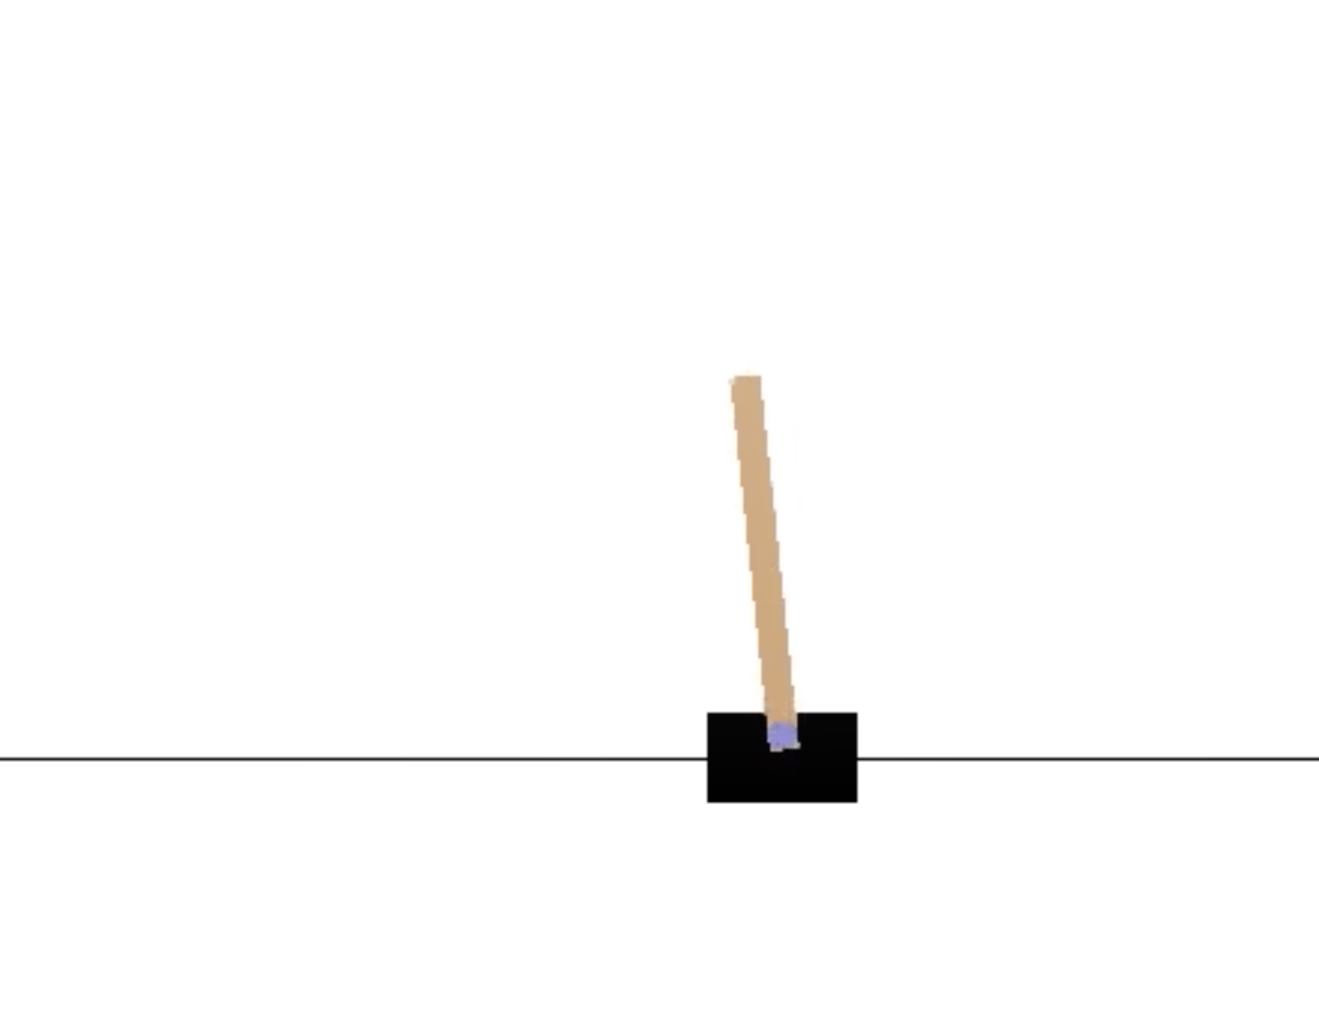
Reinforced Learning

Slide 10
Reinforced Learning
Agent

Slide 11
Reinforced Learning
Agent
(Cart)
Environment
(Road)

Slide 12
Reinforced Learning: Cart Pole
Policy:
Balance for as long as possible
Agent
Environment

Slide 13
Reinforced Learning: Cart Pole (Policy)
Positive reward (+1) for every time frame the pole survives falling
No negative Reward Needed (game ends when pole falls, could not maximise score)
Aim: Maximise Reward

Slide 14
Reinforced Learning: Cart Pole (Policy)
We basically implemented 4 methods to the cartpole problem
Brute force Approach
Weighed Vector Approach
Deep Neural Network Approach
Reinforced Learning Approach

Slide 15
Brute Force Approach
Observe the tilt of pole.
Move the carriage in the respective direction

Slide 16
Brute Force Approach
Observe the tilt of pole.
Move the carriage in the respective direction

Slide 17
Brute Force Approach: Results & Observations
Approach performs very poorly because it does not take into consideration the degree of present state, i.e. how much the pole is tilted
On 10 trail of runs the max time of survival is 118 timesteps and average survival time of about 21 time steps which is sub par.

Slide 18
Weighed Vectors
Pole Position divided into 4 parts
Each Position has a weight Vector Associated to it
Acceleration of the cart depends upon the position in which the pole is
(stronger acceleration for 4,3)
2
1
4
3

Slide 19
Weighed Vectors: Results and Observations
This method outperforms the previous method
Does not uses any machine learning algorithm
With proper number of games played this approach can last for more than 1000 time steps
On 10 episodes of this algorithm max score achieved was 762 and avg score of about 315
Can obtain better results with more calculated weight vectors

Slide 20
Neural Networks
First step would be to obtain a dataset to train the neural network upon.
We ran 50,000 episodes of brute force approach
Minimum threshold of selection = 100 time steps
If an episode lasts longer than that, add that to the training set
Else discard
(we need quality data to train on)
We train a Sequential Neural Network on the the dataset we obtained
It learns the pattern of successful cart pole balancing.

Slide 21
Neural Networks
First step would be to obtain a dataset to train the neural network upon.
We ran 50,000 episodes of brute force approach
Minimum threshold of selection = 100 time steps
If an episode lasts longer than that, add that to the training set
Else discard
(we need quality data to train on)
We train a Sequential Neural Network on the the dataset we obtained
It learns the pattern of successful cart pole balancing.
BORING , isn’t it?

Slide 22
Neural Networks: Observation and Results
No wonder in what a Neural network is capable of doing
Could easily learn the cart pole balancing from the dataset we created
Max Score was 1701 time frames and averaging 1200 time frames
“Many a times it is not possible to obtain a large dataset in order to train a Neural Network, It has always been a bottle neck”

Slide 23
Reinforced Learning
Uses a technique in which the model is rewarded if it makes correct action, penalty otherwise
Actions are made, given the observations of a state
initially the model will not be very good at guessing the output
slowly it will become good at predicting the output
Exploration and exploitation is carried simultaneously to find new improved solutions and to find the good solution in explored search space

Slide 24
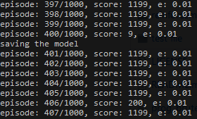
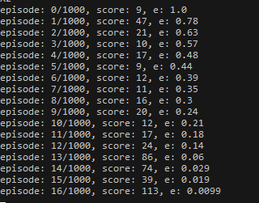
Reinforced Learning: Results and Observation
We can see that initially the model was not able to perform very good
Eventually it learns from its mistakes and performs very good
1199 is the upper time limit ...after this game is forcefully closed
Even higher avg score can be achieved by training longer and increasing the time limit

Slide 25
Reinforced Learning: Results and Observation
Agent was Completely Self Taught
No prior Requirement of any dataset
Removes the BottleNeck of huge data need for Deep Learning

