Slide 2

C1W2 Slides

Slide 3
Select and train model
Modeling overview

Slide 4
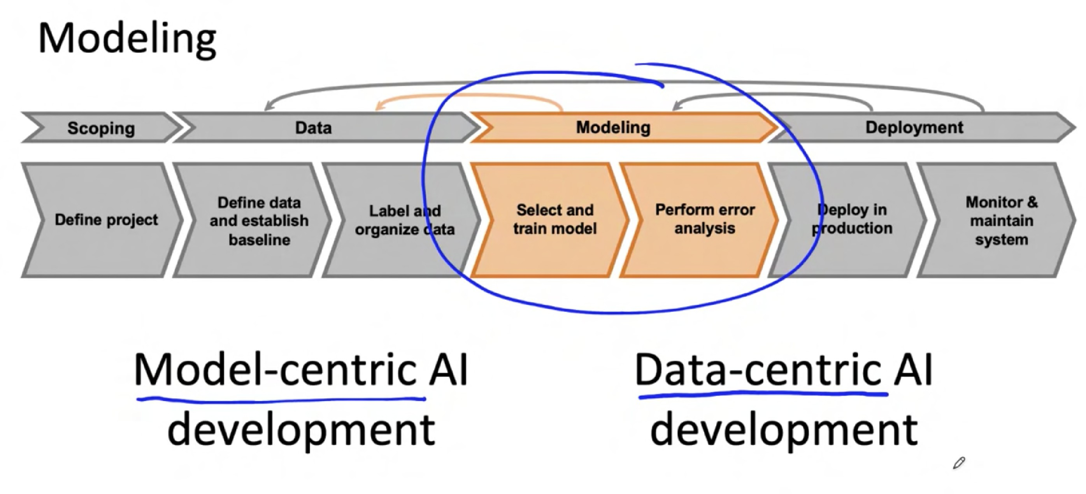


Modeling
Scoping
Data
Modeling
Deployment
Define data and establish baseline
Label and organize data
Select and train model
Perform error analysis
Deploy in production
Monitor & maintain system
Define project

Slide 5
Select and train model
Key challenges

Slide 6
AI system = Code + Data
(algorithm/model)

Slide 7
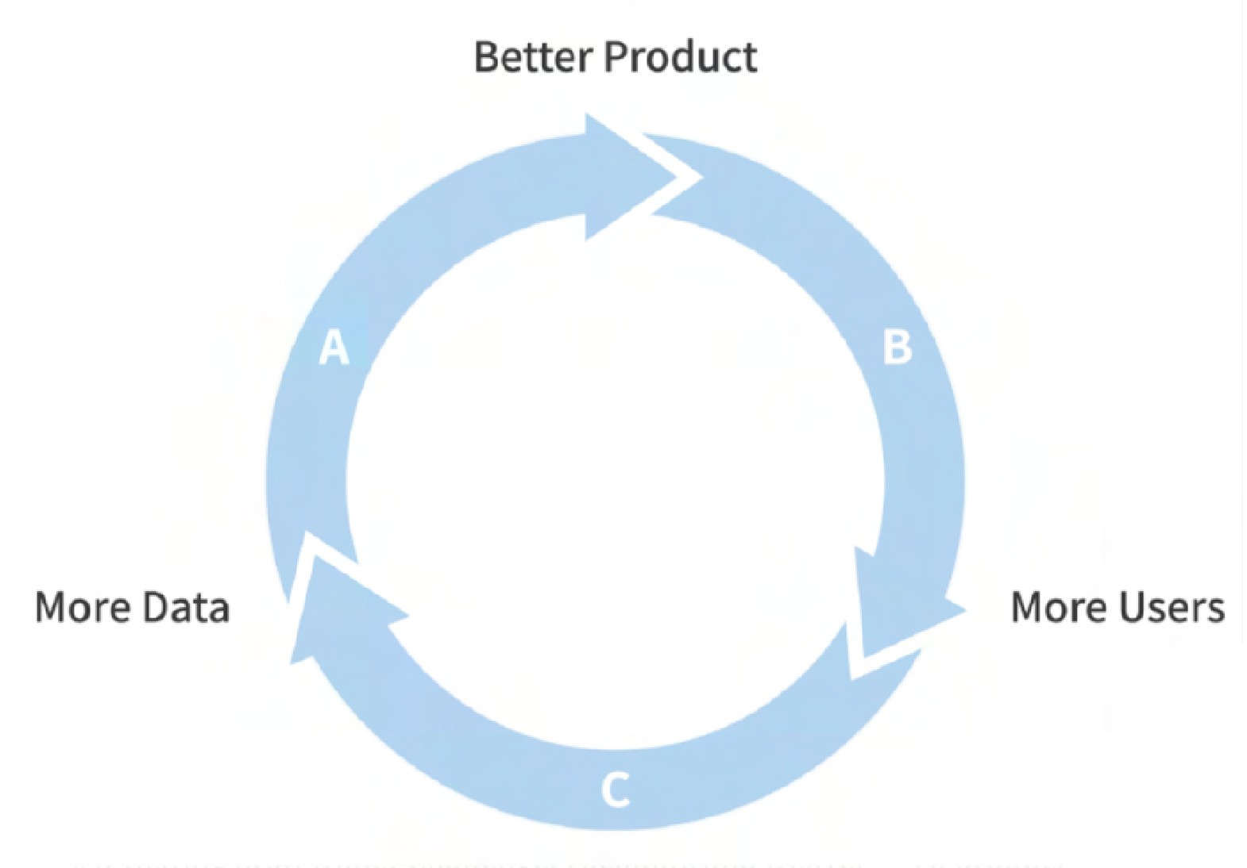

Model development is an iterative process
Model + Hyperparameters + Data
Algorithm/Model
Hyperparameters
ML Model
Data
Error analysis
Training
Audit performance

Slide 8

Challenges in model development
1. Doing well on training set (usually measured by average training error).
Price
2. Doing well on dev/test sets.
Size
3. Doing well on business metrics/project goals.

Slide 9

Select and train model
Why low average
test error isn’t good enough

Slide 10

Performance on disproportionately important examples
Web Search example
"Apple pie recipe" "Latest movies"
Informational and Transactional queries
"Wireless data plan"
"Diwali festival"
"Stanford"
"Reddit"
"Youtube"
Navigational queries

Slide 11
Performance on key slices of the dataset
Example: ML for loan approval
Make sure not to discriminate by ethnicity, gender, location, language or other protected attributes.
Example: Product recommendations from retailers
Be careful to treat fairly all major user, retailer, and product categories.

Slide 12
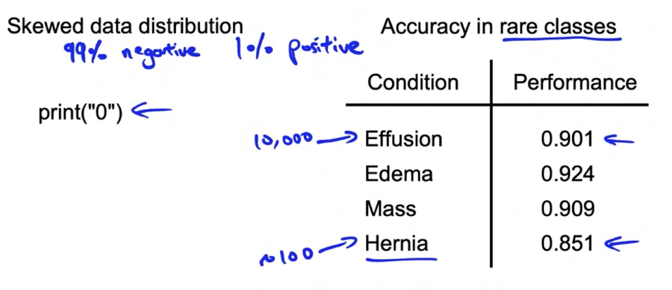
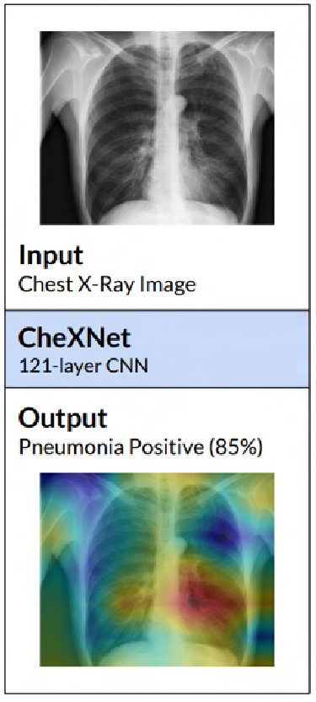
Rare classes
Skewed data distribution
Accuracy in rare classes
Condition Performance
print("0")
Effusion Edema Mass Hernia
0.901
0.924
0.909
0.851

Slide 13


Unfortunate conversation in many companies
MLE: "I did well on the test set!"
Product Owner: "But this doesn't work for my application"
MLE: "But... I did well on the test set!"

Slide 14

Select and train model
Establish a baseline

Slide 15

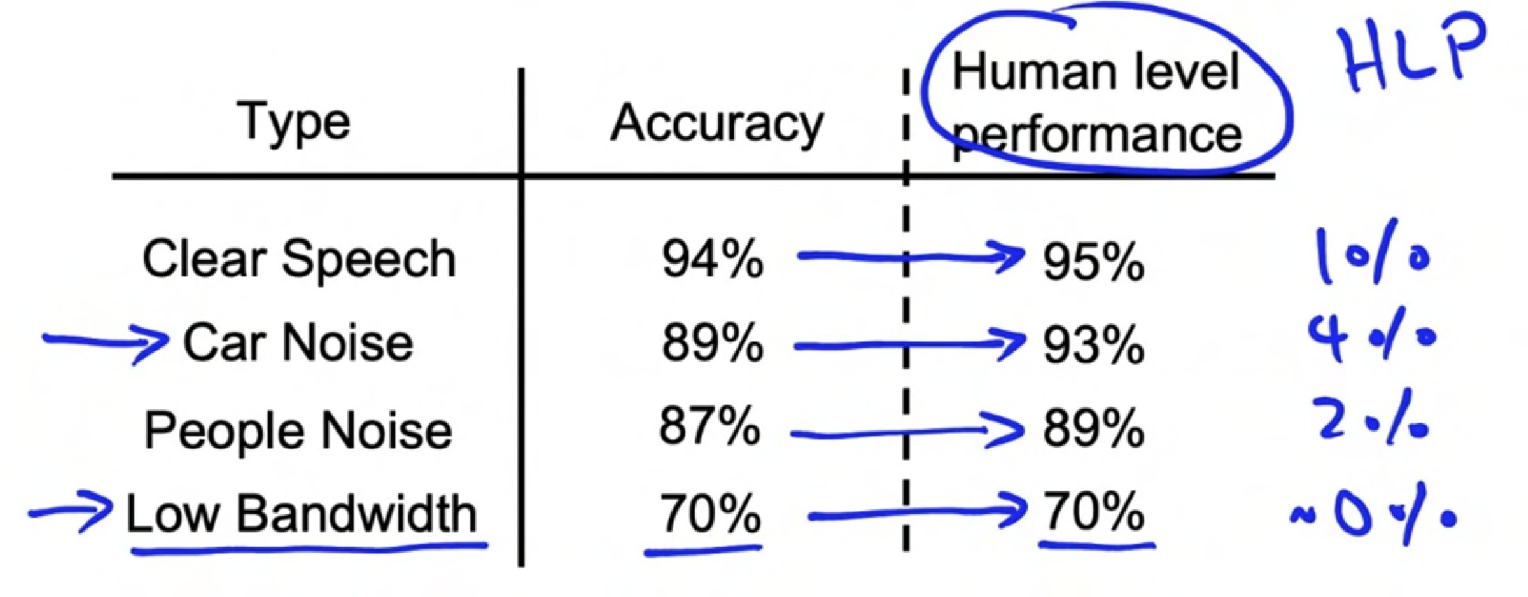
Establishing a baseline level of performance
Speech recognition example:
Human level
Type | Accuracy | performance
Clear Speech | 94% | 95%
Car Noise | 89% | 93%
People Noise | 87% | 93%
Low Bandwidth | 70% | 70%

Slide 16


Structured and unstructured data
Unstructured data
Structured Data
Image
Audio
User Id | Purchase |  | Number | Price
3421 | Blue shirt |  | 5 | $20
612 | Brown shoes |  | 1 | $35
 | Price | Product
 | 3421 | Red skirt
Text
This restaurant was great!

Slide 17
Ways to establish a baseline
Human level performance (HLP)
Literature search for state-of-the-art/open source
Older system
Baseline gives an estimate of the irreducible error / Bayes error and indicates what might be possible.

Slide 18
Select and train model
Tips for getting started

Slide 19

ML is an iterative process
Model + Hyperparameters + Data
Error analysis
Training
Audit performance

Slide 20
Getting started on modeling
Literature search to see what’s possible.
Find open-source implementations if available.
A reasonable algorithm with good data will often outperform a great algorithm with not so good data.

Slide 21
Deployment constraints when picking a model
Should you take into account deployment constraints when picking a model?
Yes, if baseline is already established and goal is to build and deploy.
No, if purpose is to establish a baseline and determine what is possible and might be worth pursuing.

Slide 22

Sanity-check for code and algorithm
" Try to overfit a small training dataset before training on a large one.
audio transcript
X Y
" Example #1: Speech recognition
Example #2: Image segmentation
Example #3: Image classification

Slide 23
Error analysis and performance auditing
Error analysis example

Slide 24
Speech recognition example
Prediction
Car Noise
People Noise
Low Bandwidth
Example
Label
1
2
3
"Stir fried lettuce recipe" "Sweetened coffee" "Sail away song"
"Stir fry lettuce recipe" "Swedish coffee" "Sell away some"
4
"Let's catch up"
"Let's ketchup"

Slide 25



Iterative process of error analysis
Example
Propose tags
Visual inspection:
Product recommendations:
Specific class labels (scratch, dent, etc.)
Image properties (blurry, dark
background, light background, reflection….)
Other meta-data: phone model, factory
User demographics
Product features

Slide 26
Useful metrics for each tag
What fraction of errors has that tag?
Of all data with that tag, what fraction is misclassified?
What fraction of all the data has that tag?
How much room of improvement is there in that tag?

Slide 27
Error analysis and performance auditing
Prioritizing what to work on

Slide 28
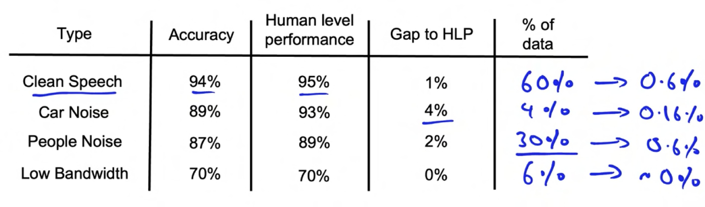
Prioritizing what to work on
Type | Accuracy | Human level performance | Gap to HLP | % of data
Clean Speech | 94% | 95% | 1% | 60%
Car Noise | 84% | 93% | 4% | 4%
People Noise | 87% | 84% | 2% | 30%
Low Bandwidth | 70% | 70% | 0% | 6%

Slide 29
Prioritizing what to work on
Decide on most important categories to work on based on:
How much room for improvement there is.
How frequently that category appears.
How easy is to improve accuracy in that category.
How important it is to improve in that category.

Slide 30
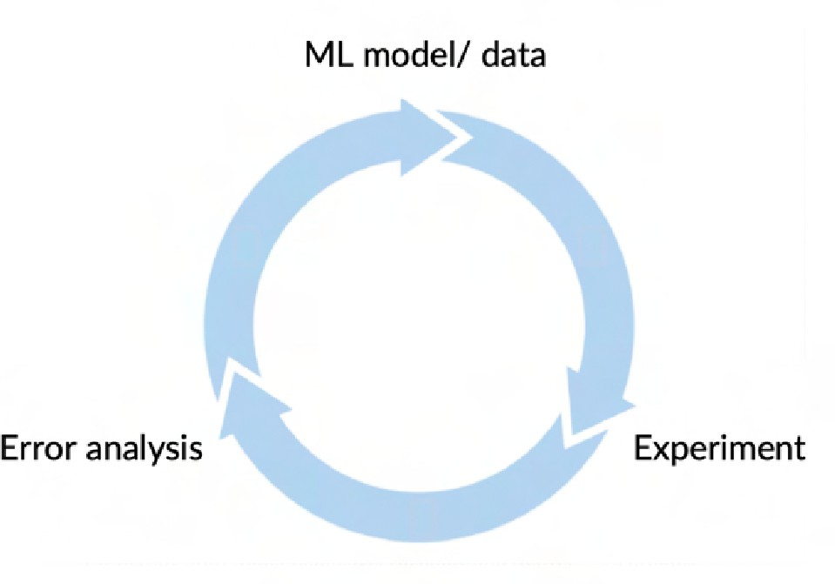
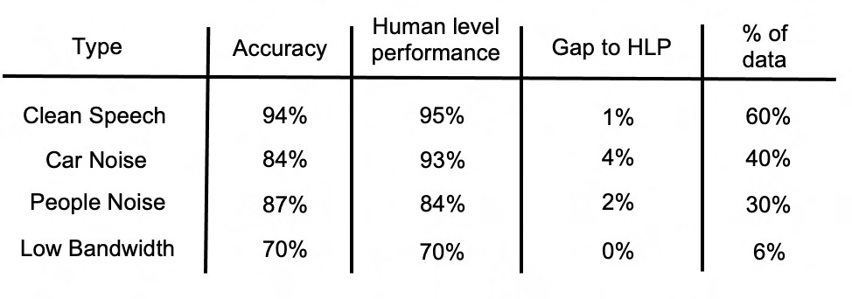
Adding data
For categories you want to prioritize:
Collect more data (or improve label accuracy)
Use data augmentation to get more data

Slide 31
Error analysis and performance auditing
Skewed datasets

Slide 32

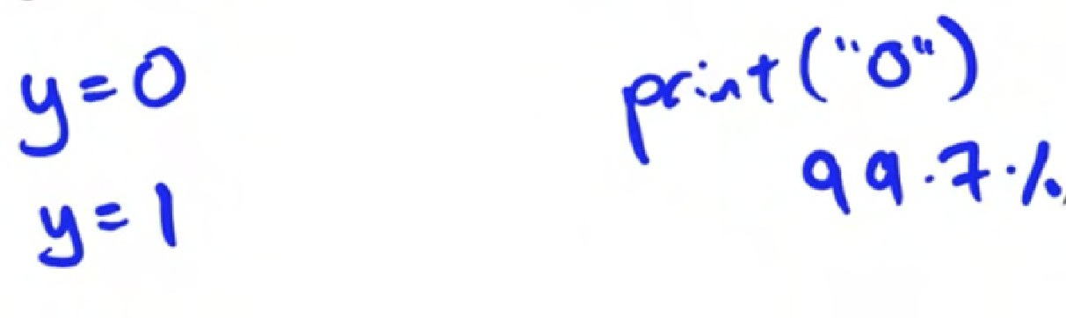


Examples of skewed datasets
Manufacturing example
99.7% no defect
0.3% defect
Medical Diagnosis example: 98% of patients don't have a disease
Speech Recognition example: In wake word detection, 96.7% of the time wake word doesn't occur

Slide 33
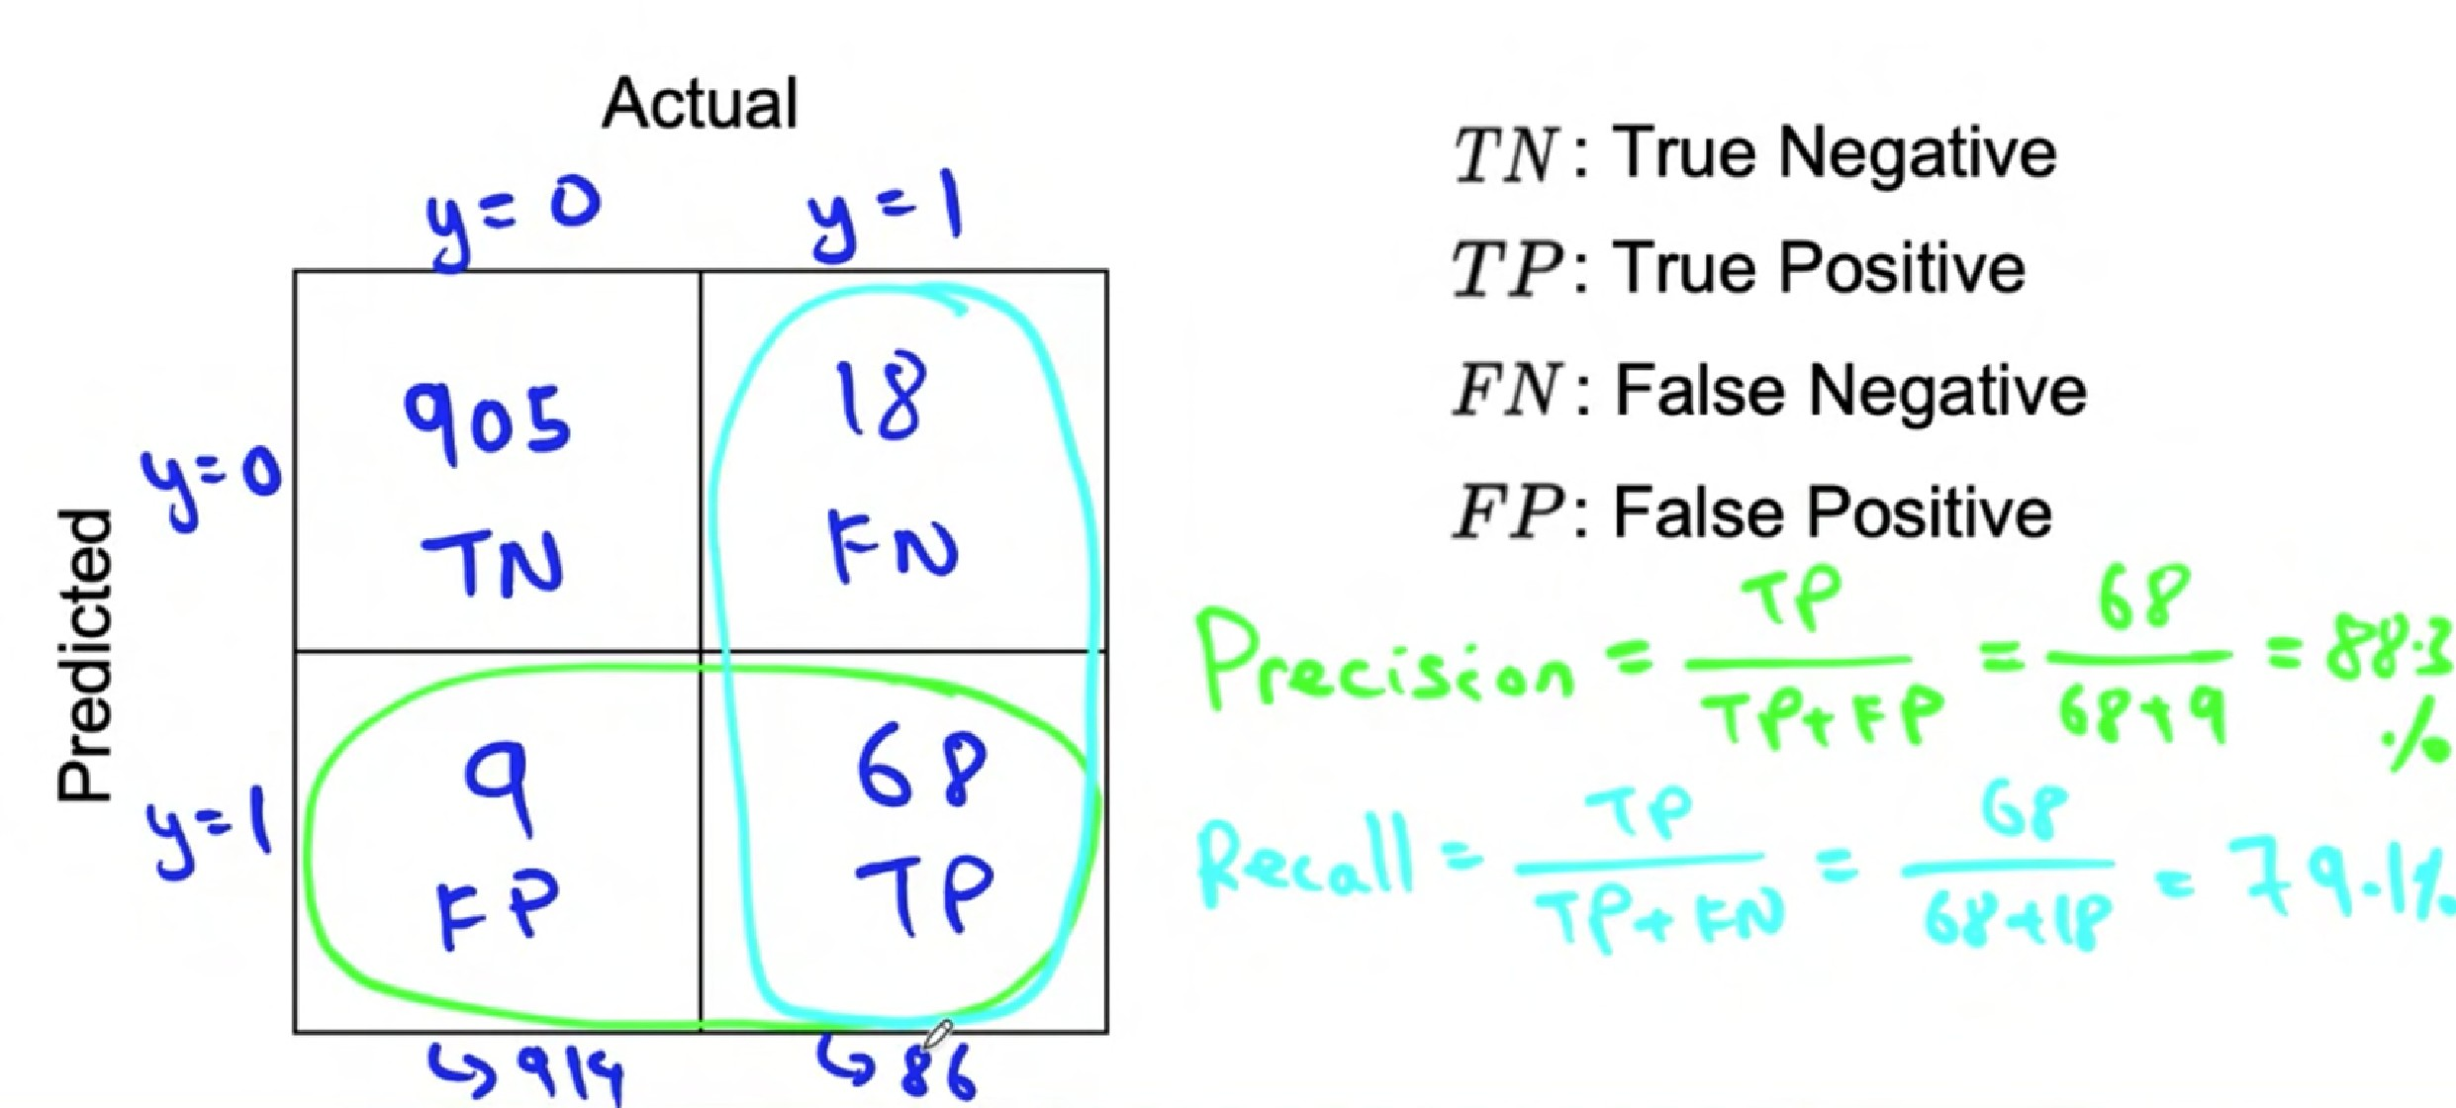


Confusion matrix: precision and recall
Actual
: True Negative
: True Positive
: False Negative
: False Positive
Predicted

Slide 34
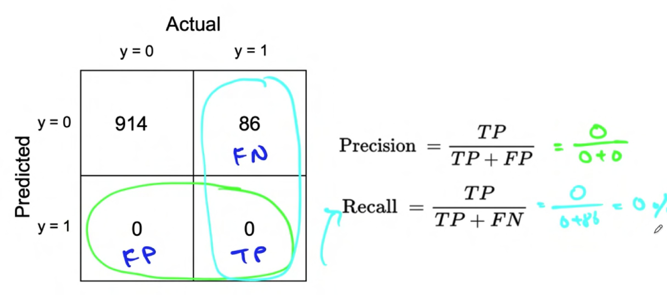


What happens with print(“0”)?
Actual
y = 0 y = 1
914 | 86
0 | 0
Predicted

Slide 35



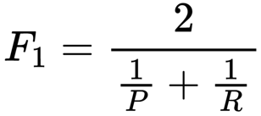
Combining precision and recall – F₁ score
Precision (
) Recall ( )
Model 1
88.3
79.1
83.4 %
Model 2
97.0
7.3
13.6 %

Slide 36
Multi-class metrics
Classes: Scratch, Dent, Pit mark, Discoloration
Defect Type
Precision
Recall
Scratch | 82.1% | 99.2% | 89.8%
Dent | 92.1% | 99.5% | 95.7%
Pit mark | 85.3% | 98.7% | 91.5%
Discoloration
72.1%
97%
82.7%

Slide 37
Error analysis and performance auditing
Performance auditing

Slide 38
Auditing framework
Check for accuracy, fairness and bias.
1. Brainstorm the ways the system might go wrong.
Performance on subsets of data (e.g., ethnicity, gender).
Prevalence of specific errors/outputs (e.g., FP, FN).
Performance on rare classes.
Establish metrics to assess performance against these issues on appropriate slices of data.
Get business/product owner buy-in.

Slide 39
Speech recognition example
Brainstorm the ways the system might go wrong.
Accuracy on different genders and ethnicities.
Accuracy on different devices.
Prevalence of rude mistranscriptions.
Establish metrics to assess performance against these issues on appropriate slices of data.
Mean accuracy for different genders and major accents.
Mean accuracy on different devices.
Check for prevalence of offensive words in the output.

Slide 40
Data iteration
Data-centric AI development

Slide 41
Data-centric AI development
Model-centric view Data-centric view
Collect what data you can, and develop a model good enough to deal with the noise in the data.
The consistency of the data is paramount. Use tools to improve the data quality; this will allow multiple models to do well.
Hold the data fixed and iteratively improve the code/ model.
Hold the code fixed and iteratively improve the data.

Slide 42
Data iteration
A useful picture of data augmentation

Slide 43
Speech recognition example
Different types of speech input:
Car noise
Plane noise
Train noise
Machine noise
Cafe noise
Library noise
Food court noise

Slide 44
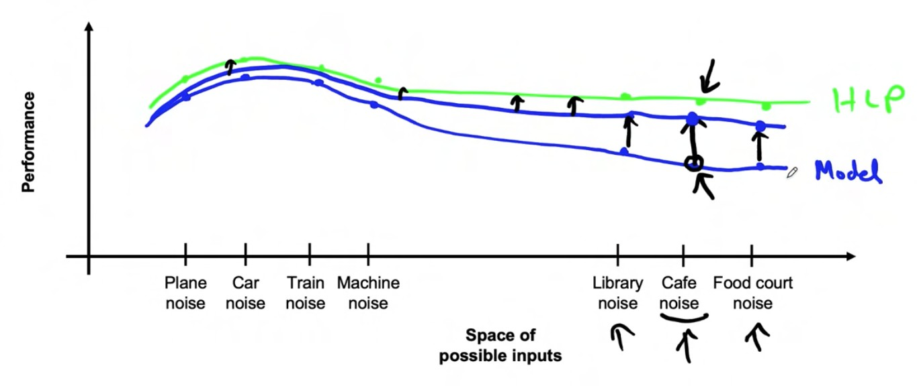


Speech recognition example
Performance
Plane noise
Car noise
Train Machine noise noise
Library Cafe Food court noise noise noise
Space of possible inputs

Slide 45
Data iteration
Data augmentation

Slide 46
Data augmentation
Goal:
Create realistic examples that (i) the algorithm does poorly on, but (ii) humans (or other baseline) do well on
Checklist:
Does it sound realistic?
Is the X !
speech?)
Is the algorithm currently doing poorly on it?
Y mapping clear? (e.g., can humans recognize

Slide 47
The rubber sheet analogy
Performance
Plane noise
Car noise
Train Machine noise noise
Library Cafe Food court noise noise noise
Space of possible inputs

Slide 48
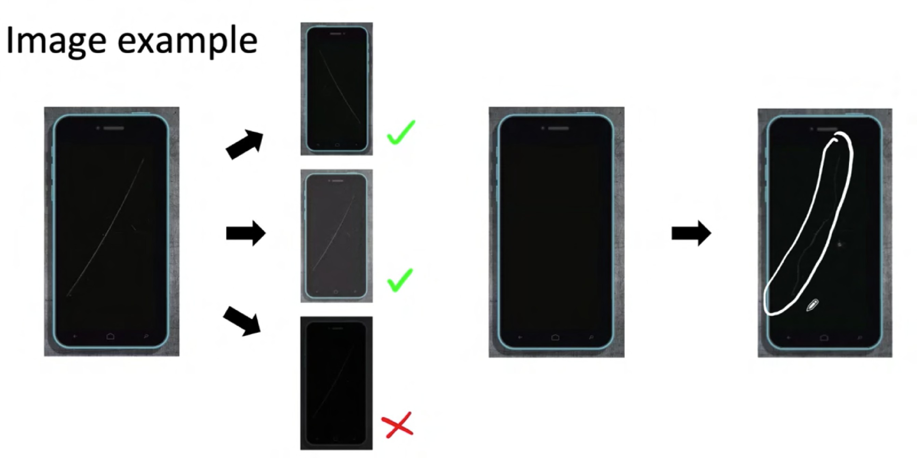





Image example

Slide 49
Data iteration loop
Add/Improve Data (holding model fixed)
Error analysis
Training

Slide 50
Data iteration
Can adding data hurt?

Slide 51
Can adding data hurt performance?
For unstructured data problems, if:
The model is large (low bias).
The mapping X !
predictions).
Then, adding data rarely hurts accuracy.
Y is clear (e.g., humans can make accurate

Slide 52
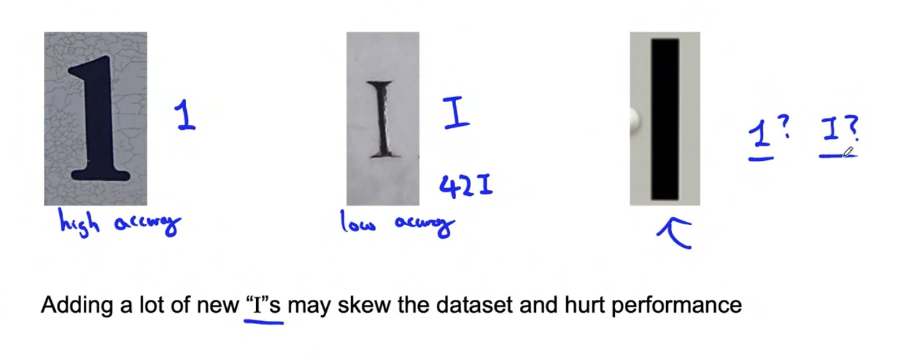



Photo OCR counterexample
Adding a lot of new "I"s may skew the dataset and hurt performance

Slide 53
Data iteration
Adding features

Slide 54

Structured data
Restaurant recommendation example
Vegetarians are frequently recommended restaurants with only meat options.
Possible features to add?
Is person vegetarian (based on past orders)?
Does restaurant have vegetarian options (based on menu)?

Slide 55
Other food delivery examples
Only tea/coffee
Only pizza
What are the added signals (features) that can help make a decision? Product recommendation:
Collaborative filtering
Context based filtering

Slide 56
Data iteration
Model architecture (add features)
" Error analysis can be harder if there is no good baseline (such as HLP) to compare to.
" Error analysis, user feedback and benchmarking to competitors can all provide inspiration for features to add.
Error analysis
Training

Slide 57
Data iteration
Experiment tracking

Slide 58
Experiment tracking
Algorithm/code versioning
Text files
What to track?
Dataset used
Tracking tools
Spreadsheet
Hyperparameters
Experiment tracking system
Results
Data needed to replicate results
Desirable features
In-depth analysis of experiment results
Perhaps also: Resource monitoring, visualization, model error analysis

Slide 59
Data iteration
From big data to good data

Slide 60
From Big Data to Good Data
Try to ensure consistently high-quality data in all phases of the ML project lifecycle.
Good data is:
Cover of important cases (good coverage of inputs x)
Defined consistently (definition of labels y is unambiguous)
Has timely feedback from production data (distribution covers data drift and concept drift)
Sized appropriately

