Slide 1
Copyright Notice
These slides are distributed under the Creative Commons License.
DeepLearning.AI makes these slides available for educational purposes. You may not use or distribute these slides for commercial purposes. You may make copies of these slides and use or distribute them for educational purposes as long as you
cite DeepLearning.AI as the source of the slides.
For the rest of the details of the license, see https://creativecommons.org/licenses/by-sa/2.0/legalcode

Slide 2
Model Serving
Welcome

Slide 3
Introduction to Model Serving
Introduction

Slide 4






What exactly is Serving a Model?
Training a model is only the ﬁrst part
Provide service or app for interaction
Make your model available to end user

Slide 5


Model Serving Patterns
A model,
An interpreter, and
Input data
Inference

Slide 6
ML workﬂows
Model training
Model prediction
Batch inference
Realtime inference

Slide 7

Important Metrics
Latency
Metrics to Optimize
Cost
Throughput

Slide 8



Latency
100ms
200ms
Latency = 100 + 200 = 300ms
Delay between user’s action and response of application to user’s action.
Latency of the whole process, starting from sending data to server, performing inference using model and returning response.
Minimal latency is a key requirement to maintain customer satisfaction.

Slide 9
Throughput
➔ Throughput -> Number of successful requests served per unit time say one second.
➔ In some applications only throughput is important and not latency.

Slide 10

Cost
The cost associated with each inference should be minimised.
Important Infrastructure requirements that are expensive:
CPU
Hardware Accelerators like GPU
Caching infrastructure for faster data retrieval.

Slide 11
Minimizing Latency, Maximizing Throughput
Minimizing Latency
Airline Recommendation Service
Reduce latency for user satisfaction
Maximizing Throughput
Airline recommendation service faces high load of inference requests per second.
Scale infrastructure (number of servers, caching requirements etc.) to meet requirements.

Slide 12

Balance Cost, Latency and Throughput
Cost increases as infrastructure is scaled
In applications where latency and throughput can suffer slightly:
Reduce costs by GPU sharing
Multi-model serving etc.,
Optimizing models used for inference

Slide 13
Introduction
Resources and Requirements for Serving Models

Slide 14
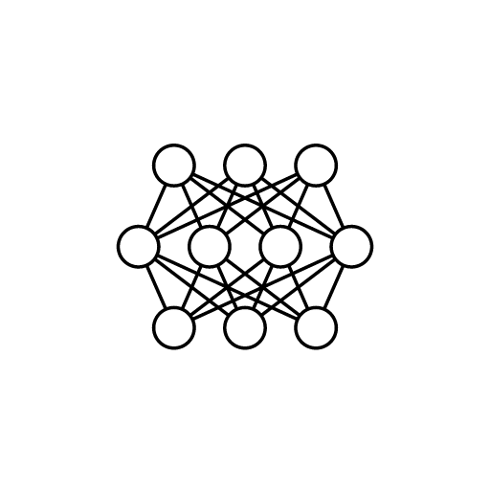



Optimizing Models for Serving
Model Size Complex functions
Prediction Latency Prediction Accuracy
Model Complexity

Slide 15
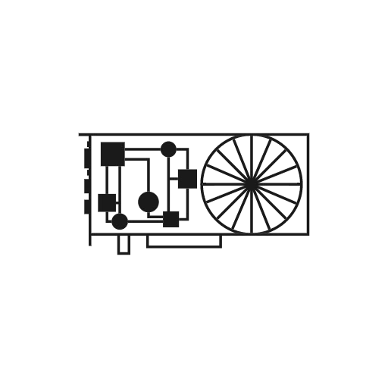



As Model Complexity Increases Cost Increases
GPU TPU
Model registry
Model Complexity
Maintenance burden

Slide 16

Balancing Cost and Complexity
The challenge for ML practitioners is to balance complexity and cost.

Slide 17



Optimizing and Satisﬁcing Metrics
Model’s optimizing metric:
Accuracy
Precision
Recall
Satisﬁcing (Gating) metric:
Latency
Model Size
GPU load

Slide 18



Optimizing and Satisﬁcing Metrics
Specify serving infrastructure
Increase model complexity
Improve predictive power
Hit gating metrics
Accept

Slide 19

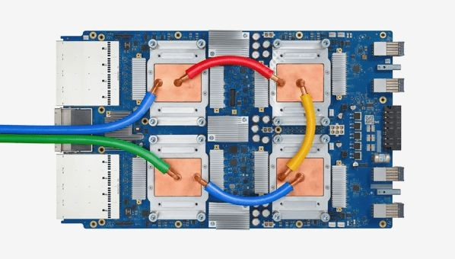
Use of Accelerators in Serving Infrastructure
GPUs for parallel throughput
TPUs for complex models and large batches
Hardware choices impact cost
Balancing complexity and hardware choices
Choices made at organizational level

Slide 20
Maintaining Input Feature Lookup
Prediction request to your ML model might not provide all features required for prediction
For example, estimating how long food delivery will require accessing features from a data store:
Incoming orders (not included in request)
Outstanding orders per minute in the past hour
Additional pre-computed or aggregated features might be read in real-time from a data store
Providing that data store is a cost

Slide 21

NoSQL Databases: Caching and Feature Lookup
Google Cloud Memorystore
In memory cache, sub-millisecond read latency
Google Cloud Firestore
Scaleable, can handle slowly changing data, millisecond read latency
Expensive. Carefully choose caching requirements
Google Cloud Bigtable
Scaleable, handles dynamically changing data, millisecond read latency
NoSQL
Databases
Amazon DynamoDB
Single digit millisecond read latency, in memory cache available

Slide 22


Model Deployments
Huge data centers
Embedded devices

Slide 23


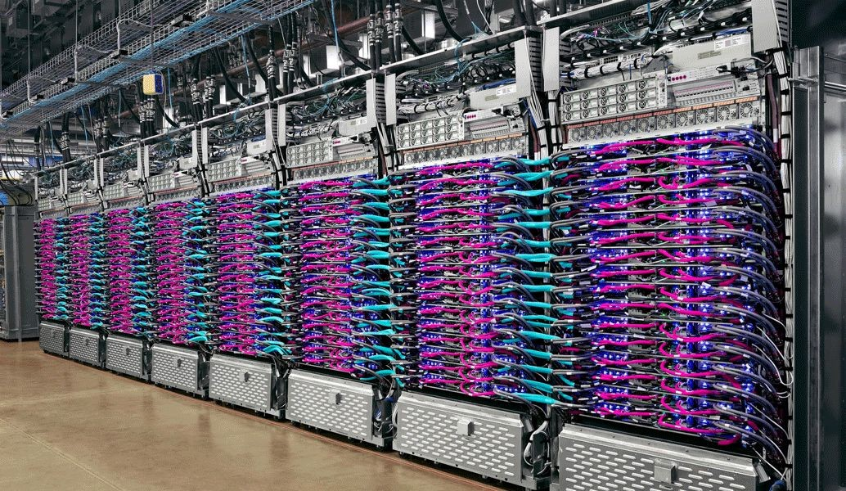

Running in Huge Data Centers
Model efﬁciency
Cost
Optimize resource utilization
Reduce cost

Slide 24



Constrained Environment: Mobile Phone
Average GPU memory size < 4GB.
Average Android app size ≅ 11MB
Users might not install your app if it uses too much storage

Slide 25






Restrictions in a Constrained Environment
X
Large, complex models
cannot be deployed to edge devices
Will not work when prediction latency is important. E.g. autonomous car.

Slide 26

Prediction Latency is Almost Always Important
Opt for on-device inference whenever possible
Enhances user experience by reducing the response time of your app
Millisecond turnaround
Model efﬁciency
Cost

Slide 27
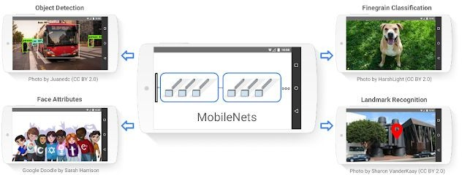
Choose Best Model for the Task

Slide 28



Other Strategies
Proﬁle and
Optimize Operators
Optimize Model
Tweak Threads
Benchmark

Slide 29





Web Applications for Users
Python:
FastAPI
Flask
Django
Java:
Spring
Apache Tomcat
Users make requests via web application
Model wrapped as API service

Slide 30




Serving systems for easy deployment
Centralized model deployment
Predictions as service
Eliminates need for custom web applications
Deployment just a few lines of code away
Easy to rollback/update models on the ﬂy

Slide 31


Clipper
Open-source project from UC Berkeley
Multiple modeling frameworks
Cluster and resources management
Settings for reliable latency
RESTful API

Slide 32



TensorFlow Serving
Open-source project from Google
Serve TensorFlow models easily
Extensible to serve other model types
Uses REST and gRPC protocol
Version manager

Slide 33



Advantages of Serving with a Managed Service
Realtime endpoint for low-latency predictions on massive batches
Deployment of models trained on premises or on the Google Cloud Platform
Scale automatically based on trafﬁc
Use GPU/TPU for faster predictions

Slide 34
TensorFlow Serving
Installing and Running TensorFlow Serving

Slide 35
Install TensorFlow Serving
Docker Images:
Easiest and most recommended method
Easiest way to get GPU support with TF Serving
docker pull tensorflow/serving
docker pull tensorflow/serving:latest-gpu

Slide 36
Install TensorFlow Serving
Available Binaries
tensorﬂow-model-server | tensorﬂow-model-server-universal:
Fully optimized server Uses some platform speciﬁc compiler optimizations May not work on older machines | Compiled with basic optimizations Doesn't include platform speciﬁc instruction sets Works on most of the machines

Slide 37
Install TensorFlow Serving
Building From Source
See the complete documentation https://www.tensorﬂow.org/tfx/serving/setup#building_from_source
Install using Aptitude (apt-get) on a Debian-based Linux system

Slide 38
Install TensorFlow Serving
!echo "deb http://storage.googleapis.com/tensorflow-serving-apt stable tensorflow-model-server tensorflow-model-server-universal" | tee
/etc/apt/sources.list.d/tensorflow-serving.list && \ curl
https://storage.googleapis.com/tensorflow-serving-apt/tensorflow-serving. release.pub.gpg | apt-key add -
!apt update
!apt-get install tensorflow-model-server

Slide 39
Import the MNIST Dataset
mnist = tf.keras.datasets.mnist
(train_images, train_labels), (test_images, test_labels) = mnist.load_data() # Scale the values of the arrays below to be between 0.0 and 1.0. train_images = train_images / 255.0
test_images = test_images / 255.0

Slide 40
Import the MNIST Dataset
# Reshape the arrays below.
train_images = train_images.reshape(train_images.shape[0], 28, 28, 1)
test_images = test_images.reshape(test_images.shape[0], 28, 28, 1) print('\ntrain_images.shape: {}, of {}'.format(train_images.shape, train_images.dtype))
print('test_images.shape: {}, of {}'.format(test_images.shape, test_images.dtype))
train_images.shape: (60000, 28, 28, 1), of float64
test_images.shape: (10000, 28, 28, 1), of float64

Slide 41
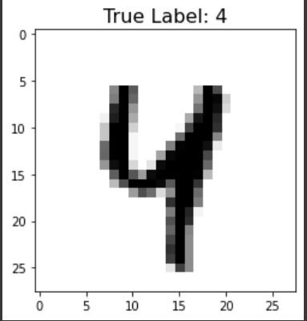
Look at a Sample Image
idx = 42
plt.imshow(test_images[idx].reshape(28,28), cmap=plt.cm.binary) plt.title('True Label: {}'.format(test_labels[idx]), fontdict={'size': 16}) plt.show()

Slide 42
Build a Model
# Create a model.
model = tf.keras.Sequential([
tf.keras.layers.Conv2D(input_shape=(28,28,1), filters=8, kernel_size=3,
strides=2, activation='relu', name='Conv1'), tf.keras.layers.Flatten(),
tf.keras.layers.Dense(10, activation=tf.nn.softmax, name='Softmax')
])
model.summary()

Slide 43
Train the Model
# Configure the model for training. model.compile(optimizer='adam',
loss='sparse_categorical_crossentropy', metrics=['accuracy'])
epochs = 5
# Train the model.
history = model.fit(train_images, train_labels, epochs=epochs)

Slide 44
Evaluate the Model
# Evaluate the model on the test images.
results_eval = model.evaluate(test_images, test_labels, verbose=0)
for metric, value in zip(model.metrics_names, results_eval): print(metric + ': {:.3}'.format(value))
loss: 0.098
accuracy: 0.969

Slide 45
Save the Model
MODEL_DIR = tempfile.gettempdir() version = 1
export_path = os.path.join(MODEL_DIR, str(version))
if os.path.isdir(export_path):
print('\n Already saved a model, cleaning up\n')
!rm -r {export_path}
model.save(export_path, save_format="tf") print('\nexport_path = {}'.format(export_path))
!ls -l {export_path}

Slide 46
Launch Your Saved Model
os.environ["MODEL_DIR"] = MODEL_DIR
%%bash --bg
nohup tensorflow_model_server \
--rest_api_port=8501 \
--model_name=digits_model \
--model_base_path="${MODEL_DIR}" >server.log
!tail server.log
2>&1

Slide 47
Send an Inference Request
data = json.dumps({"signature_name": "serving_default", "instances": test_images[0:3].tolist()})
headers = {"content-type": "application/json"} json_response =
requests.post('http://localhost:8501/v1/models/digits_model:predict',
data=data, headers=headers)
predictions = json.loads(json_response.text)['predictions']

Slide 48
Plot Predictions
plt.figure(figsize=(10,15))
for i in range(3): plt.subplot(1,3,i+1)
plt.imshow(test_images[i].reshape(28,28), cmap = plt.cm.binary) plt.axis('off')
color = 'green' if np.argmax(predictions[i]) == test_labels[i] else 'red' plt.title('Prediction: {}\n True Label: {}'.format(np.argmax(predictions[i]),
test_labels[i]), color=color)
plt.show()

Slide 49
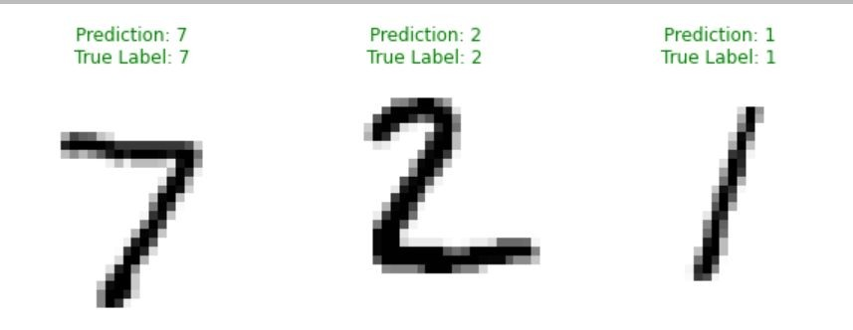
Results Demo

