Slide 1
Copyright Notice
These slides are distributed under the Creative Commons License.
DeepLearning.AI makes these slides available for educational purposes. You may not use or distribute these slides for commercial purposes. You may make copies of these slides and use or distribute them for educational purposes as long as you cite DeepLearning.AI as the source of the slides.
For the rest of the details of the license, see https://creativecommons.org/licenses/by-sa/2.0/legalcode

Slide 2
Model Monitoring
Why Monitoring Matters

Slide 3
ML Lifecycle Revisited
Model building
Model evaluation
Testing
Deployment
Monitoring & Observability
Productionze

Slide 4
Why Monitoring Matters
“An ounce of prevention is worth a pound of cure”
- Benjamin Franklin

Slide 5
Why do you need monitoring?
Immediate Data Skews
Training data is too old, not representative of live data
Model Staleness
Environmental shifts
Consumer behaviour
Adversarial scenarios
Negative Feedback Loops

Slide 6
Monitoring in ML Systems
ML Monitoring (functional monitoring)
Predictive performance Changes in serving data
Metrics used during training Characteristics of features
System monitoring (non-functional monitoring)
System performance System status
System reliability

Slide 7
Why is ML monitoring different?
Conﬁguration | Data Collection | Data Veriﬁcation |  | Machine Resource Management | Serving Infrastructure | Monitoring
 |  | ML Code | Analysis Tools
 | Feature Extraction
 |  |  | Process Management Tools

Slide 8
Model Monitoring
Observability in ML

Slide 9
What is observability?
Observability measures how well the internal states of a system can be inferred by knowing the inputs and outputs
Observability comes from control system theory
Observability and controllability are closely linked

Slide 10
Complexity of observing modern systems
Modern systems can make observability difﬁcult
Cloud-based systems
Containerized infrastructure
Distributed systems
Microservices

Slide 11
Deep observability for ML
Not only top-level metrics
Domain knowledge is important for observability
TensorFlow Model Analysis (TFMA)
Both supervised and unsupervised analysis

Slide 12
Goals of ML observability
Alertable
Metrics and thresholds designed to make failures obvious
Actionable
Root cause clearly identiﬁed

Slide 13
Model Monitoring
Monitoring Targets in ML

Slide 14
Basics: Input and output monitoring
Model input distribution
Model prediction distribution
Model versions
Input/prediction correlation

Slide 15
Input Monitoring
Errors: Input values fall within an allowed set/range?
Changes: Distributions align with what you’ve seen in the past?
Per slice, e.g., marital status (single/married/widowed/divorced)
Do these
check out?

Slide 16
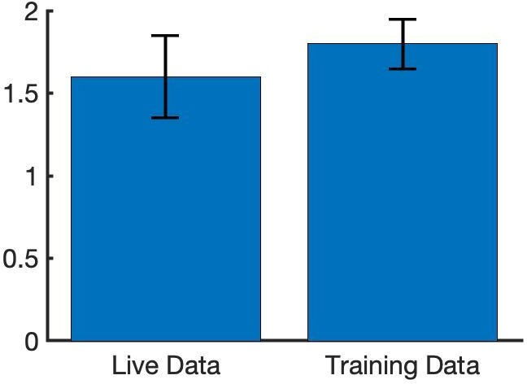
Prediction Monitoring
SEM
Statistical signiﬁcance
Unsupervised: Compare model prediction distributions
with statistical tests
e.g., median, mean, standard deviation, min/max values
Supervised: When labels are available

Slide 17
Operational Monitoring
ML engineering
Latency
IO / Memory / Disk Utilisation
System Reliability (Uptime) Auditability
Software engineering
Receiving an HTTP request Entering/leaving a function A user logging in
Reading from net / writing to disk

Slide 18
Model Monitoring
Logging for ML Monitoring

Slide 19
Steps for building observability
Start with the out-of-the-box logs, metrics and dashboards
Add agents to collect additional logs and metrics
Add logs-based metrics and alerting to create your own metrics and alerts
Use aggregated sinks and workspaces to centralize your logs and monitoring

Slide 20


Logging
Log: An event log (usually just called “logs”) is an immutable, time-stamped record of discrete events that happened over time.

Slide 21



Tools for building observability
Google Cloud Monitoring
Amazon CloudWatch
Azure Monitor
Google Cloud Monitoring

Slide 22

Logging - Advantages
Easy to generate
Great when it comes to providing valuable insight
Advantages
Focus on speciﬁc events

Slide 23

Logging - Disadvantages
Excessive logging can impact system performance
Aggregation operations on logs can be expensive (i.e., treat logs-based alerts with caution)
Disadvantages
Setting up & maintaining tooling carries with it a signiﬁcant operational cost

Slide 24
Logging in Machine Learning
Key areas
➔ Use logs to keep track of the model inputs and predictions
Input red ﬂags
➔ A feature becoming unavailable
➔ Notable shifts in the distributions
➔ Patterns speciﬁc to your model

Slide 25
Storing log data for analysis
Basic log storage is often unstructured
Parsing and storing log data in a queryable format enables analysis
Extracting values to generate distributions and statistics
Associating events with timestamps
Identifying the systems
Enables automated reporting, dashboards, and alerting

Slide 26
New Training Data
Prediction requests form new training datasets
For supervised learning, labels are required
Direct labeling
Manual labeling
Active learning
Weak supervision

Slide 27
Model Monitoring
Tracing for ML Systems

Slide 28


Distributed Tracing
Log
Monolithic System
Module
Module
Module
Module

Slide 29
Distributed Tracing
Service
Service
Log
Service
Service
Cloud

Slide 30


Tools for building observability
Sequencing and parallelism of service requests
Distributed tracing
Dapper
Zipkin
Jaeger

Slide 31

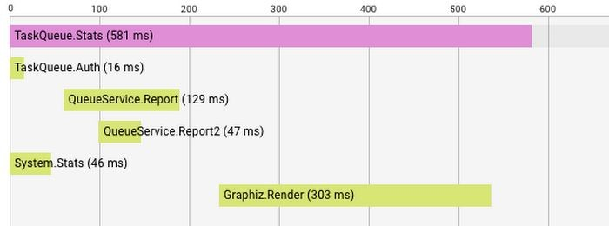
Dapper-Style Tracing
Propagate trace between services
A trace is a call tree, made up of one or more spans

Slide 32
Model Monitoring
What is Model Decay?

Slide 33
Model Decay
Production ML models often operate in a dynamic environments
The ground truth in dynamic environments changes
If the model is static and does not change, then it gradually moves farther and farther away from the ground truth
Causes of Model Drift
Data Drift
Concept Drift

Slide 34
Data Drift (aka Feature Drift)
Increase in mean and variance
Statistical properties of input changes
Trained model is not relevant for changed data
For eg., distribution of demographic data like age might change over time
Age
Change in distribution of age feature

Slide 35
Concept Drift
Relationship between features and labels changes
The very meaning of what you are trying to predict changes
Prediction drift and label drift are similar
T₁ T₂ T₃
Change in relationship between the features and the labels

Slide 36
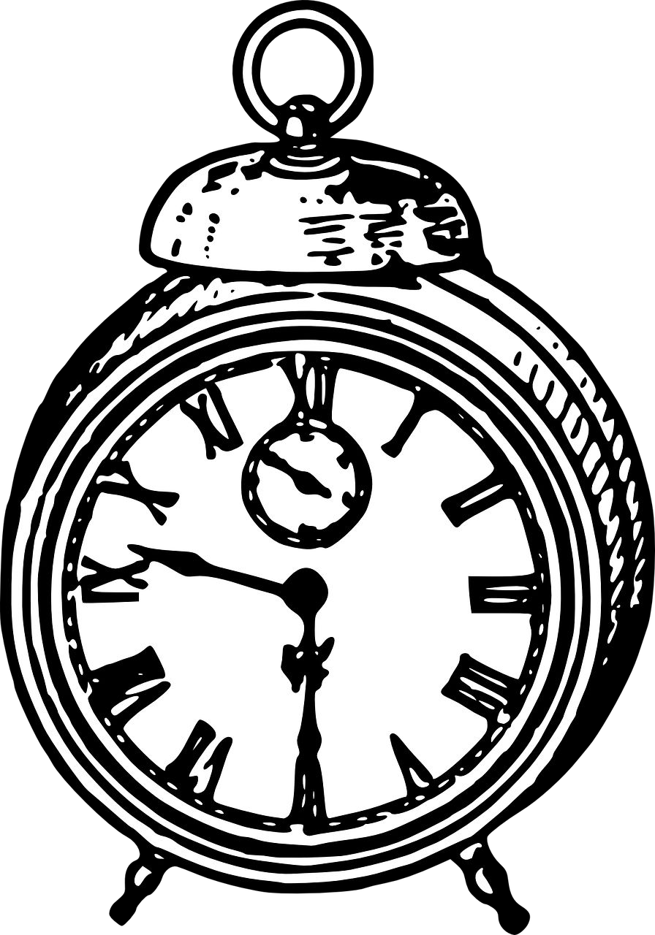
Detecting Drift on Time
Drift creeps into the system slowly with time
If it goes undetected, model accuracy suffers
Important to monitor and detect drift early

Slide 37
Model Monitoring
Model Decay Detection

Slide 38
Detecting Concept and Data Drift
Log Predictions (Full Requests and Responses)
Incoming prediction requests and generated prediction should be logged
If possible log the ground truth that should have been predicted
Can be used as labels for new training data
At a minimum log data in prediction request
This data is analysed to detect data drift that will cause model decay

Slide 39
Detecting Drift
Detected by observing the statistical properties of logged data, model predictions, and possibly ground truth
Deploy dashboards that plot statistical properties to observe how they change over time
Use specialized libraries for detecting drift
TensorFlow Data Validation (TFDV)
Scikit-multiﬂow library

Slide 40

Continuous Evaluation and Labelling in Vertex Prediction
Vertex Prediction offers continuous evaluation
Vertex Labelling Service can be used to assign ground truth labels to prediction input for retraining
Azure, AWS, and other cloud providers offer similar services

Slide 41
Model Monitoring
Ways to Mitigate Model Decay

Slide 42
Mitigating Model Decay
When you’ve detected model decay:
At the minimum operational and business stakeholders should be notiﬁed of the decay
Take steps to bring model back to acceptable performance

Slide 43
Steps in Mitigating Model Decay
What if Drift is Detected?
If possible, determine the portion of your training set that is still correct
Keep the good data, discard the bad, and add new data - OR -
Discard data collected before a certain date and add new data - OR -
Create an entirely new training dataset from new data

Slide 44
Fine Tune, or Start Over?
You can either continue training your model, ﬁne tuning from the last checkpoint using new data - OR -
Start over, reinitialize your model, and completely retrain it
Either approach is valid, so it really depends on results
How much new labelled data do you have?
How far has it drifted?
Try both and compare

Slide 45
Model Re-Training Policy
On-Demand
Manually re-train the model
On a Schedule
New labelled data is available at a daily, weekly or monthly basis
Availability of New Training Data
New data available on ad-hoc basis, when it is collected and available in source database

Slide 46
Automating Model Retraining
Model Performance Degradation
Manually retrain the model
Data Drift
When you notice signiﬁcant changes in the data

Slide 47
Redesign Data Processing Steps and Model Architecture
When model performance decays beyond an acceptable threshold you might have to consider redesigning your entire pipeline
Re-think feature engineering, feature selection
You may have to train your model from scratch
Investigate on alternative architectures

Slide 48
Model Monitoring
Responsible AI

Slide 49
Responsible AI Practices
Development of AI creates new opportunities to improve the lives of people around the world
Business, healthcare, education, etc.
But it also raises new questions about implementing responsible practices
Fairness, interpretability, privacy, and security
Far from solved, active areas of research and development

Slide 50
Human-Centered Design
Actual users’ experience is essential
Design your features with appropriate disclosures built-in
Consider augmentation and assistance
Offering multiple suggestions instead of one right answer
Model potential adverse feedback early in the design process
Engage with a diverse set of users and use-case scenarios

Slide 51
Identify Multiple Metrics
Using several metrics helps you understand the tradeoffs
Feedback from user surveys
Quantities that track overall system performance
False positive and false negative sliced across subgroups
Metrics must be appropriate for the context and goals of your system

Slide 52
Analyze your raw data carefully
For sensitive raw data, respect privacy
Compute aggregate, anonymized summaries
Does your data reﬂect your users?
Example: will be used for all ages, but all data from senior citizens
Imperfect proxy labels?
Relationship between the labels and actual targets
Using label X as a proxy for target Y - any problematic gaps?

Slide 53
Model Monitoring
Legal Requirements for Secure & Private AI

Slide 54
Legal Implications of Data Security and Privacy
Companies must comply with data privacy protection laws in regions where they operate
General Data Protection Regulation (GDPR)
California Consumer Privacy Act (CCPA)

Slide 55

General Data Protection Regulation (GDPR)
Regulation in EU law on data protection and privacy in the European Union (EU) and the European Economic Area (EEA)
Give control to individuals over their data
Companies should protect the data of employees and consumers
When the data processing is based on consent, the data subject has the right to revoke their consent at any time

Slide 56

California Consumer Privacy Act (CCPA)
Similar to GDPR
Intended to enhance privacy rights and consumer protection for residents of California
User has the right to know what personal data is being collected about them, whether the personal data is sold or disclosed, and to whom
User can access the personal data, block the sale of their data, and request a business to delete their data

Slide 57
Security and Privacy Harms from ML Models
Informational Harms
Behavioural Harms
Relate to unintended or unanticipated leakage of information
Relate to manipulating the behavior of the model itself, impacting the predictions or outcomes of the model

Slide 58
Defenses
Cryptography
Trusted Execution Environments
General Defenses
Differential Privacy
ML-Speciﬁc Approaches

Slide 59
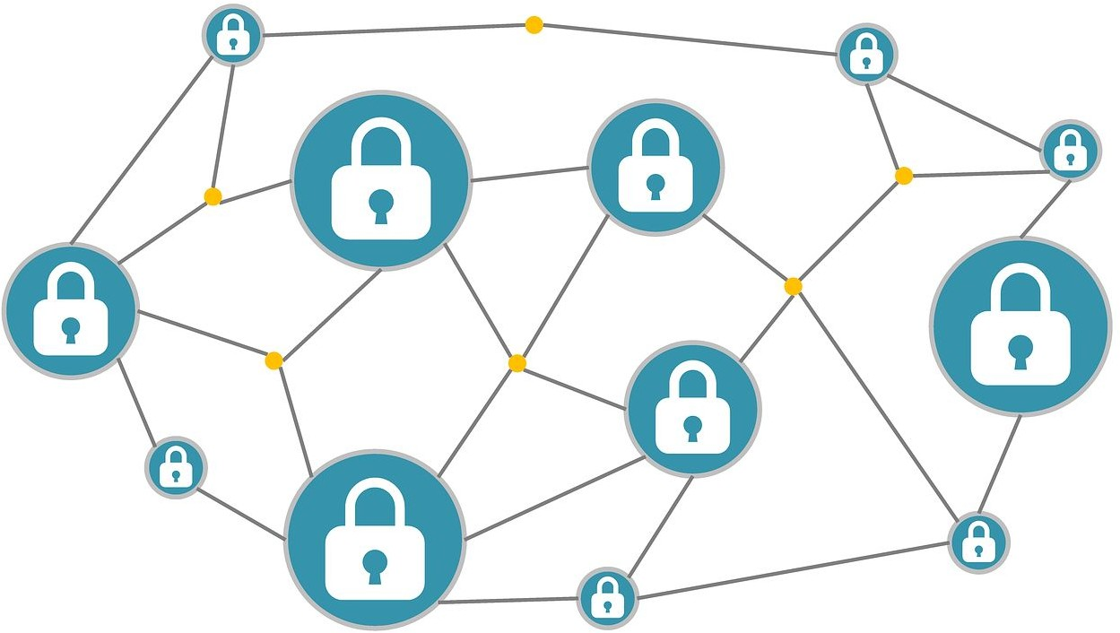
Cryptography
Privacy-enhancing tools (like SMPC and FHE) should be considered to securely train supervised machine learning models
Users can send encrypted prediction requests while preserving the conﬁdentiality of the model
Protects conﬁdentiality of the training data

Slide 60
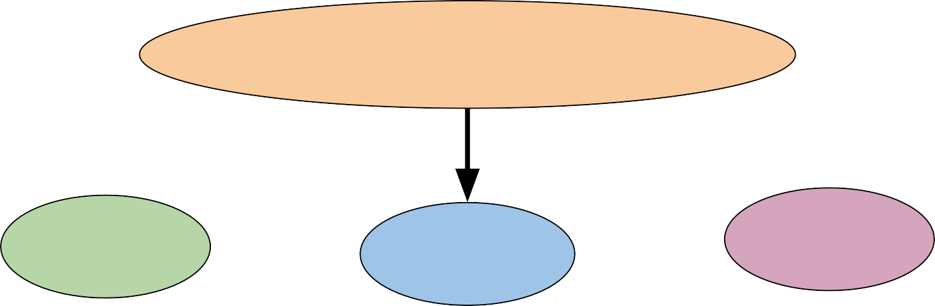


Differential Privacy
System for publicly sharing information about a dataset by describing the patterns of groups within the dataset while withholding information about individuals in the dataset
Privacy Preserving Model Training Approaches
DP-SGD
CaPC
PATE

Slide 61
Differentially-Private Stochastic Gradient Descent (DP-SGD)
Applies differential privacy during model training
Modiﬁes the minibatch stochastic optimization process
Trained model retains differential privacy because of the post-processing immunity property of differential privacy

Slide 62
Private Aggregation of Teacher Ensembles (PATE)
Not accessible by attacker Accessible by attacker
Sensitive data
Data 1
Teacher 1
Aggregate teacher
Public unlabeled data
Data 2
Teacher 2
Teacher k
Data k
Predictions
Requests
Student

Slide 63
Conﬁdential and Private Collaborative Learning (CaPC)
Enables models to collaborate while preserving the privacy of the underlying data
Integrates building blocks from cryptography and differential privacy to provide conﬁdential and private collaborative learning
Encrypts prediction requests using Homomorphic Encryption (HE)
Uses PATE to add noise to predictions for voting

Slide 64
Model Monitoring
Anonymization & Pseudonymisation

Slide 65
Data Anonymization in GDPR
GDPR includes many regulations to preserve privacy of user data
Since introduction of GDPR, two terms have been discussed widely
Anonymization Pseudonymisation

Slide 66
Data Anonymization
Recital 26 of GDPR deﬁnes Data Anonymization
True data anonymization is:
Irreversible
Done in such a way that it is impossible to identify the person
Impossible to derive insights or discrete information, even by the party responsible for anonymization
GDPR does not apply to data that has been anonymized

Slide 67
Pseudonymisation
GDPR Article 4(5) deﬁnes pseudonymisation as:
“... the processing of personal data in such a way that the data can no longer be attributed to a speciﬁc data subject without the use of additional information”
The data is anonymized by switching the identiﬁers (like email or name) with an alias or pseudonym

Slide 68
Pseudonymisation v Anonymization
Information | Pseudonymized | Anonymized
Chelsea | Puryfrn | *******
Kumar | Xhzne | *******
Zaed | Mnrq | *******
John | Wbua | *******
Doe | Qbr | *******
Alex | Nyrk | *******

Slide 69
Spectrum of Privacy Preservation
Personally identiﬁable data
Truly anonymized data
Pseudonymized data
De-identiﬁed data
Anonymized data

Slide 70
What Data Should be Anonymized?
Any data that reveals the identity of a person, referred to as identiﬁers
Identiﬁers applies to any natural or legal person, living or dead, including their dependents, ascendants, and descendants
Included are other related persons, direct or through interaction
For example: Family names, patronyms, ﬁrst names, maiden names, aliases, address, phone, bank account details, credit cards, IDs like SSN

Slide 71
Model Monitoring
Right to Be Forgotten

Slide 72
What is the Right to Be Forgotten?
“The data subject shall have the right to obtain from the controller the erasure of personal data concerning him or her without undue delay and the controller shall have the obligation to erase personal data without undue delay”
- Recitals 65 and 66 and in Article 17 of the GDPR

Slide 73
What is the Right to Be Forgotten?
“The data subject shall have the right to obtain from the controller the erasure of personal data concerning him or her without undue delay and the controller shall have the obligation to erase personal data without undue delay”
- Recitals 65 and 66 and in Article 17 of the GDPR

Slide 74
Right to Rectiﬁcation
“The data subject shall have the right to obtain from the controller without undue delay the rectiﬁcation of inaccurate personal data concerning him or her. Taking into account the purposes of the processing, the data subject shall have the right to have incomplete personal data completed, including by means of providing a supplementary statement.”
- Chapter 3, Art. 16 GDPR

Slide 75
Other Rights of the Data Subject
Chapter 3 deﬁnes a number of other rights of the data subject, including:
Art. 15 GDPR – Right of access by the data subject
Art. 18 GDPR – Right to restriction of processing
Art. 20 GDPR – Right to data portability
Art. 21 GDPR – Right to object

Slide 76
Implementing Right To Be Forgotten: Tracking Data
For a valid erasure claim
Company needs to identify all of the information related to the content requested to be removed
All of the associated metadata must also be erased
Eg., Derived data, logs etc.

Slide 77


Forgetting Digital Memories
Ways to Delete Data
Anonymize
Hard Delete

Slide 78
Issues with Hard Delete
Deleting records from a database can cause havoc
User data is often referenced in multiple tables
Deletion breaks the connections, which can be difﬁcult in large, complex databases
Can break foreign keys
Anonymization keeps the records, and only anonymizes the ﬁelds containing PII

Slide 79
Challenges in Implementing Right to Be Forgotten
Identifying if data privacy is violated
Challenges
Organisational changes for enforcing GDPR
Deleting personal data from multiple back-ups

