Slide 1


SMART INDIA HACKATHON 2025
TITLE PAGE
2025
Problem Statement ID –SIH1637
Problem Statement Title-Mobile App for Direct Market Access For Farmers
Theme-Empowering Farmers through Direct Digital Market Access
PS Category- Software
Team ID-
Team Name : HACK TITANS

Slide 2
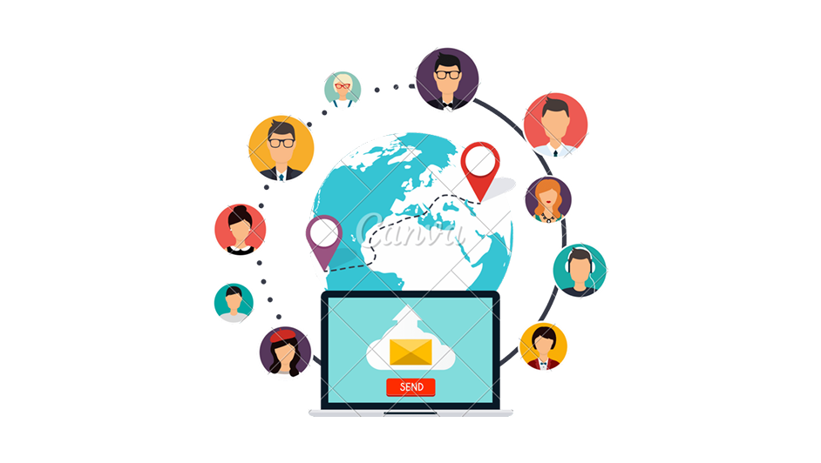

IDEA TITLE
Hack Titans
2025
j
Farmer & Company registration: Easy registration for framers to list crops and companies to specify requirements.
Crops listing & contract management: Farmers can use list crops , and companies can browse and create contracts for long- terms deals
Real-Time market data: Provides real-time crop prices and price alerts for farmers to have easy access.
Feedback: Secure payments gateway , yearly sales review , and profit growth analytics
Enhanced Security: Fast and secure payment transaction.
Connecting With Buyers: No middlemen to interact (direct connection with farmers to buyers.
Farm Gate: From Farmers to Consumers.

Slide 3
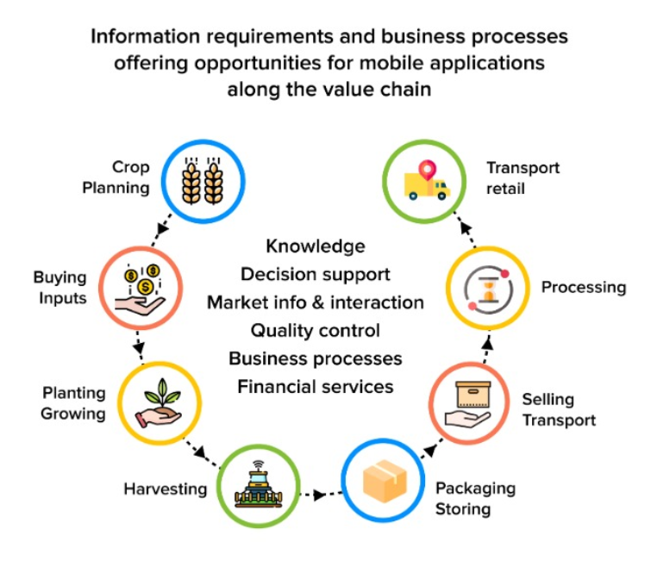
TECHNICAL APPROACH
Hack Titans
Technical Approach
Frontend: Flutter / React Native for cross-platform mobile app
Backend: Node.js / Python (Django/Flask) with REST APIs
Database: MySQL / PostgreSQL (structured data), MongoDB (unstructured data)
Cloud & Hosting: AWS / Google Cloud with Firebase for storage & notifications
Integrations: UPI/Digital Payments, Google Maps API, Push Notifications
Security: SSL encryption, JWT authentication
Methodology: Agile development – Requirement → Design → Development → Testing → Deployment
Geolocation: Google Maps API
Payment Integration: UPI, Paytm, Google Pay, Razor pay
2025

Slide 4
FEASIBILITY AND VIABILITY
Hack Titans
2025
Technical Feasibility:
Can be developed using mobile app frameworks
Economic Feasibility:
Development and maintenance costs are reasonable compared to traditional setups
Operational Feasibility:
Easy-to-use interface with multilingual support makes it suitable for farmers.
Social Feasibility:
Farmers benefit from transparency ,fair pricing , and reduced middlemen exploration.
Economic Viability:
Farmers earn higher profits by eliminating middlemen
Market Viability:
High adoption potential among farmers and buyers due to mutual benefits.
Social Viability:
Empowers farmers , promotes fair trade and builds consumer trust.
Financial Viability :
Sustainable revenue through small commissions ,ads or government subsidies

Slide 5
IMPACT AND BENEFITS
Hack Titans
2025
IMPACT Elimination of Middlemen – Farmers can sell produce directly to consumers, retailers, or wholesalers, increasing their profit margins. Price Transparency – Real-time updates on market prices empower farmers to negotiate better deals. Wider Reach – Farmers gain access to buyers beyond their local markets, including urban consumers and institutional buyers. Fair Trade – Reduces exploitation by intermediaries and ensures farmers receive a fair share of the consumer price. Digital Inclusion – Encourages adoption of digital technologies in rural areas, promoting financial literacy and inclusion. | BENEFITS Higher Income – Farmers get better returns by directly connecting with buyers. Reduced Transaction Costs – Saves transportation costs and commissions paid to middlemen. Market Intelligence – Apps provide demand trends, seasonal variations, and buyer preferences to guide crop planning. Convenience & Efficiency – Easy listing of produce, online payments, and logistics support simplify the selling process. Better Quality Assurance – Apps often include grading/quality checks that help farmers market premium produce.

Slide 6
RESEARCH AND REFERENCES
Hack Titans
2025
Agriculture Technology | Overview | https://ijcrt.org/papers/IJCRT2412239.pdf
E-Commerce / Online Marketplace | Technology Stack | https://www.irjmets.com/upload_newfiles/irjmets70500180613/paper_file/irjmets70500180613.pdf
Supply chain & Logistics | Benefits | https://www.sujalbhavsar.in/project/market-mitra
Category Details Sources

