Slide 1
📊 Retail Sales Dashboard – Summary Report
Yogendra Singh Shekhawat | Tool Used – Tableau

Slide 2
🎯 Objective
Design a dynamic dashboard for retail sales data analysis.
Provide business insights through KPIs, trend analysis, and segmentation.
Ensure interactivity using filters and slicers.

Slide 3
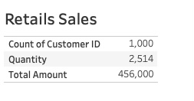
Key Performance Indicators (KPIs)

Slide 4
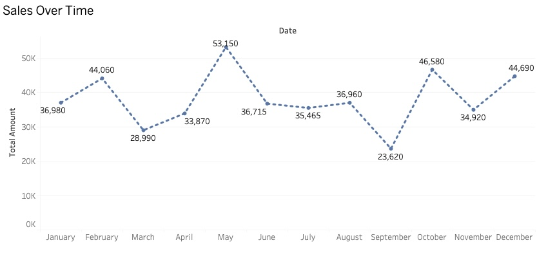
Sales Trend Over Time
Monthly Sales Trend:
Line chart showing sales trend by month
Helps identify peak sales periods and growth 📸 Insert a screenshot of the line chart

Slide 5
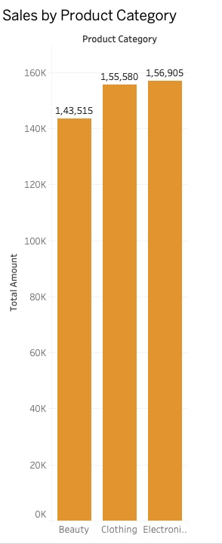
Sales by Product Category
Category Performance:
Bar chart comparing total sales by product category
Business can focus on top-performing categories

Slide 6
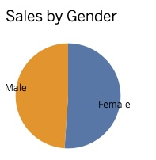
Sales by Gender
Demographic Breakdown:
Pie/Donut chart to show male vs female contribution
Insight into which demographic spends more

Slide 7
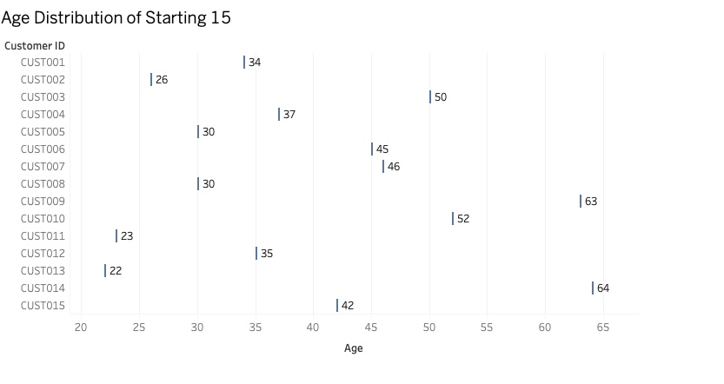
Age Group Insights
Customer Age Distribution:
Histogram of customer age
Useful for targeted marketing strategies

Slide 8
Key Insights
Most sales come from -> “Electronic”
Peak month -> “May”
Male customers contributed around “45%” of revenue
Majority of customers aged between “30-40”

Slide 9
Conclusion
The dashboard helps decision-makers focus on profitable products and customer segments.
Interactive filters allow on-the-fly exploration of key business metrics.

