Slide 1
Hotel Cancellation Prediction
By:
Yogendra Sharma Ishank Vishnoi
Trupti Koli Rahaf Perween
Gaurav Pande

Slide 2
Agenda
Introduction
System Architecture
Project Workflow
Models
Training Dataset
Metric
Prediction And Demo

Slide 3
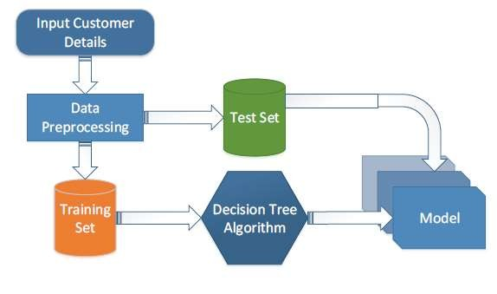
System Architecture
Algorithm

Slide 4






LIBRARIES

Slide 5
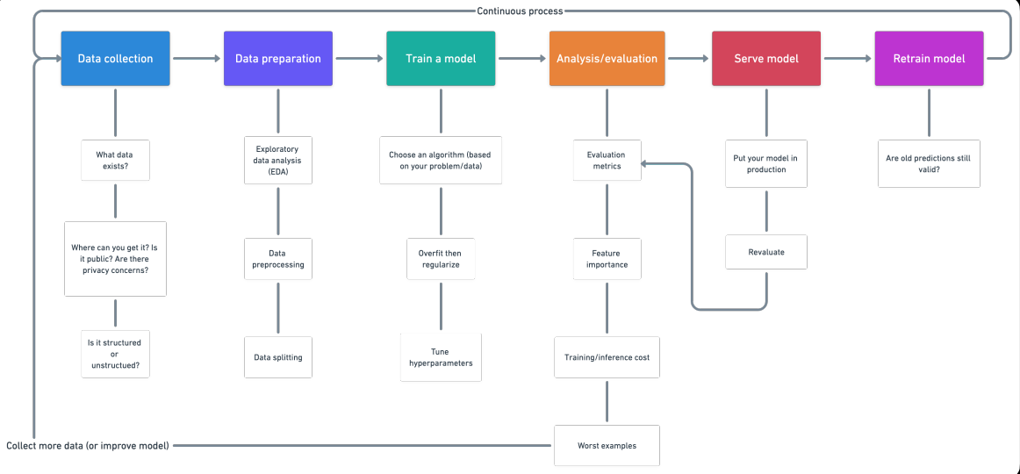
Machine Learning Project Workflow

Slide 6

Models
RandomForestClassifier
XGBClassifier

Slide 7
RandomForestClassifier
It is a versatile and widely-used ensemble learning method that
operates by constructing multiple decision trees during training and outputting
the class that is the mode of the classes (classification) of the individual trees.
Advantages:
Robustness: It reduces overfitting by averaging multiple trees, leading to more generalized models.
Feature Importance: It provides insights into the importance of different features in the dataset.
Handling Missing Values: It can handle missing values internally and still perform well.

Slide 8
Parameters Tuned
n_estimators: Number of trees in the forest.
max_depth: Maximum depth of the tree.
min_samples_split: Minimum number of samples required to split an internal node.
min_samples_leaf: Minimum number of samples required to be at a leaf node.

Slide 9
XGBoostClassifier
XGBoost (Extreme Gradient Boosting) is an efficient and scalable implementation of gradient boosting framework. It is known for its high performance and accuracy.
Advantages:
Efficiency: It is designed to be computationally efficient and has optimizations that make it faster.
Regularization: It includes L1 and L2 regularization, which helps in reducing overfitting.
Flexibility: It supports various objective functions and evaluation metrics.

Slide 10
Parameters Tuned
n_estimators: Number of boosting rounds.
learning_rate: Step size shrinkage used to prevent overfitting.
max_depth: Maximum depth of a tree.
min_child_weight: Minimum sum of instance weight (hessian) needed in a child.

Slide 11
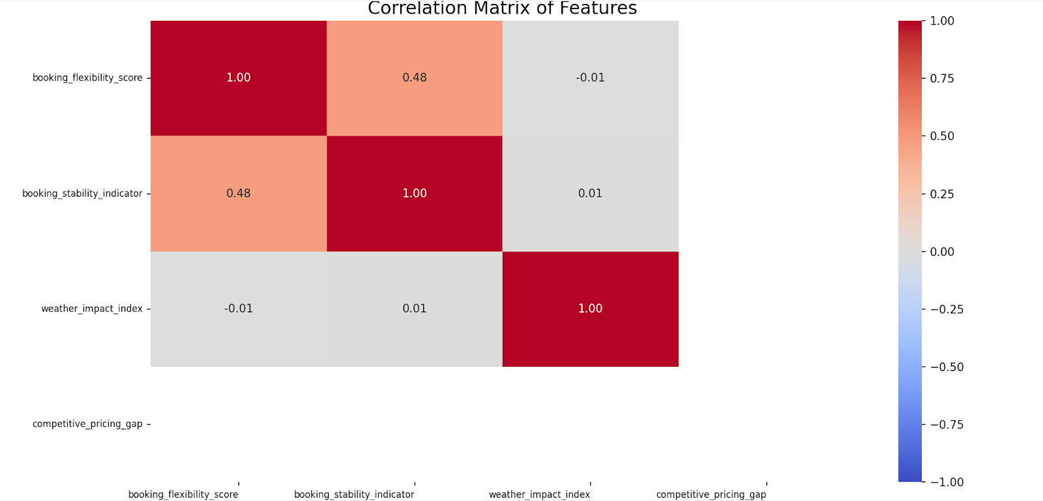
Feature Engineering
booking_flexibility_score: A score combining lead time, length of stay, and previous cancellations.
booking_stability_indicator: An indicator combining lead time, length of stay, and room type.
weather_impact_index: An index combining temperature and precipitation impact.
competitive_pricing_gap: The gap between competitor price and total cost.

Slide 12
Model Training and Evaluation
Data Imputation and Encoding: Handled missing values using SimpleImputer and encoded categorical variables using LabelEncoder.
Train-Test Split: Split the data into training and testing sets.
Feature Importance Analysis: Evaluated feature importance to understand the influence of each feature.
Hyperparameter Tuning: Used GridSearchCV to find the best hyperparameters for each model.
Model Evaluation: The best model was evaluated on the test set using classification_report.

Slide 13
label_encoder.pkl
Consistency in Encoding:
The LabelEncoder converts categorical labels into numeric values. During training, it learns the mapping from the original labels to numeric codes.
Saving this encoder ensures that the same mapping is applied when the model is used for predictions on new data. This consistency is crucial because the model expects the same numeric codes that it was trained on.
Reproducibility:
By saving the LabelEncoder, you ensure that anyone using the model can reproduce the exact same encoding process, which is essential for reproducibility of the results.
Handling Unseen Data:
If new data contains categories that were not present during training, having the original encoder allows for handling such cases appropriately (e.g., assigning a special code or handling it as an unknown category).

Slide 14
imputer.pkl
Handling Missing Values:
The SimpleImputer is used to fill missing values in the dataset. During training, it calculates statistics (like median, mean, or mode) based on the training data.
Saving the imputer ensures that the same statistics are used to fill missing values in new data, maintaining consistency in data preprocessing.
Pipeline Integrity:
The model’s performance relies on the preprocessing steps being exactly the same during training and inference. By saving the imputer, you can guarantee that the data fed into the model is processed in the same manner as during training.
Future Data Processing:
When new data becomes available, the saved imputer can be used directly to preprocess the data without recalculating the statistics, ensuring that the data transformation is consistent over time.

Slide 15
Metric
Precision recall f1-score support
0 0.91 0.91 0.91 18788 1 0.85 0.84 0.85 11060
accuracy 0.89 29848 macro avg 0.89 0.88 0.89 29848 weighted avg 0.89 0.50 0.89 29848

Slide 16
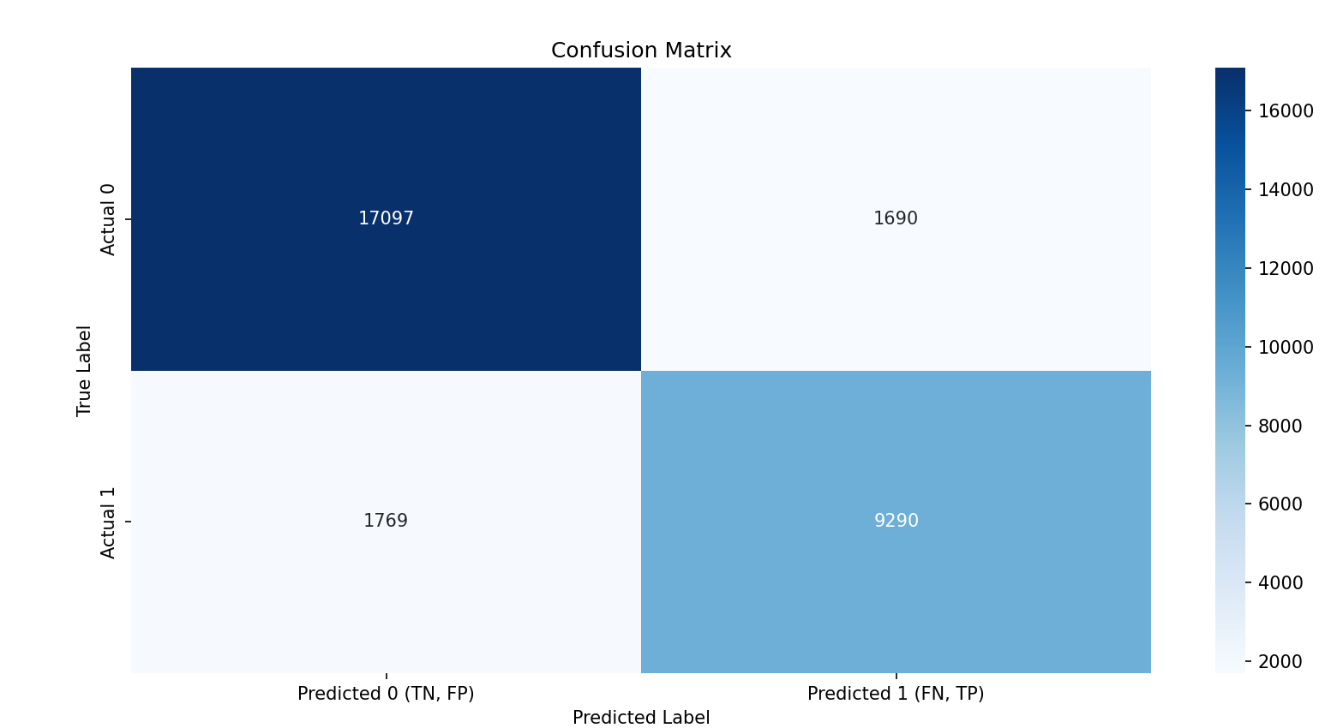

Slide 17
Save the Model
Determine the Best Model: After hyperparameter tuning, select the best model based on the performance metrics.
Save the Model: Use joblib.dump to serialize the model object to a file. (hotel_booking_model.pkl)
Why Save the Model?
Reusability: You can load the model later to make predictions on new data.
Deployment: The saved model can be deployed in a production environment where it can serve predictions to end-users.
Consistency: Ensures that the model you evaluated and tested is exactly the one being used in production.
Efficiency: Avoids the need to retrain the model every time a prediction needs to be made.

Slide 18
DEMO

Slide 19
Usability

Slide 20
Q&A

Slide 21
Thank you

