Slide 1

BT Policy Manager
Presenter: Pawan Vijay

Slide 2
Content
Introduction
BTPM Phases
BLE GATT Connection Management
BLE ACL Link Management
BLE Mesh Support
BLE connection parameter management

Slide 3
Introduction
Policy manager is introduced to better utilize ble connection resource.
With more and more Bluetooth features added into Amazon products, it become very challenging to satisfy all the Bluetooth activities concurrently.
A centralized Bluetooth policy manager is needed to take care of the complicated BT use cases.
BT airtime usage efficiently based on the priority of the BT activities.
Hardware Limitation

Slide 4
Policy Manager Phases
Phase 1: BLE GATT Connection Management
Phase 2: BLE ACL Link Management
Phase 3: BLE Mesh Support
Phase 4: BLE connection parameter management
Phase 5: BLE Scan management
Phase 6: BLE Advertising management
Phase 7: Enhancement on BLE Link Management
Phase 8: HOGP Support
Phase 9: Improve the BLE scheduling using the BT controller VSC commands
Phase 10: Dynamic BT profiles/services enable and disable
Phase 11: Concurrent BT profile management
Phase 12: COEX management

Slide 5
Connection lists in PM
For background connection:
Bg_L => background connected list
BgWait_L => background wait list
White_L => background white list
For direct connection:
Dir_L: Direct connected list
DirWait_L: Direct Connection wait list
DirPend_L: Direct Connection pending list

Slide 6
States of a LE Connection
There are 3 possible states of a LE Connection Request.
Connected
White-Listed
Wait-Listed

Slide 7
Phase 1: BLE GATT Connection Management
Manage the BLE connection requests based on the application ID, priority and the BT controller limitation.
3 Levels of priorities are defines in policy management. [High, Medium, Low]
New connection requests in waiting list managed in policy manager when the maximum number of connections is reached.
Low priority connection should make way for high priority requests. When maximum supported BLE connection number is reached.
When more than two BLE connections are available, all connection request will be allowed. Background connection requests are put in allowed list.
When one BLE connection is available, direct connection request will be allowed. Background connection requests with priority higher than the lowest priority in the connected lists will be allowed and be put in allowed list. Other background connection requests will be put in wait list.

Slide 8
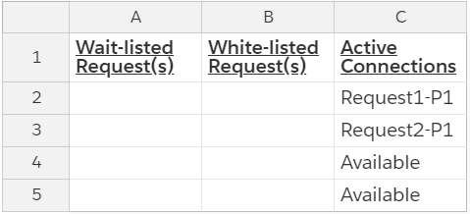
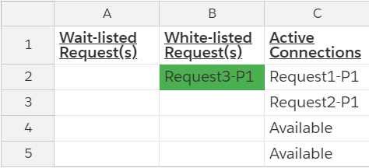
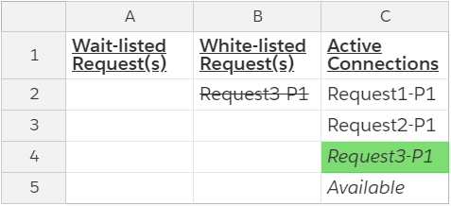
FREE CONNECTORS AND CONNECTED
BT controller has a limit of 4 connectors

Slide 9
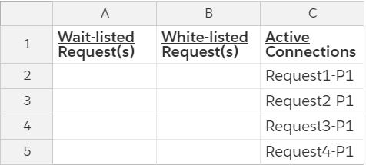
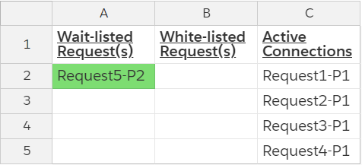
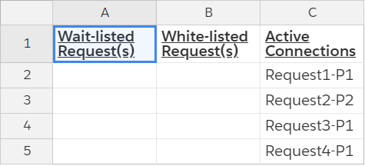
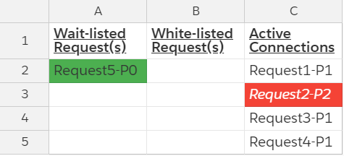
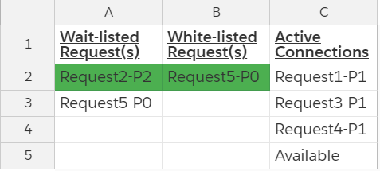
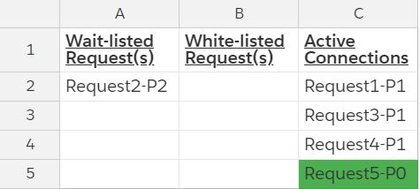
FULLY CONNECTED AND LOWER/HIGH PRIORITY CONNECTION REQUEST

Slide 10
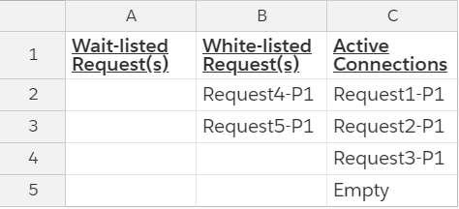
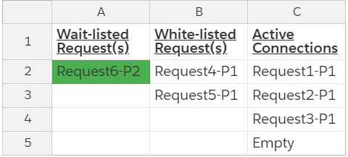

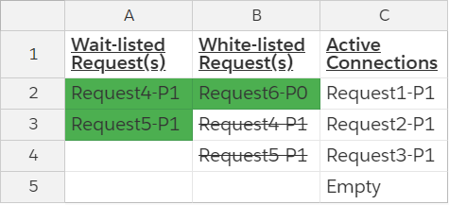
ONE FREE CONNECTOR WITH WHITE-LISTED REQUEST, THEN LOWER/HIGH PRIORITY CONNECTION REQUEST ADDED

Slide 11
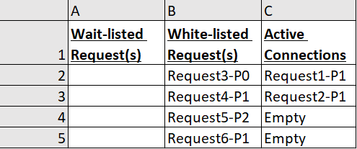
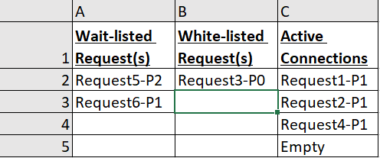
TWO FREE CONNECTORS WITH MANY WHITE-LISTED REQUESTS, THEN ONE CONNECTED

Slide 12
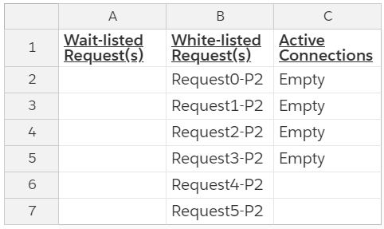
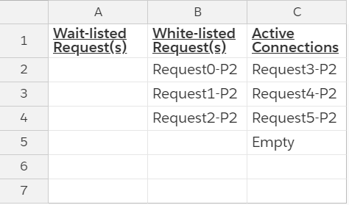
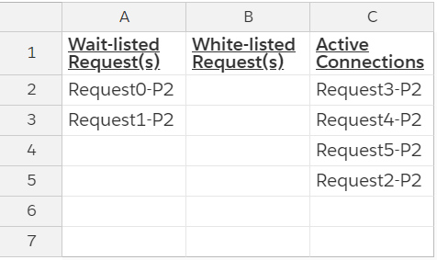
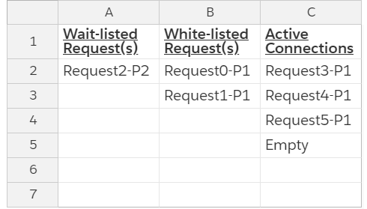
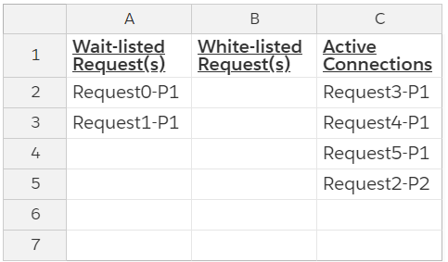
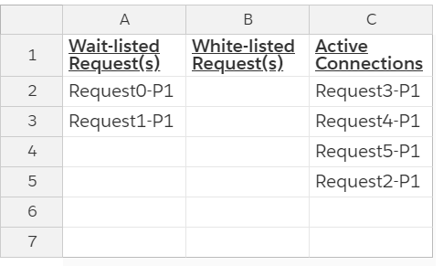
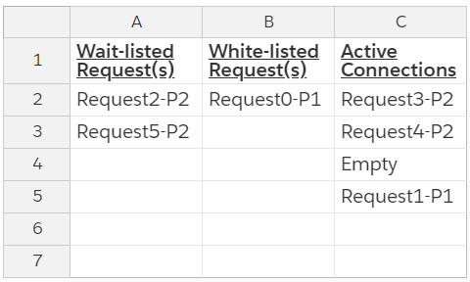

SmartHome BLE Bulb Connection Flow

Slide 13
How to read a log
//Connection request
BtGatt.GattService: clientConnect() - address=D0:95:89:1A:B7:C9, isDirect=false
btpm_internal: BTPM_BG_WHITE_L addr=D0:95:89:1A:B7:C9 appId=4 clientIf=10 pri=5 acl_pri=5 acl_state=2 localInit=0
BtGatt.FosGattService: FosGattService.onBtpmConnNotifyCallback() called. status=BTPM_STATUS_WHITEL_TO_BGL, clientIf=10, address=D0:95:89:1A:B7:C9
btpm_internal: BTPM_BG_CONN_L addr=D0:95:89:1A:B7:C9 appId=4 clientIf=10 pri=5 acl_pri=5 acl_state=2 localInit=0
FosGattService.onBtpmConnNotifyCallback() called. status=BTPM_STATUS_WHITEL_TO_BGL, clientIf=10, address=D0:95:89:1A:B7:C9
btpm_internal: BTPM_BG_CONN_L addr=D0:95:89:1A:B7:C9 appId=4 clientIf=10 pri=5 acl_pri=5 acl_state=2 localInit=0
//Set the priority to high
BtGatt.FosGattService: FosGattService.setRequestPriority() called. priority=10, clientIf=10, address=D0:95:89:1A:B7:C9
btpm_internal: BTPM_BG_CONN_L addr=D0:95:89:1A:B7:C9 appId=4 clientIf=10 pri=10 acl_pri=10 acl_state=2 localInit=0
//Set priority to low once operation is completed
BtGatt.FosGattService: FosGattService.setRequestPriority() called. priority=5, clientIf=10, address=D0:95:89:1A:B7:C9
btpm_internal: BTPM_BG_CONN_L addr=D0:95:89:1A:B7:C9 appId=4 clientIf=10 pri=5 acl_pri=5 acl_state=2 localInit=0

Slide 14
Phase 2: BLE ACL Link Management
BLE ACL link with a remote device could contain multiple GATT connections with direct and background GATT connection types, and with different priorities.
The highest priority of the GATT connections on one ACL link will be used as the ACL link priority.
ACL object contains an acl_gatt_list with all the GATT connection instances on this ACL link. The ACL link priority is updated whenever the acl_gatt_list is changed.
Whenever a GATT connection instance is add or removed from the connection list it belongs to, it is also added or removed from its ACL list and the ACL priority is updated to the current highest priority in the ACL list.
Whenever the ACL priority is updated, every GATT connection instance in the ACL list need to adjust its position in the connection list it belongs.
No connection request should be allowed on the ACL link that is in disconnecting state initiated by the policy manager. The request should be put in the waiting list and be processed after the ACL link is disconnected.

Slide 15
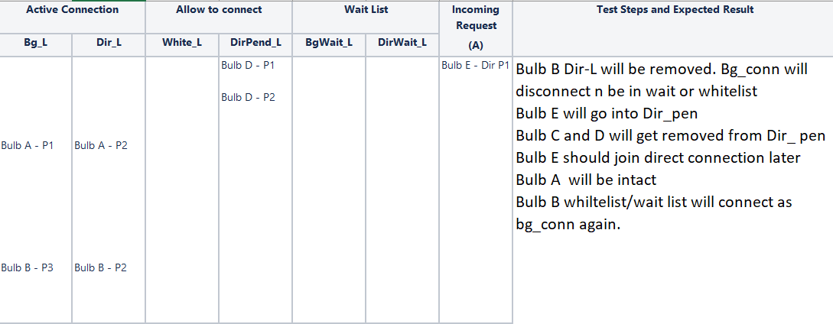
Algorithm Testing

Slide 16
GATT Connection List
btpm_internal: BTPM_DIR_CONN_L list_size=3 conn_list=0xa2e0db98
btpm_internal: BTPM_DIR_CONN_L addr=F9:48:A4:E3:74:3A appId=4 clientIf=14 pri=15 acl_pri=15 acl_state=2 localInit=0
btpm_internal: BTPM_DIR_CONN_L addr=ED:02:81:F4:7A:3D appId=4 clientIf=9 pri=10 acl_pri=15 acl_state=2 localInit=0
btpm_internal: BTPM_DIR_CONN_L addr=C4:02:81:74:8B:F1 appId=4 clientIf=11 pri=10 acl_pri=10 acl_state=2 localInit=0
btpm_internal: BTPM_DIR_WAIT_L list_size=0 conn_list=0xa2e0dbb0
btpm_internal: BTPM_DIR_PEND_L list_size=0 conn_list=0xa2e0dbc8
btpm_internal: BTPM_BG_CONN_L list_size=2 conn_list=0xa2e0dbe0
btpm_internal: BTPM_BG_CONN_L addr=ED:02:81:F4:7A:3D appId=4 clientIf=8 pri=15 acl_pri=15 acl_state=2 localInit=0
btpm_internal: BTPM_BG_CONN_L addr=C4:02:81:74:8B:F1 appId=4 clientIf=10 pri=5 acl_pri=10 acl_state=2 localInit=0
btpm_internal: BTPM_BG_WAIT_L list_size=0 conn_list=0xa2e0dc28
btpm_internal: BTPM_BG_WHITE_L list_size=0 conn_list=0xa2e0dc40

Slide 17
ACL Object List
btpm_internal: btpm_print_acl_obj_list btpm_le_acl_obj_list=0xa2e0dc58 length=3
btpm_internal: ACL_OBJ: addr=ED:02:81:F4:7A:3D acl_pri=15 link_state=2 acl_gatt_list=0xa2e0de50
btpm_internal: list_size=2 conn_list=0xa2e0de50
btpm_internal: addr=ED:02:81:F4:7A:3D appId=4 clientIf=8 pri=15 acl_pri=15 localInit=0 cur_l=0xa2e0dbe0
btpm_internal: addr=ED:02:81:F4:7A:3D appId=4 clientIf=9 pri=10 acl_pri=15 localInit=0 cur_l=0xa2e0db98
btpm_internal: ACL_OBJ: addr=C4:02:81:74:8B:F1 acl_pri=10 link_state=2 acl_gatt_list=0x8c6a3480
btpm_internal: list_size=2 conn_list=0x8c6a3480
btpm_internal: addr=C4:02:81:74:8B:F1 appId=4 clientIf=11 pri=10 acl_pri=10 localInit=0 cur_l=0xa2e0db98
btpm_internal: addr=C4:02:81:74:8B:F1 appId=4 clientIf=10 pri=5 acl_pri=10 localInit=0 cur_l=0xa2e0dbe0
btpm_internal: ACL_OBJ: addr=F9:48:A4:E3:74:3A acl_pri=15 link_state=2 acl_gatt_list=0x8c6a3228
btpm_internal: list_size=1 conn_list=0x8c6a3228
btpm_internal: addr=F9:48:A4:E3:74:3A appId=4 clientIf=14 pri=15 acl_pri=15 localInit=0 cur_l=0xa2e0db98

Slide 18
Phase 3: BLE Mesh Support
applications need to have dedicated BLE connection.
BLE mesh and the Amazon BLE remote need one dedicated BLE connection
dedicated connections won’t be preempted by other connections.

Slide 19
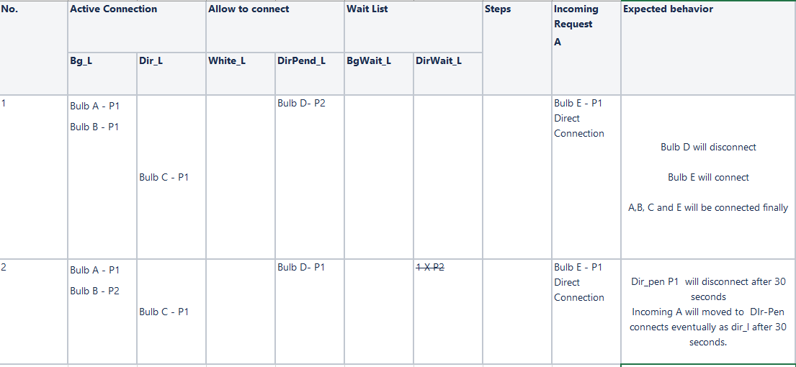
Phase 3: Algorithm

Slide 20
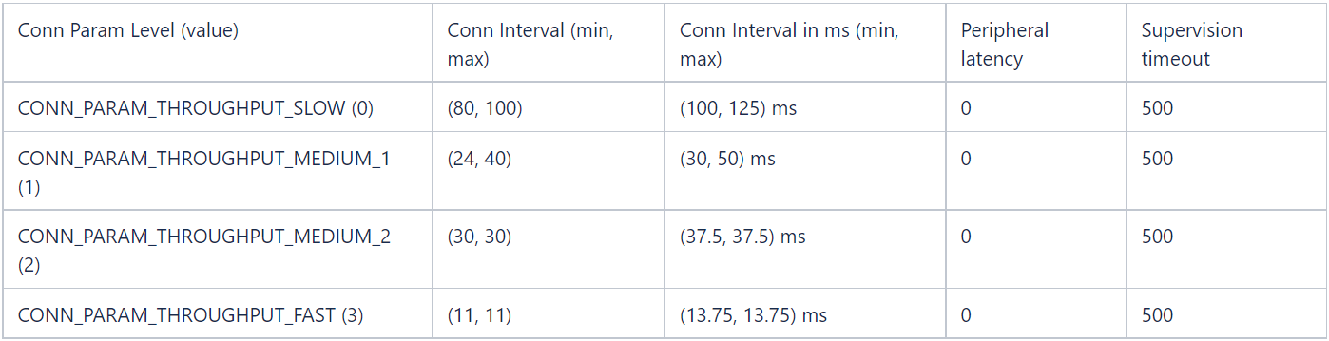
Phase 4: BLE connection parameter management
To Maintain QOS
The initial connection parameters will be decided in the BTPM configuration based on the application ID. After the GATT connection is established, application can use the AmazonBluetoothGatt.requestConnectionPriority(int connectionPriority, int timeout, int peripheralLatency) API to adjust the connection parameters.

Slide 21
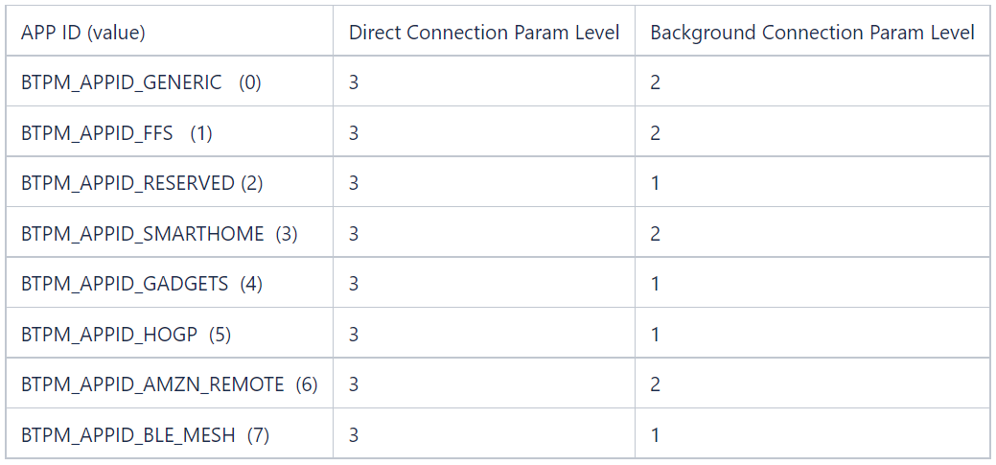
Configuration for Applications

Slide 22
Connection Parameter
[APP1]
# AppBleXXXConnParamLevel should be in range [0, 3]
# 0: slow: 100-125ms (80-100), 0, 500
# 1: medium 1: 30-50ms (24-40), 0, 500
# 2: medium 2: 37.5-37.5ms (30-30), 0, 500
# 3: fast: 13.75-13.75 (11-11), 0, 500
AppBleDirConnParamLevel = 3
AppBlebgConnParamLevel = 2

Slide 23
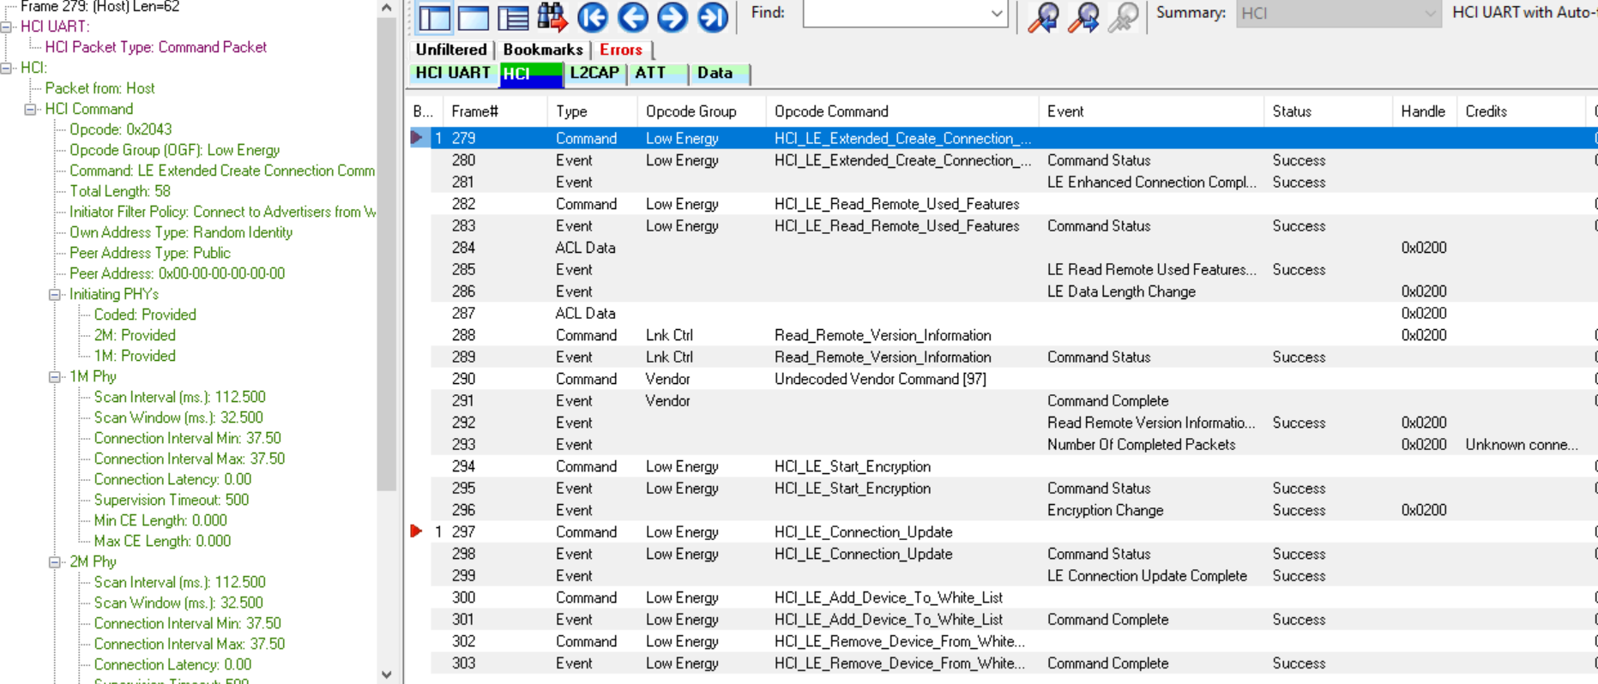
Connection Parameters for bg & dir conn

Slide 24
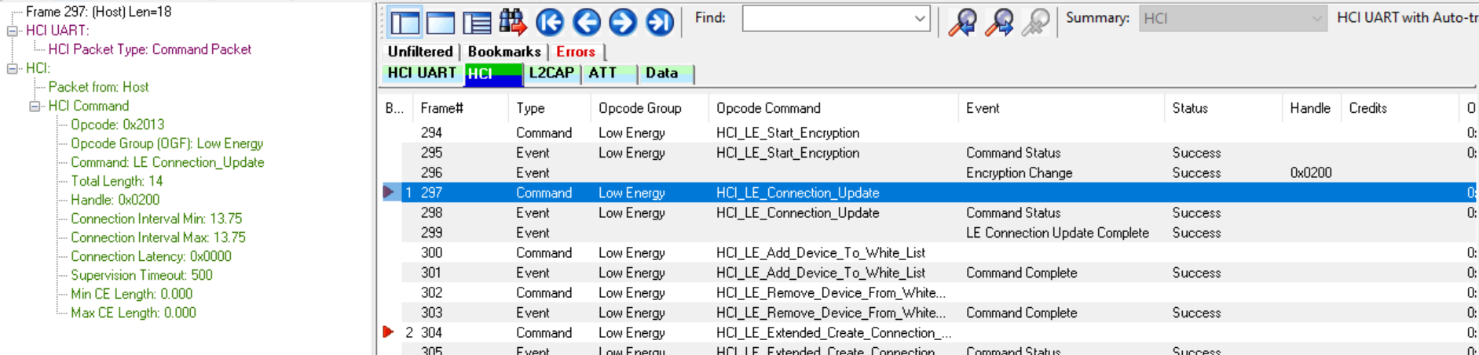
Connection Parameters for bg & dir conn

Slide 25
Proposed new connection parameters
Current Connection Interval:
CONN_PARAM_TPUT_SLOW: CI = 112.5ms (90 frame) CONN_PARAM_TPUT_MEDIUM_1: CI = 40ms (32 frames) CONN_PARAM_TPUT_MEDIUM_2: CI = 37.5ms (30 frames) CONN_PARAM_TPUT_FAST: CI = 13.75ms (11 frames)
New Connection Interval:
CONN_PARAM_TPUT_SLOW: CI = 120ms (96 frame) CONN_PARAM_TPUT_MEDIUM_1: CI = 60ms (48 frames) CONN_PARAM_TPUT_MEDIUM_2: CI = 30ms (24 frames) CONN_PARAM_TPUT_FAST: CI = 15 ms (12 frames)

Slide 26
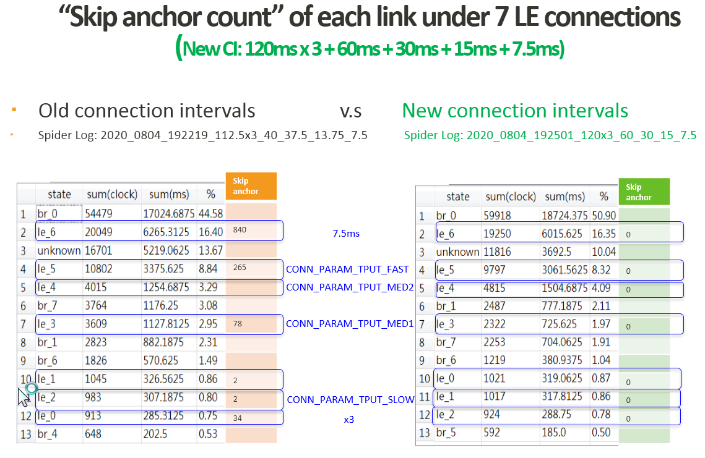
Comparison between old and new connection parameters

Slide 27
Reference
https://wiki.labcollab.net/confluence/display/BLUETOOTH/Bluetooth+Policy+Manager+Design

Slide 28
Q & A

