Slide 1
“Lockdown” blessing in disguise for OTT platforms in India.
Yogesh Haresh Bojja(s3789918)

Slide 2
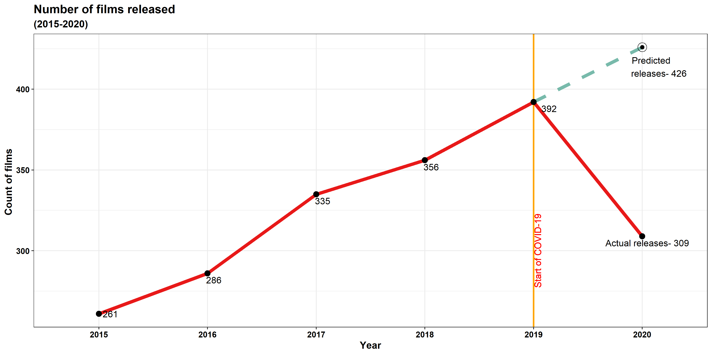
Closed movie theatres lead to loss of approx. 117 movie releases during lockdown.

Slide 3
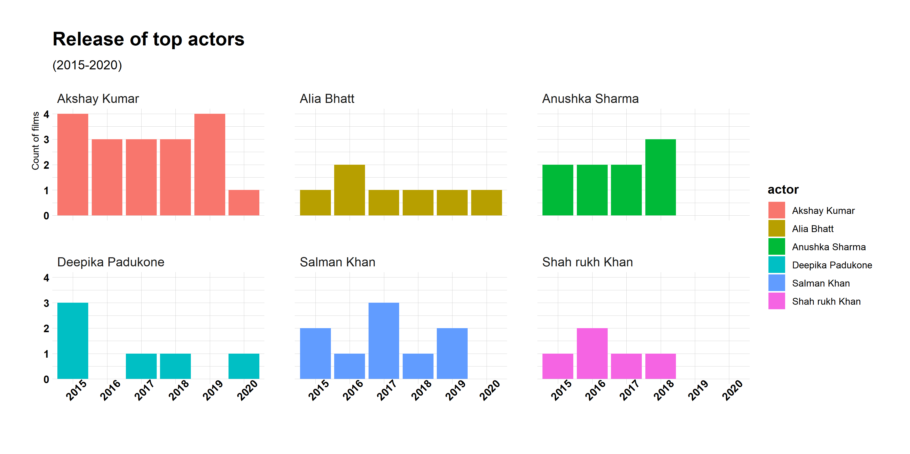
Lockdown halted careers of most top-rated actors in the movie industry.

Slide 4
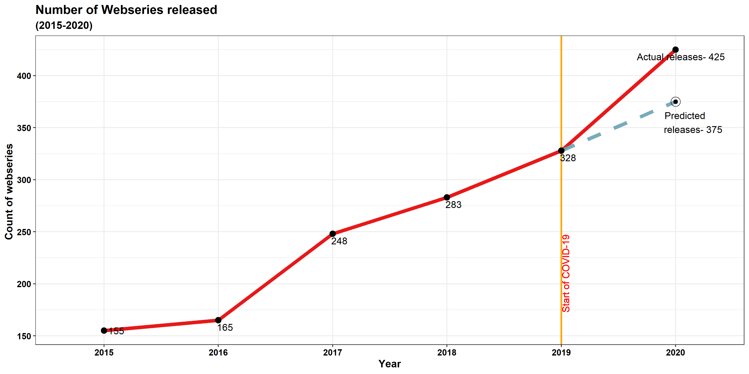
Web series on the other hand had hike of 50 new releases during lockdown.

Slide 5
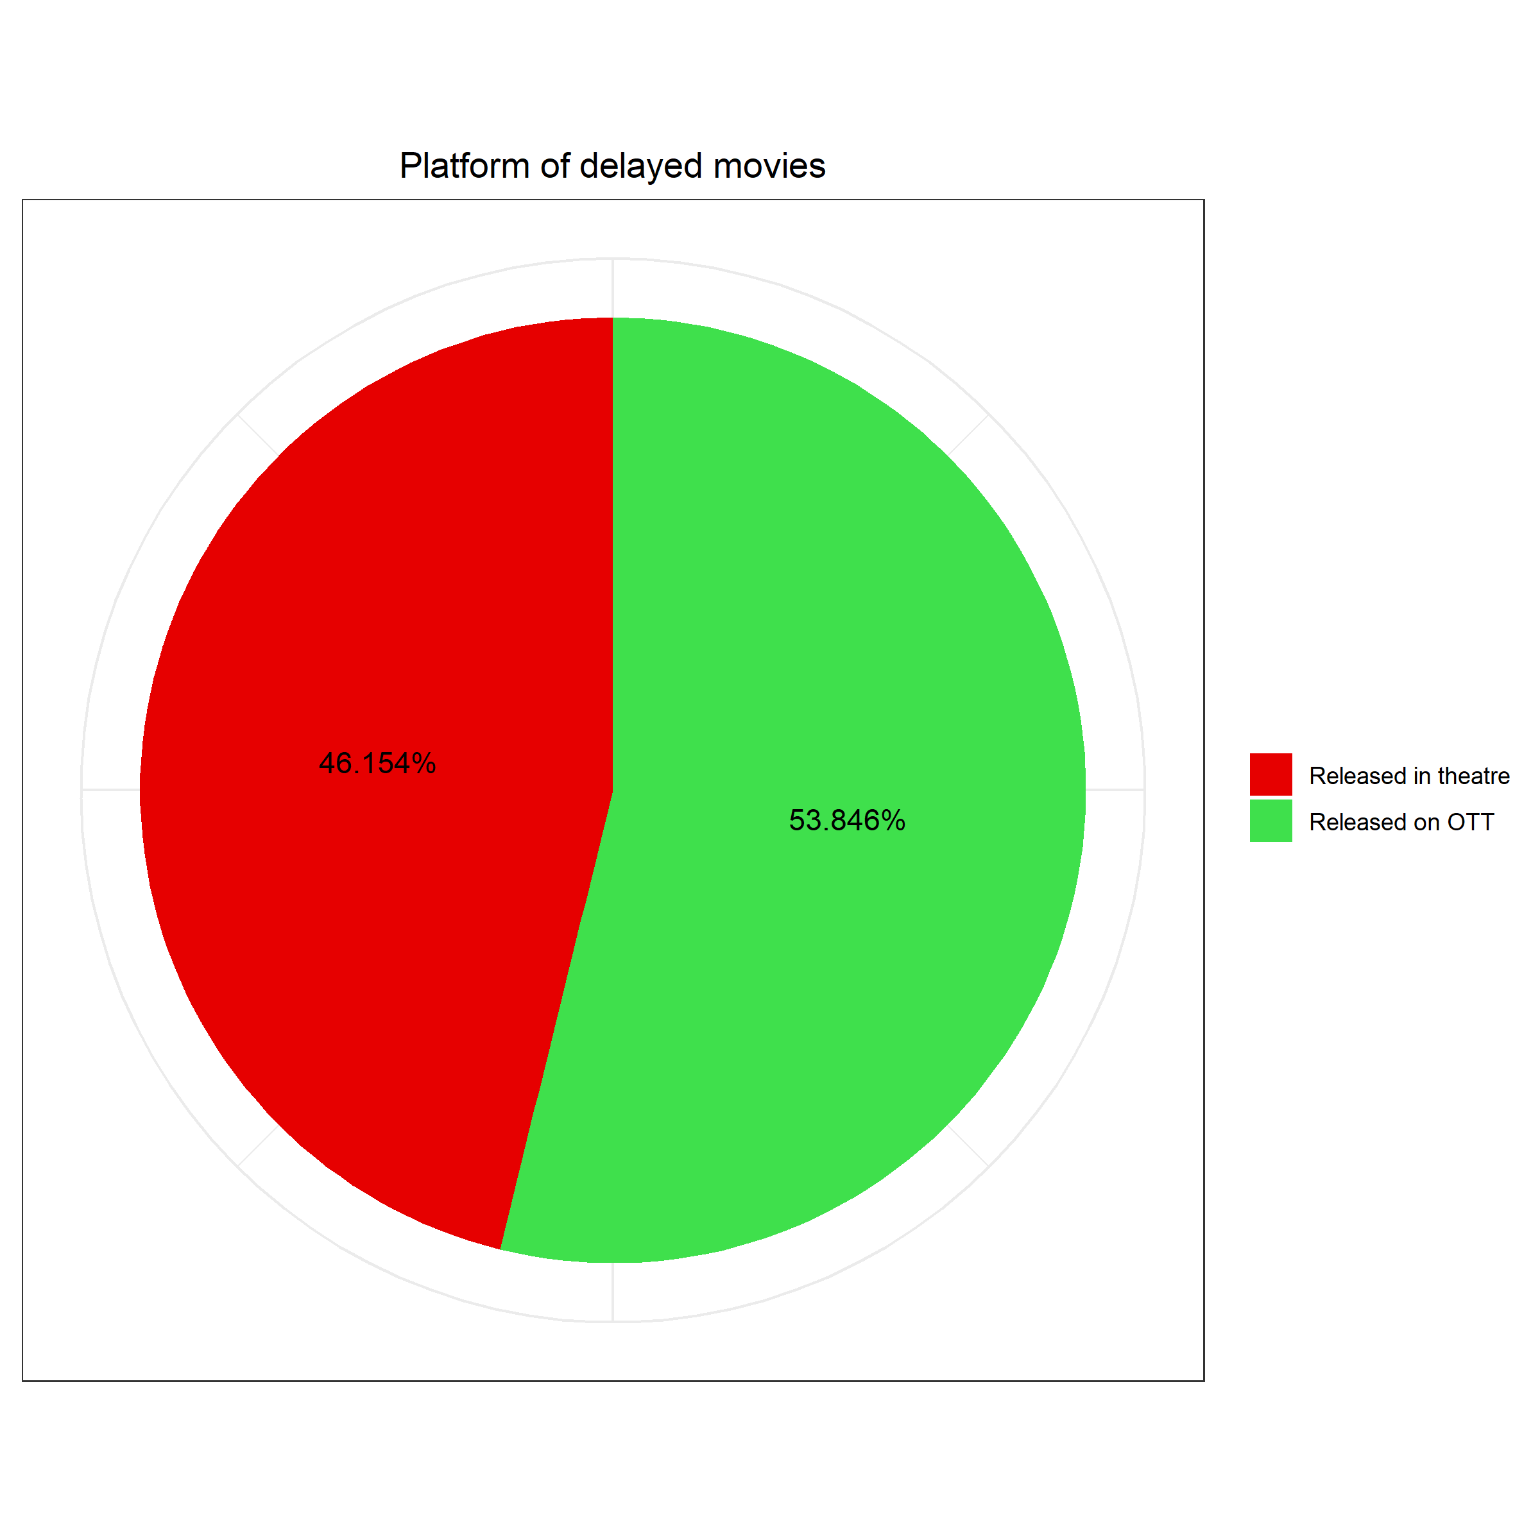
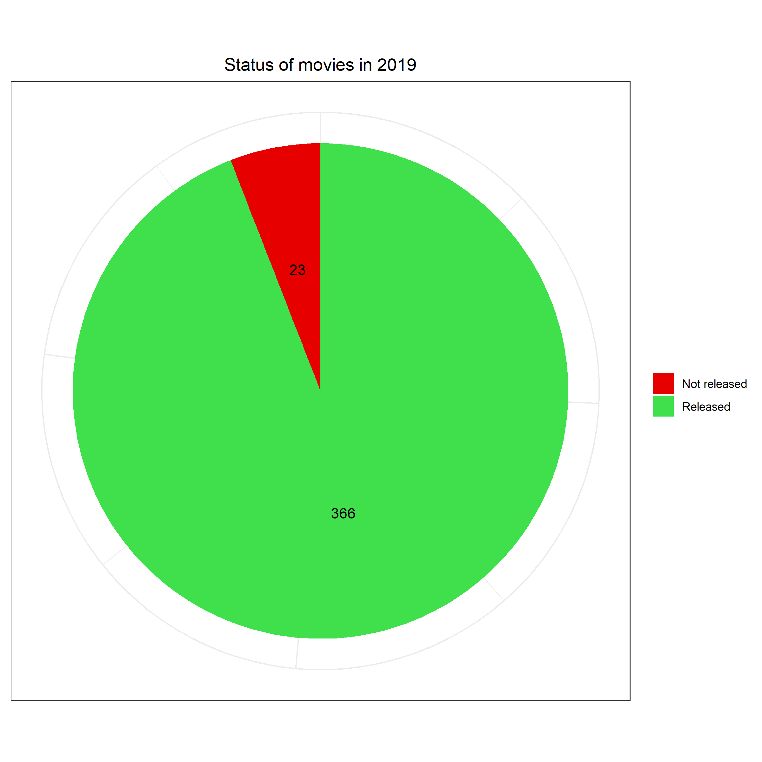
Around 50% movies not released due to lockdown were later released on the OTT platforms.

Slide 6
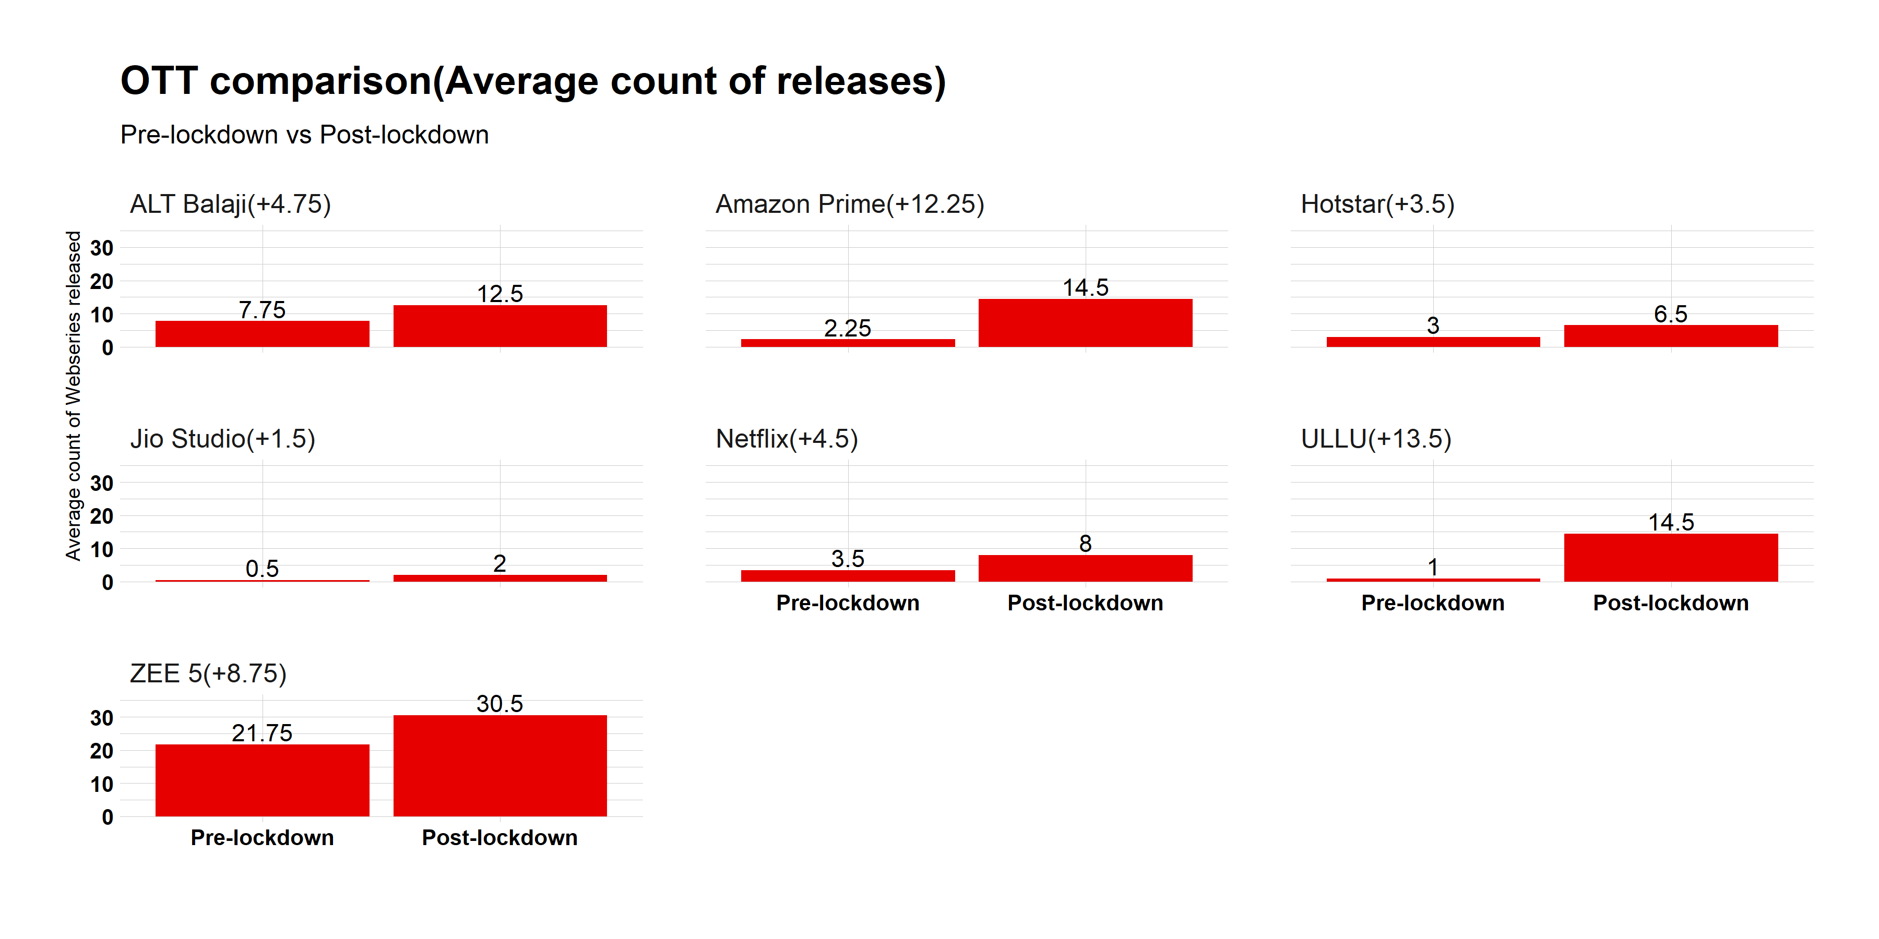
Major OTT platforms showing boost in the release of web series breaking the Indian tradition of daily soap.

Slide 7
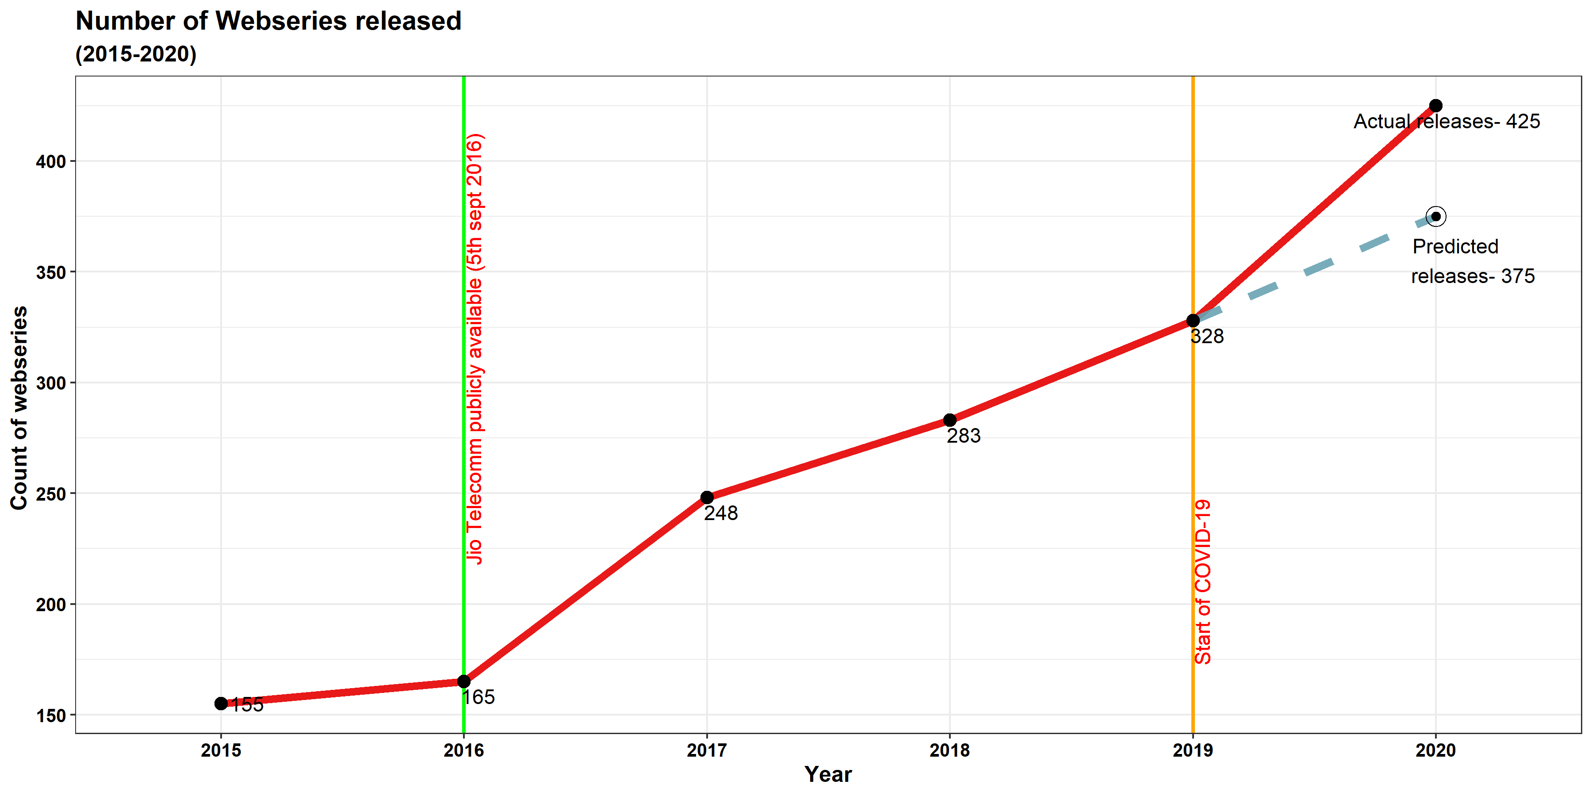
Exponential rise in the number of web series after the introduction of Jio Telecommunication.

Slide 8
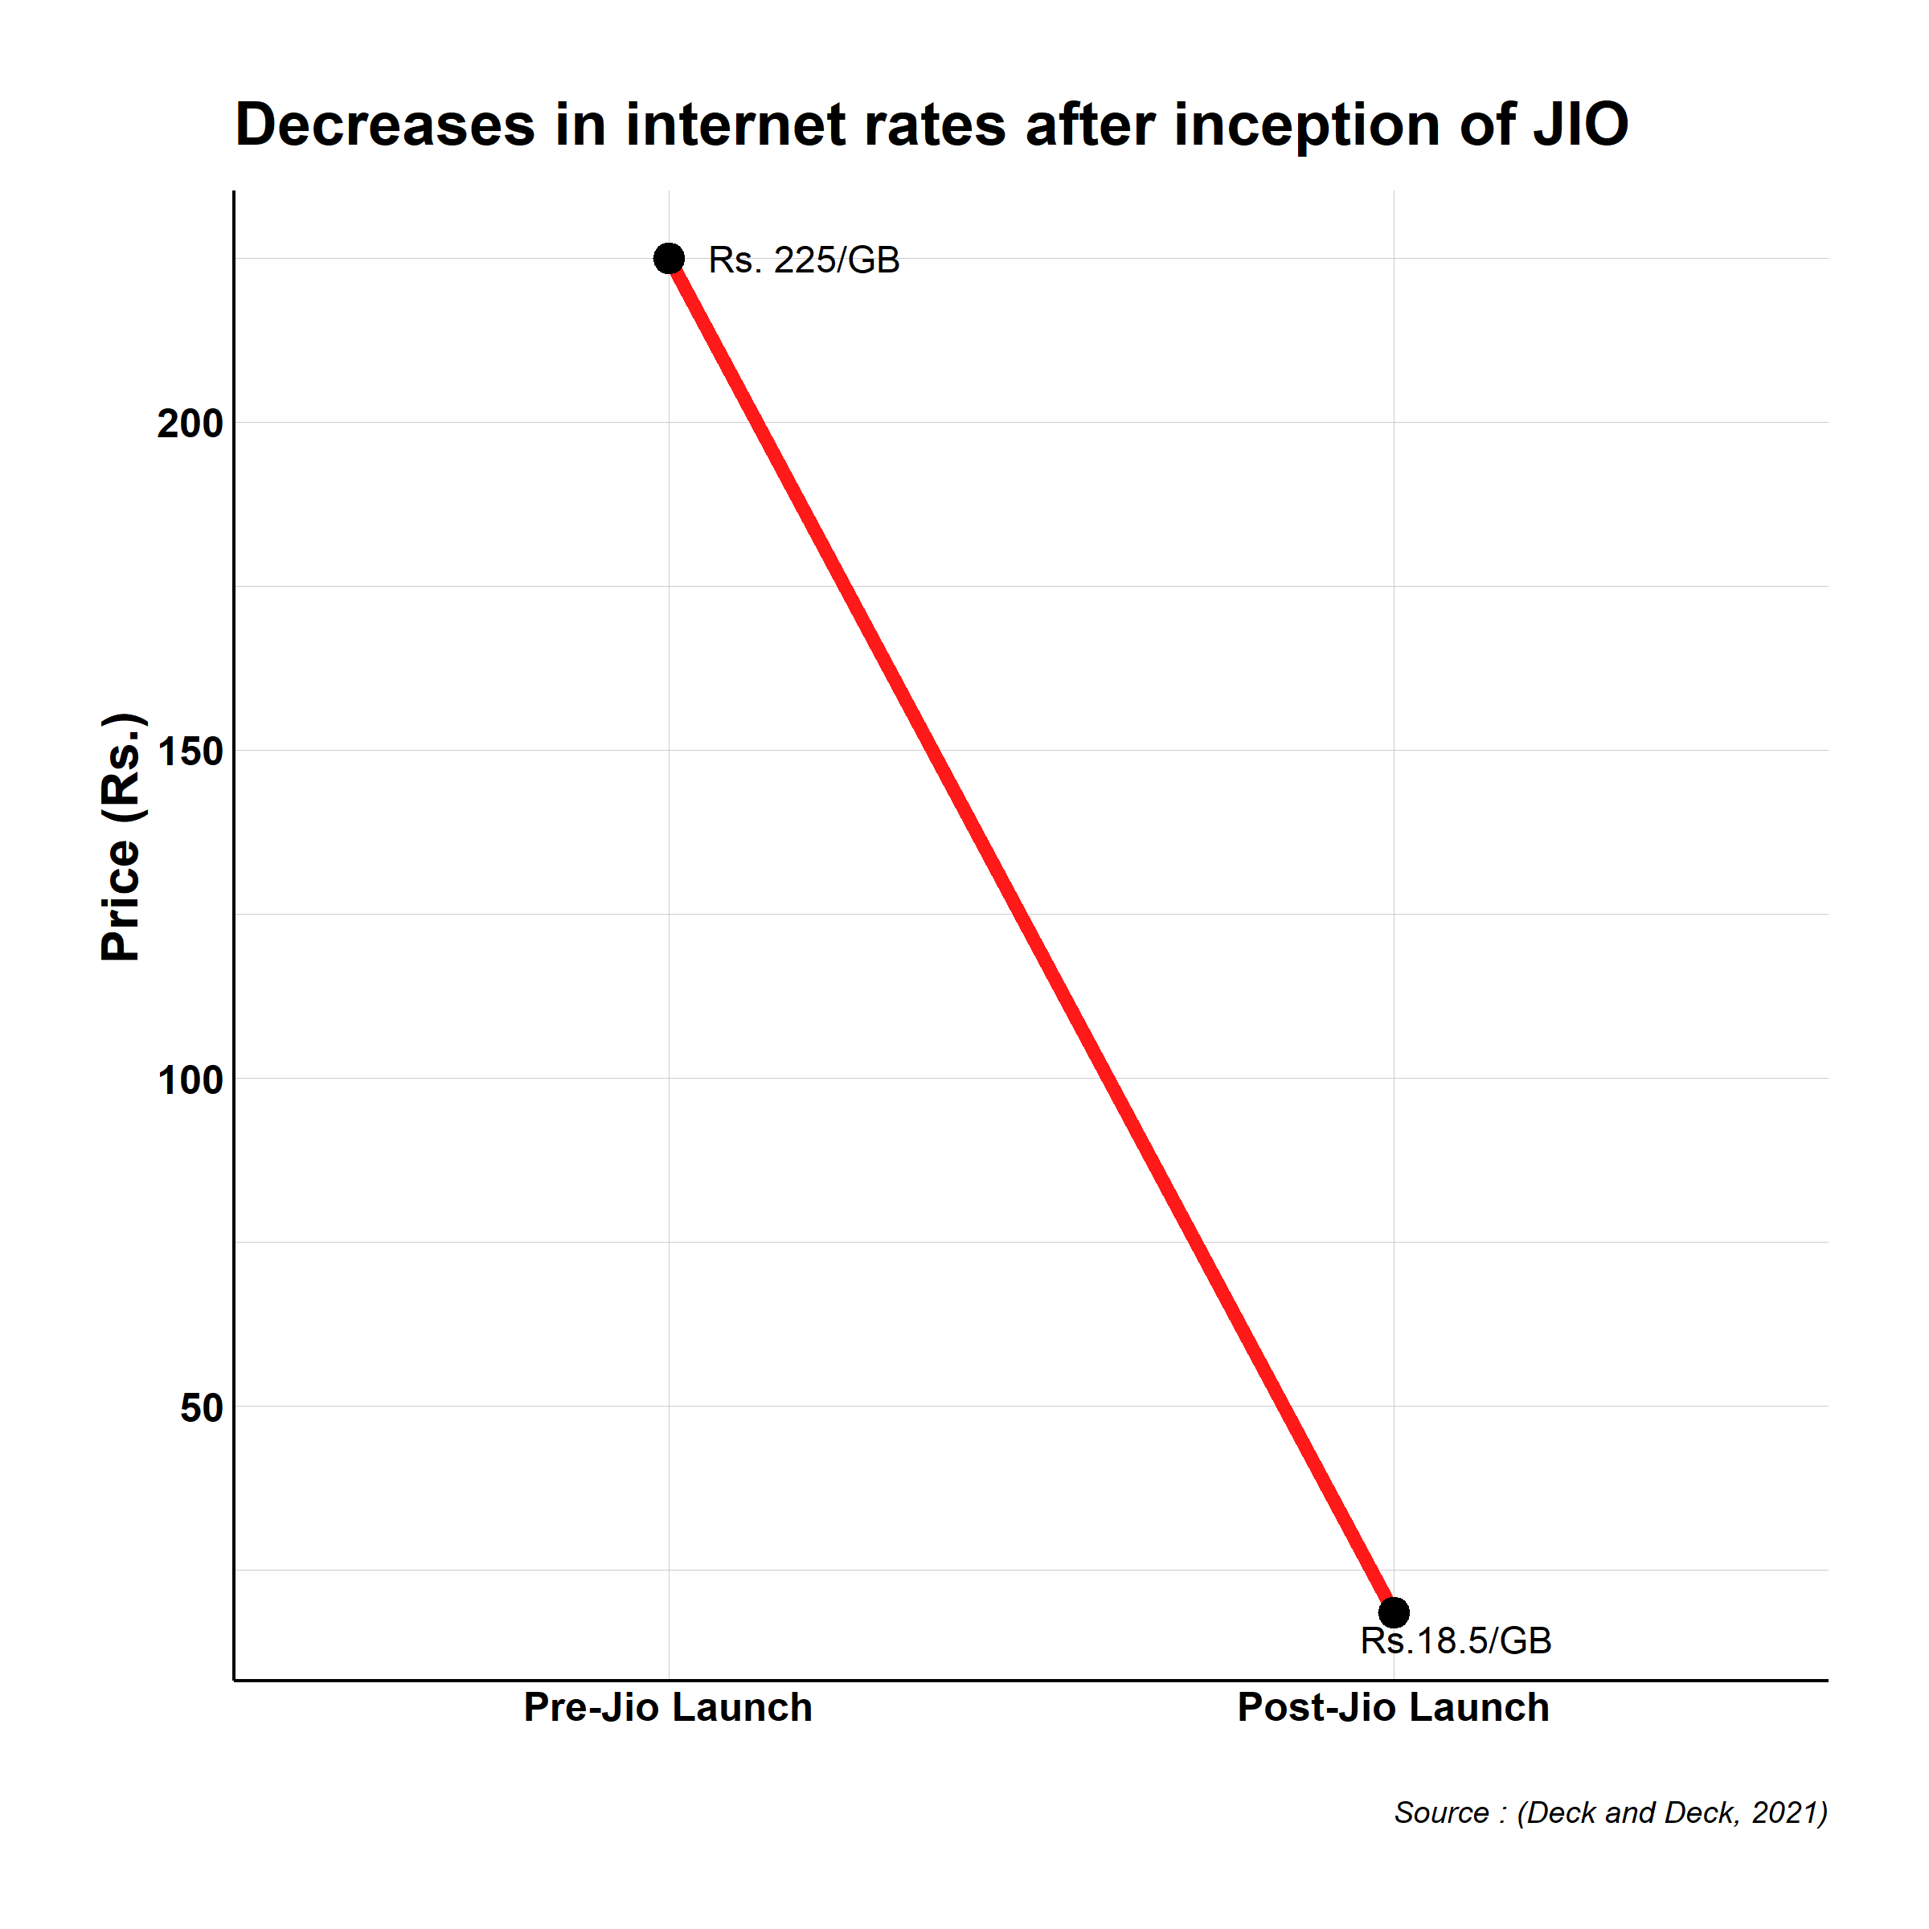
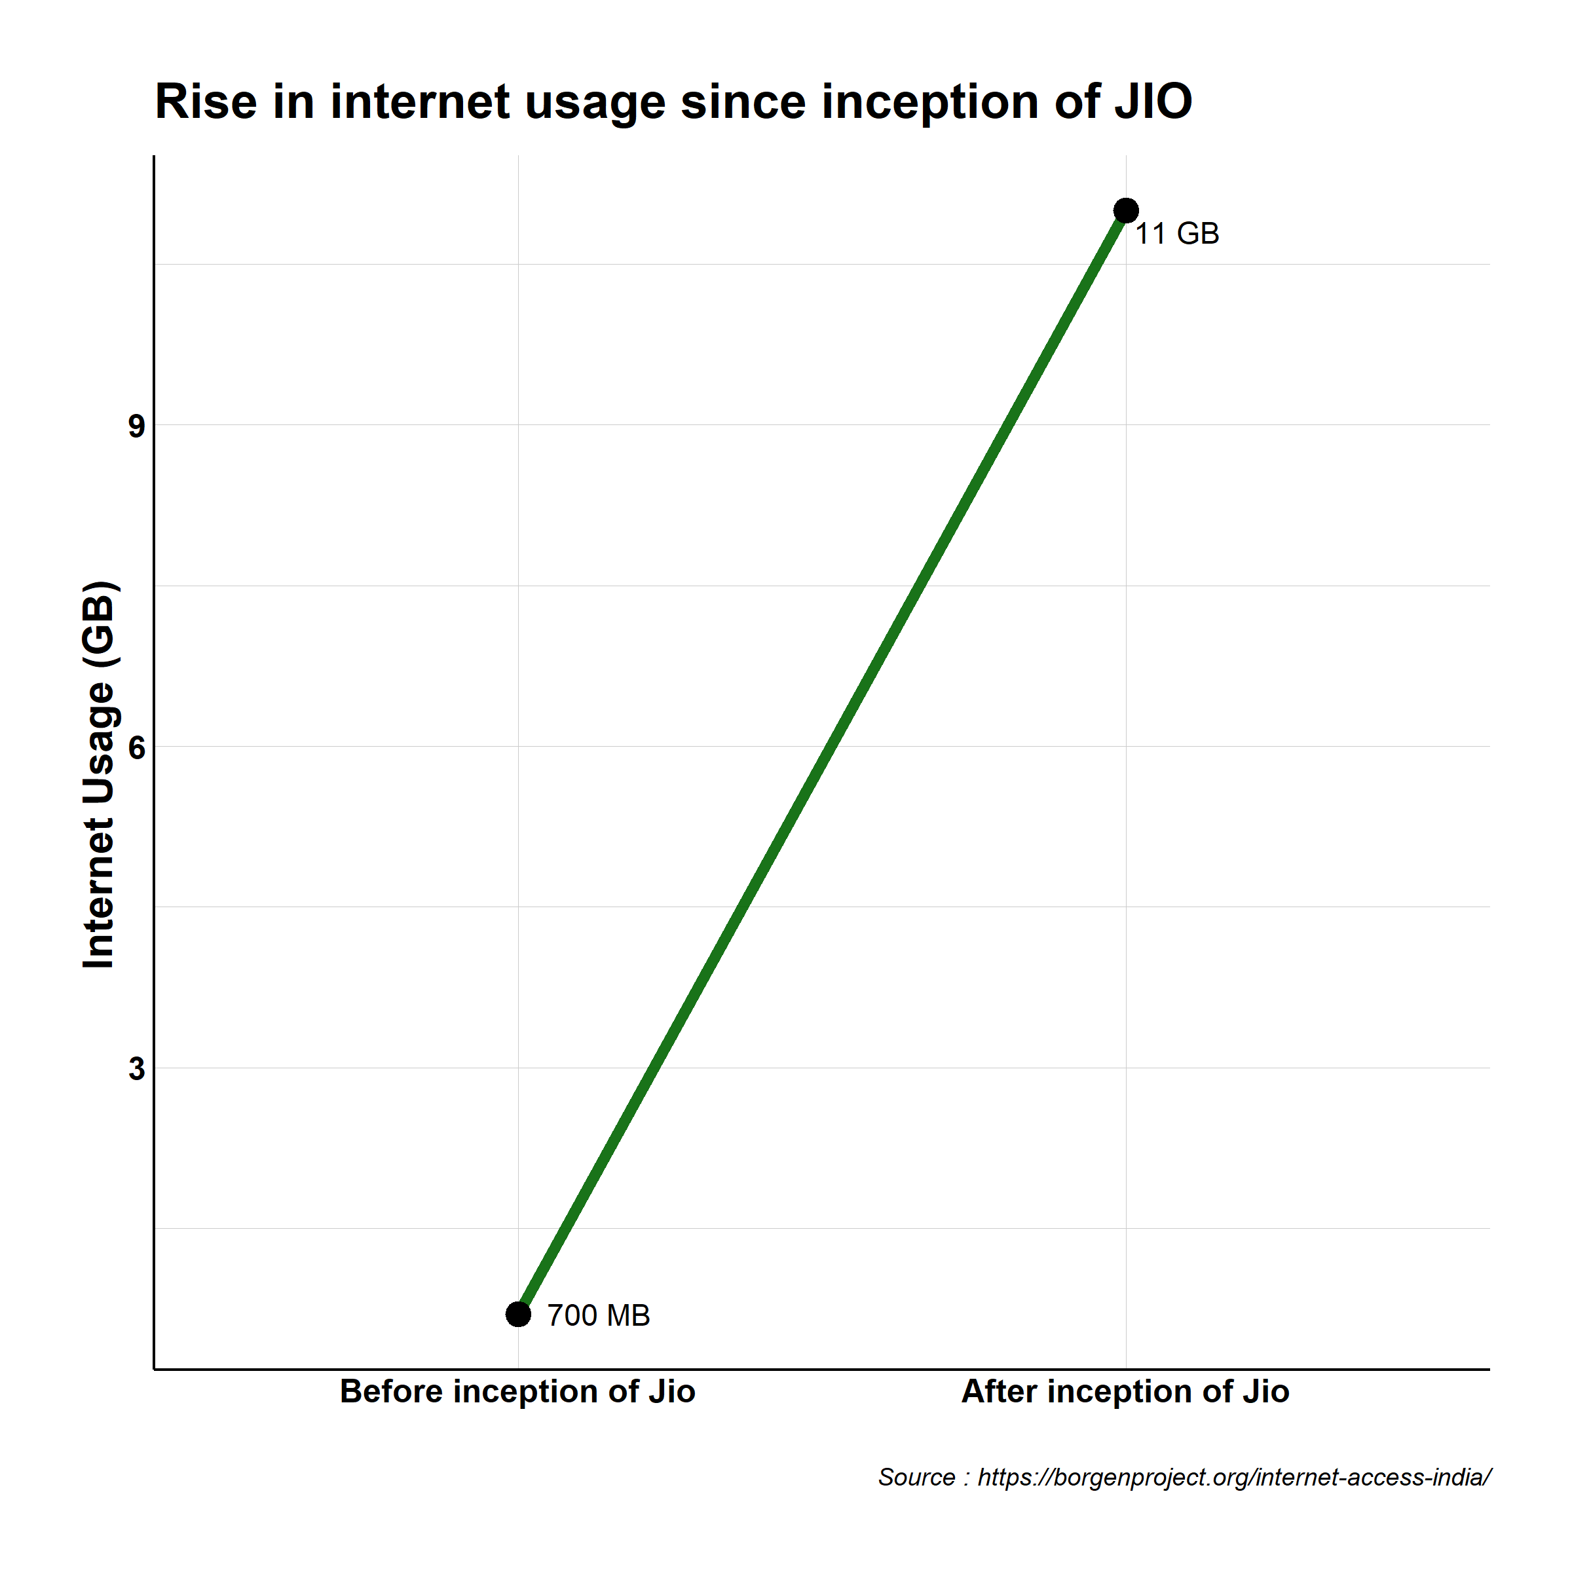
Availability of cheaper internet during lockdown by Jio increased the demand of OTT platforms , helping them bloom!

Slide 9
References:
IMDb: Advanced Title Search - IMDb
https://borgenproject.org/internet-access-india/
https://restofworld.org/2020/how-india-mobile-data-became-worlds-cheapest/#:~:text=At%20one%20point%20in%202016,approximately%20225%20rupees%20(%243).

