Slide 1
Tower Defense Game –Team 3
Yogesh Thakare
Gagandeep Singh
Gaurav Amrutkar

Slide 2
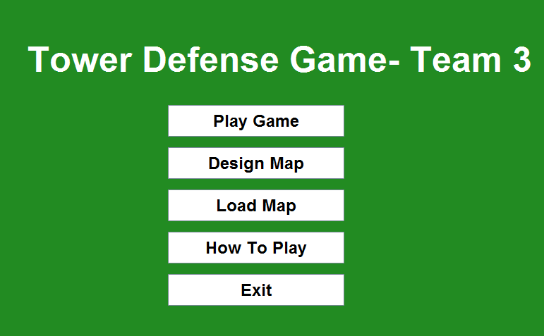

Slide 3
Functional Requirements
A. The User should be able to create and edit a map:
User- Driven interactive creation of a map, user should be able to choose the size of the map.
User Driven allocation of map elements such as scenery, path, entry and exit point.
The user should be able to save a valid map.
A map is considered valid if:
It consists of an entry point
It consists of an exit point
The map should be of size 29 * 15
(Maximum)(Width*Height) , 5*5 (minimum)
The map should be continuous and connected.
The user should be able to load and edit an existing map.

Slide 4
Functional Requirements
B. The User should be able to play the game
Game starts by user selection of a previously user-saved map, then loads the map
Wave-based play: First (pre-wave phase) the player can place new towers, upgrade towers, sell towers, and signify that critters are allowed in on the map, when all critters in a wave have been killed or reached the end point, a new wave starts.
End of game, e.g. when a certain number of critters reach the exit point of the map, or the critters steal all the player’s coins, or the player succeeds in killing a certain number of waves.
Implementation of currency, cost to buy/sell a tower, and reward for killing critters.
Critter waves are created with a level of difficulty increasing at every wave. Difficulty must involve increasing critter speed and toughness

Slide 5
Functional Requirements
Implementation of at least three different kinds of towers that are characterized by special damage effects. The mandatory special damage effects are: splash (inflicts damage to critters around the targeted critter), burning (inflicts damage over time after a critter has been hit), freezing (slows down the critter for some time).
The towers can target the critters using the following mandatory strategies: nearest to the tower, nearest to the end point, weakest critter, strongest critter. It must be possible to set a different targeting strategies for individual towers.
Tower inspection window that dynamically shows its current characteristics, allows to sell the tower, increase the level of the tower, select the tower’s targeting strategy and view the individual tower’s log (see below).
Critter observer that allows to dynamically observe the current hit points of any critter on the map.

Slide 6
Functional Requirements
C. The user should be able to manage the game by checking the logs:
Game log that records all events happening in the game, including placement/upgrade/selling of towers, critter wave creation, etc. The log must allow for the viewing of the whole log in sequential order (i.e. ordered in time) or certain portions of the log related to a certain aspect of the game, also ordered according to time, e.g. –
Individual tower log: time-ordered log of all events related to a specific tower
Collective tower log: time-ordered log of all events related to all towers (i.e. time inter-meshing of the previous)
Wave log: all activities that happened in any specific wave of the game (select a wave and list sorted by time the events happened in this wave, from pre-wave tower edition phase to end of the wave).
Global game log: all events that happened throughout the entire game up to now, sorted by time.

Slide 7
Functional Requirements
Map log that records in the map file the time of original creation of the map, when it was edited, when it was played and what was the result of the game every time it was played. When a map is being played, the list of five highest scores is presented before the game starts, as well as when the game ends.
Save/Load a game in progress: As a game is being played, allow the user to save the game in progress to a file, and allow the user to load the game in exactly the same state as saved.

Slide 8
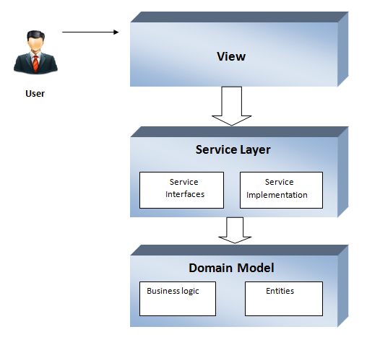
Architecture

Slide 9
Architecture
View
The view classes of the game render the model into a suitable form for visualization or interaction. Multiple views exist for a single model element of the game and rendered based on the game’s state.
Service Layer
Service layer defines an application’s boundary with a layer of services that establishes a set of available operations and coordinates the application’s response in each operation.
Domain Model
The model of the game controls the behavior of the application independent of the graphical user interface. The model directly manages the data, logic and rules of the application.

Slide 10
Programming Process
Design Patterns
The following design patterns have been used and implemented in the project:
Factory pattern for creating different types of Towers and waves
Singleton pattern for maintaining Money and Life throughout the game
Observer pattern for information about critter position and tower inspection panel
Decorator pattern for decoration tower features like firing speed, firing power and firing range

Slide 11
Programming Process
Coding Standards
The most general coding conventions have been followed while developing the codes which are as follows.
The name of the classes start with a upper case character e.g.:
GameMainApp.java
Constants are named with upper case characters and include
underscore between two words (if applicable).
The name of the variables are descriptive and are written in lower
case including a capital letter to separate between words.
The name of the methods start with a lower case character and
use uppercase letters to separate words.
Enums are named with upper case characters

Slide 12
Programming Process
Software Versioning Repository
The Concurrent Versioning System (CVS) in Eclipse has been used effectively in the development process. It has been used by the members to maintain different version as well has parallel development of the same class/module.
API Documentation
Javadoc has been used in the project to make all the necessary comments for classes methods and inline code and also to document it.

Slide 13
Programming Process
Unit testing Framework
Junit has been used in the project to write test cases for different tested class and tested methods. 52 different test cases have been written for the build 3 of the project.

Slide 14
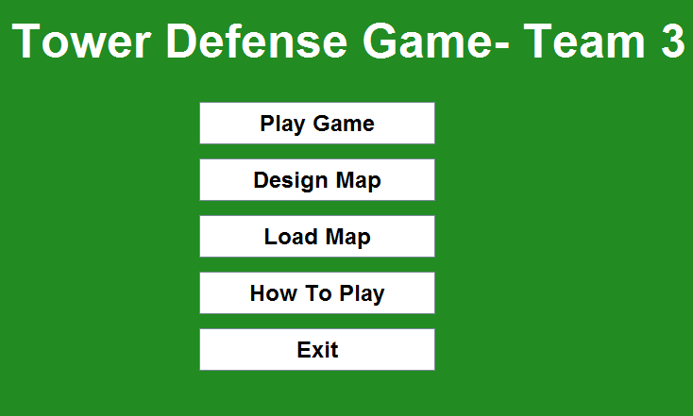
Screenshots

Slide 15
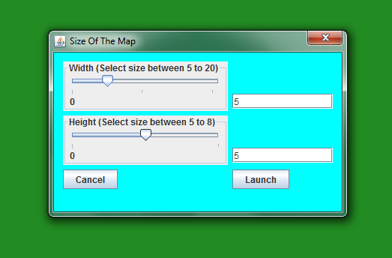
Screenshots

Slide 16
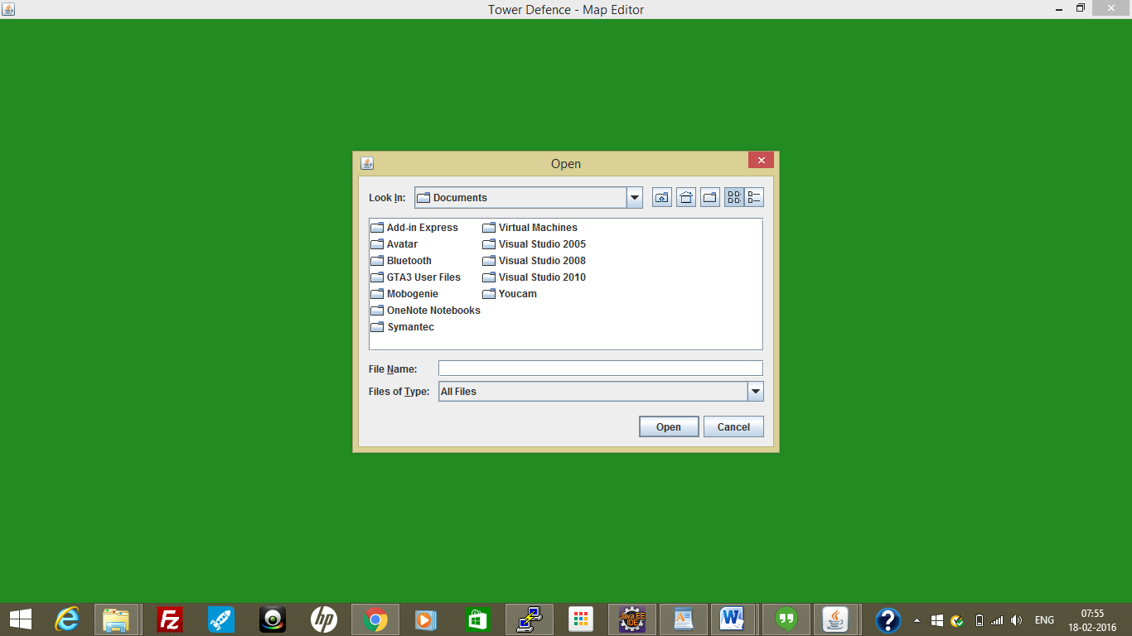
Screenshots

Slide 17
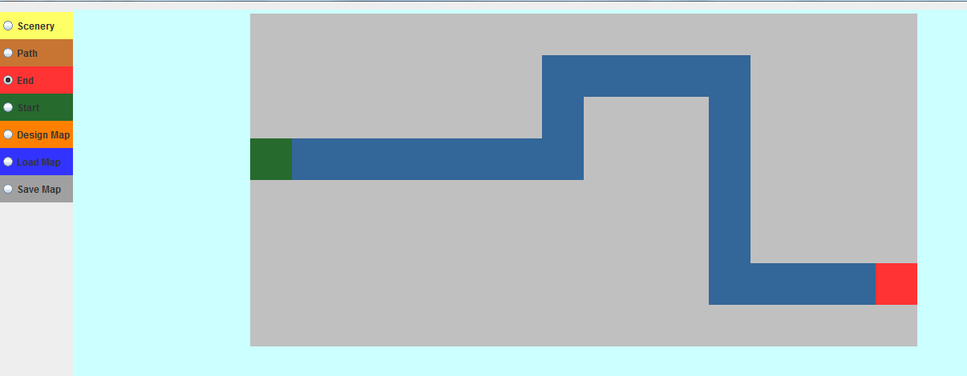
Screenshots

Slide 18
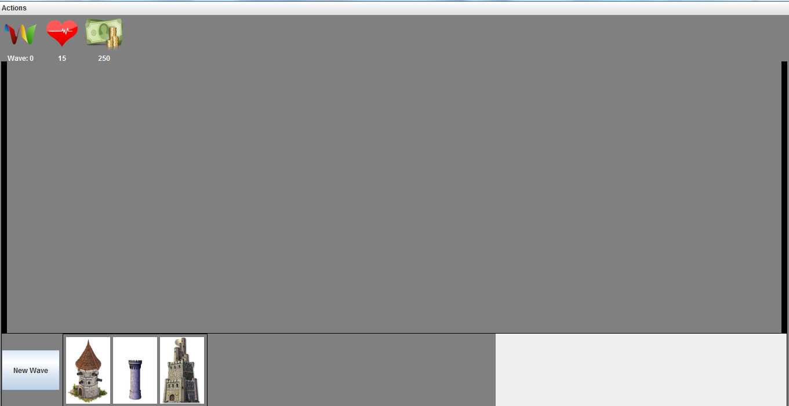
Screenshots

Slide 19
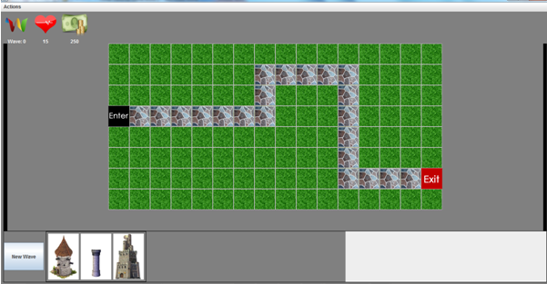
Screenshots

Slide 20
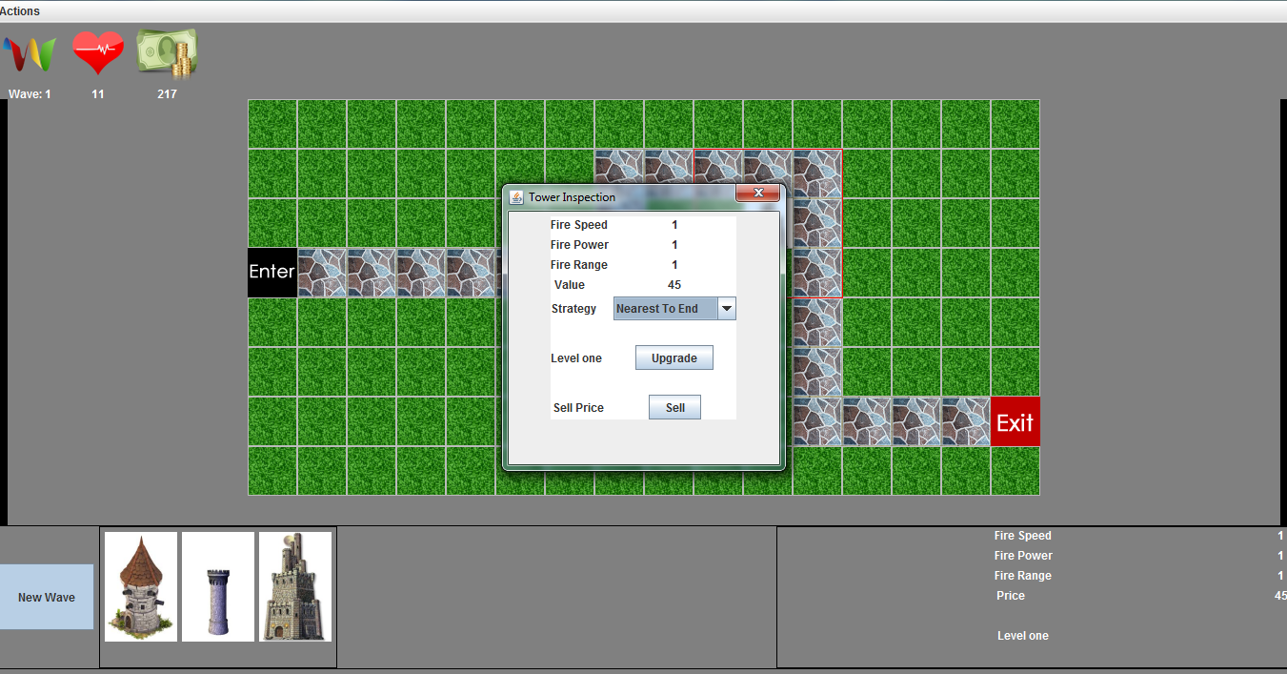
Screenshots

Slide 21
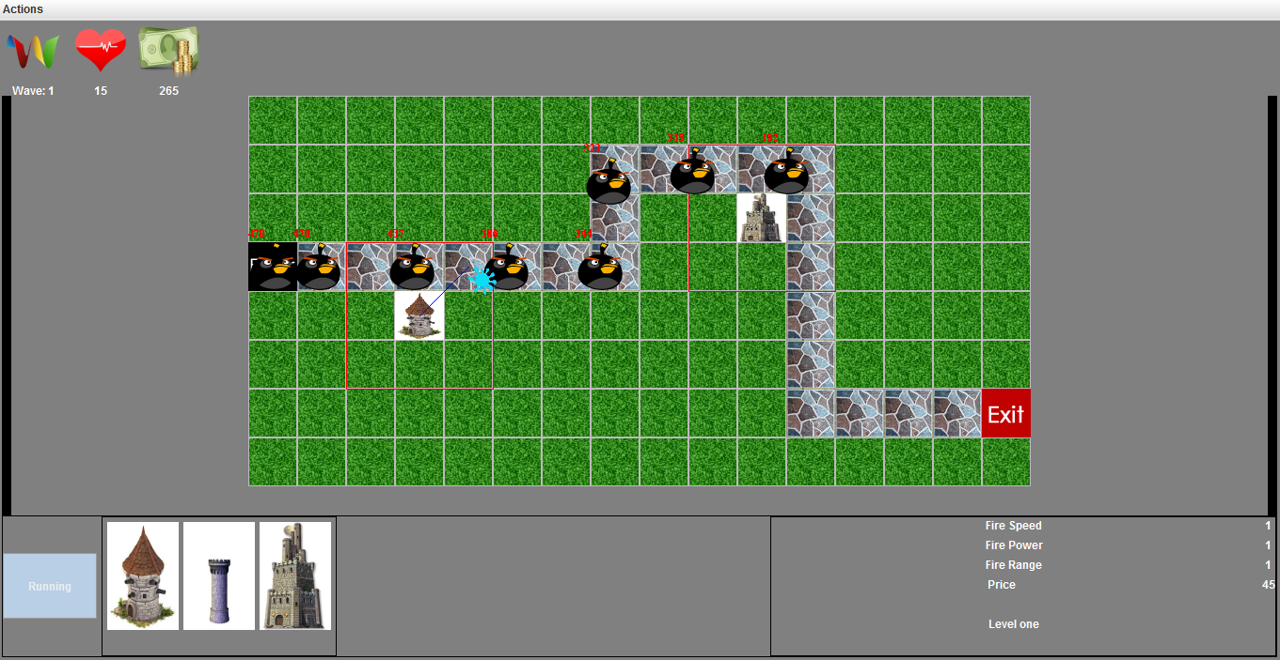
Screenshots

Slide 22
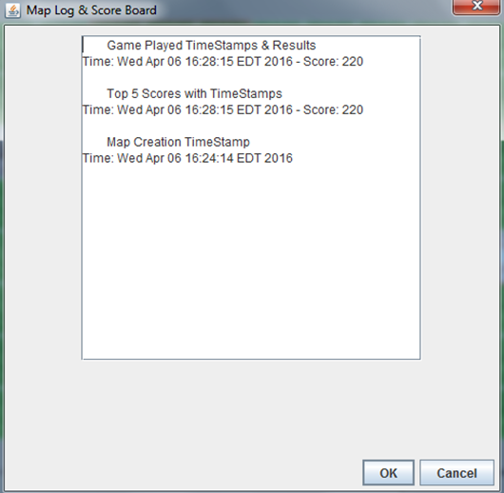
Screenshots

Slide 23
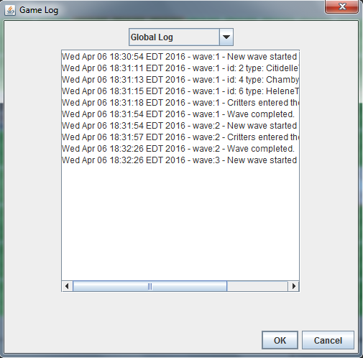
Screenshots

Slide 24
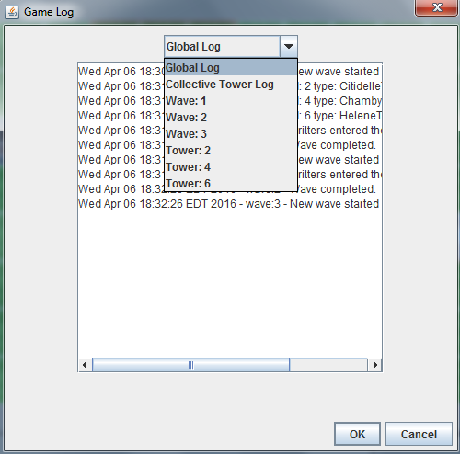
Screenshots

Slide 25
Thank you

