Slide 1

Logistic and Delivery Enhancing Efficiency in Supply Chain Management Prescriptive Modelling and Optimization : GENBUS 730
Presented by
Yogesh Anugula Ramachandra
Rama Mohan Reddy Bigivemula

Slide 2






Project Background
The logistic and delivery optimization project focuses on enhancing the efficiency of transporting goods between five cities in Wisconsin.
The goal is to find the best and shortest routes covering all the cities exactly once and to get back to the origin city for delivery vehicles, minimizing travel time and associated costs.
The five cities involved in the optimization are Madison, Milwaukee, Eau Claire, Appleton, and Green Bay.

Slide 3
Why do this ?
Cost Efficiency: This helps minimize transportation costs by finding the most efficient paths between locations.
Time Savings: Efficient routes lead to shorter delivery times
Resource Utilization: Efficient route planning ensures better utilization of delivery resources, such as vehicles and drivers.
Environmental Impact: Optimized routes contribute to reducing the carbon footprint of delivery operations.
Customer Satisfaction: Timely deliveries contribute to a positive customer experience.

Slide 4
Optimizing Logistics: Who Cares?
Logistics and Delivery Services: Delivery route optimization, fleet management.
Sales: To allocate their sales team efficiently for smooth operations.
Telecommunications: Network design and optimization.
Healthcare: Medical sample collection route optimization, ambulance routing.
Tourism and Hospitality: Tour planning for sightseeing.

Slide 5
Optimization: Key Components
This optimization problem has 3 key components:
Decision Variables
Objective Function
Constraints

Slide 6
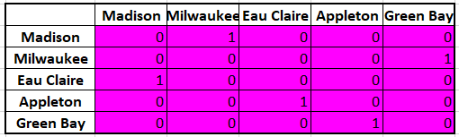
Decision Variables
The decision variables are binary with the following interpretation below:
1 = if the destination city is visited from the origin city
0 = otherwise
Sample DV matrix:

Slide 7
Objective
Objective Function: Minimize the total distance
This is achieved by finding the sumproduct of distance matrix and DV's
Minimize Transportation Costs
Reduce Environmental Impact
Maximize Efficiency

Slide 8
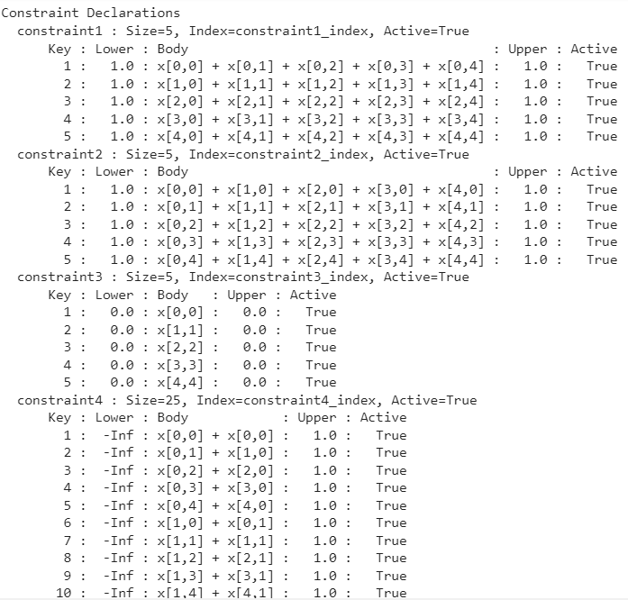
Constraints
Constraint 1: Each city must be visited exactly once i.e inflow = 1 and outflow = 1
Constraint 2: No subtours are allowed
Constraint 3: Ensures that the origin and destination are not the same.

Slide 9
Model Formulation
Use Python for this problem
Extract the distances Matrix using the Gmap Distance API
Create a Pyomo model object
Declare the key components which includes DV's, Obj and Constraints
Optimize using the Pyomo's CBC solver as this is a MILP problem
Convert the optimized DV values into an interpretable path
Replicate the same model in Excel inorder to make it easy for non-technical people

Slide 10
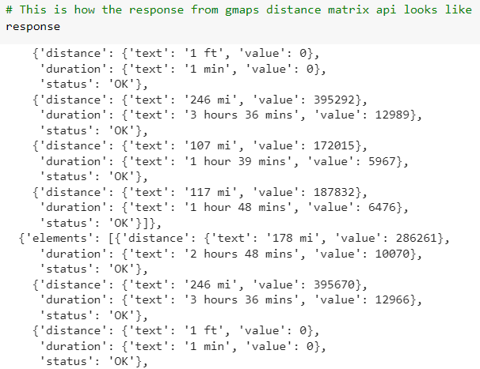
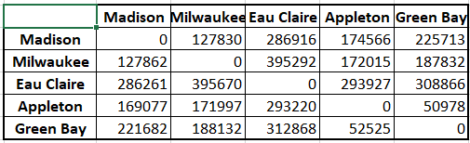
Distance Data
We are using the Google Maps API to produce the Distance Matrix.
Here, the distance matrix which contains the distances between cities which is extracted from json response

Slide 11
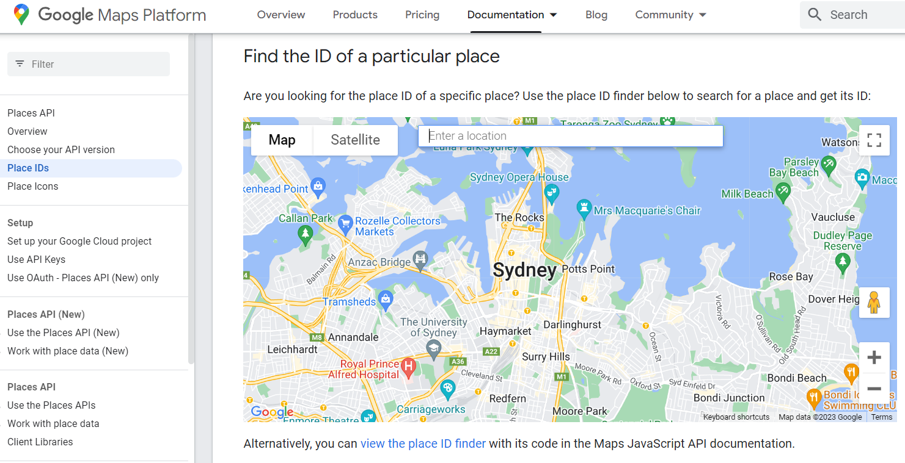
Google Maps Distance API
We used the Gmap Distance API to find the distance matrix for following cities using place ID:
Milwaukee
Place ID: ChIJ50eLV9cCBYgRhHtBtSIZX0Q
Milwaukee, WI, USA
Madison
Place ID: ChIJ_xkgOm1TBogRmEFIurX8DE4
Madison, WI, USA
Eau Claire
Place ID: ChIJs9ETUBW9-IcRdZOTQ-uLQz0
Eau Claire, WI, USA
Appleton
Place ID: ChIJyfYDuYK2A4gRW5N1BqXWoZw
Appleton, WI, USA
Green Bay
Place ID: ChIJ84CzCejiAogRcfXcFFIEcGM
Green Bay, WI, USA

Slide 12

Results
To solve our model, we have used pyomo’s cbc solver. Our python model provides solution in the format as shown on the right and we tried to make it user friendly using python
User Friendly Response:
Madison
Milwaukee
Eau Claire
Appleton
Green Bay

Slide 13
Best Part: Flexibility
Using this model, we can easily scale up to any number of cities depending on the computation power of the system by just including additional the place_id in the inputs.
Using API's to get the real time data helps us automate this task.
We can replicate the same model into various business applications just by replacing our inputs.

Slide 14
Client: FHL Logistics
Business Problem: FHL has a main distribution center located at Madison. All the couries gets transferred to the sub hub located across few cities in WI. FHL wants to find the optimal path to deliver.
Need for this model to FHL to:
Minimize Transportation Costs
Reduce Environmental Impact
Maximize Efficiency

Slide 15
Challenges and Limitations
Challenges
Limitations
Dynamic nature of Logistics
Dependency on the response from Gmap API
Curse of Dimensionality if scaled up
Technical issues in operations
Lack of Standardization
Weather-Dependent Challenges

Slide 16
Future Development
We can scale up the model to larger datasets
We can try incorporating best possibles routes between two cities
Improve the UI of the model
Try to make the model more dynamic in terms of capturing the cities list.

Slide 17
Files:
Link to Python code: https://colab.research.google.com/drive/1yA58JDMlmALOhNkP768dnMIs7PMxJKRF?usp=sharing
Excel Model:
Distance_Matrix.xlsx

Slide 18

Our Team Members
Both team members equally contributed to project design, implementation, result analysis, and manuscript writing.
(Yogesh & Rama)

Slide 19

Thank You

