Slide 1

UNIREACH TECHNOLOGIES PVT LTD

Slide 2
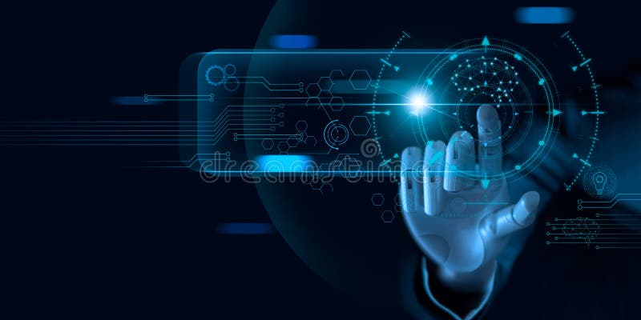
FUNDAMENTALS OF MACHINE LEARNING

Slide 3

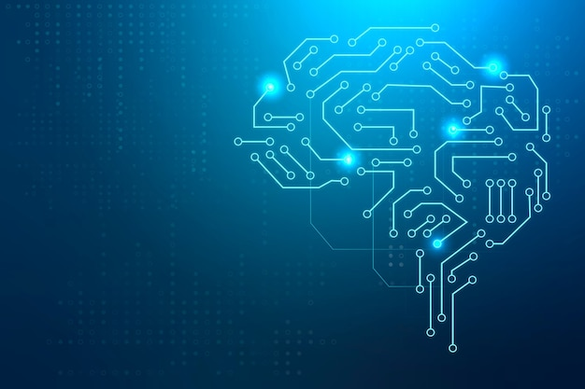
FUNDAMENTALS OF MACHINE LEARNING

Slide 4
Applications
TRAFFIC ALERTS
SELF DRIVING CARS
SOCIAL MEDIA
DYNAMIC PRICING
TRANSPORTATION AND COMMUTING
GOOGLE TRANSLATE
PRODUCTS RECOMENDATIONS
ONLINE VIDEO STREAMING
VIRTUAL PERSONAL ASSISTENTS
FRAUD DETECTION
I’ll be discussing the following Applications of Machine Learning one by one

Slide 5
Applications
MARKET BASKET ANALYSIS
EMAIL
PARALYSIS
YOU TUBE INSTA
TWITTER SENTIMENTAL ANALYSISIL
TRAFFIC IN SHANGAI
FB TAGGING
GOOGLE PHOTOS
ADS PERSONAL RECOMENDATIONS
EMAILSEARCH ENGINE
CLUSTERING
APPLE WATCH
BREAST CANCER
FLIPKART
NETFLIX

Slide 6


Slide 7
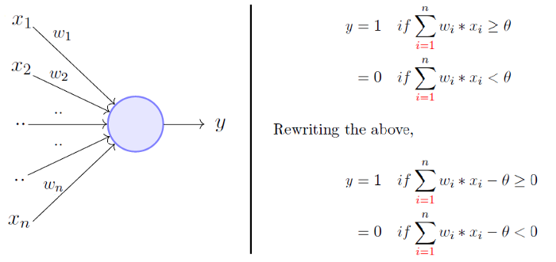
PERCEPTRON

Slide 8
BRIEF HISTORY ON MACHINE LEARNING
Arthur Samuel first came up with the phrase “Machine Learning” in 1952.
In 1957, Frank Rosenblatt – at the Cornell Aeronautical Laboratory – combined Donald Hebb's model of brain cell interaction with Arthur Samuel's Machine Learning efforts and created the perceptron.
The Perceptron
The perceptron was initially planned as a machine, not a program. The software, originally designed for the IBM 704, was installed in a custom-built machine called the Mark 1 perceptron, which had been constructed for image recognition. This made the software and the algorithms transferable and available for other machines
Described as the first successful neuro-computer, the Mark I perceptron developed some problems with broken expectations. Although the perceptron seemed promising, it could not recognize many kinds of visual patterns (such as faces), causing frustration and stalling neural network research. It would be several years before the frustrations of investors and funding agencies faded. Neural network/Machine Learning research struggled until a resurgence during the 1990s.
Machine Learning and Artificial Intelligence take Separate Paths

Slide 9
BRIEF HISTORY ON MACHINE LEARNING
Machine Learning and Artificial Intelligence take Separate Paths
In the late 1970s and early 1980s, Artificial Intelligence research had focused on using logical, knowledge-based approaches rather than algorithms. Additionally, neural network research was abandoned by computer science and AI researchers. This caused a schism between Artificial Intelligence and Machine Learning. Until then, Machine Learning had been used as a training program for AI.
The Machine Learning industry, which included a large number of researchers and technicians, was reorganized into a separate field and struggled for nearly a decade. The industry goal shifted from training for Artificial Intelligence to solving practical problems in terms of providing services. Its focus shifted from the approaches inherited from AI research to methods and tactics used in probability theory and statistics. During this time, the ML industry maintained its focus on neural networks and then flourished in the 1990s. Most of this success was a result of Internet growth, benefiting from the ever-growing availability of digital data and the ability to share its services by way of the Internet.

Slide 10
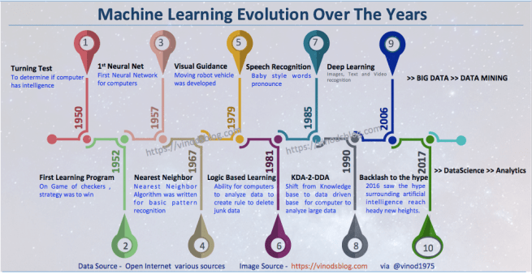
PERCEPTRON

Slide 11
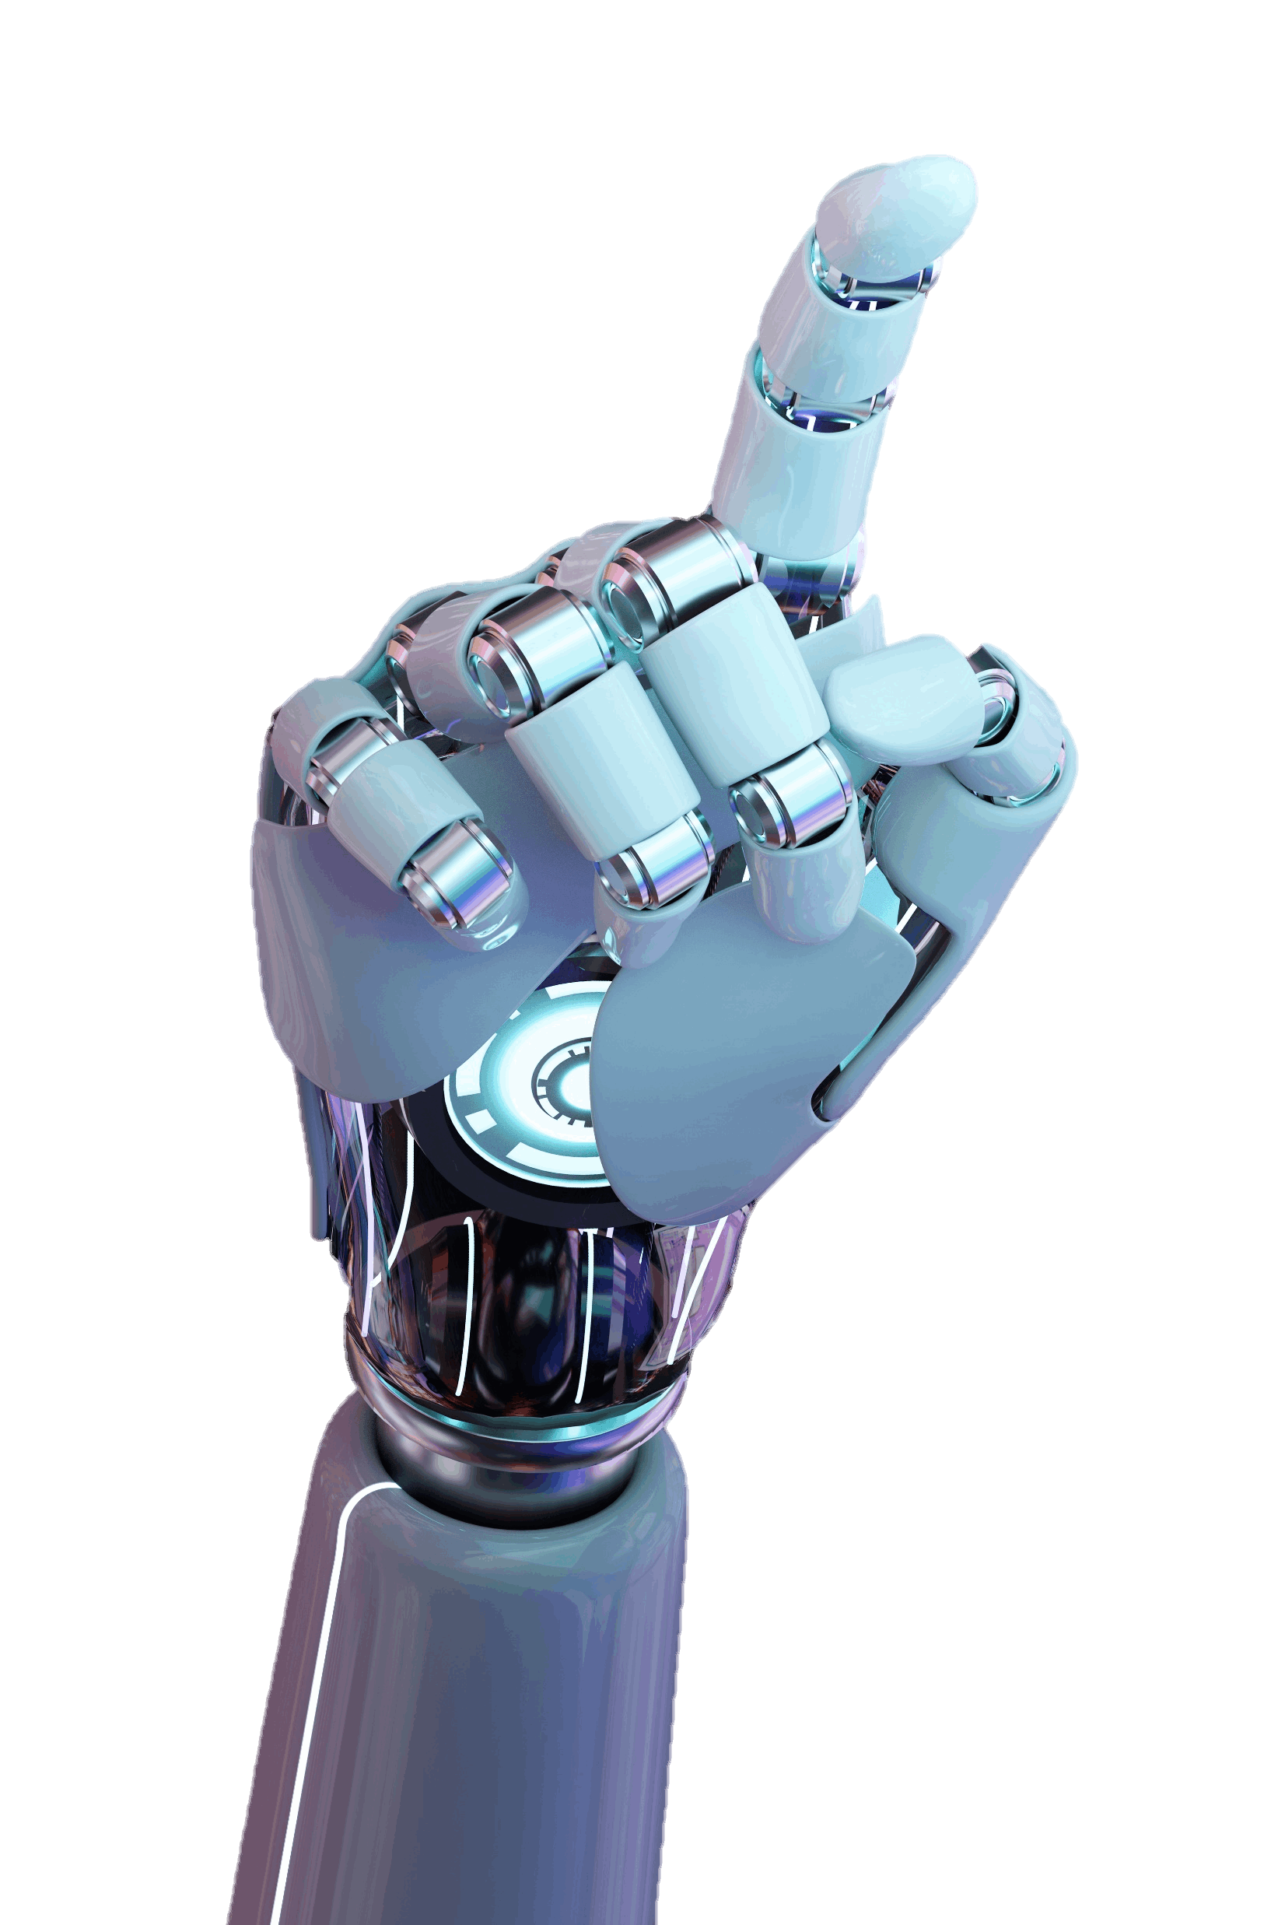
Reasons for evolution of machine learning
Machine Learning is a buzzword in the technology world right now and for good reason, it represents a major step forward in how computers can learn. The need for Machine Learning Engineers are high in demand and this surge is due to evolving technology and generation of huge amounts of data aka Big Data.
In the 1990s, the evolution of machine learning made a turn. Driven by the rise of the internet and increase in the availability of usable data, the field began to shift from a knowledge-driven approach to a data-driven approach, paving the way for the machine learning models that we see today
The explosion of big data
Hunger for new business and revenue streams in this business shrinking times
Advancements in machine learning algorithms
Development of extremely powerful machine with high capacity & faster computing ability
Storage capacity
Today the major problem is to find resources that are skilled enough to demonstrate & differentiate their learning from university & PhD books in real business

Slide 12
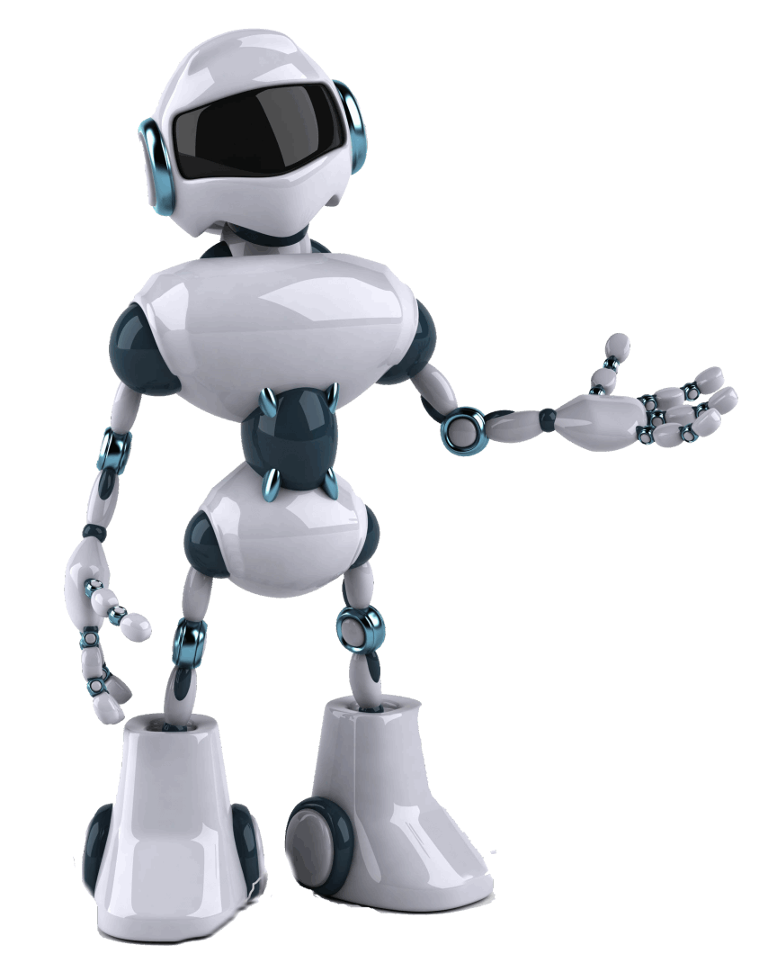
What is Machine learning
What is deep learning
What is reinforcement learning
What is artificial intelligence
What is data science
What are algorithms
What are neural networks
What exactly the definitions of each thing above mean
What exactly the differences between each
And the role of statistics in machine learning

Slide 13
Machine learning at present
Recently, Machine Learning was defined by Stanford University as “the science of getting computers to act without being explicitly programmed.” Machine Learning is now responsible for some of the most significant advancements in technology, such as the new industry of self-driving vehicles. Machine Learning has prompted a new array of concepts and technologies, including supervised and unsupervised learning, new algorithms for robots, the Internet of Things, analytics tools, chatbots, and more. Listed below are seven common ways the world of business is currently using Machine Learning:
Analyzing Sales Data: Streamlining the data
Real-Time Mobile Personalization: Promoting the experience
Fraud Detection: Detecting pattern changes
Product Recommendations: Customer personalization
Learning Management Systems: Decision-making programs
Dynamic Pricing: Flexible pricing based on a need or demand
Natural Language Processing: Speaking with humans
Machine Learning models have become quite adaptive in continuously learning, which makes them increasingly accurate the longer they operate. ML algorithms combined with new computing technologies promote scalability and improve efficiency. Combined with business analytics, Machine Learning can resolve a variety of organizational complexities. Modern ML models can be used to make predictions ranging from outbreaks of disease to the rise and fall of stocks.

Slide 14
Artificial intelligence
Artificial intelligence is intelligence demonstrated by machines, as opposed to the natural intelligence displayed by humans or animals…WIKI
Artificial intelligence leverages computers and machines to mimic the problem-solving and decision-making capabilities of the human mind…IBM
Weak AI—also called Narrow AI or Artificial Narrow Intelligence (ANI)—is AI trained and focused to perform specific tasks. Weak AI drives most of the AI that surrounds us today. ‘Narrow’ might be a more accurate descriptor for this type of AI as it is anything but weak; it enables some very robust applications, such as Apple's Siri, Amazon's Alexa, IBM Watson, and autonomous vehicles
In the simplest terms, AI which stands for artificial intelligence refers to systems or machines that mimic human intelligence to perform tasks and can iteratively improve themselves based on the information they collect….ORACLE

Slide 15
Machine learning
Machine learning is a branch of artificial intelligence (AI) and computer science which focuses on the use of data and algorithms to imitate the way that humans learn, gradually improving its accuracy. ... Machine learning is an important component of the growing field of data science…IBM
Machine learning is a method of data analysis that automates analytical model building. It is a branch of artificial intelligence based on the idea that systems can learn from data, identify patterns and make decisions with minimal human intervention….SAS
Machine learning is the study of computer algorithms that can improve automatically through experience and by the use of data. It is seen as a part of artificial intelligence…WIKIPEDIA

Slide 16
Deep Learning
Deep learning neural networks, or artificial neural networks, attempts to mimic the human brain through a combination of data inputs, weights, and bias. These elements work together to accurately recognize, classify, and describe objects within the data.
Deep learning is a subset of machine learning where artificial neural networks, algorithms inspired by the human brain, learn from large amounts of data.
Deep learning allows machines to solve complex problems even when using a data set that is very diverse, unstructured and inter-connected.

Slide 17
Reinforcement Learning:
An example for a form of learning not obviously covered by supervised or unsupervised learning is learning how to walk: in particular, a child that learns how to walk does not first collect data on all possible ways of successfully walking to extract rules on how to walk best. Rather, the child performs an action, sees what happens, and then adjusts their actions accordingly. This kind of learning thus happens best ‘on-the-fly’, in other words while performing the attempted task. Reinforcement learning formalizes this different kind of learning and introduces suitable (computational) methods
Reinforcement learning (RL) is an area of machine learning concerned with how intelligent agents ought to take actions in an environment in order to maximize the notion of cumulative reward. Reinforcement learning is one of three basic machine learning paradigms, alongside supervised learning and unsupervised learning

Slide 18
Kids often make mistakes. Adults try to make sure they learn from it and try not to repeat it again. In this case, we can take the concept of feedbacks. If the parents are strict, they will scold the children for any mistakes. This is a negative type of feedback. The child will remember it as if it does a certain wrong action, the parents will scold the kid.
Then there is positive feedback, where the parent might praise them for doing something right. This type of learning is called enforced learning.
Here, we enforce or try to force a correct action in a certain way.
So, in short, reinforcement learning is the type of learning methodology where we give rewards of feedback to the algorithm to learn from and improve future results.
This type of learning is on the many research fields on a global scale, as it is a big help to technologies like AI

Slide 19
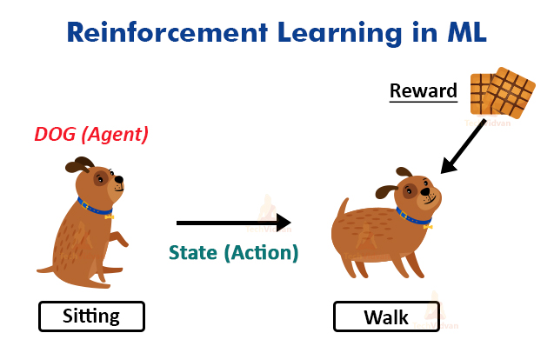

Slide 20
Data Science:
Data science is an interdisciplinary field that uses scientific methods, processes, algorithms and systems to extract knowledge and insights from noisy, structured and unstructured data, and apply knowledge and actionable insights from data across a broad range of application domains…WIKI
Data science is a multidisciplinary approach to extracting actionable insights from the large and ever-increasing volumes of data collected and created by today’s organizations. Data science encompasses preparing data for analysis and processing, performing advanced data analysis, and presenting the results to reveal patterns and enable stakeholders to draw informed conclusions….IBM
A data science platform that improves productivity with unparalleled abilities. Build and evaluate higher-quality machine learning (ML) models. Increase business flexibility by putting enterprise-trusted data to work quickly and support data-driven business objectives with easier deployment of ML models….ORACLE
trusted data to work quickly and support data-driven business objectives with easier deployment of ML models.

Slide 21
Three phases of a data science project:
The first phase is preparation—time and effort spent gathering information at the beginning of a project can spare big headaches later.
The second phase is building the product, from planning through execution, using what you learned during the preparation phase and all the tools that statistics and software can provide.
The third and final phase is finishing—delivering the product, getting feedback, making revisions, supporting the product, and wrapping up the project.

Slide 22
And…. NOW
What exactly the difference between…

Slide 23
Machine Learning Presentation PPT
Any technique that enables computers to mimic human intelligence, using logic,if- then rules decision trees,and including deep learning .
ARTIFICIAL INTELLIGENCE
MACHINE LEARNING
The subset of machine learning composed of algorithms that permit software totrain itself to perform tasks,like speech and image recognition, by exposing multi layered neural networks to vast amounts of data
Asubset of Ai that includes abstruse stastical techniques that enabmachines to improve at tasks with experience. The category includes deep learning
DEEP LEARNING

Slide 24
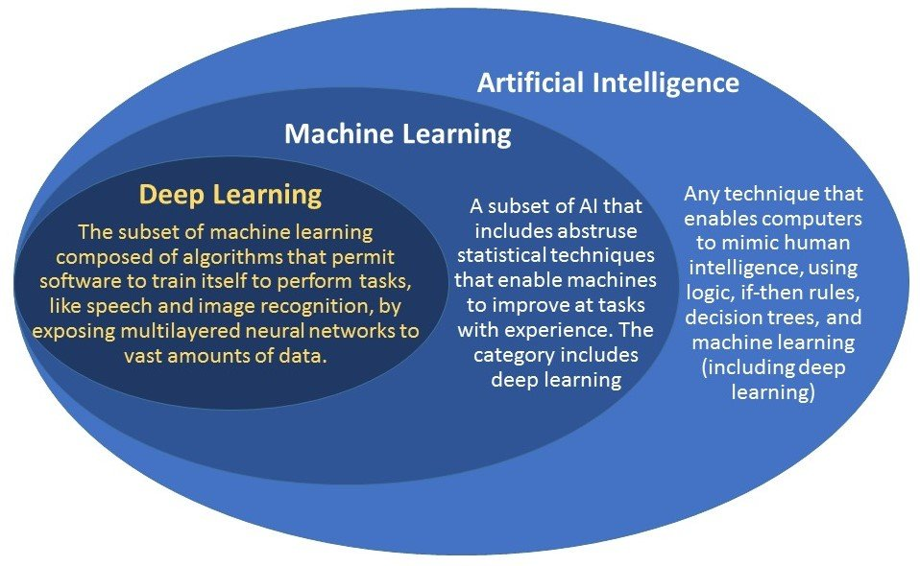

Slide 25
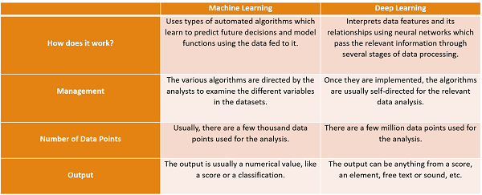

Slide 26
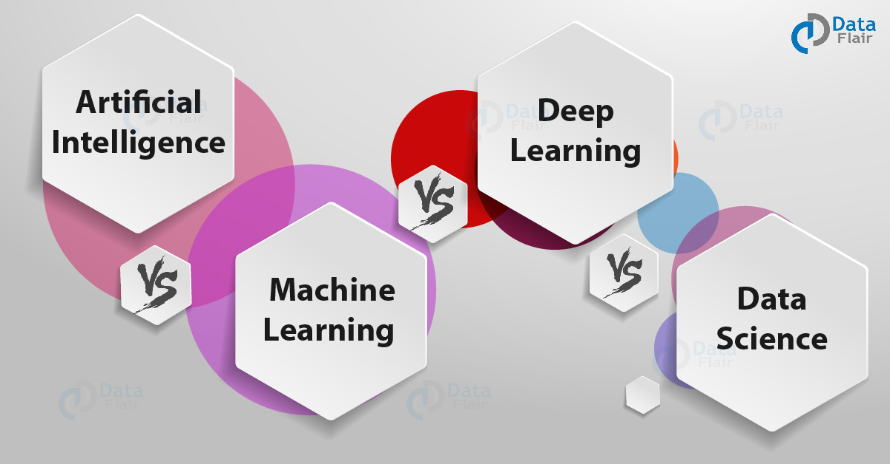

Slide 27
Deep Learning vs Machine Learning
We use a machine algorithm to parse data, learn from that data. And make informed decisions based on what it has learned. Basically, deep learning is used in layers to create an artificial “neural network”. That can learn and make intelligent decisions on its own.
Performance is the main key difference between both algorithms. Although, when the data is small, deep learning algorithms don’t perform well. This is the only reason Deep Learning algorithms need a large amount of data to understand it perfectly.

Slide 28
AI vs ML vs DL vs DATA SCIENCE
Artificial Intelligence
Artificial Intelligence is the intelligence that machines can portray- they can think and act like humans. They can perform logical reasoning, learning, and also self-correction. AI can make predictions and take decisions
Machine Learning
Machine Learning is giving machines the ability to learn by training algorithms with huge amounts of data. This is great for making predictions.
Deep Learning
Likewise, Deep Learning is an approach to ML itself and claims to benefit it. Deep Learning makes use of Deep Neural Networks, inspired by the structure and function of the human brain.
These networks are made of multiple layers that data must pass through before producing the output. Deep Learning improves AI by enabling many of its practical applications- DL makes it possible
Data Science
It is a field concerned with extracting insights from data by making use of scientific methods and algorithms so businesses can benefit. Data Science uses Machine Learning to analyze data and make predictions; this can also be used in utilitarian prospects.

Slide 29
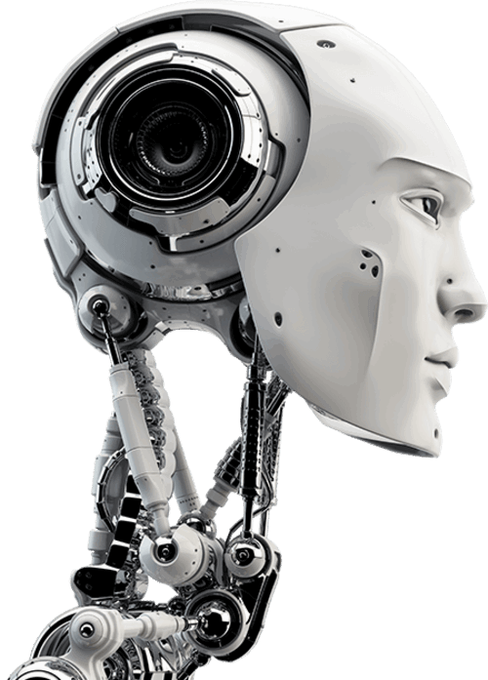
AI deals with the following issues-
Reasoning and Problem Solving
Knowledge representation
Planning
Learning
Natural Language Processing (NLP)
Perception
Motion and Manipulation
Social Intelligence
General Intelligence

Slide 30
AI deals with the following issues-
Reasoning and Problem Solving
Knowledge representation
Planning
Learning
Natural Language Processing (NLP)
Perception
Motion and Manipulation
Social Intelligence
General Intelligence

Slide 31





Thank You!
We respect your valuable time with UNIREACH TECHNOLOGIES
If you have any questions, please reach us
Do you have a design request, please visit our redesign page.
www. UNIREACH TECHNOLOGIES PVT LTD.com

